Slide 1

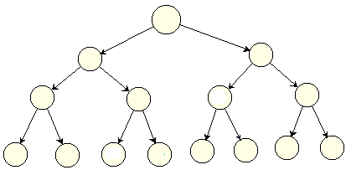
Trees and Binary Trees
Thân mến chào các sinh viên. Chúc các SV an lành
Deadline bài Recursion: Thêm 1 ngày, đến hết 08/2/2011
NHỚ THEO DÕI THÔNG BÁO VỀ HỌC OFFLINE NHÉ.

Slide 2
Why are Trees needed?
Linked lists and Arrays: LLs support some more efficient algorithms including operations: memory allocating, add new elements (O(1)), remove elements(O(1)) but they do not improve search operations (O(n)).
Relations between nodes must be described such as: Parent-Child relations in family problem. Generated/created-from relations in chess problem.
Performance of search operation needs to be improved.
➔ Tree structure is introduced.

Slide 3
Learning Outcomes
LO4.1 Define general tree, Binary Tree and Binary Search Tree (BST).
LO4.2 Given a BST , draw resulted tree after an insert/ delete operations
LO4.3 Find the smallest and largest elements, number of nodes in a
tree and its’ height.
LO4.4 Write code to implement features of a binary search tree, such as insertion, deletion, searching, traversals, nodes and height calculation, rotation ...
LO4.5 Derive the time complexities for the above operations on a BST.
LO4.6: Compare a BST over other data structures
LO4.7: Identify applications where a binary search tree will be useful.
LO4.8: Define balanced BST and explain simple balancing algorithm
LO4.9: Define AVL Tree and explain by examples the insertion and deletion operations in it.
LO4.10: Define heap and explain its’ application.

Slide 4
Contents (from textbook)
Part 1: General Trees
8 Trees 307
8.1 General Trees - 308
8.1.1 Tree Definitions and Properties - 309
8.1.2 The Tree Abstract Data Type - 312
8.2 Binary Trees - 317
8.2.1 The Binary Tree Abstract Data Type - 319
8.2.2 Properties of Binary Trees - 321
8.3 Implementing Trees - 323
8.4 Tree Traversal Algorithms - 334

Slide 5
Contents (from textbook)
Part 2: Binary Search Trees
11.1 Binary Search Trees - 460
11.1.1 Searching Within a Binary Search Tree - 461
11.1.2 Insertions and Deletions - 463
11.2 Balanced Search Trees - 472
11.3 AVL Trees - 479
9.3 Heaps - 370
9.3.1 The Heap Data Structure - 370
9.3.2 Implementing a Priority Queue with a Heap - 372
Part 3: Heaps

Slide 6
Part 1: Trees and General Binary Trees (2 slots)

Slide 7
Objectives
What is tree?
What are tree’s properties?
How to describe a node?
How to manager a tree?
How to used binary tree instead of n-ary tree
Algorithms:
Add new node
Traversals and applications:
Getting minimum, maximum value stored in a binary tree
Getting tree’s height
Searching a specific data
Deleting a specific data
No practical assignment is issued in this part.

Slide 8
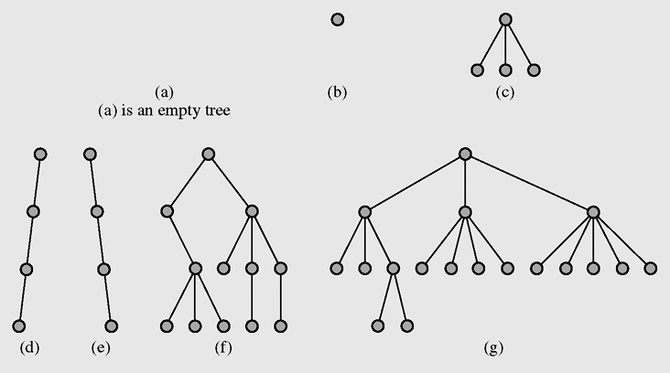
General Trees: Definitions
A tree is a data type that consists of nodes and arcs (edges) → A tree can be empty
Rooted tree: A tree in which a specific node is chosen as ROOT(a reference in practice).
A tree is depicted upside down with the root at the top.
An arc describes the father-child relation between 2 nodes
The root is a node that has no parent; it can have only child nodes
Leaves (terminal nodes) have no children (their children are null)
Non-terminal: Node having at least one child

Slide 9
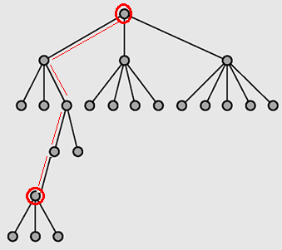
General Trees: Definitions
Each node has to be reachable from the root through a unique sequence of arcs, called a path
Path length = The number of arcs in a path = number of nodes of a path -1 = number of moving steps to a specific node
Level 1
Level of a node = Path length from the root to this node +1
Level 2
Level 3
Level 4
In some textbooks, level of the root is defined as 0. So, node level = path length
Tree is a Hierachical Structure
(cầu trúc thứ bậc/ phân cấp)
Level 5
Level 6

Slide 10
General Trees: Definitions
Tree Height: maximum level of nodes
The height of the following tree is 6
Level 1
Tree Height tells us complexity of search operation when a path is chosen.
Level 2
Level 3
Level 4
Level 5
Level 6

Slide 11
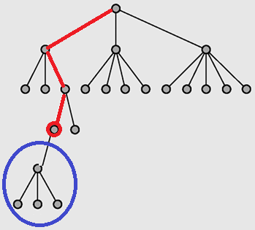
General Trees: Definitions
Ancestors/ predecessors of current node
Current node
Descendants/ successors of current node

Slide 12
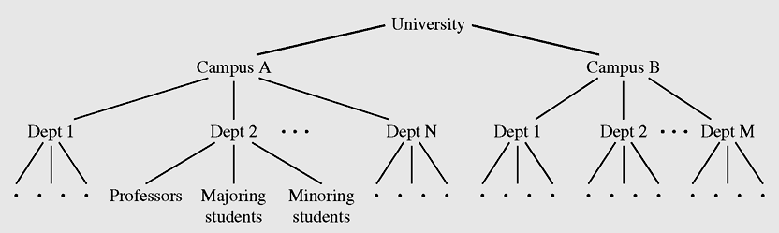
General Trees: Application Demo.
Hierarchical structure of a university shown as a tree
You can draw your family
- You can draw states of 3-checker game, two-player board chess game, China chess, …
In a tree, there are some paths which can be used to move from one node to others ➔ Non-linear data structure.

Slide 13
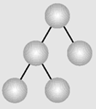
General Trees: Definitions
Degree of a tree: Maximum number of children of each node → Branching ability → Number of references to children in the structure of each tree node.
class TreeNode {
Object data;
TreeNode child1;
TreeNode child2;
TreeNode child3;
….
TreeNode childn;
}
Deg. | Tree
n | N-ary tree
2 | Binary tree
3 | Ternary tree
class BinTreeNode {
Object data;
BinTreeNode left;
BinTreeNode right;
}
More child references more memory must be allocated.
How to save memory?

Slide 14
General Trees: Definitions…
Binary tree can be used instead of n-ary tree:
- References to children have their own meaning.
class BinTreeNode{
Object data;
BinTreeNode left; ← The first child
BinTreeNode right; ← The next sibling
}
t = root.left; // con cả của ông tổ
while( t!= null) {
process (t); // xử lý cây con cả
t = t.right; // sang xử lý các cây con kế
}
So, algorithms on binary tree will be introduced.

Slide 15
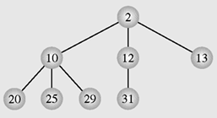
General Trees: Orderly Trees
An orderly tree is where all elements are stored according to some predetermined criterion of ordering
Ternary tree
Criterion: value in father node must be less than those in children.

Slide 16
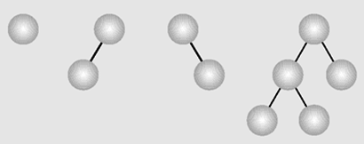
General Binary Tree (Binary Trees)
A binary tree is a tree whose nodes have two children (possibly empty), and each child is designated as either a left child or a right child
→ In Binary tree, each node may have at most two children.
class BinTreeNode {
Object data;
BinTreeNode left;
BinTreeNode right;
}
Examples of binary trees

Slide 17
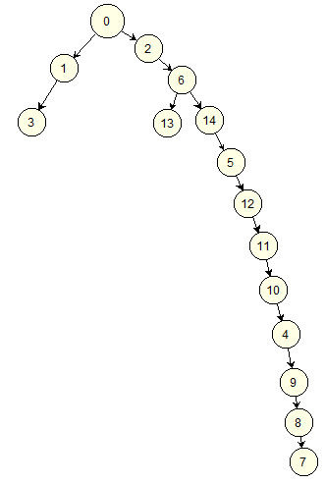
Binary Trees: Complete BT
In a perfect (hoàn hảo) binary tree, all non-terminal nodes have both their children, and all leaves are at the same level → Shortest tree, all path lengths from the root to leaves are the same.
- Complete (đầy đủ) binary tree: all non-terminal nodes have both their children.
Degraded tree
Cây suy biến
What do you think about search operations which are applied to perfect or complete binary trees?
Break

Slide 18
Binary Trees: Complete BT
Perfect binary tree: Number of nodes and tree’s height
No. of nodes (n) | Heigh (H)
1 | 1
3 | 2
7 | 3
15 | 4
31 | 5
H = log₂(n+1)
➔ Cây BT 20 nodes có chiều cao trong khoảng [5, 20]
Cây BT có 15/30/52/100/110 nút, hỏi chiều cao tối thiểu?

Slide 19
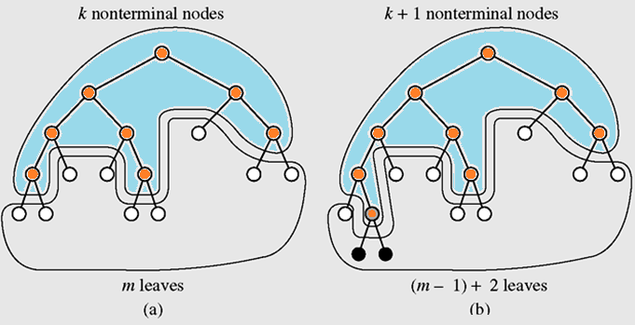
Binary Trees: Complete BT
Complete BT: Relation between leaves and non-terminal nodes
leaves= non-terminals + 1

Slide 20
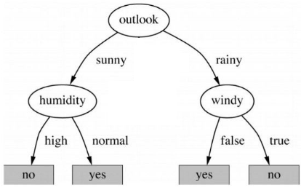
Binary Trees: Decision Trees
A decision tree is a binary tree in which all nodes have either zero or two nonempty children.
Decision tree is a means to model a real-world decision
Root: Start the decision process
Non-terminal node is a test
A leaf is a specific final decision

Slide 21
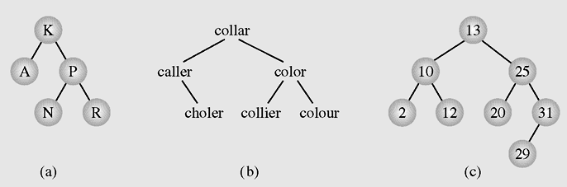
Binary Search Trees (BST)
BST is a binary tree in which all nodes are designated at exact positions based on pre-defined criteria.
Natural orders: numeric order , dictionary order
Normal Position: Left to right/ smaller to greater
Examples of binary search trees
Notes:
at

Slide 22
Binary Tree: Implementations
Approach 1: Using one-dimensional array
Case 1: There are rules to specify father-child relations
Case 2: There is no rule to specify father-child relations
Approach 2: Using a linked data structure

Slide 23
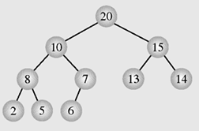
BT Imp. : An Array as a Binary Tree
Index | 0 | 1 | 2 | 3 | 4 | 5 | 6 | 7 | 8 | 9
Array | 20 | 10 | 15 | 8 | 7 | 13 | 14 | 2 | 5 | 6
Case 1: There are rules to specify father-child relations
Root: Element at the position 0.
Relations between father index and child index:
Left child index = 2* father index + 1
Right child index = 2* father index + 2
Father index = floor(child index/2)
The equivalent binary tree

Slide 24
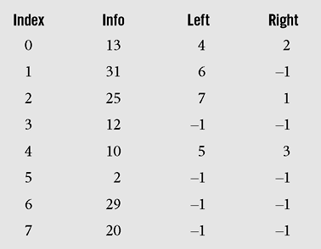
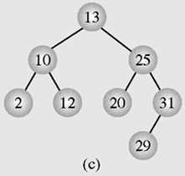
BT Imp. : An Array as a Binary Tree
Case 2: There is NO rule to specify father-child relations
Root: Element at the position 0.
Child indices must be stored ➔ 3 arrays (Info, Left, Right)
The equivalent binary tree

Slide 25
BT Imp. : Linked-Structured BT
Declarations:
class BTNode <T>{
T data;
BTNode left;
BTNode right;
}
class BTree <T>{
BTNode root;
……..
}
Structure of a Node in Binary Tree
Structure of a Binary Tree

Slide 26
BT Imp. : Algorithms on BT
Common and basic algorithms on BT using linked data structure are introduced:
Add new node
Traversing a BT
Search a data in BT
Remove a data in BT

Slide 27
BT Imp. : Algorithms on BT…
Add new node to BT:
BTNode newNode = new BTNode(data);
If (root==null) root = newNode;
Else {
Determine the father_node
Determine direction;
if (direction==left) father_node.left = newNode;
else father_node.right= newNode;
}
Adding a new node to a general binary tree depends on the problem data property

Slide 28
BT Imp. : Algorithms on BT…
Tree Traversal:
Tree traversal is the process of visiting each node in the tree exactly one time → O(number of nodes)
Breadth-first traversal is visiting each node starting from the lowest (or highest) level and moving down (or up) level by level, visiting nodes on each level from left to right (or from right to left)
Depth-first traversal proceeds as far as possible to the left (or right), then backs up until the first crossroad, goes one step to the right (or left), and again as far as possible to the left (or right)

Slide 29
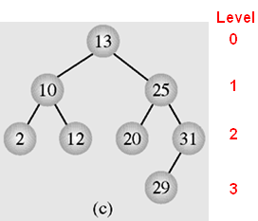
BT Imp. : Algorithms on BT…
Breadth-First Traversal is called as level-based traversal also.
Levels will be traversed in top-down direction.
Nodes in a level will be traversed in left-to-right direction.
Node’s Address
1000
Result:
13, 10, 25, 2, 12, 20, 31, 29
500
2000
200
100
800
300
A figure of a queue
3000

Slide 30
BT Imp. : Algorithms on BT…
Breadth-First Traversal
q = new Queue(); // Initialize a queue
q.enqueue(root);
while (!q.empty()){
BTNode v = q.dequeue();
if (v.left!=null) q.enqueue(v.left);
if (v.right!=null) q.enqueue(v.right);
visit(v);
}
1000
500
2000
200
100
800
300
3000
1000 500 2000 200 100 800 300 3000
Queue
Result:
13, 10, 25, 2, 12, 20, 31, 29

Slide 31
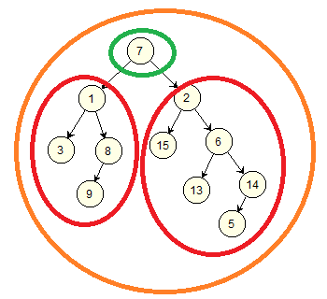
BT Imp. : Algorithms on BT…
Depth-First Traversal: Recursive implementations
Condition:
p != null
Visiting the node p: (N)
Traversing the tree root p
3 operations: N, L, R.
An specific order of 3 operations gives us a specific traversal such as NLR, RNL, …
Traversing the tree root p.left
(L)
Traversing the tree root p.right
(R)

Slide 32
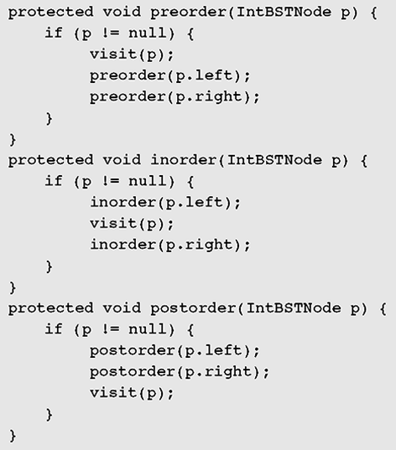
BT Imp. : Algorithms on BT…
Depth-First Traversals: Some recursive implementations:
NLR
Duyệt thứ tự trước
NLR: Pre-order traversal
Duyệt thứ tự giữa
LNR: In-order traversal
Duyệt thứ tự sau
LRN: Post-order traversal
LNR
LRN

Slide 33
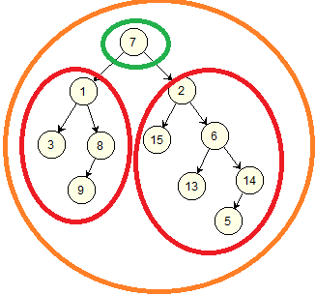
BT Imp. : Algorithms on BT…
Depth-First Traversals: Practice
Results:
NLR:
7, 1, 3, 8, 9, 2, 15, 6, 13, 14, 5
LNR:
3, 1, 9, 8, 7, 15, 2, 13, 6, 5, 14
LRN:
3, 9, 8, 1, 15, 13, 5, 14, 6, 2, 7

Slide 34
BT Imp. : Algorithms on BT…
Practice:
Give yourself 3 binary trees then write down results of:
Breadth-First traversals
Depth-First traversals

Slide 35
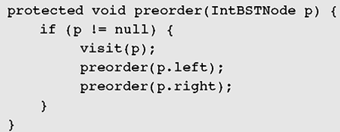
BT Imp. : Algorithms on BT…
Depth-First Traversals: Implementation using stacks
(Eliminating recursion)
If (root==null) return;
Stack stk= new Stack();
BTNode node;
stk.push(root);
while (!stk.empty()) {
node= stk.pop();
visit (node);
if (node.right!=null) stk.push(node.right);
if (node.left!=null) stk.push(node.left);
}
LIFO
Give yourself algorithms of in-order and post-order traversals

Slide 36
BT Imp. : Algorithms on BT…
Modifying traverse algorithms to utilities:
A general binary tree is not orderly. So, traversals are the core of all algorithms on a tree.
We can modify a traversal algorithm to create other algorithm, the breadth-first traversal is usually chosen, such as:
Counting number of nodes
Get maximum value in a tree
Get minimum value in a tree
Get the tree’s height
Searching on a tree

Slide 37
BT Imp. : Algorithms on BT…
Counting number of nodes in a BT
int countNodes() {
int count=0;
if (root != null) {
Queue q = new Queue();
BTNode v;
q. enqueue (root);
while (! q.empty()) {
v = q.dequeue();
count = count +1;
if (v.left != null) q.enqueue(v.left);
if (v.right != null) q.enqueue(v.right);
}
}
return count;
}
The breadth-first traversal is modified to count number of tree’s nodes.
Visit(v)

Slide 38
BT Imp. : Algorithms on BT…
Get maximum/minimum data
<T> getMax() {
if (root == null) throws new Exception (“Empty tree”);
<T> result = root.data;
Queue q = new Queue();
BTNode v;
q. enqueue (root);
while (! q.empty()) {
v = q.dequeue();
if (result < v.data) result = v.data;
if (v.left != null) q.enqueue(v.left);
if (v.right != null) q.enqueue(v.right);
}
return result;
}
Visit(v)
Give yourself the algorithm for getting minimum data in a tree.

Slide 39
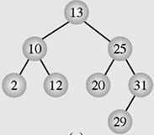
BT Imp. : Algorithms on BT…
int <T> getHeight() {
if (root == null) return 0;
int maxLevel=0, curL;
Queue q = new Queue<Node_Level>();
Node_Level nv;
q. enqueue (new Node_Level(root, 1));
while (! q.empty()) {
nv = q.dequeue(); curL = nv.level;
if (maxLevel < curL) maxLevel = curL;
BTNode left = nv.node.left;
BTNode right = nv.node.right;
if (left != null)
q.enqueue(new Node_Level (left, curL +1));
if (right != null)
q.enqueue(new Node_Level(right, curL +1));
}
return maxLevel;
}
Get Tree’s Height
Tree’s height = max level of nodes.
Root has level 1
class Node_Level { // utility class
BTNode node
int level;
Node_Level (BTNode p, int L) {
node = p;
level = L;
}
}
(13,1), (10,2), (25,2), (2,3), (12,3), (20,3), (31,3), (29,4)
Queue

Slide 40
BT Imp. : Algorithms on BT…
Search the data x in a binary tree:
Based on previous demonstrations you can do yourself the search algorithm
Deleting the data x in a binary tree:
When a node is removed, it’s children need to be linked from some other chosen nodes. So, deleting operation depends on the specific problem. There is no common way to implement this operation.

Slide 41
Summary

LO4.1 Define general tree, Binary Tree (and Binary Search)
Tree: Trees are a non-linear data structures including nodes and arcs and they are usually implemented using linked structures.
A tree node is described: data + references to related others. References describe relationship between some nodes.
A tree can be managed using only one reference to the root of the tree.
Definitions: root, leaf, father, child, accessors/predecessor, descendants/ successor, path, path length, node level, tree’s height, tree’s degree, complete tree
We can use binary tree instead of n-ary tree.

Slide 42
Summary
Tree can be used to manage unorderly related nodes. Problems in which data in current state are created from previous state (chess, human family, manager-staff relations,…)
Orderly tree is a tree whose nodes are designated their positions based on a pre-defined comparisional criteria.
LO4.3 Find the smallest and largest elements, number of nodes in a tree and its’ height.
Tree traversal is central algorithm of almost all algorithms applied to trees ➔ O(n) → General binary tree do not improve any operations when it is compared over other structures including arrays, linked lists.
2 traversals: breadth-first (level-based, using queue) traversal, depth-first traversal (recursive or using stack implementations).
Threaded tree is a tree in which node’s references are used to point to node’s predecessor or successor. So, stack is not needed in depth-first traversals.


Slide 43
Ôn tập- Viết vào vở
1- Cây là gì?
2- Tại sao cây được gọi là cấu trúc liên kết phi tuyến?
3- Tại sao cây được gọi là cấu trúc phân lớp (hierachical structure)?
4- Hãy định nghĩa các khái niệm cơ bản liên quan đến cây: nút, cạnh, nút gốc, nút lá, nút trung gian, mức của nút, chiều cao của cây.
5- Mô tả một nút trong cây bằng những gì?
6- Với góc nhìn hiệu suất, chiều cao của cây có ý nghĩa gì?
7- Với góc nhìn thực hành, mức độ phân nhánh của một nút (bậc của cây- cây n-phân) có ý nghĩa gì?
8- Làm thế nào để cây nhị phân có thể biều diễn được cây n-phân?
9- Duyệt cây là gì?
10- Hãy vẽ 1 cây nhị phân tuỳ ý rồi cho kết quả của phép duyệt theo chiều rộng.
11- Hãy vẽ 1 cây nhị phân tuỳ ý rồi cho kết quả của phép duyệt theo chiều sâu theo thuật toán pre-order traversal.
12- Hãy vẽ 1 cây nhị phân tuỳ ý rồi cho kết quả của phép duyệt theo chiều sâu theo thuật toán in-order traversal.
13- Hãy vẽ 1 cây nhị phân tuỳ ý rồi cho kết quả của phép duyệt theo chiều sâu theo thuật toán post-order traversal.

Slide 44
Next part: Binary Search Trees

