Slide 1
2
DERIVATIVES

Slide 2
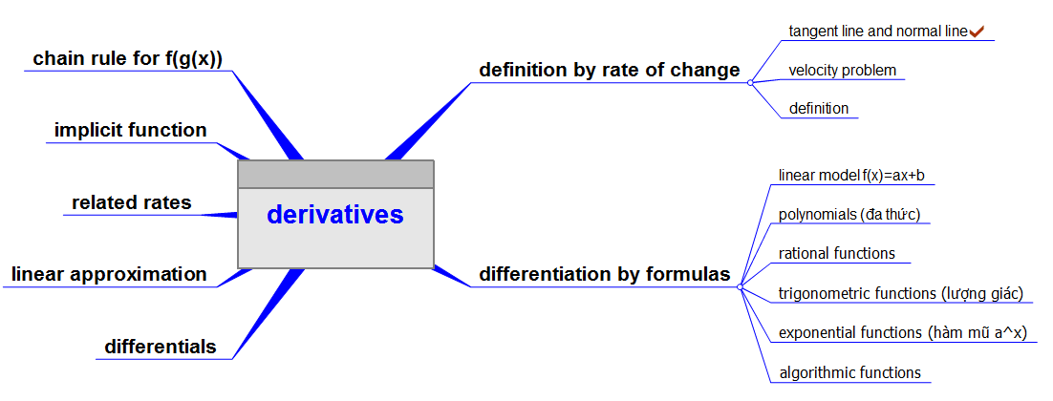

Slide 3
DERIVATIVES
2.1 Derivatives and Rates of Change
In this section, we will learn:
How the derivative can be interpreted as a rate
of change in any of the sciences or engineering.

Slide 4
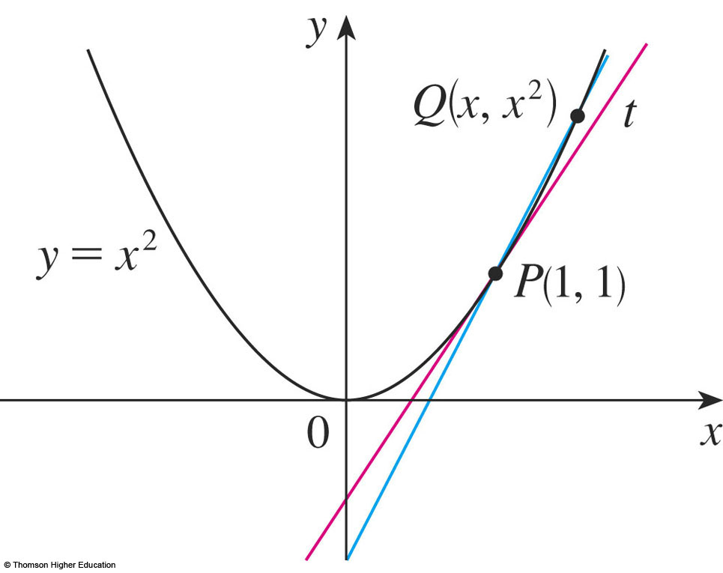
THE TANGENT PROBLEM
Example 1
Find an equation of the tangent line to the parabola y = x² at the point P(1,1).
We will be able to find an equation of the tangent line as soon as we know its slope m.

Slide 5
THE TANGENT PROBLEM
Example 1
The slope of the tangent line is said to be the limit of the slopes of the secant lines.
The equation of the tangent line through (1, 1) as:

Slide 6
TANGENTS
1. Definition
The tangent line to the curve y = f(x) at the point P(a, f(a)) is the line through P with slope
provided that this limit exists.

Slide 7

THE VELOCITY PROBLEM
Example 3
Investigate the example of a falling ball.
Suppose that a ball is dropped from the upper observation deck of the CN Tower in Toronto, 450 m above the ground.
Find the velocity of the ball after 5 seconds.

Slide 8
THE VELOCITY PROBLEM
Example 3
If the distance fallen after t seconds is denoted by s(t) and measured in meters, then Galileo’s law is expressed by the following equation.
s(t) = 4.9t²

Slide 9
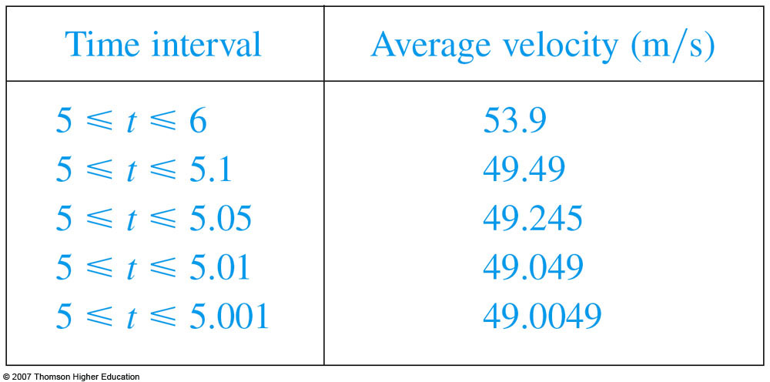
THE VELOCITY PROBLEM
Thus, the (instantaneous) velocity after 5 s is:
v = 49 m/s

Slide 10
VELOCITIES
3. Definition
We define the velocity (or instantaneous velocity) v(a) at time t = a to be the limit of these average velocities:

Slide 11
DERIVATIVES
4. Definition
The derivative of a function f at a number a, denoted by f’(a), is:
if this limit exists. Or

Slide 12
DERIVATIVES
2.2
The Derivative as a Function
In this section, we will learn about: The derivative of a function f.

Slide 13
DERIVATIVES
1. Equation
In the preceding section, we considered the derivative of a function f at a fixed number a:
If we replace a in Equation 1 by a variable x, we obtain:

Slide 14
OTHER NOTATIONS
Some common alternative notations for the derivative are as follows:
The symbols D and d/dx are called differentiation operators.
The symbol dy/dx is called Leibniz notation

Slide 15
OTHER NOTATIONS
If we want to indicate the value of a derivative dy/dx in Leibniz notation at a specific number a, we use the notation
which is a synonym for f’(a).

Slide 16
OTHER NOTATIONS
3. Definition
A function f is differentiable at a if f’(a) exists.
It is differentiable on an open interval D if it is differentiable at every number in the interval D.

Slide 17
HOW CAN A FUNCTION FAIL TO BE DIFFERENTIABLE?
Theorem
If f is differentiable at a,
then f is continuous at a.
This theorem states that, if f is not continuous at a, then f is not differentiable at a.

Slide 18
HIGHER DERIVATIVES
If f is a differentiable function, then its derivative f’ is also a function.
So, f’ may have a derivative of its own, denoted by (f’)’= f’’.
This new function f’’ is called the second derivative of f.

Slide 19
HIGHER DERIVATIVES
The process can be continued.
In general, the nth derivative of f is denoted by f^{(n)} and is obtained from f by differentiating n times.
If y = f(x), we write:

Slide 20
DERIVATIVES
2.3 Differentiation Formulas
In this section, we will learn:
How to differentiate constant functions,
power functions, polynomials, and
exponential functions.

Slide 21
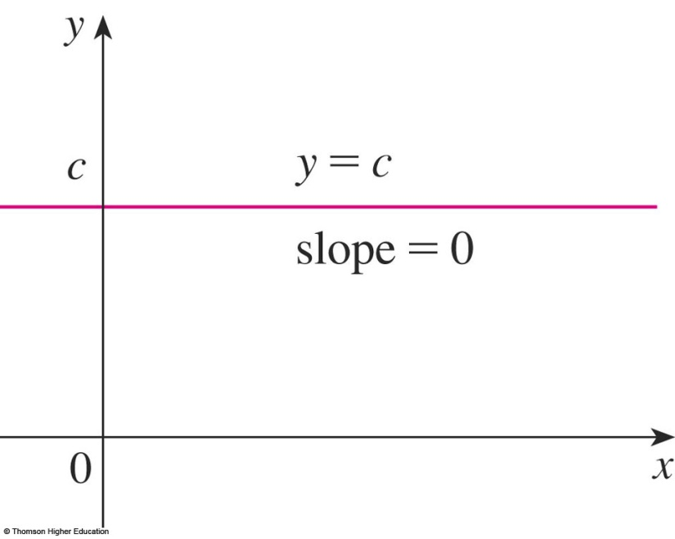
CONSTANT FUNCTION—DERIVATIVE
In Leibniz notation, we write this rule as follows.
(Reference Pages, p.5)

Slide 22
DIFFERENTIATION FORMULAS
Here’s a summary of the differentiation formulas we have learned so far.

Slide 23
TANGENT AND NORMAL LINES
Example 12
Find equations of the tangent line and normal line to the curve at the point (1, ½).
© Thomson Higher Education

Slide 24
THE CHAIN RULE
If g is differentiable at x and f is differentiable at g(x), the composite function F = f ◦ g is differentiable at x and F’ is given by the product:
F’(x) = f’(g(x)) . g’(x)
In Leibniz notation, if y = f(u) and u = g(x) are both differentiable functions, then:

Slide 25
Let f(x)=g(sin3x). Find f’ in terms of g’.
A | 3cos3xg’(x)
B | 3cos3xg’(sin3x)
C | cos3xg’(sin3x)
Answer: b

Slide 26
Suppose h(x)=f(g(x)) and f(2)=3, g(2)=1, g’(2)=-1, f’(2)=2, f’(1)=5. Find h’(2).
A | 1
B | 2
C | 5
D | 4
E | -5
Answer: e

Slide 27
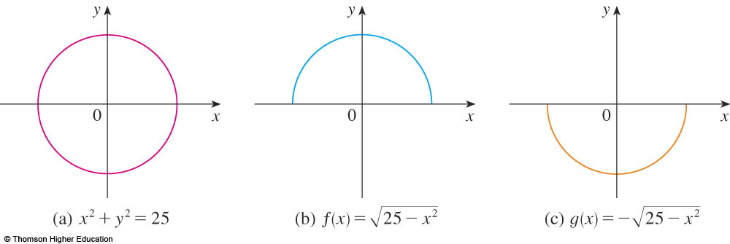
IMPLICIT DIFFERENTIATION
The graphs of f and g are the upper and lower semicircles of the circle
x² + y² = 25.

Slide 28
IMPLICIT DIFFERENTIATION METHOD
Instead, we can use the method of implicit differentiation.
This consists of differentiating both sides of the equation with respect to x and then solving the resulting equation for y’.

Slide 29
IMPLICIT DIFFERENTIATION
Example 1
a. If x² + y² = 25, find .
b. Find an equation of the tangent to the circle x² + y² = 25 at the point (3, 4).

Slide 30
IMPLICIT DIFFERENTIATION
Example 1 a
Remembering that y is a function of x and using the Chain Rule, we have:
Then, we solve this equation for :

Slide 31
IMPLICIT DIFFERENTIATION
E. g. 1 b—Solution 1
At the point (3, 4) we have x = 3 and y = 4.
So,
Thus, an equation of the tangent to the circle at (3, 4) is: y – 4 = – ¾(x – 3) or 3x + 4y = 25.

Slide 32
DERIVATIVES
2.7 Related Rates
In this section, we will learn:
How to compute the rate of change of one quantity
in terms of that of another quantity.

Slide 33
STRATEGY
It is useful to recall some of the problem-solving principles from Chapter 1 and adapt them to related rates in light of our experience in Examples 1–3.
Read the problem carefully.
Draw a diagram if possible.
Introduce notation. Assign symbols to all quantities that are functions of time.
(…, p.129)

Slide 34
RELATED RATES
Example 1
Air is being pumped into a spherical balloon so that its volume increases at a rate of 100 cm³/s.
How fast is the radius of the balloon increasing when the diameter is 50 cm?

Slide 35
Example 1
The key thing to remember is that rates of change are derivatives.
In this problem, the volume and the radius are both functions of the time t.
The rate of increase of the volume with respect to time is the derivative dV / dt.
The rate of increase of the radius is dr / dt.

Slide 36
RELATED RATES
Example 1
To connect dV/dt and dr/dt, first we relate V and r by the formula for the volume of a sphere:

Slide 37
Example 1
To use the given information, we differentiate each side of the equation with respect to t.
To differentiate the right side, we need to use the Chain Rule:

Slide 38
Example 1
Now, we solve for the unknown quantity:
If we put r = 25 and dV / dt = 100 in this equation, we obtain:
The radius of the balloon is increasing at the rate of 1/(25π) ≈ 0.0127 cm/s.

Slide 39
RELATED RATES
Example 1
Now, we solve for the unknown quantity:
If we put r = 25 and dV / dt = 100 in this equation, we obtain:
The radius of the balloon is increasing at the rate of 1/(25π) ≈ 0.0127 cm/s.

Slide 40
Example 2
A ladder 10 ft long rests against a vertical wall. If the bottom of the ladder slides away from the wall at a rate of 1 ft/s, how fast is the top of the ladder sliding down the wall when the bottom of the ladder is 6 ft from the wall?

Slide 41
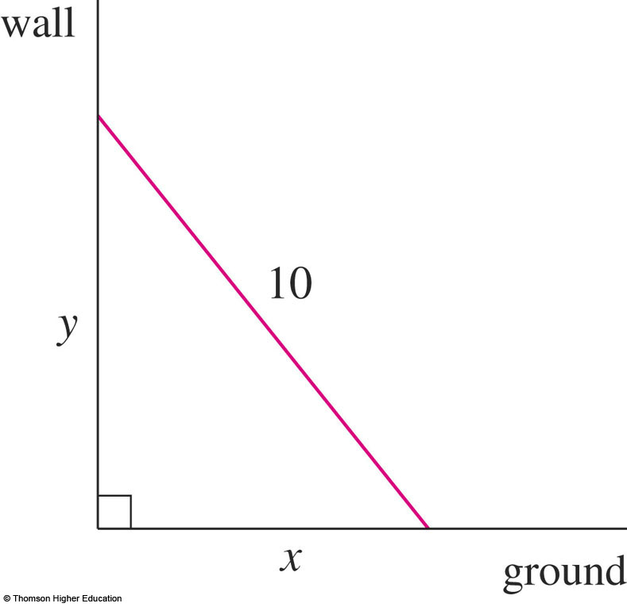
Example 2
We first draw a diagram and label it as in the figure.
Let x feet be the distance from the bottom of the ladder to the wall and y feet the distance from the top of the ladder to the ground.
Note that x and y are both functions of t (time, measured in seconds).

Slide 42
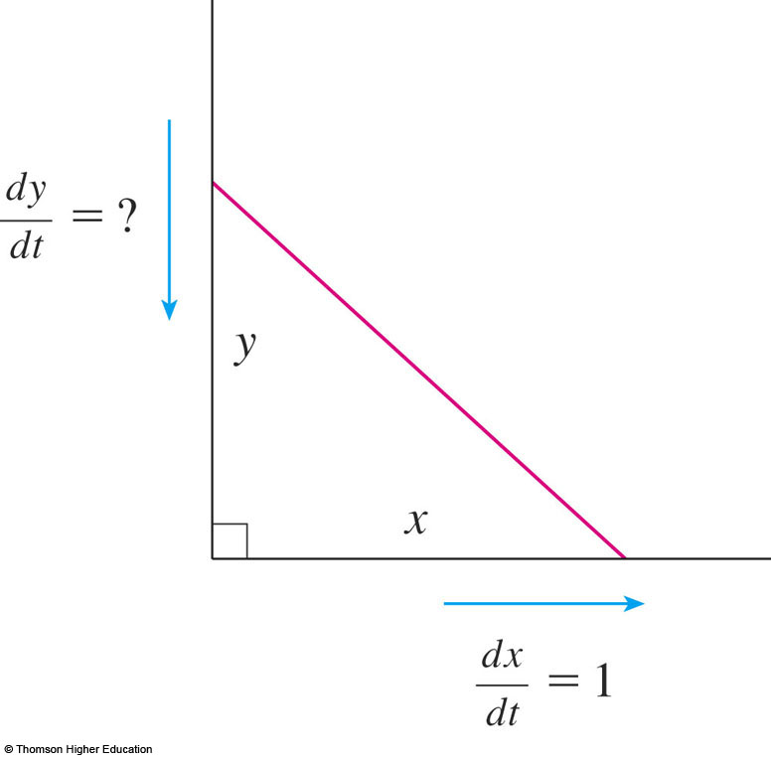
Example 2
We are given that dx / dt = 1 ft/s and we are asked to find dy / dt when x = 6 ft.

Slide 43
Example 2
In this problem, the relationship between x and y is given by the Pythagorean Theorem: x² + y² = 100

Slide 44
Example 2
Differentiating each side with respect to t using the Chain Rule, we have:
Solving this equation for the desired rate, we obtain:

Slide 45
Example 2
When x = 6 , the Pythagorean Theorem gives y = 8 and so, substituting these values and dx / dt = 1, we have:
The fact that dy / dt is negative means that the distance from the top of the ladder to the ground is decreasing at a rate of ¾ ft/s.
That is, the top of the ladder is sliding down the wall at a rate of ¾ ft/s.

Slide 46
DERIVATIVES
2.8 Linear Approximations and Differentials
In this section, we will learn about:
Linear approximations and differentials
and their applications.

Slide 47
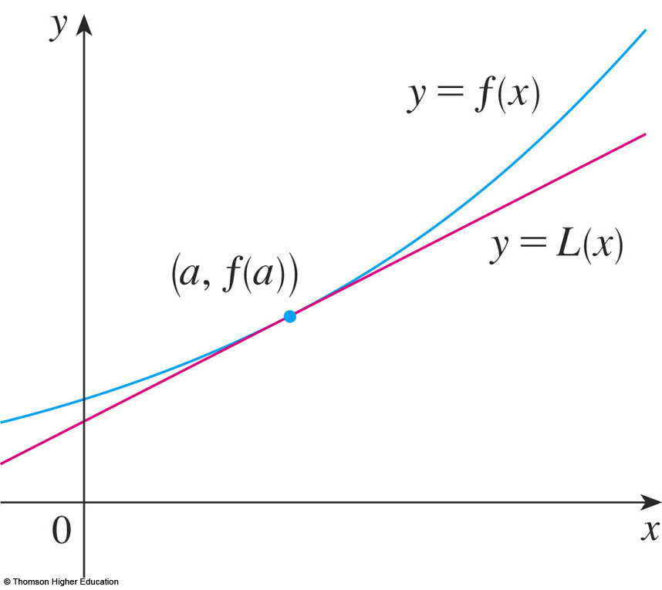
LINEAR APPROXIMATIONS
We use the tangent line at (a, f(a)) as an approximation to the curve y = f(x) when x is near a.
An equation of this tangent line is
L(x) = y = f(a) + f’(a)(x - a)

Slide 48
LINEAR APPROXIMATION
Equation 1
The approximation
f(x) ≈ f(a) + f’(a)(x – a) = L(x)
is called the linear approximation of f at a.

Slide 49
LINEAR APPROXIMATIONS
Example 1
Find the linearization of the function at a = 1 and use it to approximate the numbers
Are these approximations overestimates or underestimates?

Slide 50
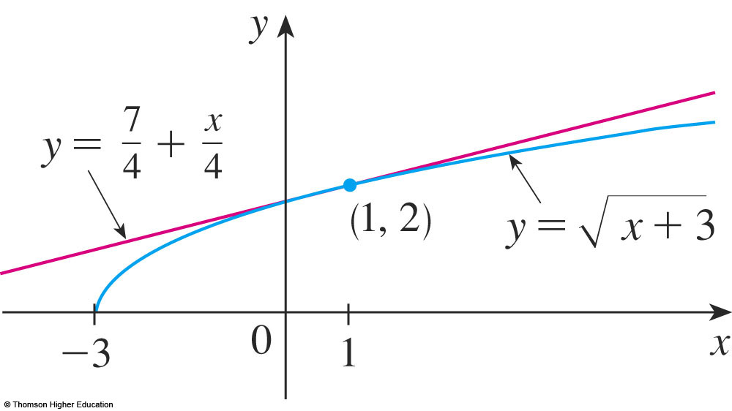
LINEAR APPROXIMATIONS
Example 1
Putting these values into Equation 2, we see that the linearization is:

Slide 51
LINEAR APPROXIMATIONS
Example 1
The corresponding linear approximation is:
(when x is near 1)
In particular, we have:

Slide 52
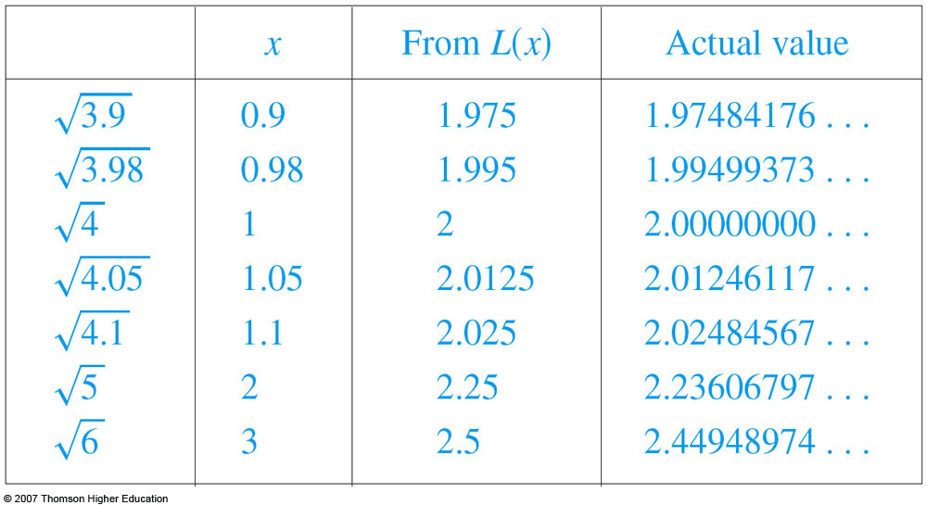
LINEAR APPROXIMATIONS
Look at the table and the figure.
The tangent line approximation gives good estimates if x is close to 1.
However, the accuracy decreases when x is farther away from 1.

Slide 53
DIFFERENTIALS
Example 4
The radius of a sphere was measured and found to be 21 cm with a possible error in measurement of at most 0.05 cm.
What is the maximum error in using this value of the radius to compute the volume of the sphere?

Slide 54
DIFFERENTIALS
Example 4
If the radius of the sphere is r, then its volume is V = 4/3πr³.
If the error in the measured value of r is denoted by dr = ∆r, then the corresponding error in the calculated value of V is ∆V.

Slide 55
DIFFERENTIALS
Example 4
This can be approximated by the differential
dV = 4πr²dr
When r = 21 and dr = 0.05, this becomes:
dV = 4π(21)² 0.05 ≈ 277
The maximum error in the calculated volume is about 277 cm³.

Slide 56
RELATIVE ERROR
Note
Relative error is computed by dividing the error by the total volume:
Thus, the relative error in the volume is about three times the relative error in the radius.

Slide 57
RELATIVE ERROR
Note
In the example, the relative error in the radius is approximately dr/r = 0.05/21 ≈ 0.0024 and it produces a relative error of about 0.007 in the volume.
The errors could also be expressed as percentage errors of 0.24% in the radius and 0.7% in the volume.

Slide 58
Thanks

