Slide 1
3
APPLICATIONS OF DIFFERENTIATION

Slide 2
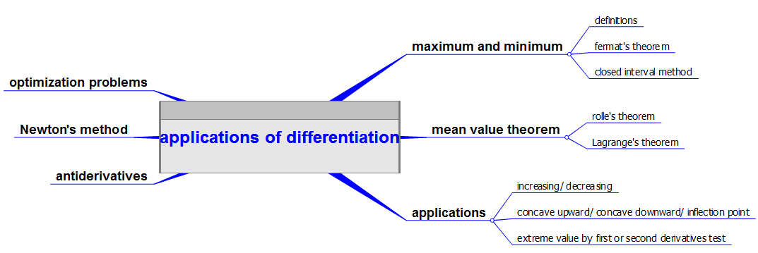

Slide 3
APPLICATIONS OF DIFFERENTIATION
3.1 Maximum and Minimum Values
In this section, we will learn:
How to find the maximum
and minimum values of a function.

Slide 4
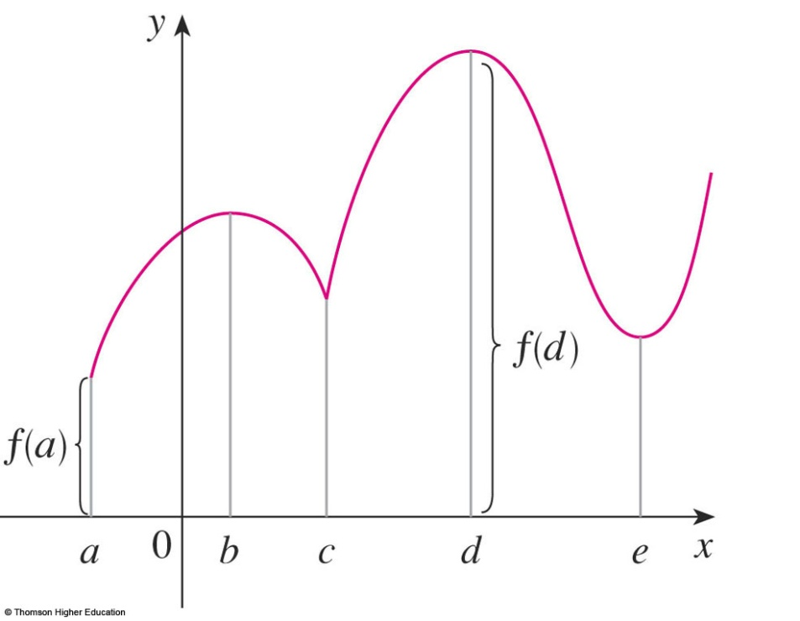
MAXIMUM & MINIMUM VALUES
Definition 1
A function f has an absolute maximum (or global maximum) at c if f(c) ≥ f(x) for all x in D, where D is the domain of f.
The number f(c) is called the maximum value of f on D.

Slide 5
MAXIMUM & MINIMUM VALUES
Definition 1
Similarly, f has an absolute minimum at c if f(c) ≤ f(x) for all x in D and the number f(c) is called the minimum value of f on D.
The maximum and minimum values of f are called the extreme values of f.

Slide 6
MAXIMUM & MINIMUM VALUES
Definition 2
A function f has a local maximum (or relative maximum) at c if f(c) ≥ f(x) when x is near c.
Similarly, f has a local minimum at c if f(c) ≤ f(x) when x is near c.

Slide 7
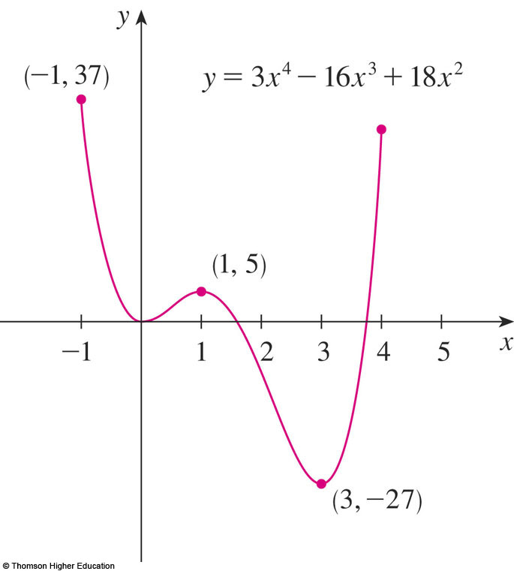
MAXIMUM & MINIMUM VALUES
Example 4
The graph of the function
f(x) = 3x⁴ – 16x³ + 18x², -1 ≤ x ≤ 4
is shown here.
f(1) = 5 is a local maximum
the absolute maximum is f(-1) = 37
f(0) = 0 is a local minimum and
f(3) = -27 is both a local and an absolute minimum.

Slide 8
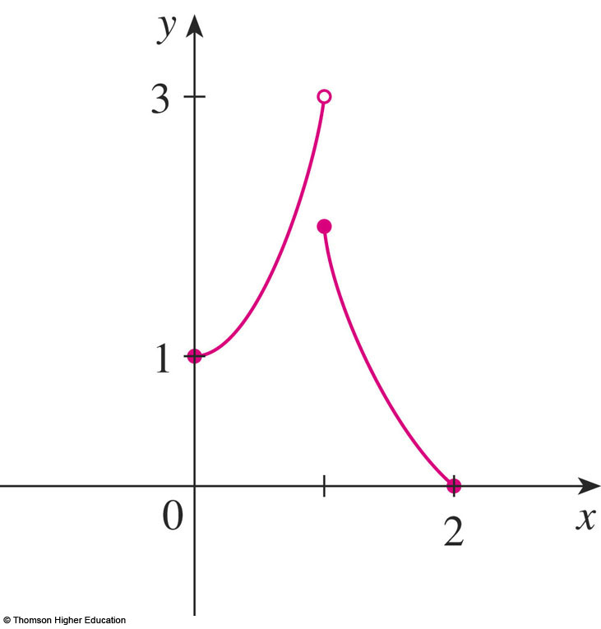
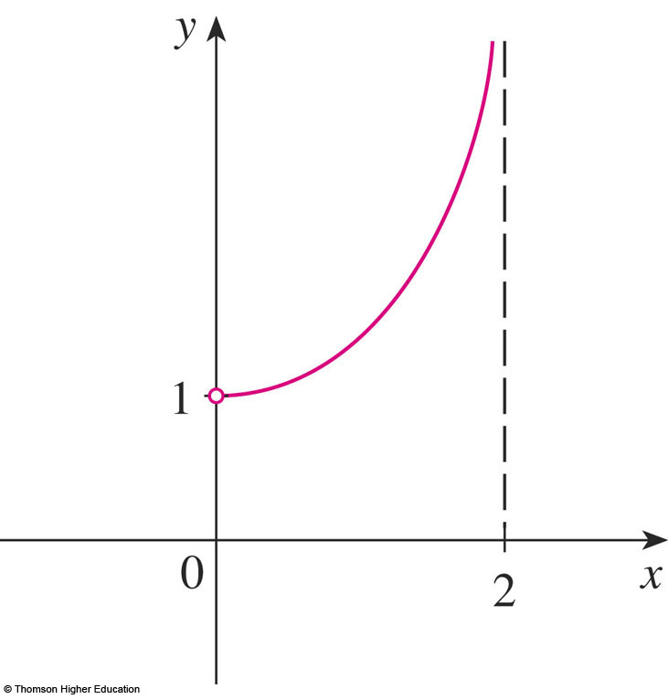
EXTREME VALUE THEOREM
In the first figure, why isn’t 3 the absolute maximum value?
In the second, does it have the absolute maximum and minimum value?

Slide 9
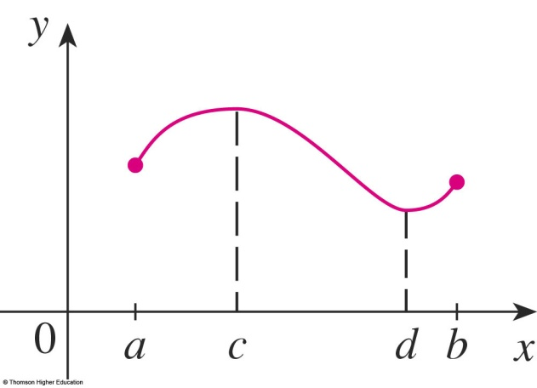
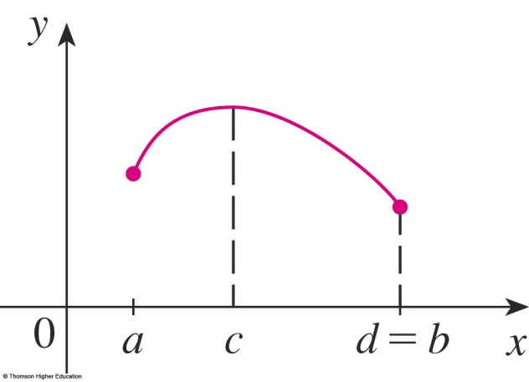
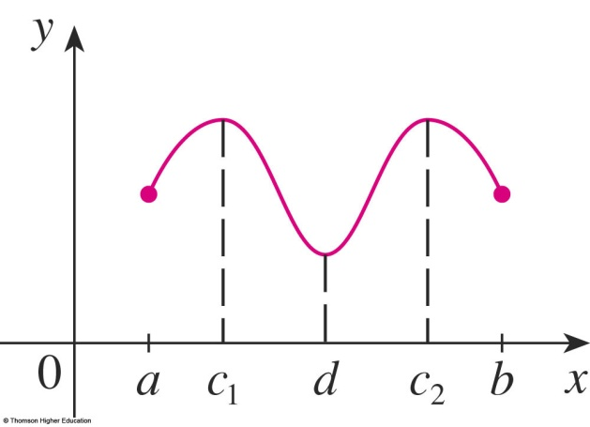
EXTREME VALUE THEOREM
Theorem 3
If f is continuous on a closed interval [a, b],
then f attains an absolute maximum value f(c)
and an absolute minimum value f(d)
at some numbers c and d in [a, b].

Slide 10
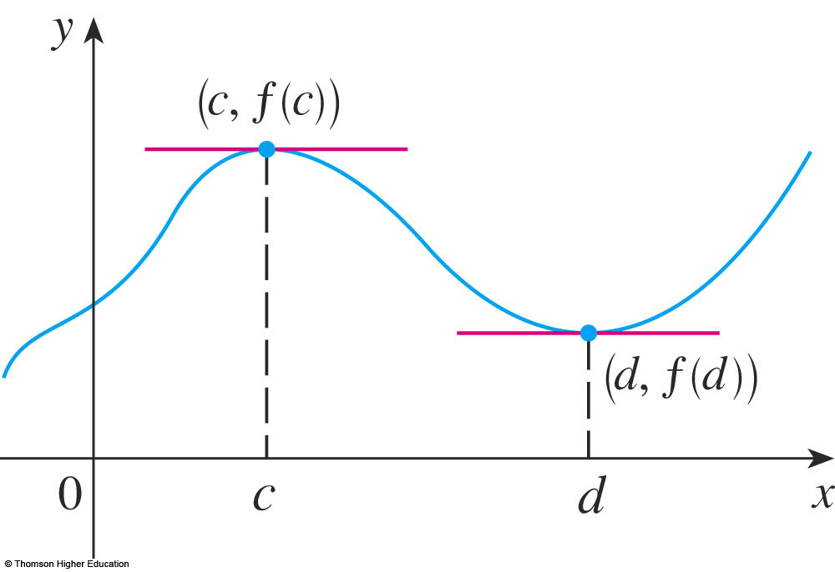
EXTREME VALUE THEOREM
The theorem does not tell us how to find these extreme values.
We start by looking for local extreme values.

Slide 11
FERMAT’S THEOREM
Theorem 4
If f has a local maximum or minimum at c, and
if f ’(c) exists,
then f ’(c) = 0.

Slide 12
Is it true if say that
” f’(c)=0 if f has local extrem value at c?”
Answer: It is false, see next

Slide 13
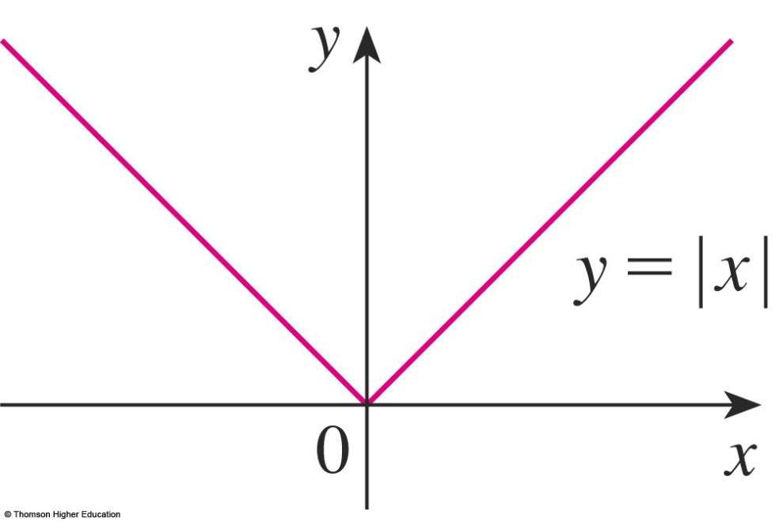
CRITICAL NUMBERS
Example
The function f(x) = |x| has its (local and absolute) minimum value at 0.
f ’(0) does not exist.

Slide 14
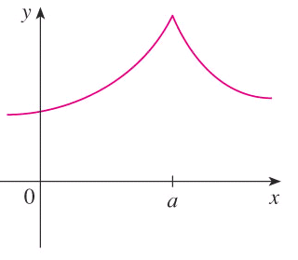

CRITICAL NUMBERS
Definition 6
A critical number (điểm tới hạn)
of a function f is a number c in the domain of f
such that either f ’(c) = 0 or f ’(c) does not exist.

Slide 15
CRITICAL NUMBERS
Theorem 7
If f has a local maximum or minimum at c, then c is a critical number of f.

Slide 16
CLOSED INTERVAL METHOD
To find the absolute maximum and minimum values of a continuous function f on a closed interval [a, b]:
Find the values of f at the critical numbers of f in (a, b).
Find the values of f at the endpoints of the interval.
The largest value from 1 and 2 is the absolute maximum value. The smallest is the absolute minimum value.

Slide 17
APPLICATIONS OF DIFFERENTIATION
3.2 The Mean Value Theorem
In this section, we will learn about:
The significance of the mean value theorem.

Slide 18
ROLLE’S THEOREM
Let f be a function that satisfies the following three hypotheses:
f is continuous on the closed interval [a, b]
f is differentiable on the open interval (a, b)
f(a) = f(b)
Then, there is a number c in (a, b) such that f’(c) = 0.

Slide 19
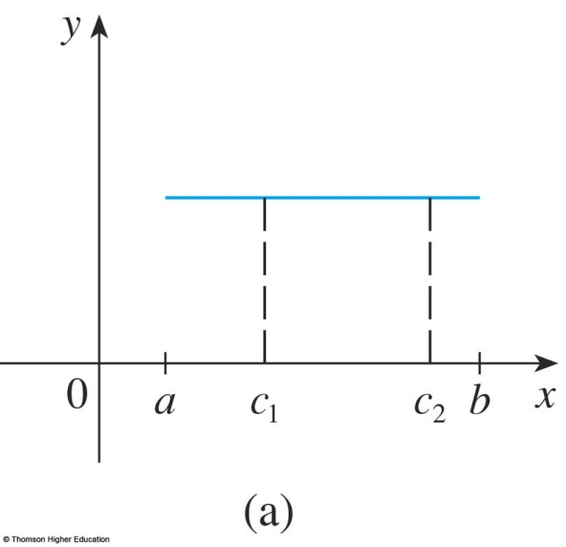
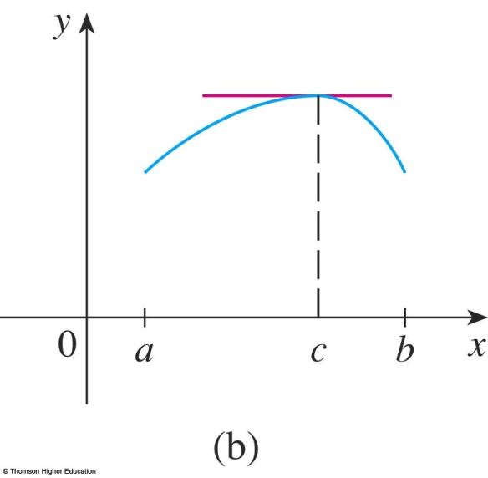
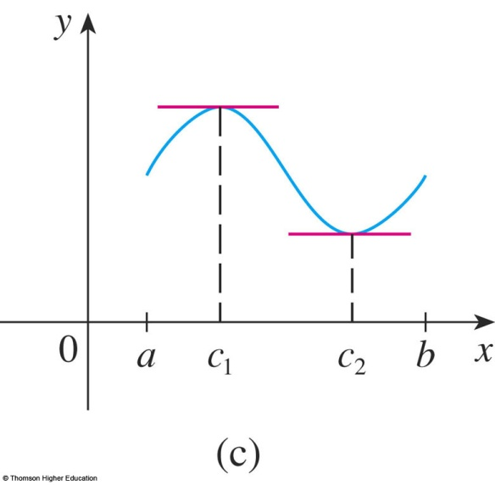
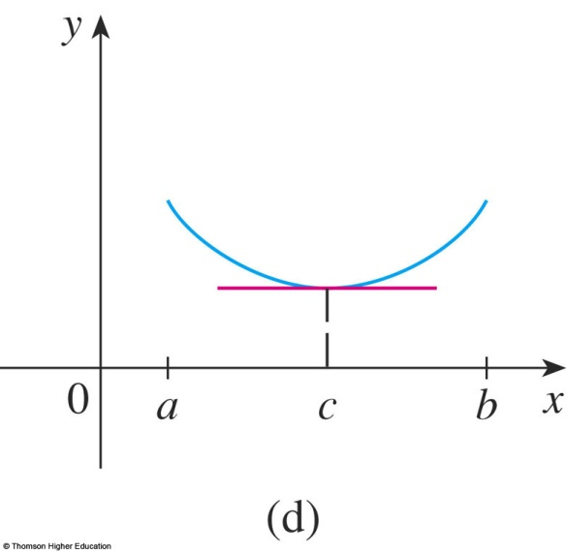
ROLLE’S THEOREM
The figures show the graphs of four such functions.
Let f(x)=x³-2x²+x-5. Find the numbers c in the Rolle’s theorem?

Slide 20
MEAN VALUE THEOREM
Equations 1 and 2
Let f be a function that fulfills two hypotheses:
f is continuous on the closed interval [a, b].
f is differentiable on the open interval (a, b).
Then, there is a number c in (a, b) such that
or, equivalently,

Slide 21
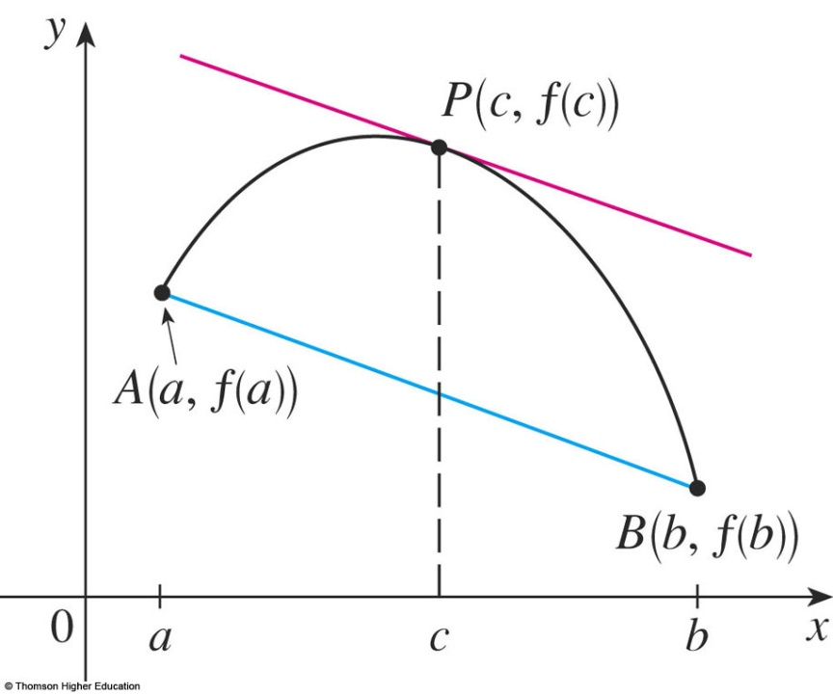
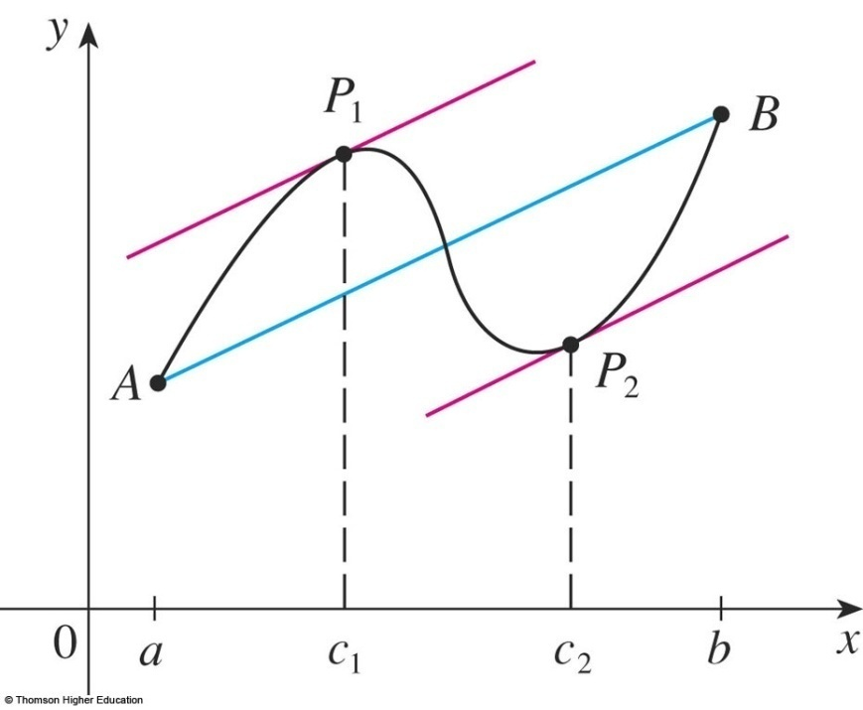
MEAN VALUE THEOREM
f ’(c) is the slope of the tangent line at (c, f(c)).
There is at least one point P(c, f(c)) on the graph where the slope of the tangent line is the same as the slope of the secant line AB.

Slide 22
Example 5
Suppose that f(0) = -3 and f ’(x) ≤ 5 for all values of x.
How large can f(2) possibly be?
We are given that f is differentiable - and therefore continuous - everywhere.
In particular, we can apply the Mean Value Theorem on the interval [0, 2].
There exists a number c such that f(2) – f(0) = f ’(c)(2 – 0)
So, f(2) = – 3 + 2 f ’(c)

Slide 23
Example 5
We are given that f ’(x) ≤ 5 ∀x
⇒ f ’(c) ≤ 5.
⇒ 2 f ’(c) ≤ 10.
⇒ f(2) = – 3 + 2 f ’(c) ≤ – 3 + 10 = 7
The largest possible value for f(2) is 7.

Slide 24
MEAN VALUE THEOREM
Theorem 5
If f ’(x) = 0 for all x in an interval (a, b),
then f is constant on (a, b).

Slide 25
MEAN VALUE THEOREM
Corollary 7
If f ’(x) = g’(x) for all x in an interval (a, b),
then f – g is constant on (a, b).
That is, f(x) = g(x) + c where c is a constant.

Slide 26
APPLICATIONS OF DIFFERENTIATION
3.3 Derivatives and the Shapes of Graphs
In this section, we will learn:
How the derivative of a function gives us the direction
in which the curve proceeds at each point.

Slide 27
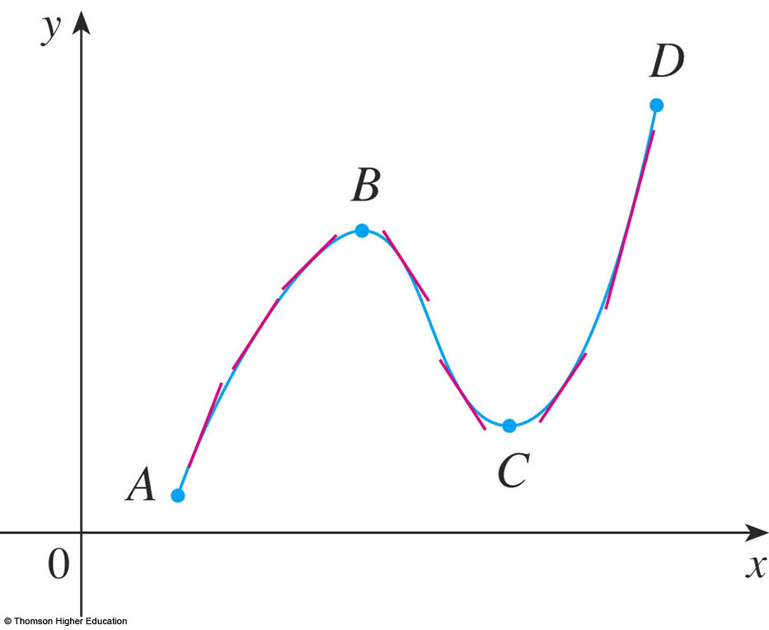
INCREASING/DECREASING TEST (I/D TEST)
If f’(x) > 0 on an interval, then f is increasing on that interval.
If f’(x) < 0 on an interval, then f is decreasing on that interval.

Slide 28
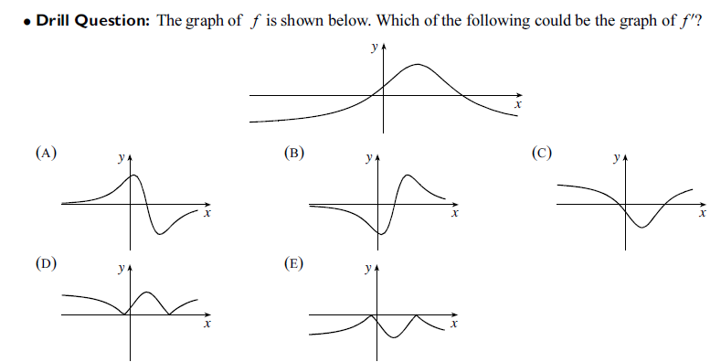
Answer: (A)

Slide 29
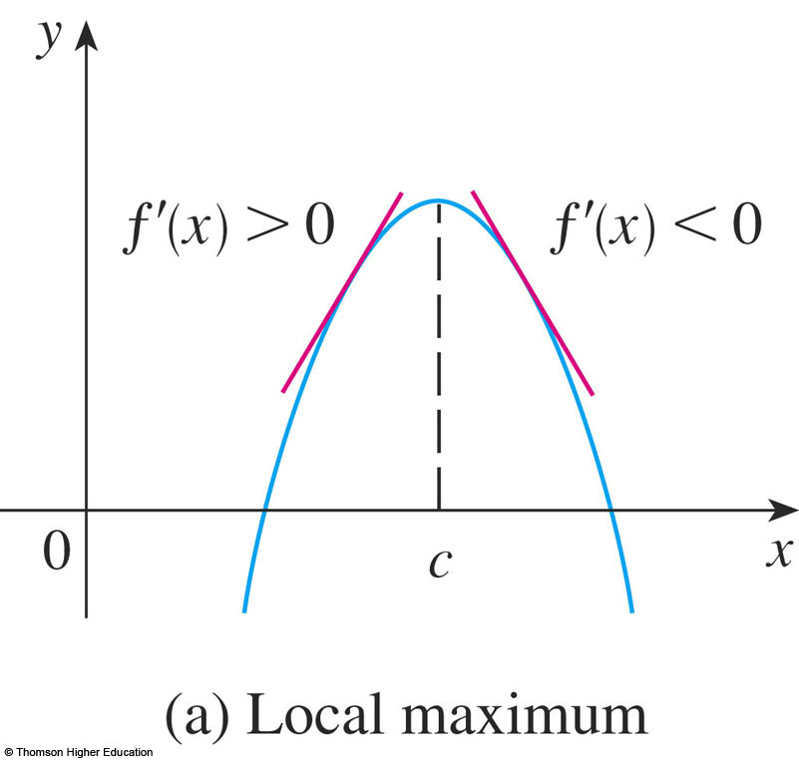
FIRST DERIVATIVE TEST
Suppose that c is a critical number of a continuous function f.
If f’ changes from positive to negative at c, then f has a local maximum at c.

Slide 30
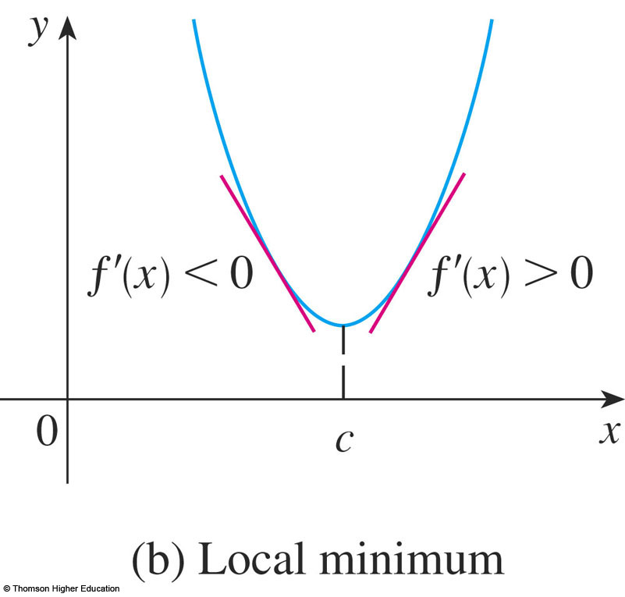
FIRST DERIVATIVE TEST
b. If f’ changes from negative to positive at c, then f has a local minimum at c.

Slide 31
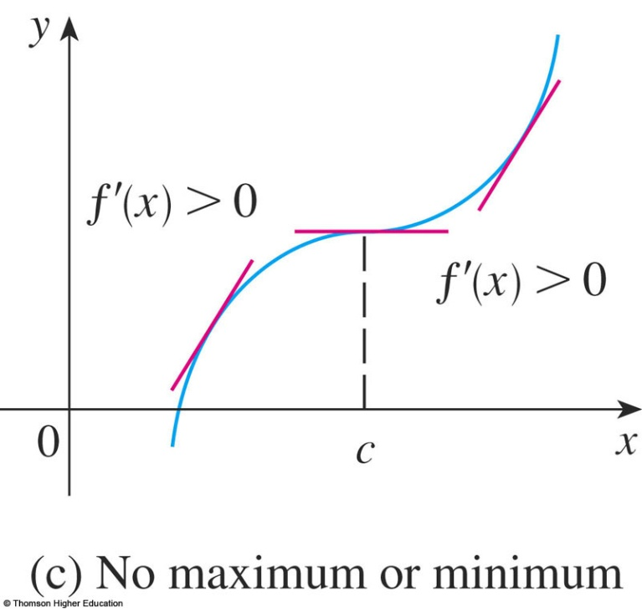
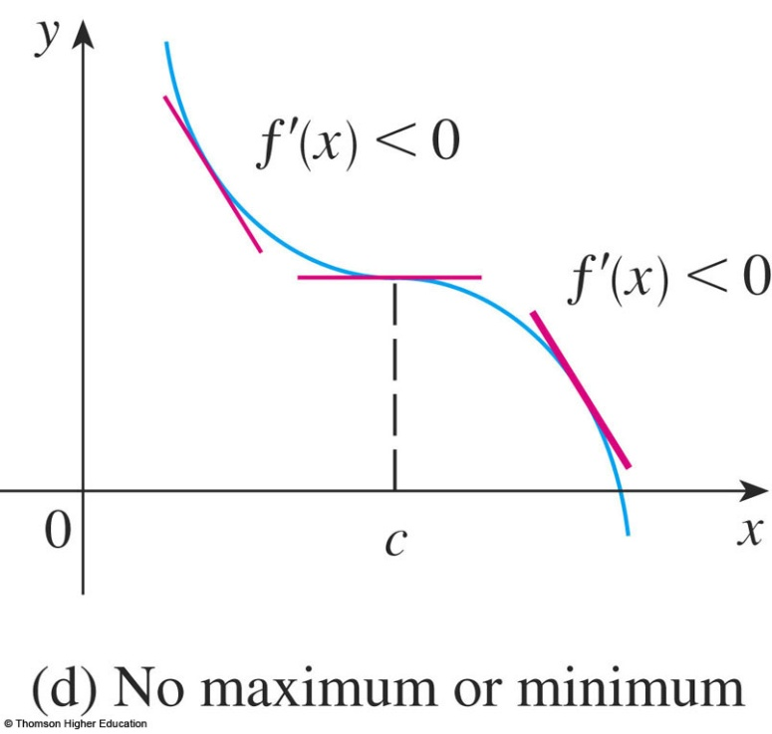
FIRST DERIVATIVE TEST
c. If f’ does not change sign at c then f has no local maximum or minimum at c.

Slide 32
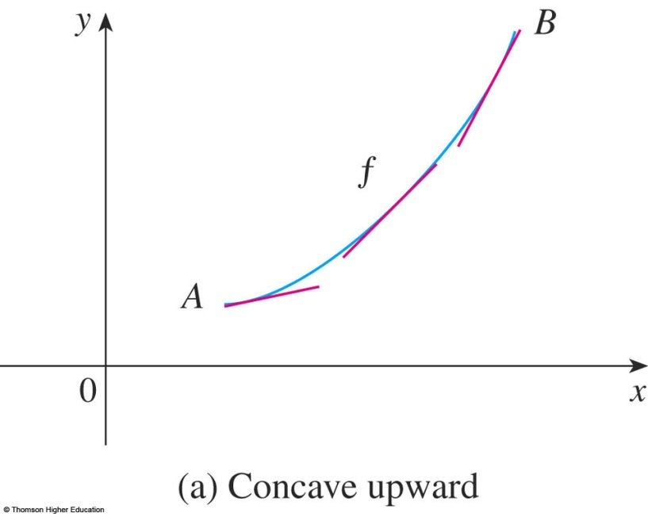
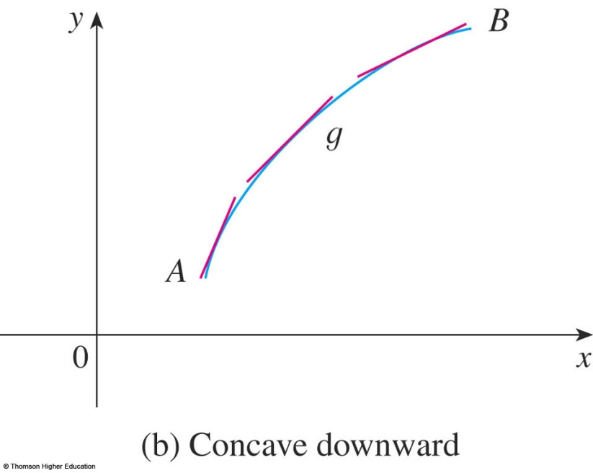
CONCAVE UPWARD/DOWNDWARD
The curve lies above the tangents and f is called concave upward (lõm lên) on (a, b).
The curve lies below the tangents and g is called concave downward (lõm xuống) on (a, b).

Slide 33
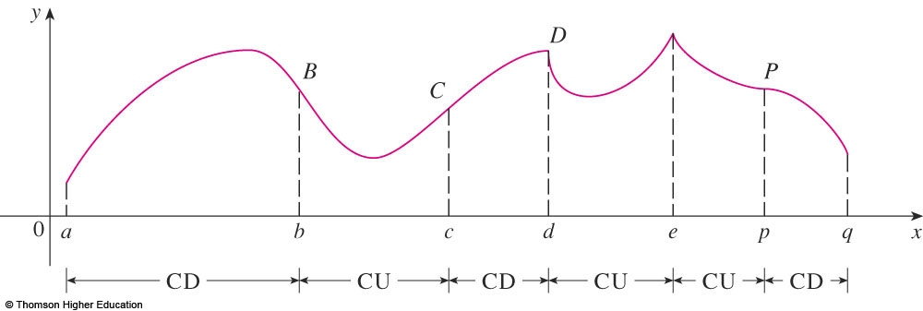
CONCAVITY TEST
If f’’(x) > 0 for all x in I, then the graph of f is concave upward on I.
If f’’(x) < 0 for all x in I, then the graph of f is concave downward on I.

Slide 34
INFLECTION POINT—DEFINITION
A point P on a curve y = f(x) is called an inflection point (điểm uốn)
if f is continuous there and the curve changes from concave upward to concave downward
(or from concave downward to concave upward at P).

Slide 35
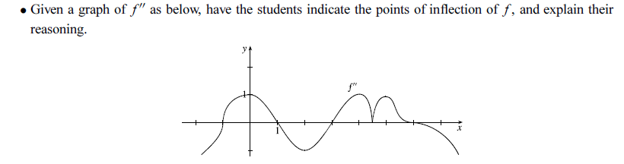
Answer: (-1,f(-1)),(1,f(1)),(3,f(3)),(6,f(6))

Slide 36
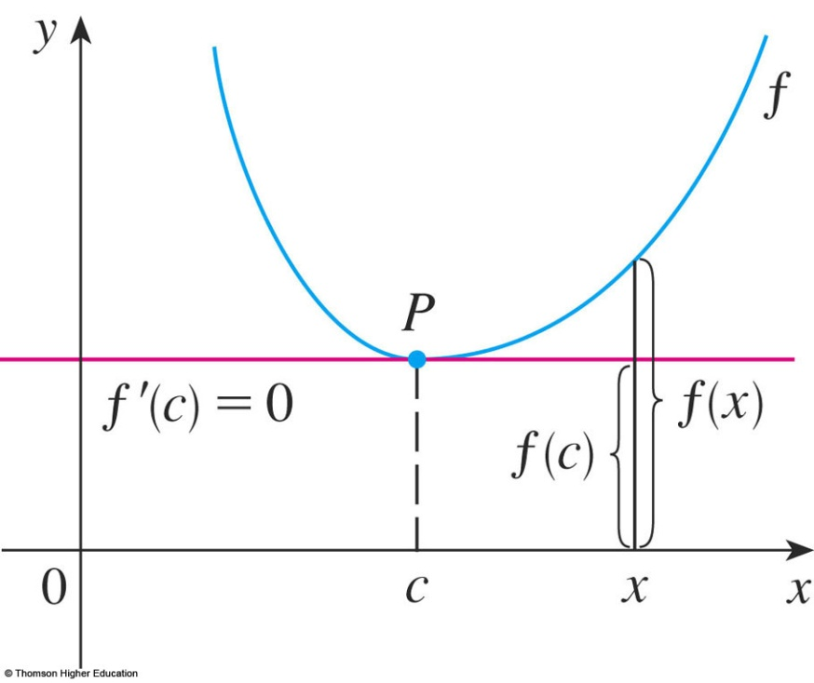
SECOND DERIVATIVE TEST
Suppose f’’ is continuous near c.
If f’(c) = 0 and f’’(c) > 0, then f has a local minimum at c.
If f’(c) = 0 and f’’(c) < 0, then f has a local maximum at c.

Slide 37
Choose the correct one.
A | If f has local extreme value at c then f’(c)=0.
B | If f’(c)=0 then f has local extreme value at c.
C | If f’’(3)=0 then (3,f(3)) is an inflection point of f.
D | There exists a function such that f’(x) is nonzero for all x and f(1)=f(0).
E | None of the above
Answer: e

Slide 38
APPLICATIONS OF DIFFERENTIATION
3.5
Optimization Problems
In this section, we will learn:
How to solve problems involving
maximization and minimization of factors.

Slide 39
Read the problem carefully until it is clearly understood.
What is the unknown?
What are the given quantities?
What are the given conditions?

Slide 40
6. FIND THE ABSOLUTE MAX./MIN. VALUE OF f
Use the methods of Sections 4.1 and 4.3 to find the absolute maximum or minimum value of f.
In particular, if the domain of f is a closed interval, then the Closed Interval Method in Section 4.1 can be used.

Slide 41
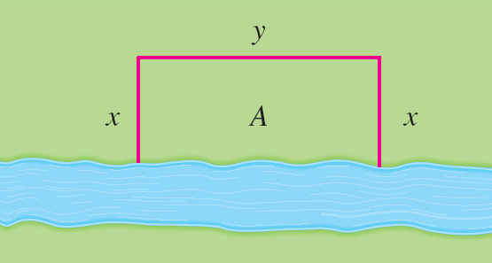
OPTIMIZATION PROBLEMS
Example 1
A farmer has 2400 ft of fencing and wants to fence off a rectangular field that borders a straight river. He needs no fence along the river.
What are the dimensions of the field that has the largest area ?

Slide 42
OPTIMIZATION PROBLEMS
Example 1
This figure illustrates the general case.
We wish to maximize the area A of the rectangle.
Then, we express A in terms of x and y: A = xy
2x + y = 2400
So, A(x) = 2400x – 2x², 0 ≤ x ≤ 1200
…

Slide 43
APPLICATIONS OF DIFFERENTIATION
3.6 Newton’s Method
In this section, we will learn:
How to solve high-degree equations
using Newton’s method.

Slide 44
How do those numerical rootfinders work?
They use a variety of methods.
Most, though, make some use of Newton’s method, also called the Newton-Raphson method.

Slide 45
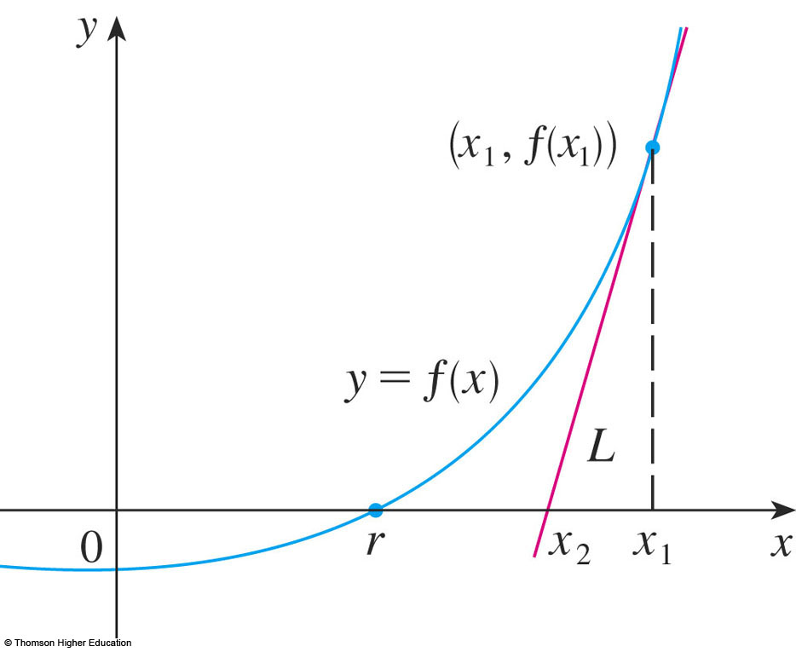
NEWTON’S METHOD
We start with a first approximation x_{1,} which is obtained by one of the following methods:
Guessing
A rough sketch of the graph of f
A computer- generated graph of f

Slide 46
NEWTON’S METHOD
Consider the tangent line L to the curve y = f(x) at the point (x₁, f(x₁)) and look at the x-intercept of L, labeled x₂.

Slide 47
As the x-intercept of L is x₂, we set y = 0 and obtain:
0 - f(x₁) = f’(x₁)(x₂ - x₁)
If f’(x₁) ≠ 0, we can solve this equation for x₂:
We use x₂ as a second approximation to r.

Slide 48
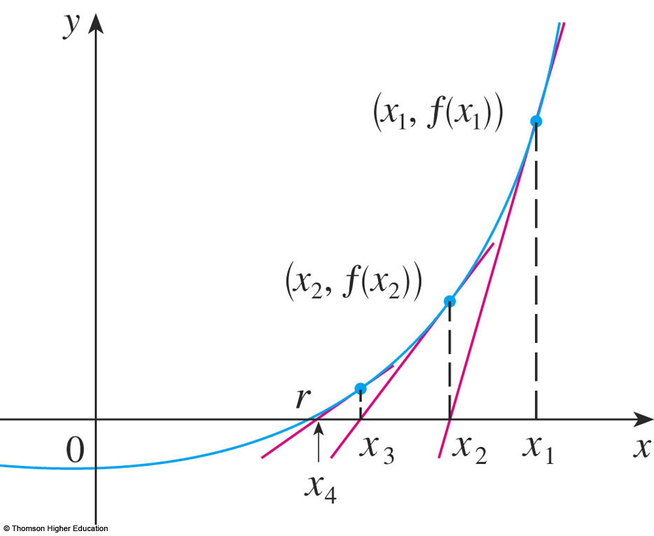
SUBSEQUENT APPROXIMATION
Equation/Formula 2
In general, if the nth approximation is x_{n} and f’(x_{n}) ≠ 0, then the next approximation is given by:

Slide 49
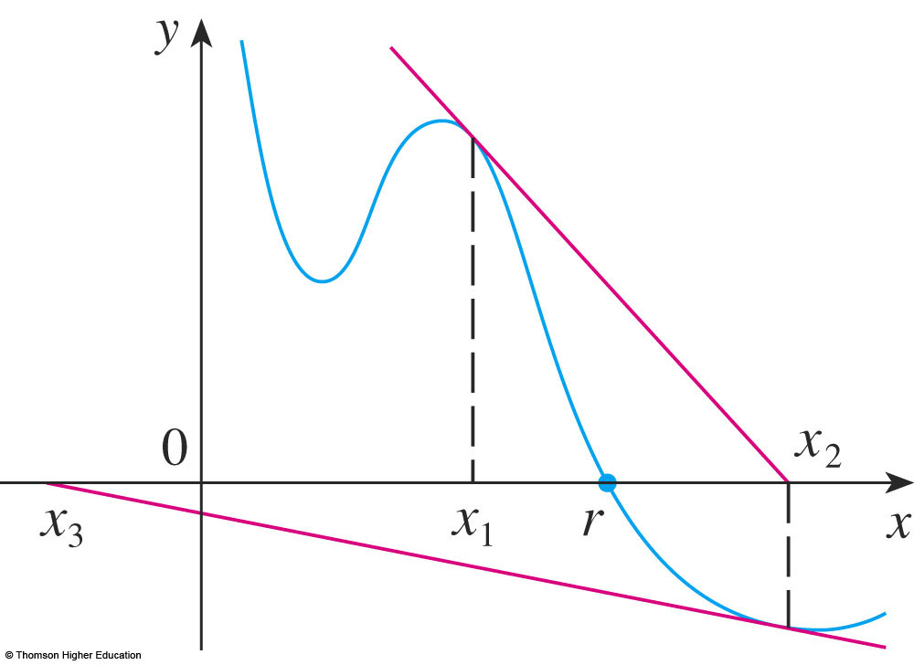
If the numbers x_{n} become closer and closer to r as n becomes large, then we say that the sequence converges to r and we write:

Slide 50
NEWTON’S METHOD
Example 2
Use Newton’s method to find correct to eight decimal places.
First, we observe that finding is equivalent to finding the positive root of the equation x⁶ – 2 = 0
So, we take f(x) = x⁶ – 2
Then, f’(x) = 6x⁵

Slide 51
NEWTON’S METHOD
Example 2
So, Formula 2 (Newton’s method) becomes:

Slide 52
NEWTON’S METHOD
Example 2
Choosing x₁ = 1 as the initial approximation, we obtain:
As x₅ and x₆ agree to eight decimal places, we conclude that to eight decimal places.

Slide 53
APPLICATIONS OF DIFFERENTIATION
3.7
Antiderivatives
In this section, we will learn about:
Antiderivatives and how they are useful
in solving certain scientific problems.

Slide 54
DEFINITION
A function F is called an antiderivative of f on an interval I if F’(x) = f(x) for all x in I.

Slide 55
ANTIDERIVATIVES
Theorem 1
If F is an antiderivative of f on an interval I, the most general antiderivative of f on I is F(x) + C
where C is an arbitrary constant.

Slide 56
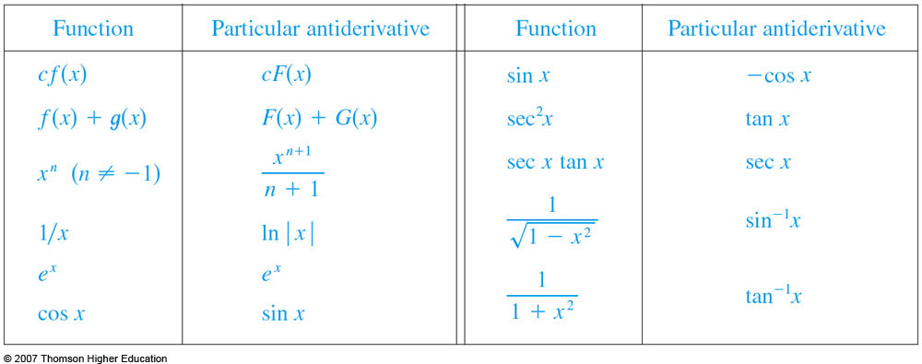
ANTIDERIVATIVE FORMULA
Table 2
Here, we list some particular antiderivatives.

Slide 57
RECTILINEAR MOTION
Example 6
A particle moves in a straight line and has acceleration given by a(t) = 6t + 4.
Its initial velocity is v(0) = -6 cm/s and its initial displacement is s(0) = 9 cm.
Find its position function s(t).

Slide 58
Thanks

