Slide 1

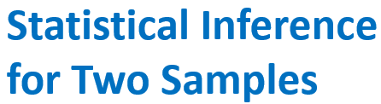

Slide 2
Learning Objectives for Chapter 10
After careful study of this chapter, you should be able to do the following:
Structure comparative experiments involving two samples as hypothesis tests.
Test hypotheses and construct confidence intervals on the difference in means of two normal distributions.
Test hypotheses and construct confidence intervals on the ratio of the variances or standard deviations of two normal distributions.
Test hypotheses and construct confidence intervals on the difference in two population proportions.
Use the P-value approach for making decisions in hypothesis tests.
Compute power, Type II error probability, and make sample size decisions for two-sample tests on means, variances & proportions.
Explain & use the relationship between confidence intervals and hypothesis tests.

Slide 3
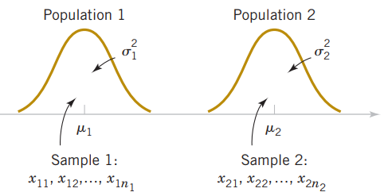
10.1 Inference on the Difference in Means of Two Normal Distributions, Variances Known
Assumptions for Two-Sample Inference
X₁₁, X₁₂, …, X_{1n1} is a random sample from population 1.
X₂₁, X₂₂, …, X_{2n2} is a random sample from population 2.
The two populations represented by X₁ and X₂ are independent.
(4) Both populations are normal.

Slide 4

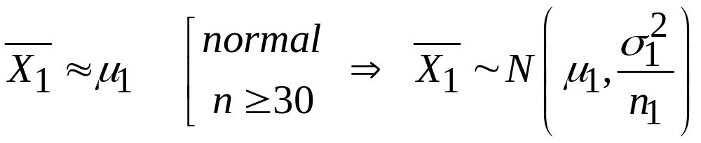

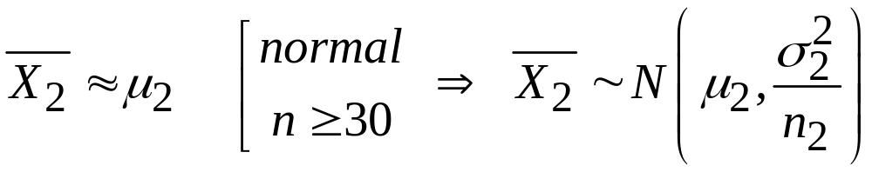


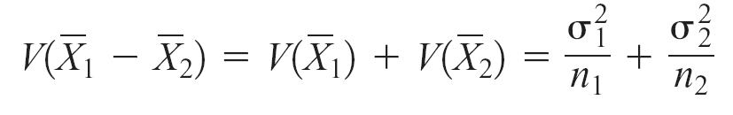
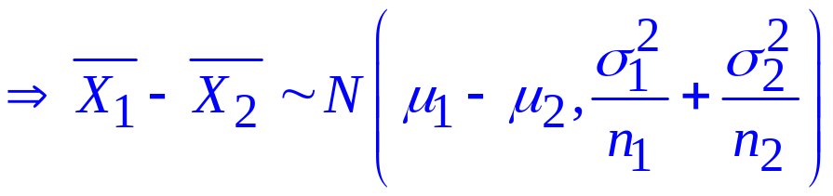
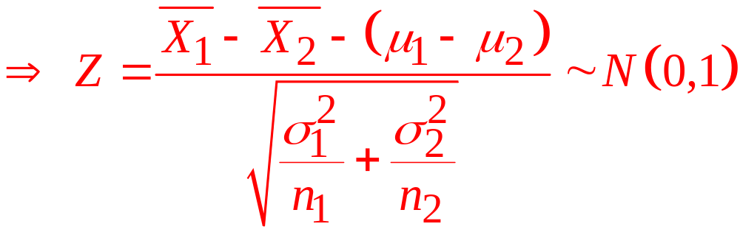
10.1 Inference on the Difference in Means of Two Normal Distributions, Variances Known

Slide 5
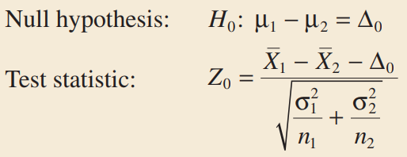
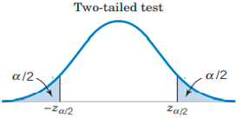


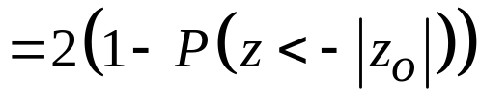


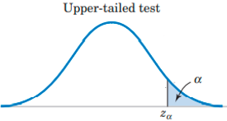



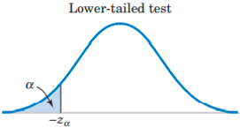



Tests on the Difference in Means, Variances Known

Slide 6


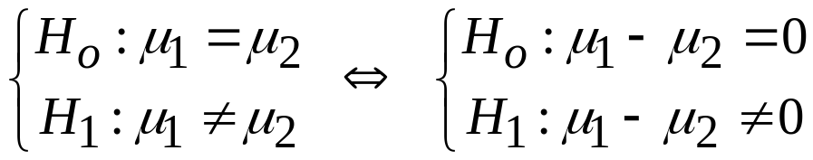
10.1 Inference on the Difference in Means of Two Normal Distributions, Variances Known
EX1: A product developer is interested in reducing the drying time of a primer paint. Two formulations of the paint are tested; formulation 1 is the standard chemistry, and formulation 2 has a new drying ingredient that should reduce the drying time. From experience, it is known that the standard deviation of drying time is 8 minutes, and this inherent variability should be unaffected by the addition of the new ingredient. Ten specimens are painted with formulation 1, and another 10 specimens are painted with formulation 2; the 20 specimens are painted in random order. The two sample average drying times are minutes and minutes, respectively. What conclusions can the product developer draw about the effectiveness of the new ingredient, using α = 0.05?
Solution:

Slide 7

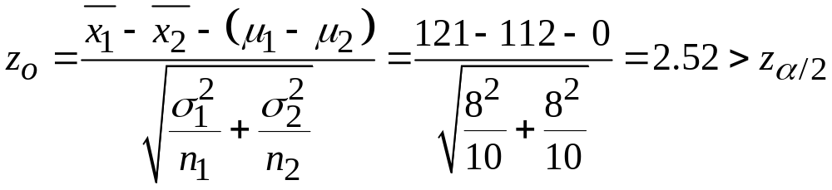




10.1 Inference on the Difference in Means of Two Normal Distributions, Variances Known
Critical value:
Test statistic:
We conclude that adding the new ingredient to the paint significantly reduces the drying time.

Slide 8

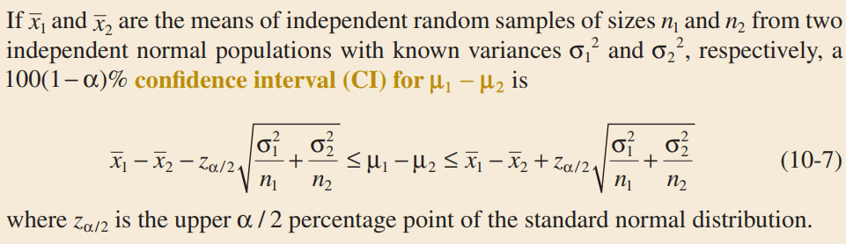
10.1 Inference on the Difference in Means of Two Normal Distributions, Variances Known
Confidence Interval

Slide 9
10.1 Inference on the Difference in Means of Two Normal Distributions, Variances Known
EX2: A manager evaluates effectiveness of a major hardware upgrade by running a certain process 50 times before the upgrade and 50 times after it. Based on these data, the average running time is 8.5 minutes before the upgrade, 7.2 minutes after it. Historically, the standard deviation has been 1.8 minutes, and presumably it has not changed. Construct a 95% confidence interval showing how much the mean running time reduced due to the hardware upgrade.

Slide 10
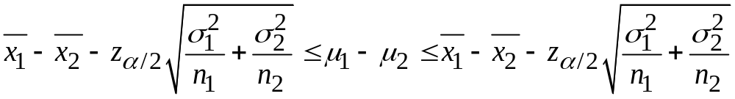
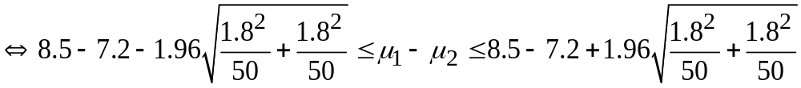

10.1 Inference on the Difference in Means of Two Normal Distributions, Variances Known
EX2: A manager evaluates effectiveness of a major hardware upgrade by running a certain process 50 times before the upgrade and 50 times after it. Based on these data, the average running time is 8.5 minutes before the upgrade, 7.2 minutes after it. Historically, the standard deviation has been 1.8 minutes, and presumably it has not changed. Construct a 95% confidence interval showing how much the mean running time reduced due to the hardware upgrade.
Solution:

Slide 11


10.1 Inference on the Difference in Means of Two Normal Distributions, Variances Known
One-Sided Confidence Bounds
Upper Confidence Bound
Lower Confidence Bound

Slide 12
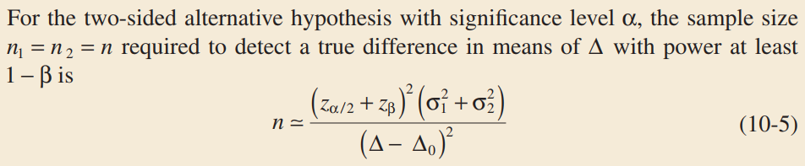
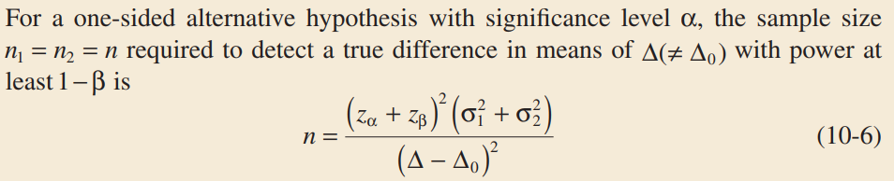
10.1 Inference on the Difference in Means of Two Normal Distributions, Variances Known
Choice of Sample Size
Two-sided alternative:
One-sided alternative:

Slide 13


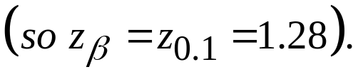
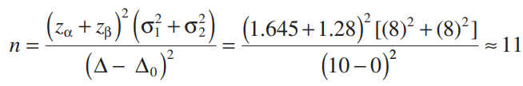
10.1 Inference on the Difference in Means of Two Normal Distributions, Variances Known
EX3: To illustrate the use of these sample size equations, consider the situation described in EX1, and suppose that if the true difference in drying times is as much as 10 minutes, we want to detect this with probability at least 0.90. Under the null hypothesis, . We have a one-sided alternative hypothesis with
Δ =10, α = 0.05 , and because the power is 0.9, β = 0.10
Therefore, we may find the required sample size from
Equation 10-6 as follows:

Slide 14
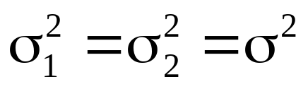

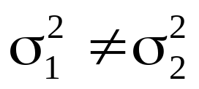
10.2 Inference on the Difference in Means of Two Normal Distributions, Variances Unknown
Case 1:
Case 2:

Slide 15
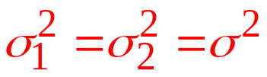
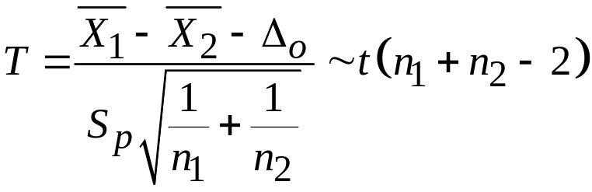
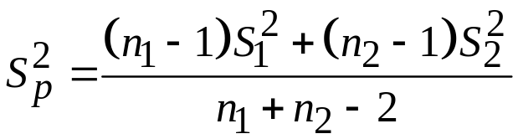

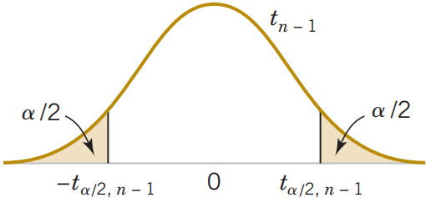
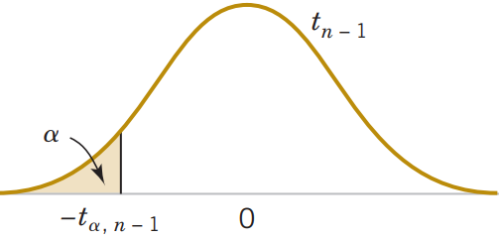
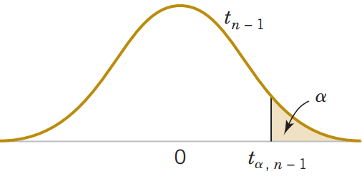








10.2 Inference on the Difference in Means of Two Normal Distributions, Variances Unknown
Case 1:
degrees of freedom

Slide 16
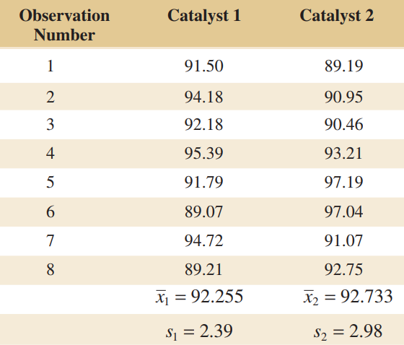
10.2 Inference on the Difference in Means of Two Normal Distributions, Variances Unknown
EX4: Two catalysts are being analyzed to determine how they affect the mean yield of a chemical process. Specifically, catalyst 1 is currently used; but catalyst 2 is acceptable. Because catalyst 2 is cheaper, it should be adopted, if it does not change the process yield. A test is run in the pilot plant and results in the data shown in Table 10-1. Is there any difference in the mean yields? Use α = 0.05, and assume equal variances.

Slide 17
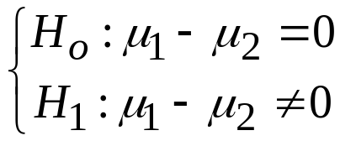
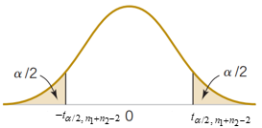



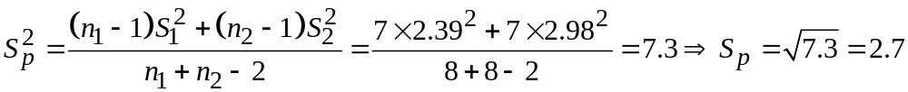
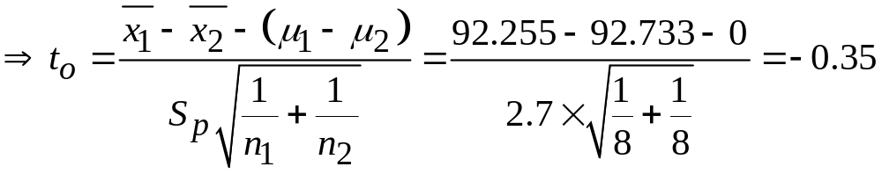
10.2 Inference on the Difference in Means of Two Normal Distributions, Variances Unknown
Solution:
We have:
Critical value:
Test statistic:
At the 0.05 level of significance, we do not have strong evidence to conclude that catalyst 2 results in a mean yield that differs from the mean yield when catalyst 1 is used.

Slide 18
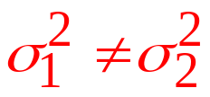
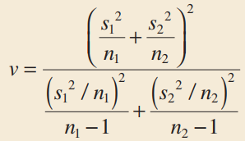
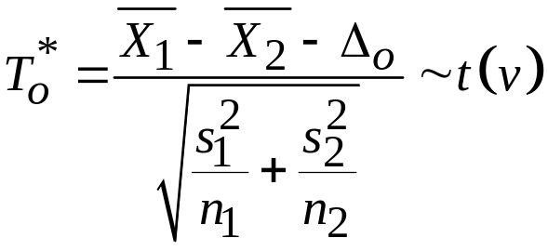








10.2 Inference on the Difference in Means of Two Normal Distributions, Variances Unknown
Case 2:
degrees of freedom

Slide 19
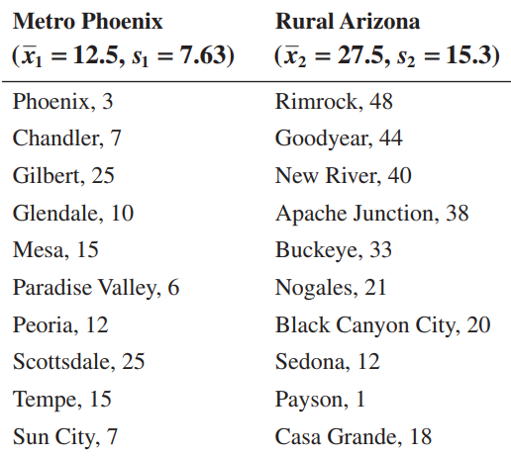
10.2 Inference on the Difference in Means of Two Normal Distributions, Variances Unknown
EX5: Arsenic concentration in public drinking water supplies is a potential health risk. An article in the Arizona Republic (May 27, 2001) reported drinking water arsenic concentrations in parts per billion (ppb) for 10 metropolitan Phoenix communities and 10 communities in rural Arizona. The data follow:
We wish to determine whether any difference exists in mean arsenic concentrations for metropolitan Phoenix communities and for communities in rural Arizona. The assumption of normality appears quite reasonable, but because the slopes of the two straight lines are very different, it is unlikely that the population variances are the same. Use α = 0.05.

Slide 20
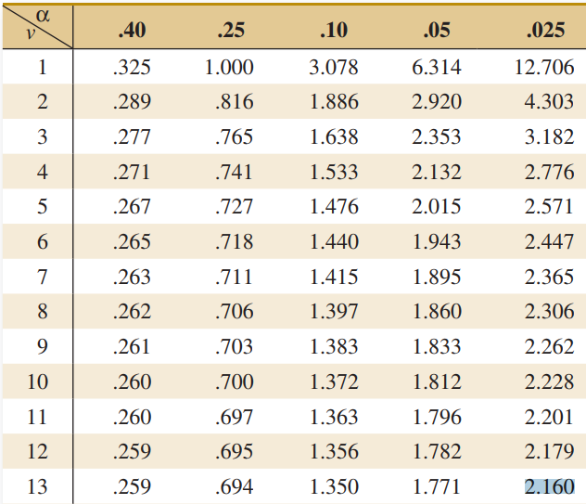
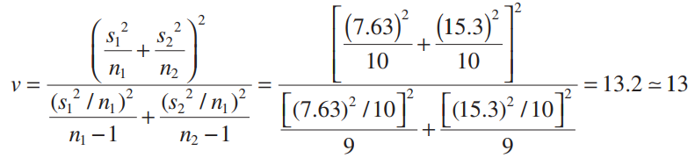
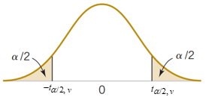



10.2 Inference on the Difference in Means of Two Normal Distributions, Variances Unknown
Solution:
We have:
The degrees of freedom:
Critical value:

Slide 21
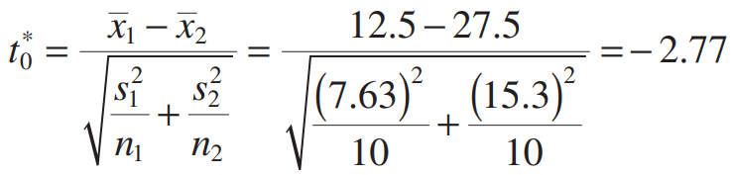


10.2 Inference on the Difference in Means of Two Normal Distributions, Variances Unknown
Test statistic:
There is strong evidence to conclude that mean arsenic concentration in the drinking water in rural Arizona is different from the mean arsenic concentration in metropolitan Phoenix drinking water. Furthermore, the mean arsenic concentration is higher in rural Arizona communities.

Slide 22
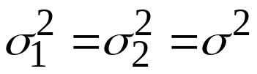
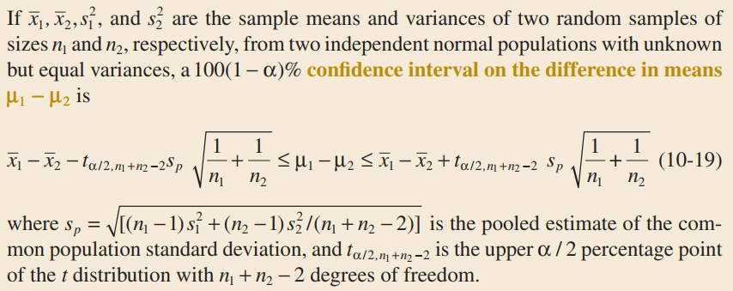
10.2 Inference on the Difference in Means of Two Normal Distributions, Variances Unknown
Confidence Interval
Case 1:

Slide 23
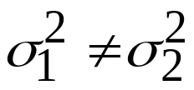
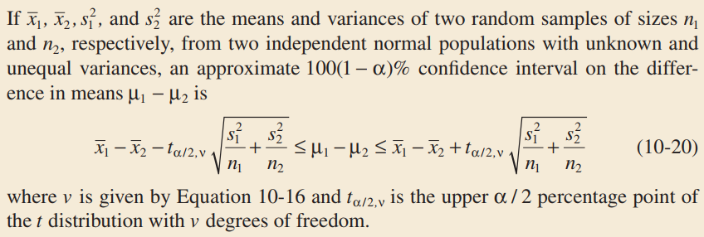
10.2 Inference on the Difference in Means of Two Normal Distributions, Variances Unknown
Confidence Interval
Case 2:

Slide 24
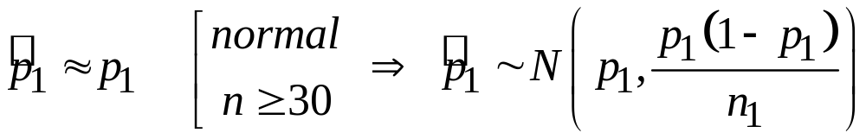
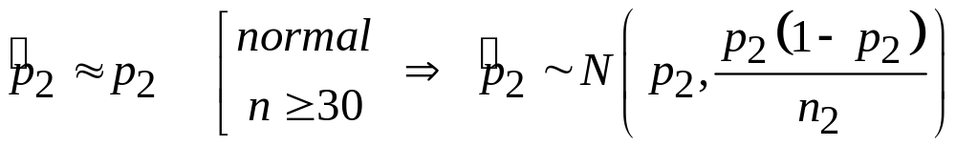
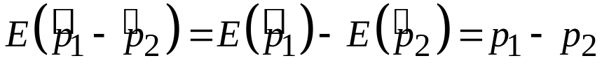
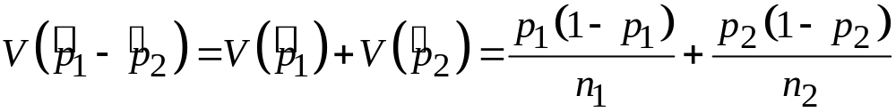


10.6 Inference on Two Population Proportions

Slide 25





10.6 Inference on Two Population Proportions
Large-Sample Test on the Difference in Population Proportions

Slide 26
10.6 Inference on Two Population Proportions
EX6: Extracts of St. John’s Wort are widely used to treat depression. An article in the April 18, 2001, issue of the Journal of the American Medical Association (“Effectiveness of St. John’s Wort on Major Depression: A Randomized Controlled Trial”) compared the efficacy of a standard extract of St. John’s Wort with a placebo in 200 outpatients diagnosed with major depression. Patients were randomly assigned to two groups; one group received the St. John’s Wort, and the other received the placebo. After eight weeks, 19 of the placebo-treated patients showed improvement, and 27 of those treated with St. John’s Wort improved. Is there any reason to believe that St. John’s Wort is effective in treating major depression? Use α = 0.05.

Slide 27




10.6 Inference on Two Population Proportions
Solution:
We have:
Critical value:
Test statistic:
There is insufficient evidence to support the claim that St. John’s Wort is effective in treating major depression.

Slide 28

10.6 Inference on Two Population Proportions
Confidence Interval

Slide 29
Review chapter 10

Slide 30
















Difference in Means
Independent
Confidence Interval:
degrees of freedom
Confidence Interval:
degrees of freedom
Confidence Interval:

Slide 31




Two Population Proportions
Test statistic:
Confidence Interval:

