Slide 1
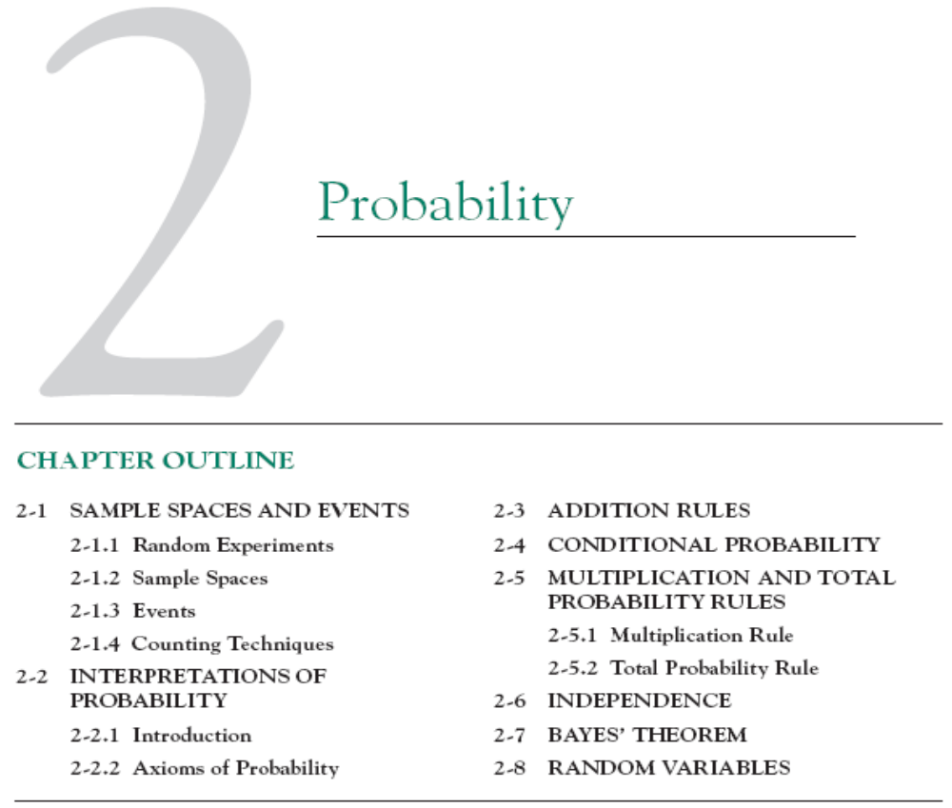

Slide 2

2.2 Interpretations of Probability
1. Each of the possible five outcomes of a random experiment is equally likely. The sample space is {a, b, c, d, e}. All outcomes are equally likely. Let A denote the event {a, b}, and let B denote the event {c, d, e}. Determine the following:

Slide 3

2.2 Interpretations of Probability
2. The sample space of a random experiment is {a, b, c, d, e} with probabilities 0.1, 0.1, 0.2, 0.4, and 0.2 respectively. Let A denote the event {a, b, c}, and let B denote the event {c, d, e}. Determine:

Slide 4



2.3 Addition Rules
3. If and determine the following probabilities:

Slide 5





2.3 Addition Rules
4. If A, B, and C are mutually exclusive events with
and determine the following probabilities:

Slide 6
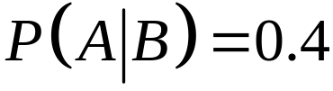

2.5 Multiplication and Total Probability Rules
5. Suppose that and . Determine the following:

Slide 7
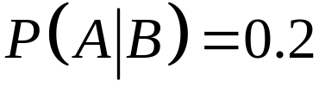
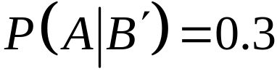


2.5 Multiplication and Total Probability Rules
6. Suppose that , and . What is ?

Slide 8
2.5 Multiplication and Total Probability Rules
7. The probability is 1% that an electrical connector that is kept dry fails during the warranty period of a portable computer. If the connector is ever wet, the probability of a failure during the warranty period is 5%. If 90% of the connectors are kept dry and 10% are wet, what proportion of connectors fail during the warranty period?

Slide 9
2.5 Multiplication and Total Probability Rules
8. Suppose 2% of cotton fabric rolls and 3% of nylon fabric rolls contain flaws. Of the rolls used by a manufacturer, 70% are cotton and 30% are nylon. What is the probability that a randomly selected roll used by the manufacturer contains flaws

Slide 10
2.5 Multiplication and Total Probability Rules
9. The edge roughness of slit paper products increases as knife blades wear. Only 1% of products slit with new blades have rough edges, 3% of products slit with blades of average sharpness exhibit roughness, and 5% of products slit with worn blades exhibit roughness. If 25% of the blades in manufacturing are new, 60% are of average sharpness, and 15% are worn, what is the proportion of products that exhibit edge roughness?

Slide 11
2.7 Bayes’ Theorem
10. An e-mail filter is planned to separate valid e-mails from spam. The word free occurs in 60% of the spam messages and only 4% of the valid messages. Also, 20% of the messages are spam. Determine the following probabilities:
(a) The message contains free.
(b) The message is spam given that it contains free.
(c) The message is valid given that it does not contain free.

Slide 12
2.7 Bayes’ Theorem
11. A recreational equipment supplier finds that among orders
that include tents, 40% also include sleeping mats. Only 5%
of orders that do not include tents do include sleeping mats. Also, 20% of orders include tents. Determine the following probabilities:
(a) The order includes sleeping mats.
(b) The order includes a tent given it includes sleeping mats.

