Slide 1
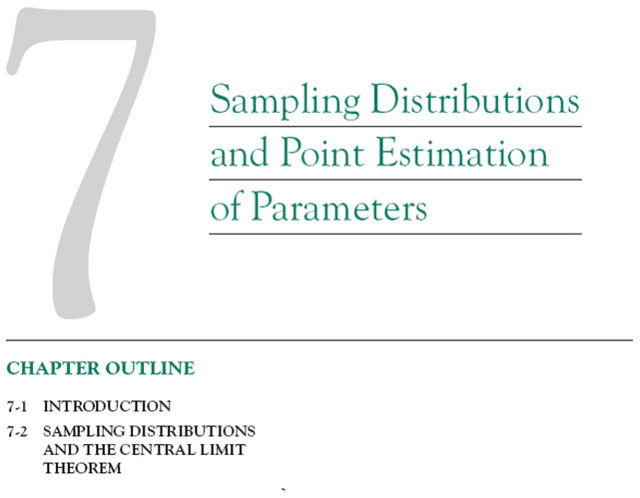

Slide 2
1. PVC pipe is manufactured with a mean diameter of 1.01 inch and a standard deviation of 0.003 inch. Find the probability that a random sample of n = 9 sections of pipe will have a sample mean diameter greater than 1.009 inch and less than 1.012 inch.

Slide 3

2. Suppose that samples of size n = 25 are selected at random from a normal population with mean 100 and standard deviation 10. What is the probability that the sample mean falls in the interval from to ?

Slide 4
3. A synthetic fiber used in manufacturing carpet has tensile strength that is normally distributed with mean 75.5 psi and standard deviation 3.5 psi. Find the probability that a random sample of n = 6 fiber specimens will have sample mean tensile strength that exceeds 75.75 psi.

Slide 5




4. A random sample of size is selected from a normal population with a mean of 75 and a standard deviation of 8. A second random sample of size is taken from another normal population with mean 70 and standard deviation 12. Let and be the two sample means. Find:
(a) The probability that exceeds 4
(b) The probability that

