Slide 1
Android Overview

Slide 2
Contents
Android operating system
Android platform architecture
Android versions

Slide 3

Android operating system
Android is a Linux-based operating system
Open source
https://source.android.com/
Just the OS, not the Play store or Google play services
User Interface for touch screens
Highly customizable for devices / by vendors

Slide 4
Android Ecosystem
Android - phones and tablets
Android wear - smartwatch
Extended notification center
Android TV - televisions, consoles
Native TV app experience for IPTV
Android auto - cars
Connecting phone with the car
Android things
Platform for IoT
Google glass

Slide 5
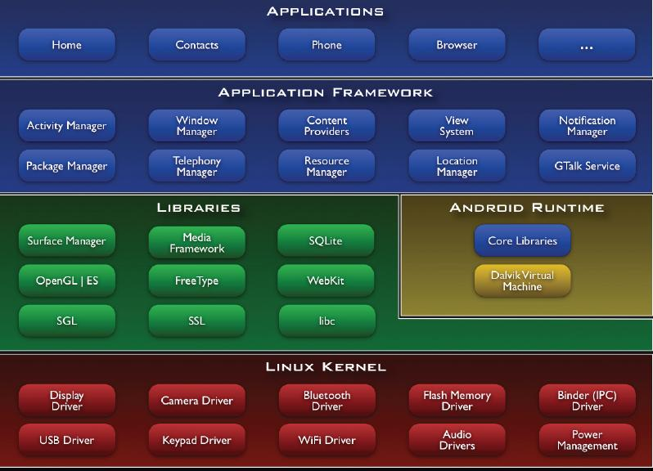
Android Platform Architecture

Slide 6
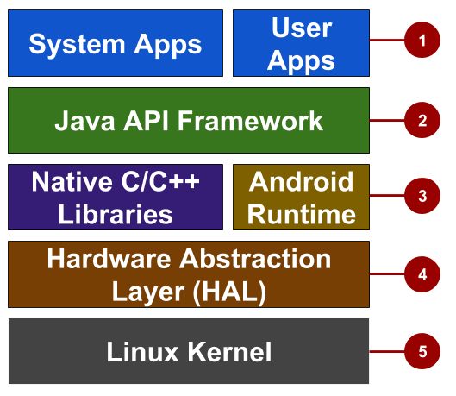
Android Platform Architecture
System and user apps
Android OS API in Java framework
Expose native APIs; run apps
Expose device hardware capabilities
Linux Kernel

Slide 7
Android Platform Architecture
1. System and user apps
System apps have no special status
System apps provide key capabilities to app developers
Example:
Your app can use a system app to deliver a SMS message.

Slide 8
Android Platform Architecture
2. Java API Framework:
The entire feature-set of the Android OS is available to you through APIs written in the Java language.
View class hierarchy to create UI screens
Notification manager
Activity manager for life cycles and navigation

Slide 9
Android Platform Architecture
3. Android runtime: Each app runs in its own process with its own instance of the Android Runtime.
4. C/C++ libraries: give access to core native Android system components and services.
5. Hardware Abstraction Layer (HAL): Standard interfaces that expose device hardware capabilities as libraries
Examples: Camera, bluetooth module

Slide 10
Android Platform Architecture
6. Linux Kernel
Threading and low-level memory management
Security features
Drivers

Slide 11
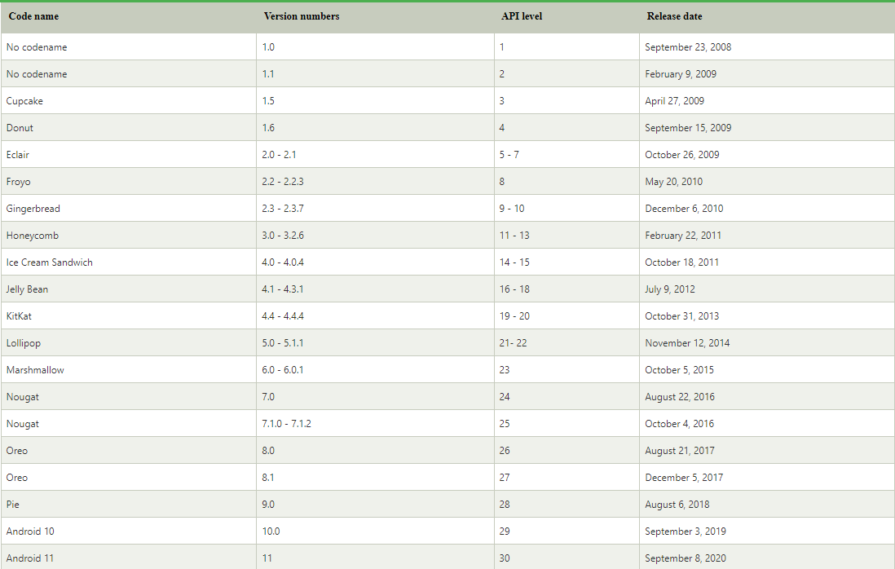
Android versions

Slide 12
Challenges of Android development
Multiple screen sizes and resolutions
Performance: make your apps responsive and smooth
Security: keep source code and user data safe
Compatibility: run well on older platform versions

Slide 13
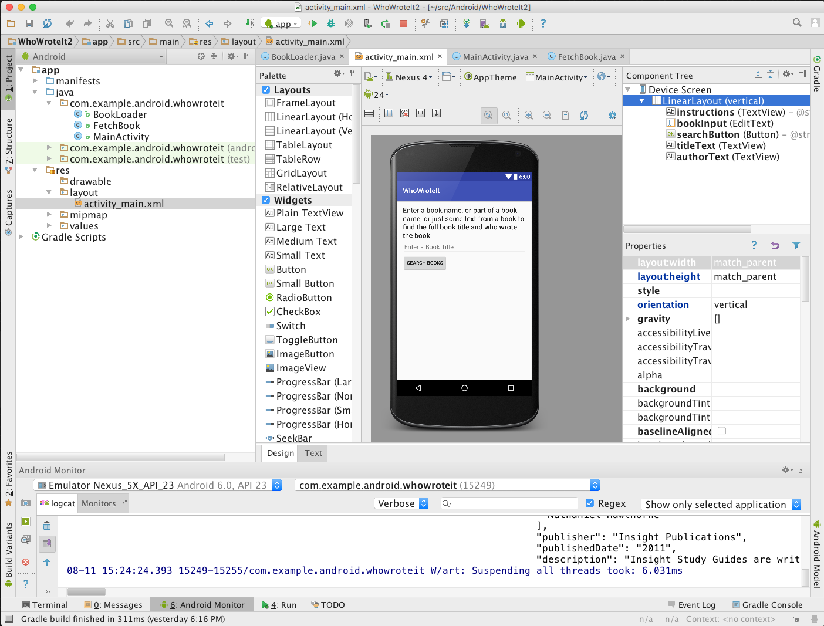
Android application development
Android Studio
Develop, run, debug, test, and package apps
Monitors and performance tools
Virtual devices
Project views
Visual layout editor

Slide 14
Android application development
Android Software Developer Kit (SDK)
Development tools (debugger, monitors, editors)
Libraries (maps, wearables)
Virtual devices (emulators)
Documentation (developers.android.com)
Sample code

Slide 15
References
https://google-developer-training.github.io/android-developer-fundamentals-course-concepts-v2/

Slide 16
Practice Project
Describe: Develop an Android application for Product Sale
Database: Sqlite or MySQL (using Restful API)
Functions:
Sign Up/Login screen: manage users
List of Products screen: show list of products
Product details screen: show information of a product
Product Cart screen: show products that user selects to buy
Billing screen: process payment of user
Show a notification if Cart has products when opening the application
Map screen: show Store’s location
Chat screen: customers can chat with Store
Notes:
Màn hình Đăng ký/Đăng nhập: quản lý người dùng Danh sách màn hình sản phẩm: hiển thị danh sách sản phẩm Màn hình chi tiết sản phẩm: hiển thị thông tin của sản phẩm Màn hình Giỏ hàng sản phẩm: hiển thị các sản phẩm mà người dùng chọn mua Màn hình thanh toán: xử lý thanh toán của người dùng Hiển thị thông báo nếu Giỏ hàng có sản phẩm khi mở ứng dụng Màn hình bản đồ: hiện vị trí của Cửa hàng Màn hình trò chuyện: khách hàng có thể trò chuyện với Store

