Slide 1


Slide 2
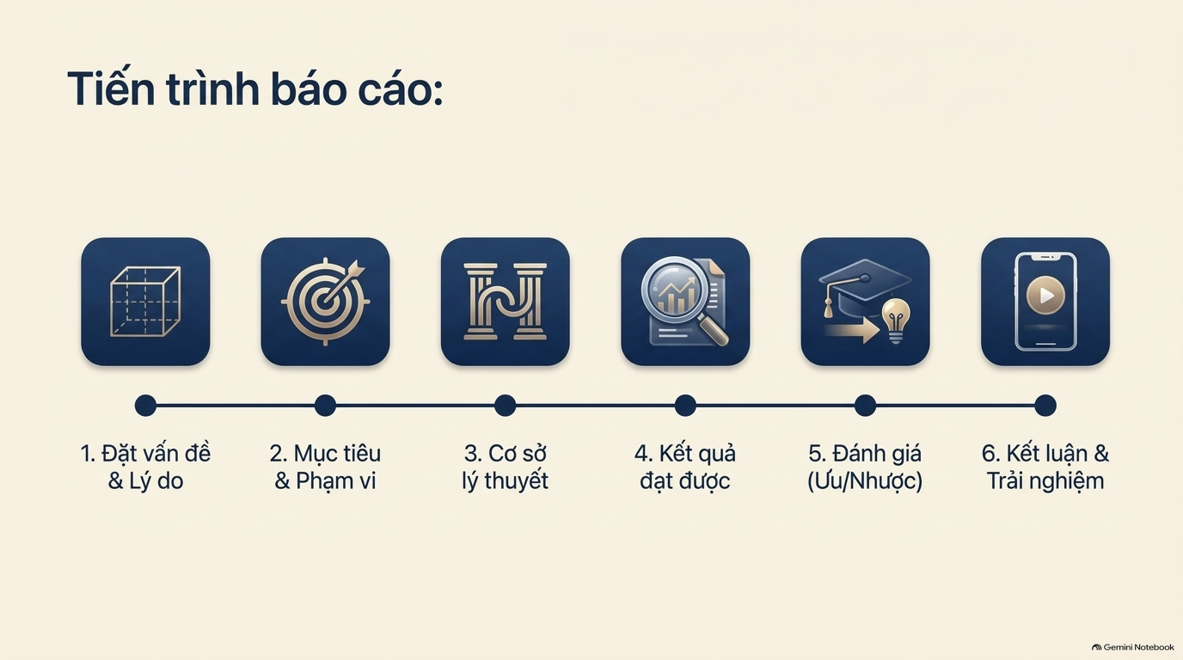

Slide 3
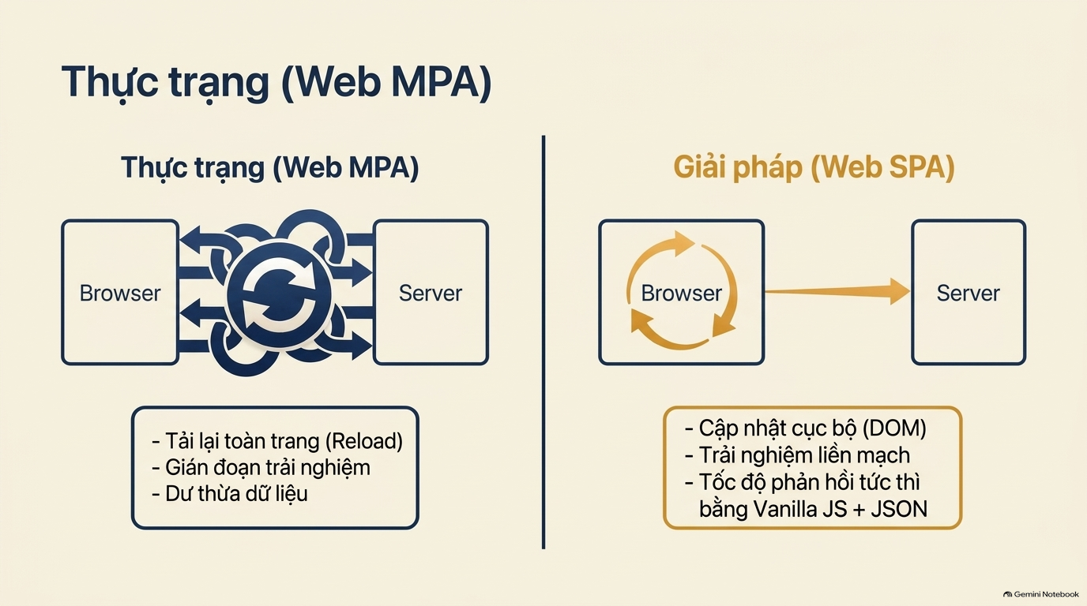

Slide 4


Slide 5
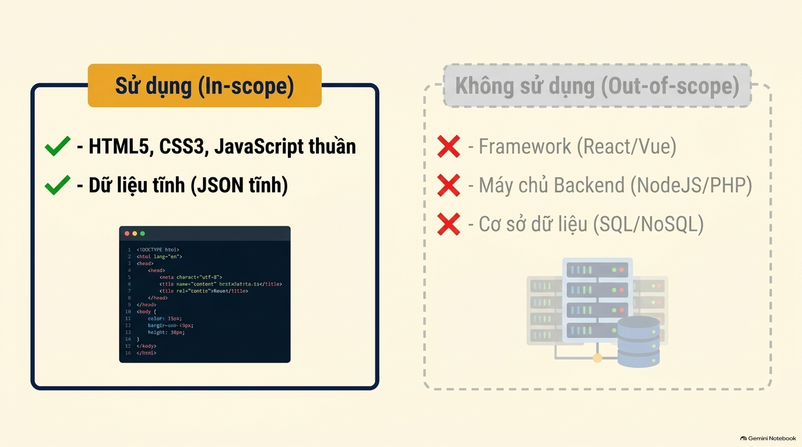

Slide 6


Slide 7
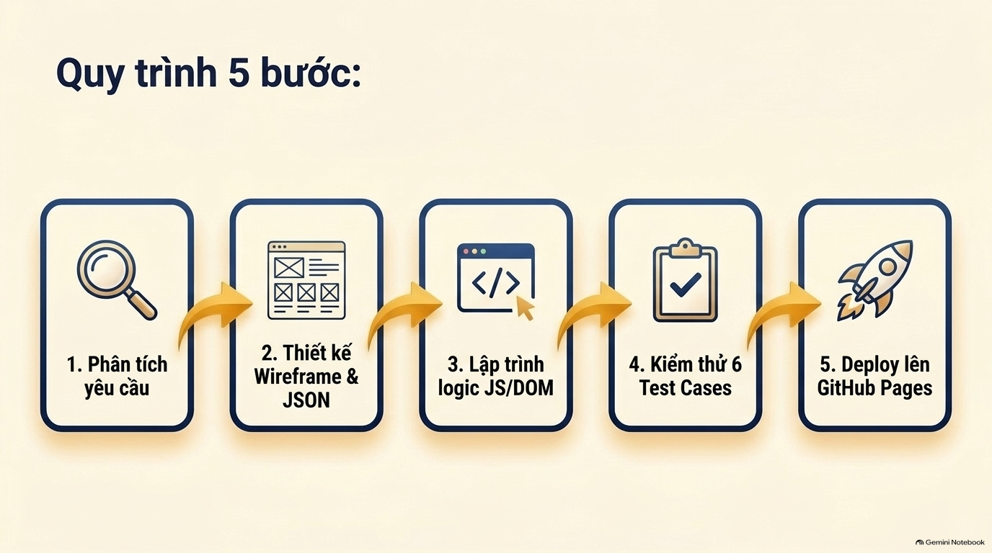

Slide 8
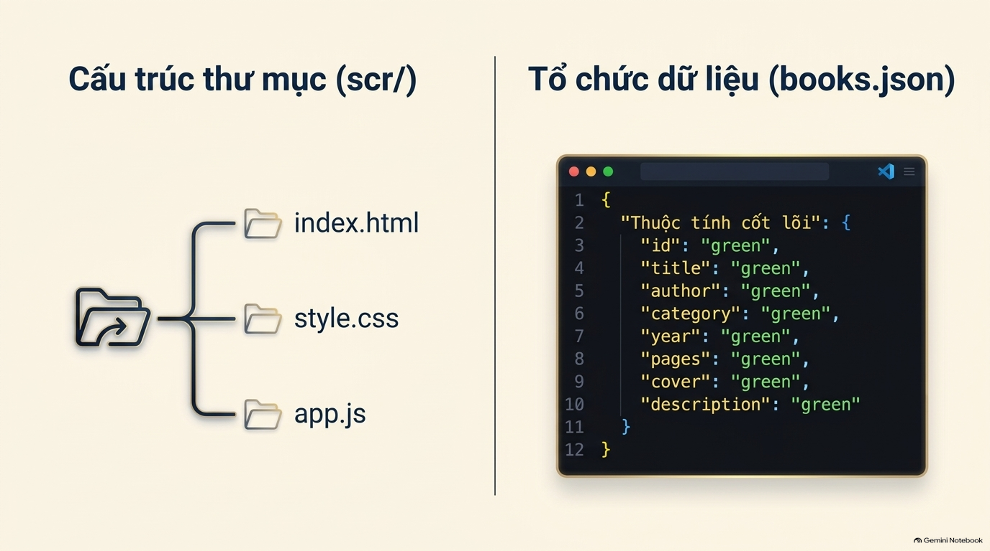

Slide 9


Slide 10


Slide 11


Slide 12


Slide 13


Slide 14


Slide 15


Slide 16

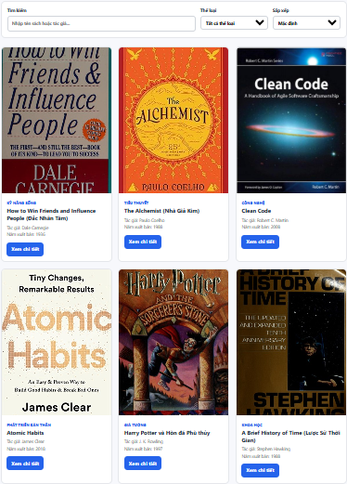


Slide 17
Link sản phẩm:
https://nghianv271091-coder.github.io/csn-dx24tt8-nguyenvannghia-webgioithieusach-nodejs/scr/index.html
Link Video báo cáo: https://drive.google.com/file/d/1lsx37WHM4_AJM74-ntgwkturQUdEKYIK/view?usp=sharing
Link Source Code: https://github.com/nghianv271091-coder/csn-dx24tt8-nguyenvannghia-webgioithieusach-nodejs

Slide 18


