Slide 1
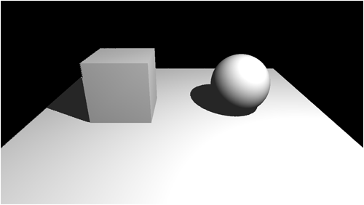
Shading
Shading: object's own color
Shadow of other objects (difficult to handle)

Slide 2
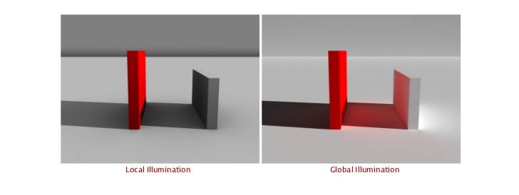
Local illumination: only direct effect of light source

Slide 3
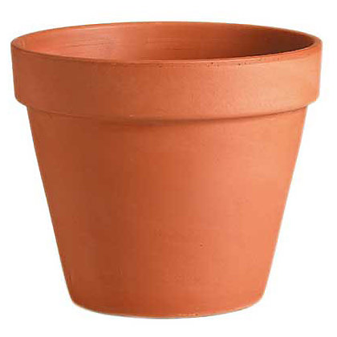
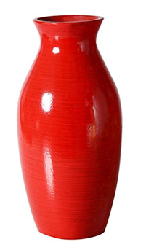
Material attributes
We can model (simplified) materials with 3 parameters
Ambient component: no regard to light source place
Diffuse component: direction of incoming light rays is important
Specular component: direction of reflected rays also important (do they go towards the camera)

Slide 4
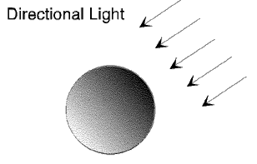
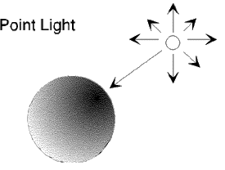
Light source
Directional light :
Point light:

Slide 5
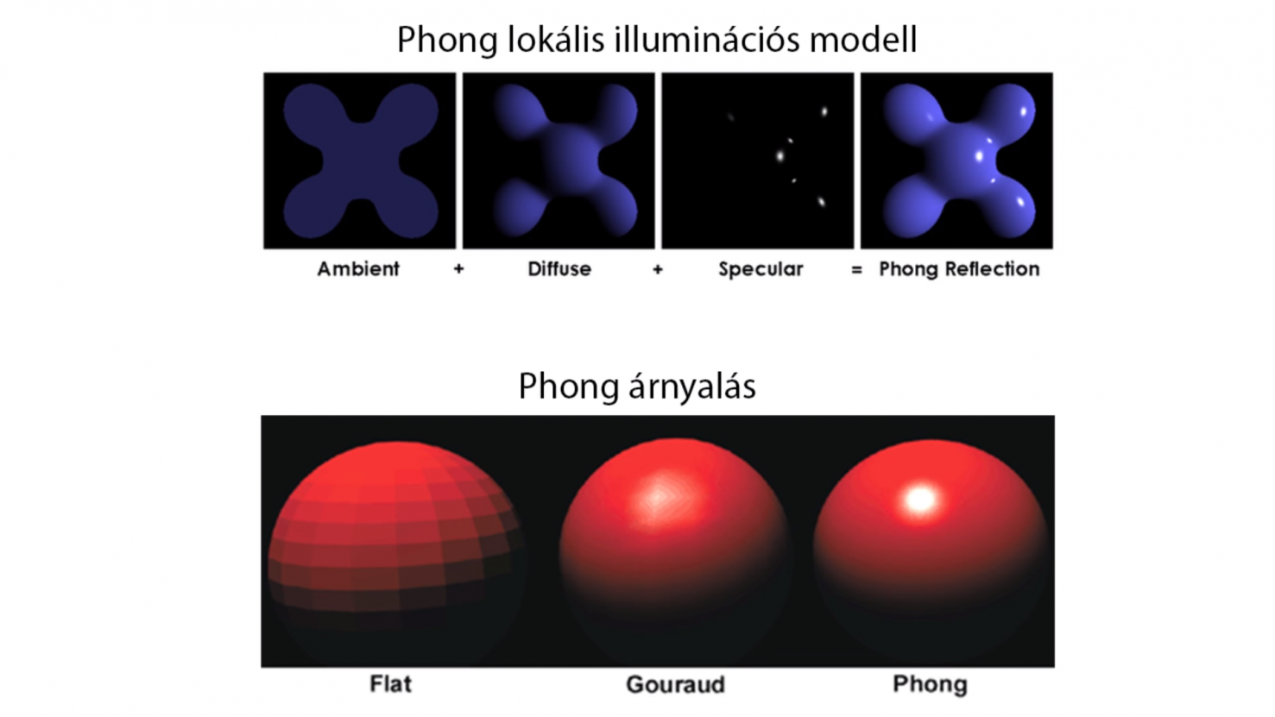
Fragmentenként számítjuk ki
Per fragment calculation
Összeadódnak

Slide 6
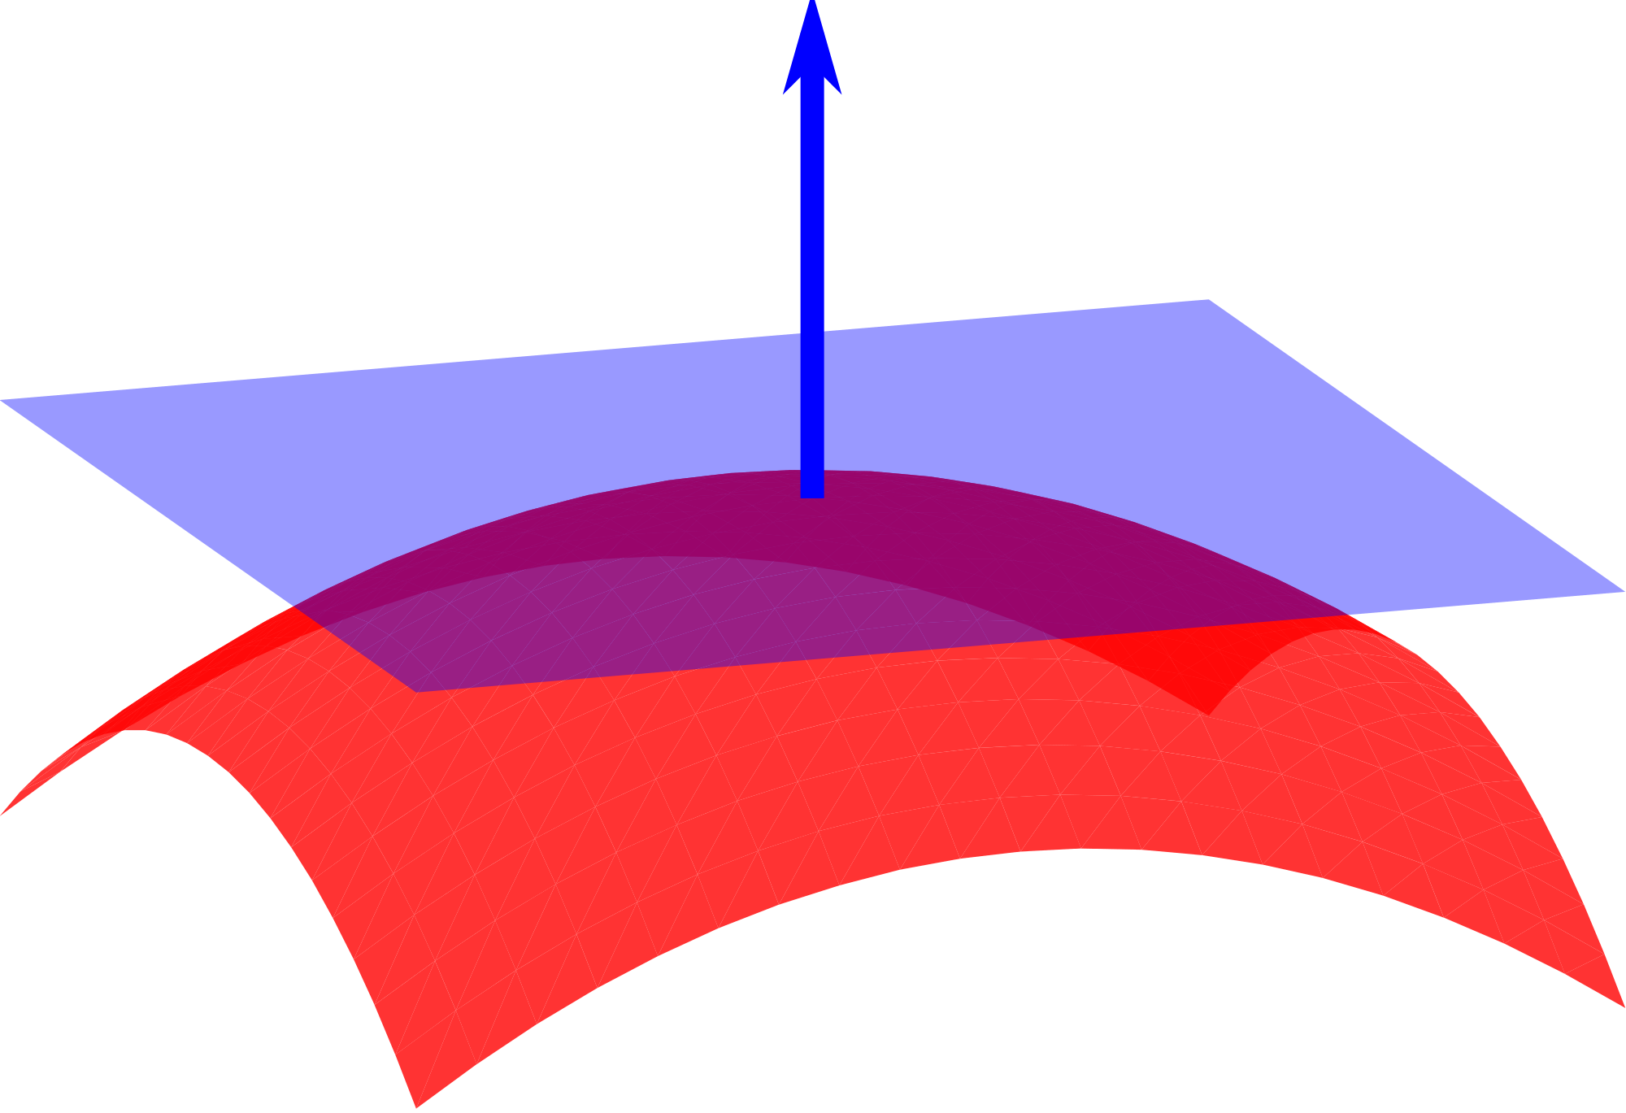
Vertex normals
Normals are needed to reflect light rays
Normal is a perpendicular vector to the surface

Slide 7
Triangle normals
Cross product of two side vectors (in example: (C-A)×(B-A))
C
C-A
A
B
B-A

