Slide 1
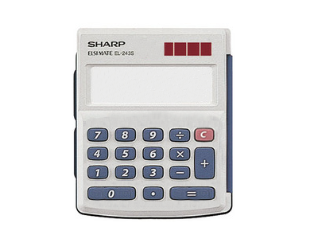
1. Example – Calculator

Slide 2
1. Example – Calculator
clear
operators
operands
calculate

Slide 3
1. Example – Calculator States and Attributes
356
Buffer: 356
356

Slide 4
1. Example – Calculator States and Attributes
356 +
Buffer: -
356
Left side of operation (+): 356

Slide 5
1. Example – Calculator States and Attributes
356 + 675
Buffer: 675
675
Left side of operation (+): 356

Slide 6
1. Example – Calculator States and Attributes
(356 + 675) x
Buffer: -
1031
Left side of operation (x): 1031

Slide 7
1. Example – Calculator States and Attributes
(356 + 675) x 2
Buffer: 2
2
Left side of operation (x): 1031

Slide 8
1. Example – Calculator States and Attributes
(356 + 675) x 2 =
Buffer: -
2062
Left side of operation (x): 2062
Calculator
- screen : String - leftside : Float
- buffer : Float
- operator : String

Slide 9
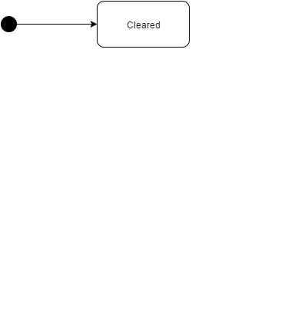
1. Example – Calculator

Slide 10
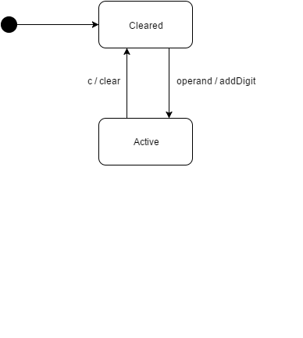
1. Example – Calculator

Slide 11
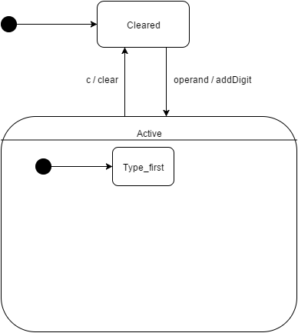
1. Example – Calculator

Slide 12
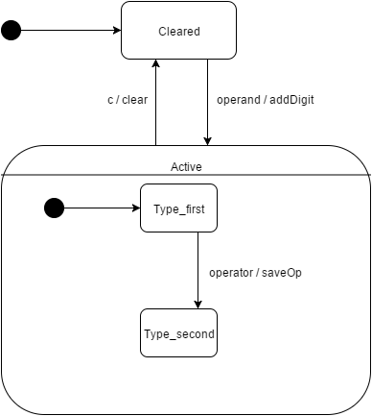
1. Example – Calculator

Slide 13
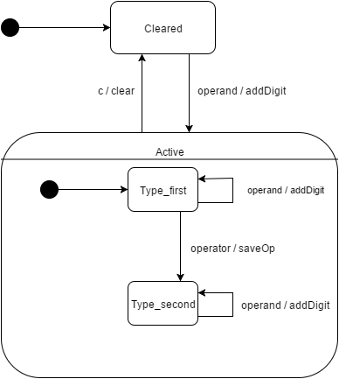
1. Example – Calculator

Slide 14
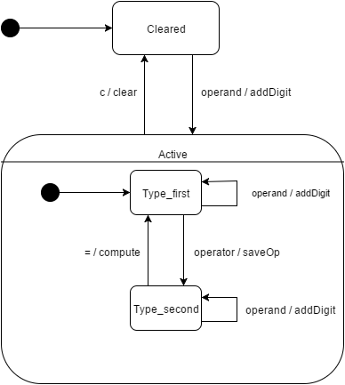
1. Example – Calculator

Slide 15
1. Example – Calculator

Slide 16
1. Example – Calculator States and Attributes
Cleared:
leftside = -
screen = ””
operator = ”” buffer = -
Active:
screen != ””
Type_first:
leftside = -
screen != ””
operator = ””
Type_second:
leftside != -
screen != ””
operator != ””

Slide 17
1. Example – Calculator States and Attributes
: Calculator
leftside = -
screen = ””
operator = ””
buffer = -

Slide 18
1. Example – Calculator States and Attributes
: Calculator
leftside = -
screen = ”3”
operator = ””
buffer = 3
3
3

Slide 19
1. Example – Calculator States and Attributes
: Calculator
leftside = -
screen = ”35”
operator = ””
buffer = 35
35
35

Slide 20
1. Example – Calculator States and Attributes
: Calculator
leftside = 35
screen = ”35”
operator = ”+”
buffer = -
35+
35

Slide 21
1. Example – Calculator States and Attributes
: Calculator
leftside = 35
screen = ”7”
operator = ”+”
buffer = 7
35+7
7

Slide 22
1. Example – Calculator States and Attributes
: Calculator
leftside = 42
screen = ”42”
operator = ”/”
buffer = -
35+7/
42

Slide 23
1. Example – Calculator States and Attributes
: Calculator
leftside = 42
screen = ”2”
operator = ”/”
buffer = 2
35+7/2
2

Slide 24
1. Example – Calculator States and Attributes
: Calculator
leftside = -
screen = ”21”
operator = ””
buffer = -
35+7/2=
21

Slide 25
1. Example – Calculator States and Attributes
: Calculator
leftside = -
screen = ””
operator = ””
buffer = -
35+7/2=C

Slide 26
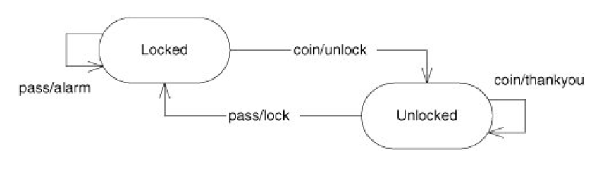
2. Example – Turnstile

Slide 27
2. Example – Turnstile
Locked
Coin
Action: unlock
State: Unlocked
Pass
Action: alarm
State: Locked
Unlocked
Coin
Action: thankyou
State: Unlocked
Pass
Action: lock
State: Locked

Slide 28
2. Example – Turnstile
switch(state)
case LOCKED:
switch(event)
case COIN:
unlock() changeState(UNLOCKED)
case PASS:
alarm()
changeState(LOCKED)
case UNLOCKED:
switch(event)
case COIN:
thankyou()
changeState(UNLOCKED)
case PASS:
lock()
changeState(LOCKED)

Slide 29
2. Example – Turnstile
State | Event | Action | Next State

Slide 30
2. Example – Turnstile
State | Event | Action | Next State
Locked | Coin | unlock | Unlocked

Slide 31
2. Example – Turnstile
State | Event | Action | Next State
Locked | Coin | unlock | Unlocked
Locked | Pass | alarm | Locked

Slide 32
2. Example – Turnstile
State | Event | Action | Next State
Locked | Coin | unlock | Unlocked
Locked | Pass | alarm | Locked
Unlocked | Coin | thankyou | Unlocked

Slide 33
2. Example – Turnstile
State | Event | Action | Next State
Locked | Coin | unlock | Unlocked
Locked | Pass | alarm | Locked
Unlocked | Coin | thankyou | Unlocked
Unlocked | Pass | lock | Locked

Slide 34
3. Example – Cursor

Slide 35
3. Example – Cursor

Slide 36
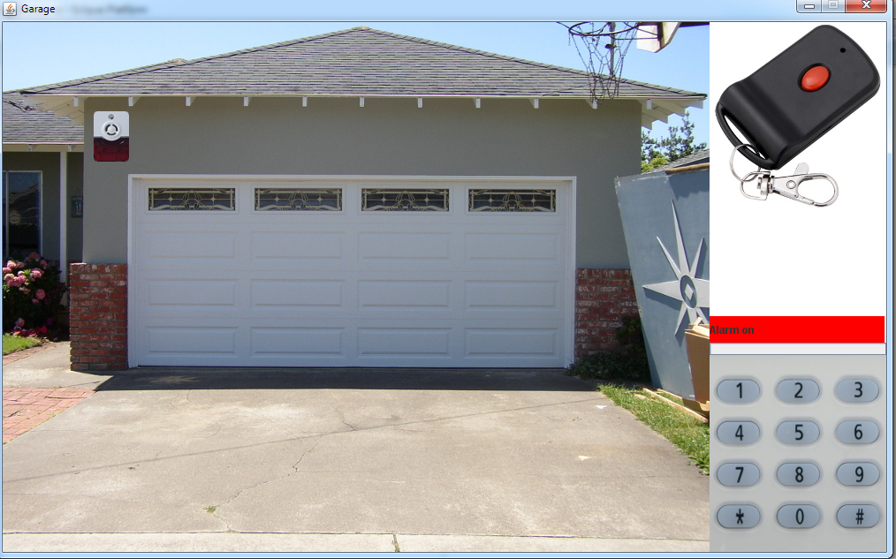
4. Example – Garage door

Slide 37

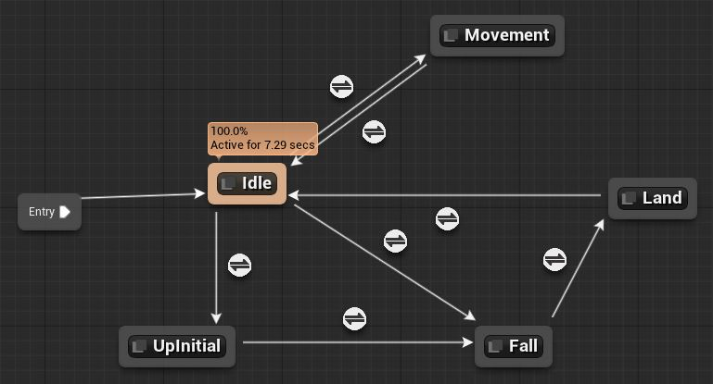
Industrial application – Game industry

Slide 38

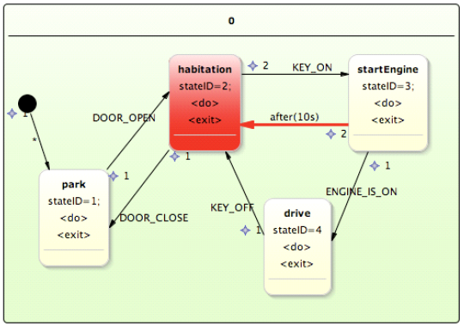
Industrial application – Embedded systems

