Slide 1
Capstone Project Boston Crime in 2019
The Battle of Neighborhood

Slide 2
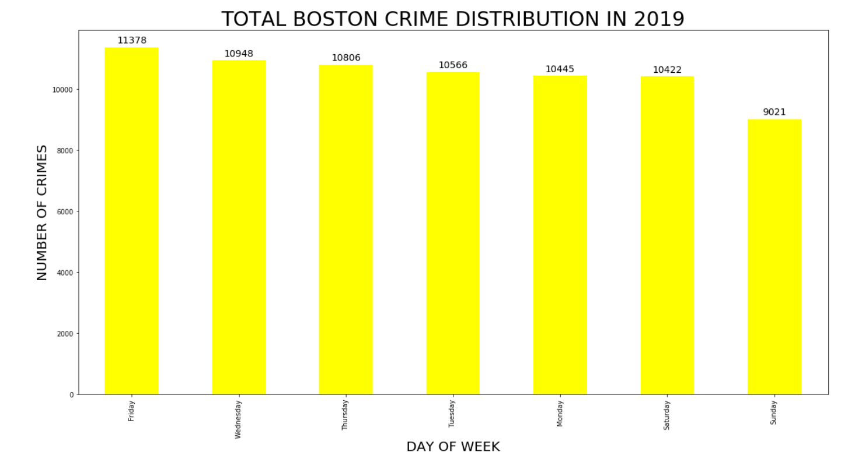
Observation: Sunday is considered the day has least crime recorded, maybe because people stay at home.

Slide 3
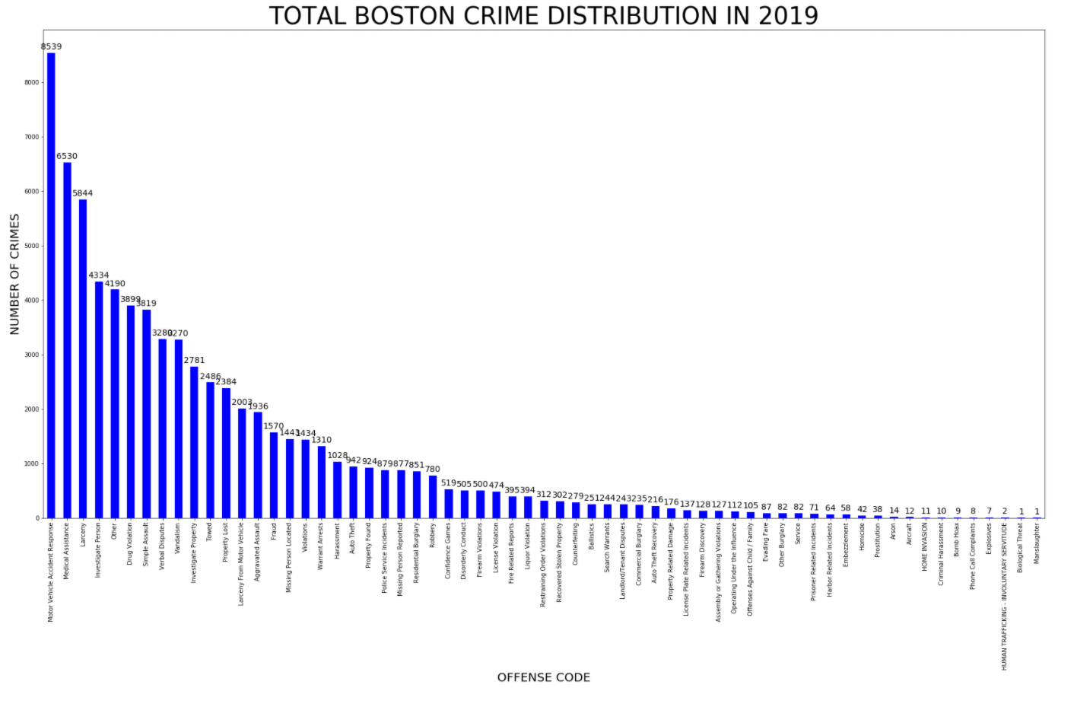
Observation: Motor vehicle Accidentt Reponses is the highest incident, it means the traffic is very in Boston

Slide 4
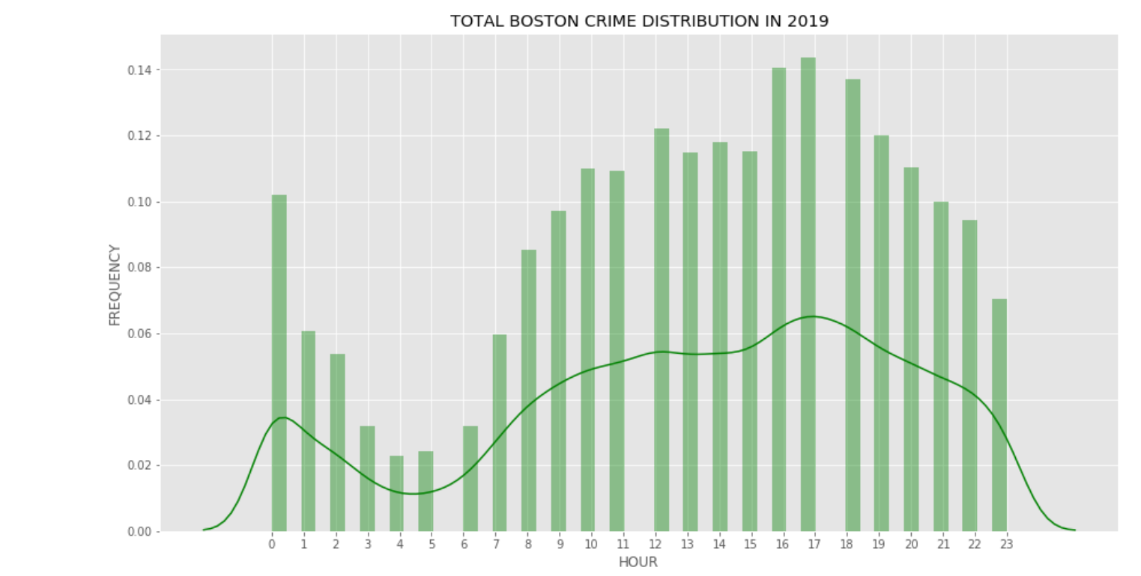
Observation: The crime rate seem to be very slow around 4 to 5 AM in the morning.

Slide 5
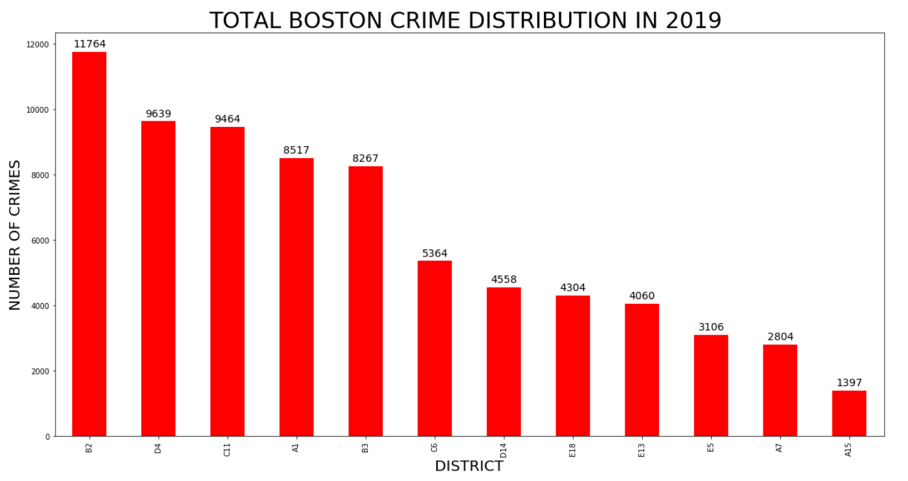
Observation: District A15 is the area with the least crime in Boston area. It is recommended to buy house in this area for safety concern.

Slide 6
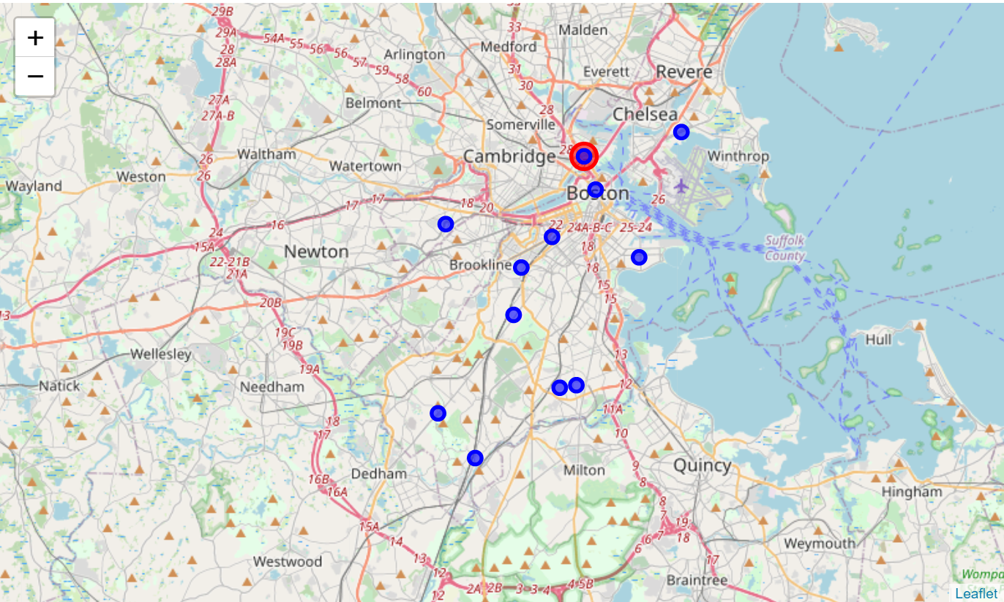
Area A15 is safest area in Boston in 2019

