Slide 1
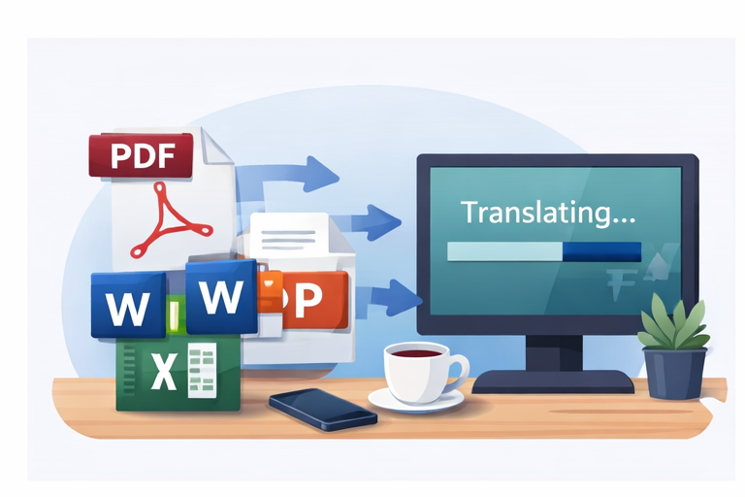
End-User Guide
translator_docs_book_v5.exe
A concise customer guide for running the CLI, choosing OCR, reviewing outputs, and escalating issues.
Customer-facing quick reference
Designed for PDF, Word, PowerPoint, Excel, ebook, and mixed document batches.
CLI · OCR · Logs · QA
translator_docs_book_v5.exe
Notes:
[Sources] - Internal basis: user-provided translator_docs_book_v5.py (CLI options, OCR modes, output artifacts, runtime behavior). [/Sources]

Slide 2
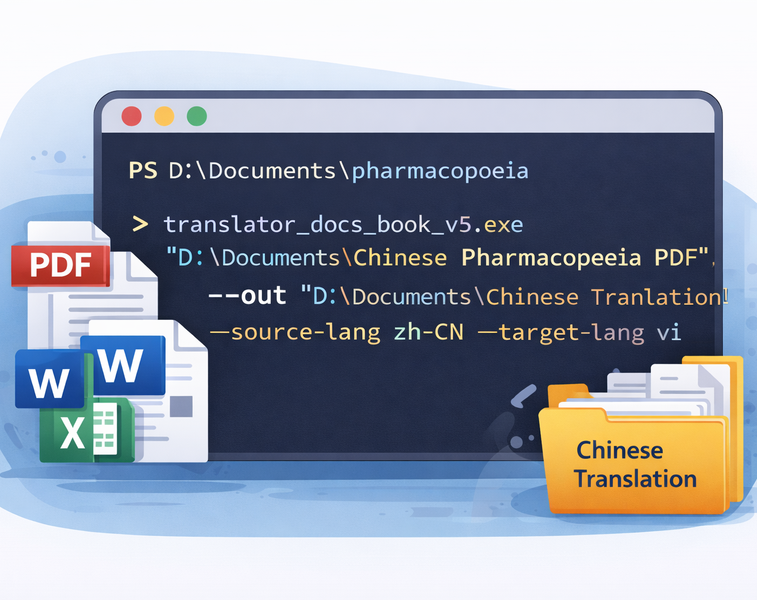
CORE COMMAND
Quick start
Open PowerShell in the EXE folder and call it with .\translator_docs_book_v5.exe.
Pass either a single file or an input folder as input_path.
Always provide an output root with --out.
Use --ocr auto when you are not sure whether a PDF is text-based or scanned.
Pilot with --max-files 3 before running a large batch.
Example: .\translator_docs_book_v5.exe "D:\Input" --out "D:\Output" --ocr auto --source-lang auto --target-lang vi
Notes:
[Sources] - Internal basis: user-provided translator_docs_book_v5.py (CLI options, OCR modes, output artifacts, runtime behavior). [/Sources]

Slide 3

COMMON SCENARIOS
Common formats and presets
The tool works well for mixed batches such as PDF, DOCX, PPTX, XLSX, EPUB, HTML, Markdown, TXT, and several auxiliary formats.
Useful presets
• Scanned Chinese PDF → --ocr all --ocr-lang chi_sim+eng --source-lang zh-CN --target-lang vi
• Scanned Japanese PDF → --ocr all --ocr-lang jpn+eng --source-lang ja --target-lang en
• Internal Word / PowerPoint / Excel set → --ocr off or --ocr auto
• Fast pilot run → --max-files 3
Use --list-supported-formats to print the supported extension list.
Notes:
[Sources] - Internal basis: user-provided translator_docs_book_v5.py (CLI options, OCR modes, output artifacts, runtime behavior). [/Sources]

Slide 4
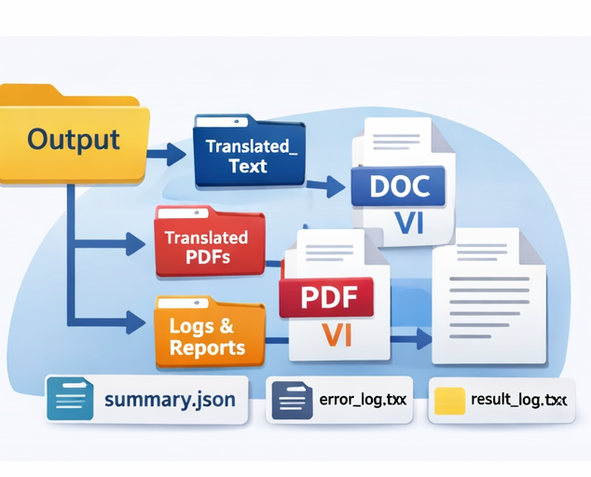
WHAT TO CHECK
What the output package contains
Review four artifact groups first: batch_summary.json for the overall batch view, translation_report.json for document detail, translation_log.csv for segment issues, and bilingual.md for a human-readable QA pass.
Typical structure
• 01_source
• 02_extracted
• 03_translation
• 04_indexes
• 08_logs
• 09_reports
• manifest.json
• batch_summary.json
Keep logs and indexes enabled for QA, traceability, and support handoff.
Notes:
[Sources] - Internal basis: user-provided translator_docs_book_v5.py (CLI options, OCR modes, output artifacts, runtime behavior). [/Sources]

Slide 5
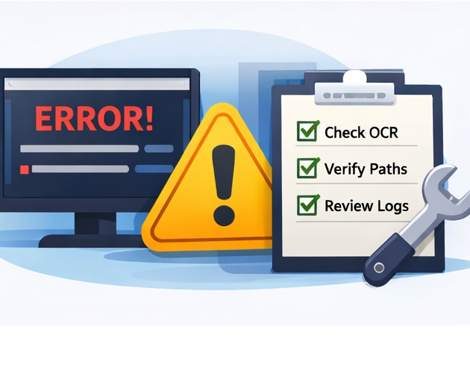
WHEN THINGS GO WRONG
Troubleshooting and support checklist
If PowerShell does not recognize the command, prefix the EXE with .\.
If OCR output is sparse or empty, verify Tesseract and try --show-tesseract-info or --ocr all.
If documents are skipped, consider --overwrite-translation and --no-skip-existing.
If you want to retry only failed parts, use --retranslate-errors-only.
For support escalation, include the exact command, batch_summary.json, translation_report.json, and translation_log.csv.
Recommendation: always run a small pilot before a large batch.
Notes:
[Sources] - Internal basis: user-provided translator_docs_book_v5.py (CLI options, OCR modes, output artifacts, runtime behavior). [/Sources]

