Slide 1
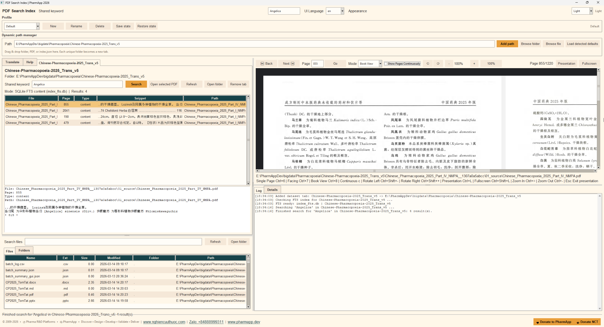
PharmApp PDF Search Index v3
End-User Guide
Search large PDF libraries, open the right file fast, and review the exact page in one workspace.
Core functions
Search indexed PDF content
Open exact matching pages
Review in presentation or fullscreen
Translate terms and manage profiles
© 2009-2026 • Pharma R&D Platforms • PharmApp • Discover • Design • Develop • Validate • Deliver | www.nghiencuuthuoc.com | Zalo: +84888999311 | www.pharmapp.dev

Slide 2
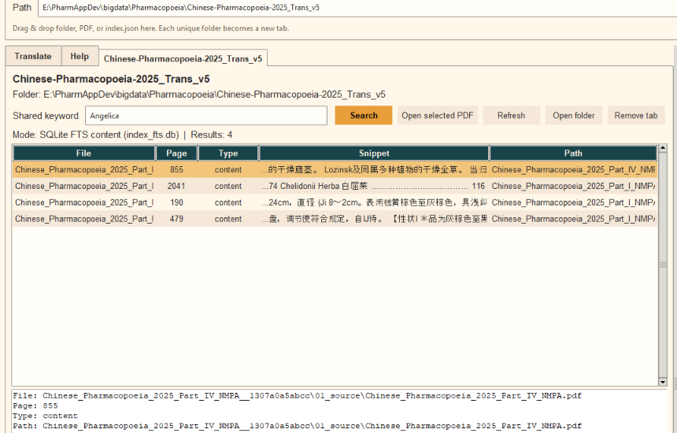
Getting started
Launch pdf_search_index_v3.exe.
Add a folder, PDF, or index.json in Dynamic path manager.
A new dataset tab is created for each unique folder.
If available, the app may prepare index_fts.db automatically for faster search.
Tip: use a folder that already contains index.json for the best first-run experience.
© 2009-2026 • Pharma R&D Platforms • PharmApp • Discover • Design • Develop • Validate • Deliver | www.nghiencuuthuoc.com | Zalo: +84888999311 | www.pharmapp.dev

Slide 3
Search and open results
Enter a keyword in the dataset search box or Shared keyword.
Review file name, page, type, snippet, and path in the result grid.
Select a result and click Open selected PDF to jump to the matched page.
Use Refresh after dataset files are changed.
© 2009-2026 • Pharma R&D Platforms • PharmApp • Discover • Design • Develop • Validate • Deliver | www.nghiencuuthuoc.com | Zalo: +84888999311 | www.pharmapp.dev

Slide 4
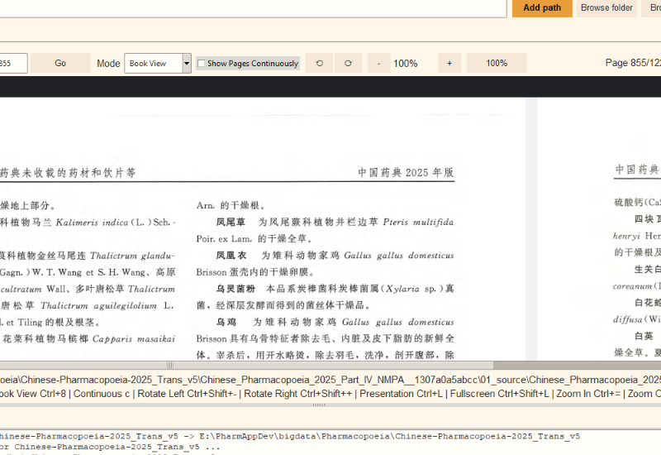
Use the PDF viewer
Modes: Single Page, Facing, Book View, and Continuous.
Back / Next and Go help you navigate quickly.
Zoom, rotation, presentation, and fullscreen support review sessions.
Use Presentation for clean page display during teaching or meetings.
© 2009-2026 • Pharma R&D Platforms • PharmApp • Discover • Design • Develop • Validate • Deliver | www.nghiencuuthuoc.com | Zalo: +84888999311 | www.pharmapp.dev

Slide 5
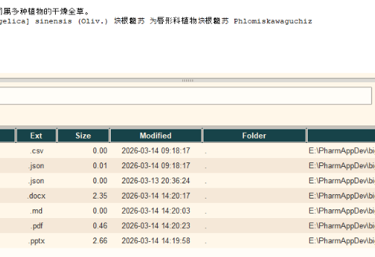
Translation, profiles, and explorer
Translate terms and search translated PDF names.
Save and restore profiles for different users or workflows.
Browse Files and Folders in the dataset explorer.
Check Log and Details to confirm search mode and status.
Need help? Ask your administrator which dataset folder should be added first.
© 2009-2026 • Pharma R&D Platforms • PharmApp • Discover • Design • Develop • Validate • Deliver | www.nghiencuuthuoc.com | Zalo: +84888999311 | www.pharmapp.dev

