Slide 1
PharmApp PDF Search Index
End-User Guide
Windows EXE build for indexed PDF collections
What users can do
Best fit
• Search indexed content or PDF filenames
• Open the matching PDF page directly
• Use the built-in viewer, explorer, and log panels
• Work faster after SQLite FTS is available
• Technical PDF libraries
• Pharma, R&D, QA, validation
• Large and organized document folders
Use this guide to help customers complete their first successful search.
© 2009-2026 • Pharma R&D Platforms • PharmApp • Discover • Design • Develop • Validate • Deliver | www.nghiencuuthuoc.com | Zalo:
+84888999311 | www.pharmapp.dev

Slide 2
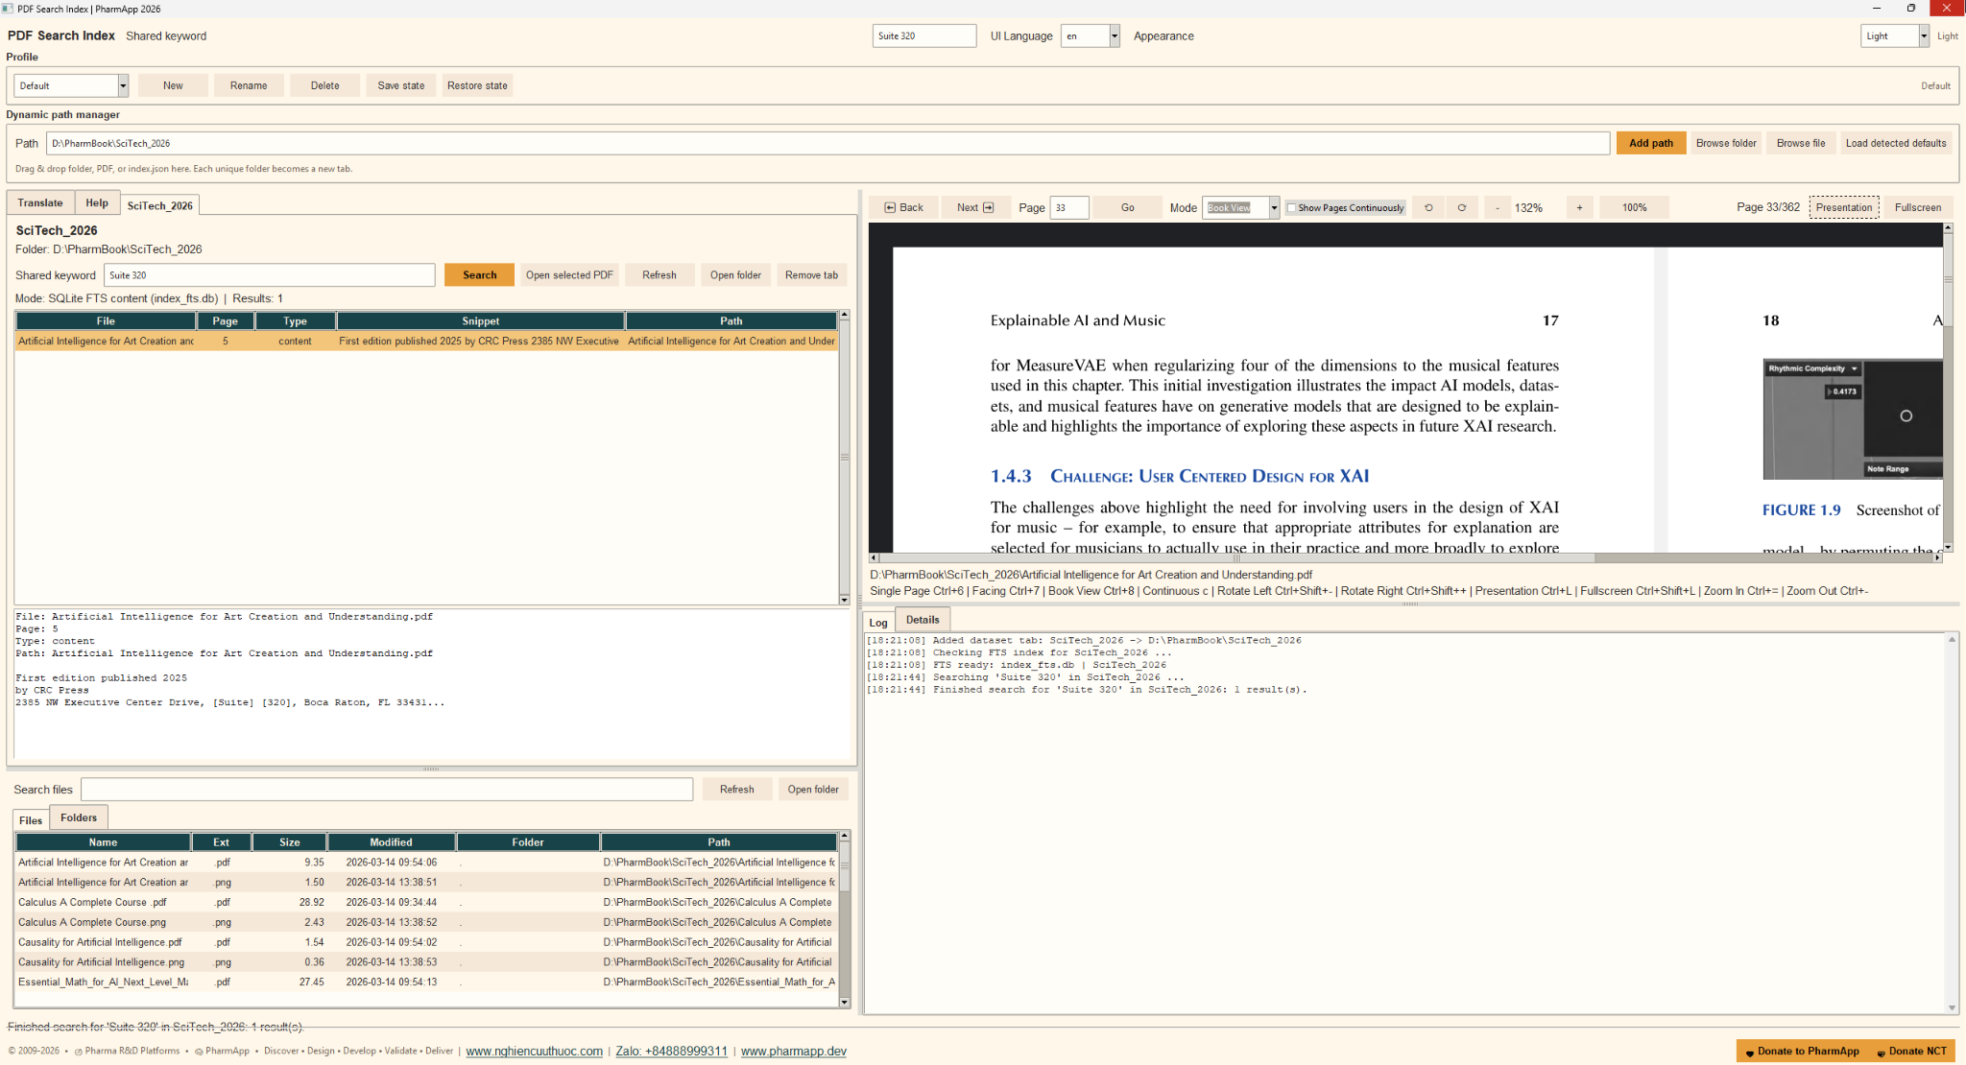
Main interface overview
Example application screen
Key areas
• Dynamic path manager: add a folder, PDF, or index.json
• Dataset tabs: one searchable library per folder
• Results: file, page, match type, snippet, path
• Viewer: navigation, zoom, rotate, fullscreen
• Explorer + log: browse files and monitor indexing
© 2009-2026 • Pharma R&D Platforms • PharmApp • Discover • Design • Develop • Validate • Deliver | www.nghiencuuthuoc.com | Zalo:
+84888999311 | www.pharmapp.dev

Slide 3
Quick start
Four simple steps
What to expect on first use
1. Launch the EXE and add the working folder.
2. Open the new dataset tab and enter a keyword.
3. Click Search and review the result list.
4. Select a result to load the matching PDF page.
• The first search can be slower if the app needs to create index_fts.db.
• Logs show when the FTS index is checked or ready.
• After the FTS file exists, repeated searches are much faster.
• Use Refresh after source files change.
© 2009-2026 • Pharma R&D Platforms • PharmApp • Discover • Design • Develop • Validate • Deliver | www.nghiencuuthuoc.com | Zalo:
+84888999311 | www.pharmapp.dev

Slide 4
Search workflow and indexing
Input
Search engine
Output
• Folder with PDFs
• Optional index.json
• Optional existing index_fts.db
• Uses SQLite FTS when available
• Can build FTS from index.json
• Falls back to filename search if needed
• Result list with snippets
• Open the target PDF page
• Log and detail trace
→
→
When to refresh
Performance note
• After adding, removing, or replacing PDFs
• After updating index.json or the folder structure
• The first indexing pass can take longer.
• Once index_fts.db exists, search is much faster and more consistent.
© 2009-2026 • Pharma R&D Platforms • PharmApp • Discover • Design • Develop • Validate • Deliver | www.nghiencuuthuoc.com | Zalo:
+84888999311 | www.pharmapp.dev

Slide 5
Viewer controls users need most
Shortcuts
Best practices
Single Page: Ctrl+6
Facing: Ctrl+7
Book View: Ctrl+8
Continuous mode: c
Zoom in / out: Ctrl+= / Ctrl+-
Rotate left / right: Ctrl+Shift+- / Ctrl+Shift++
Presentation: Ctrl+L
Fullscreen: Ctrl+Shift+L
• Select a result row before clicking Open selected PDF.
• Use the page box and Go button for direct navigation.
• Use fullscreen or presentation for large pages.
• Try a shorter keyword if the result list is empty.
© 2009-2026 • Pharma R&D Platforms • PharmApp • Discover • Design • Develop • Validate • Deliver | www.nghiencuuthuoc.com | Zalo:
+84888999311 | www.pharmapp.dev

Slide 6
Customer handoff checklist
Before delivery
Tell the customer
Successful adoption
• Confirm the EXE launches correctly.
• Confirm the customer can reach the dataset folder.
• Run one successful search and open one PDF page.
• Check whether index_fts.db is already prepared.
• Which folder to add first
• Which keyword to test first
• How long the first indexing pass may take
• When to use Refresh
• Search returns useful results quickly
• The correct PDF opens to the right page
• Logs confirm the active search mode
• Users can repeat the workflow without assistance
PharmApp works best when the dataset stays organized and indexing is allowed to complete before heavy use.
© 2009-2026 • Pharma R&D Platforms • PharmApp • Discover • Design • Develop • Validate • Deliver | www.nghiencuuthuoc.com | Zalo:
+84888999311 | www.pharmapp.dev

