Slide 1
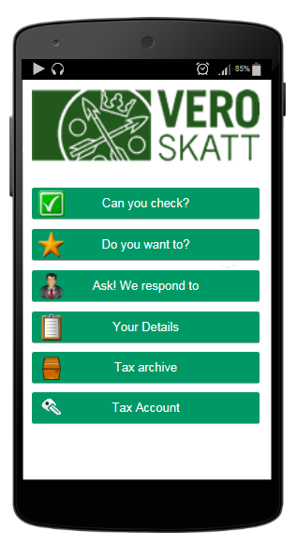



Wed April 9th 2015
Item’s to check: 3
Suggested applications:
Application 2
Application 7
Application 14
My data
Archive
Account

Slide 2
This is the ”active” part of the screen – kind of an INBOX or a ”Task List”
Request to the customer (taxpayer) to check existing information & provide additional information (working name: “Check and Add”)
Wed April 9th 2015
Item’s to check: 3
Payments due: 2
Suggested applications:
This is a ”semi-active part” = the suggested applications should reflect the customers present situation..
Possibility for customer to apply for something (working name: “My applications”)
Application 2
Application 7
Possibility for customer to review existing information about himself (working name: “My data”)
My data
This is a ”passive” part of the screen – similar for all customers, not profiled in any way…
Archive
View of the customers financial situation (“tax account”) & possibilitcy to make necessary payments (working name: “My account”)
“Archive” function – possibility for customer to view “old cases” > primarly documents, ie. letters or decisions or requests for information.
Proactive guidance (working name: “General information”)
“powers of attorney” > a possibility for the customer to mandate someone to act on his behalf (NB: this is something that has to be solved on a governmental level) (working name: “My mandates”)

