Slide 1
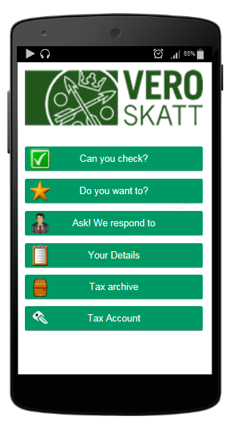



Wed April 9th 2015
Item’s to check: 3
Suggested applications:
Application 2
Application 7
Application 14
My data
Archive
Account

Slide 2
This is the ”active” part of the screen – kind of an INBOX or a ”Task List”
Wed April 9th 2015
Item’s to check: 3
Payments due: 2
Suggested applications:
This is a ”semi-active part” = the suggested applications should reflect the customers present situation..
Application 2
Application 7
My data
This is a ”passive” part of the screen – similar for all customers, not profiled in any way…
Archive

