Slide 1
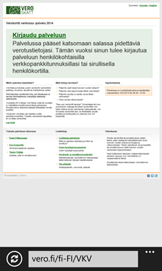
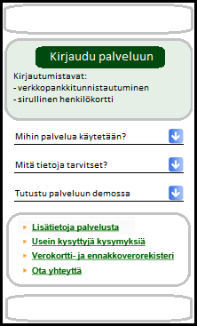
Front page, information in example
Left side: web solution, Right side: mobile solution
Features and functionalities are in more important role than design at this stage.
Sign in
- network banking User ID
-HST card
Option 1 info as present on left side:
What does Tax Card Online do
What information do you need
Launch the demo
---
-Read more about Tax Card Online
-Frequently asked questions
//Description of Register (we can skip this)//
-Contact us
Option2 info:
you can use this mobile solution if you declare no other income as pay and study grant and have no deductions. In other case, use our web solution in address http://www.tax.fi/en-US/VKV

