Slide 1

Vocabulary
HCI201
Lecturer : Võ Hồng Khanh

Slide 2
Group 5
Huỳnh Bá Đạt – CE140320
Phạm Quốc Nghị - CE140179
Tăng Minh Tín – CE130438
Trần Chấn Dương – CE140484
Trương Nhật Nam – CE140370

Slide 3
Group 5
Introduce vocabulary
Introduce tool Figma
Use case
Site map
Demo
Q&A

Slide 4
I. Introduce Vocabulary

Slide 5
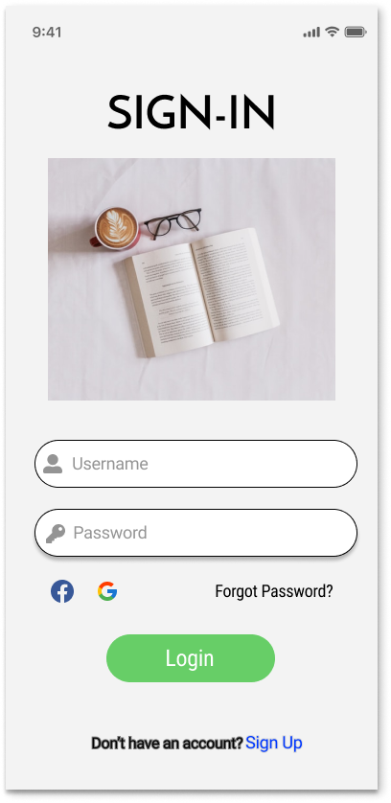


Slide 6
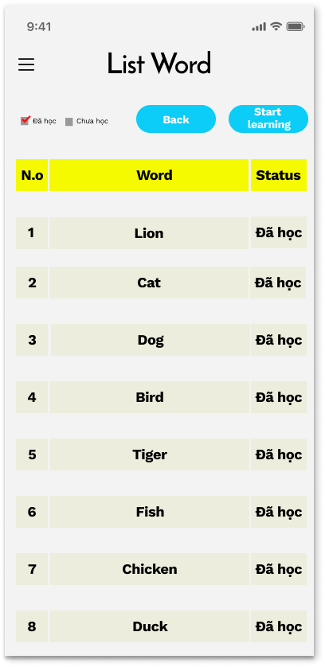
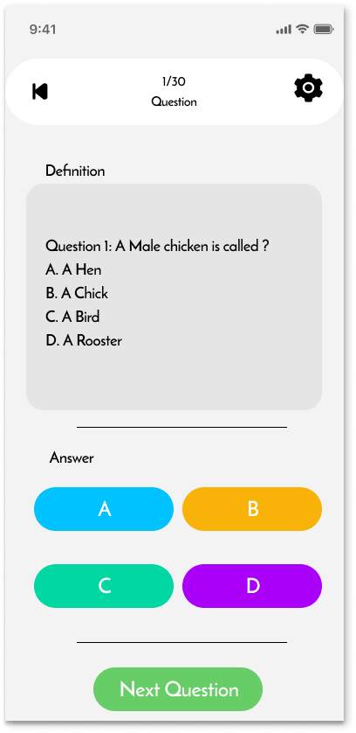

Slide 7
II. Introduce Tool Figma

Slide 8
Main advantages
Compatibility
Effectively support the workgroup
Simple file share
Convenient feedback support
Everything is stored online

Slide 9
Main DISadvantages
No too many plugin
Subscription plan instead of a one-time purchase
No variety of image editing tools

Slide 10
III. Use case

Slide 11
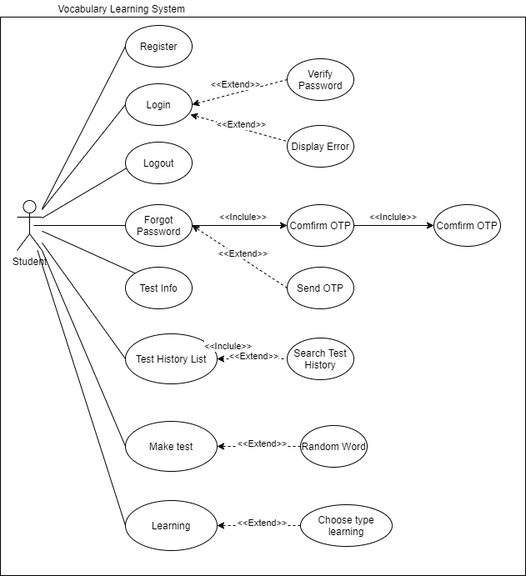

Slide 12
IV. Site map

Slide 13
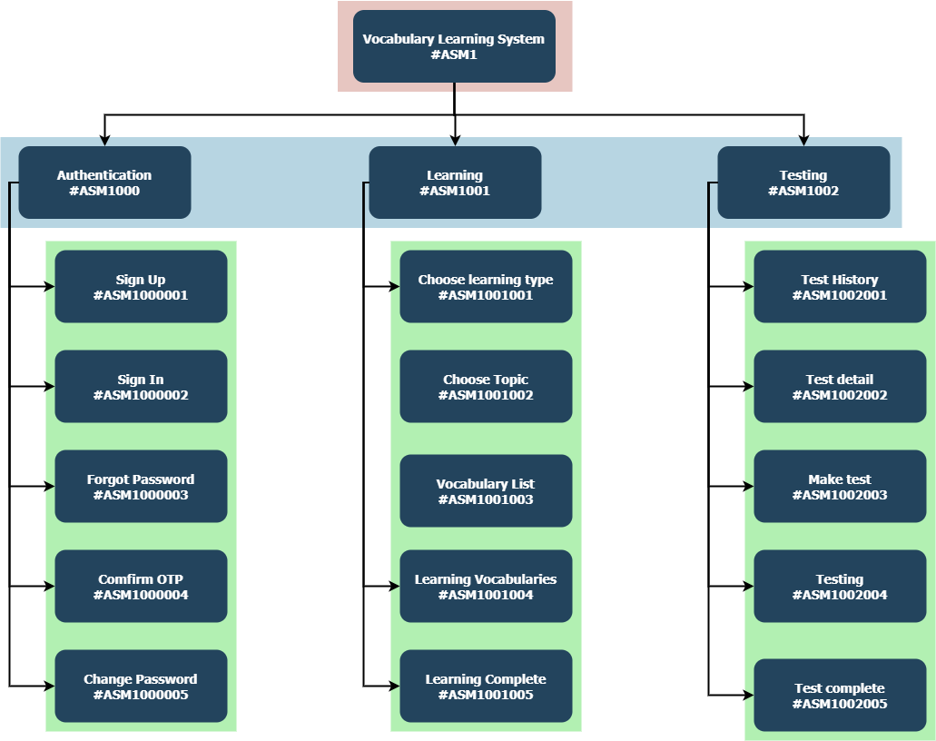

Slide 14
V. Demo

Slide 15
VI. Q&A

Slide 16

Thank
you

