Slide 1
Hidden Markov Models
Manning, C. D. and Schütze, H. (1999): Foundations of Statistical Natural Language Processing. MIT Press: Cambridge, Massachusetts. Chapter 9.
From Markov Chains to HMMs
08.05.19
Language Technology Group – Chris Biemann

Slide 2
Hiding Markov
Training of Markov Chains: Count n-grams, normalize to probabilities
Sparse data: many n-grams not in training
Back-off smoothing: use shorter n-grams for interpolated estimation
Recap: Mixture Model:
Hidden Markov Models (HMMs) can be used to
model this interpolation
train the λ weights
08.05.19
Language Technology Group – Chris Biemann

Slide 3
Hidden States
λ₁
a:P(a)
ε:λ₁
ba
b:P(b)
a:P(a|b)
a:P(a|ab)
ε:λ₂
ab
λ₂
b:P(b|b)
bb
ε:λ₃
λ₃
b:P(b|ab)
The path through this non-deterministic WFSA is not determined by the sequence of symbols. There are “hidden” states.
08.05.19
Language Technology Group – Chris Biemann

Slide 4
Hidden Markov Model
A Hidden Markov Model HMM=(Φ,Σ,δ, Π) consists of
finite set of states Φ = {z₀, ... z_{n}}
initial state probability distribution Π:π_{i}=P(z¹=z_{i})
finite alphabet Σ={s₁, s₂, ... , s_{m} } of input symbols
transition function δ: Φ→(Σ∪{ε})×[0,1]×Φ
Non-deterministic: several transitions from the same state with the same input symbol are valid and common.
Normalized over all possible combinations of state sequence and symbols.
08.05.19
Language Technology Group – Chris Biemann

Slide 5
The probability of a sequence
(1)
(2)
(3)
(4)
Expansion with conditional probabilities
Markov assumption, horizon = 1
write as product
probability of a sequence is the sum of the probability of all possible paths through the HMM for this sequence of symbols
Note that superscripts indicate time points, subscripts enumerate symbols of an alphabet
08.05.19
Language Technology Group – Chris Biemann

Slide 6
Three Tasks for HMMs
Given a model defined by a HMM, how do we efficiently compute the probability of an observation sequence?
Given an observation sequence and a model defined by a HMM, how do we choose the state sequence that best explains the observations?
Given an observation sequence and a space of possible models found by varying model parameters, how do we find the model that best explains the observation? This is is called training of the model.
08.05.19
Language Technology Group – Chris Biemann

Slide 7
Computing the probability of an observation
Observation: sequence of symbols s¹s²... s^{T}, given
Naïve strategy:
exhaustive search of all possible paths for that sequence
probabilities of single paths: product of transition probabilities
probabilities of the observation: sum of single path probabilities
This is obviously not efficient for long paths and many bifurcations.
If N is the number of states and T the length of the sequence, then the computational complexity is O(T*N^{T})!
08.05.19
Language Technology Group – Chris Biemann

Slide 8
Forward/backward procedures
Idea: use common short sub-paths and combine into larger sub-paths
dynamic programming: store intermediate results and thus re-use previous computations for further computations
Forward Probability:
α_{i}(t)=P(s¹...s^{t-1},z^{t}=z_{i}) is the probability of ending up in state z_{i} after t-1 symbols.
This is computed iteratively for all t in 1..T for all states z_{i} with i in 1..N.
Sum over α_{i}(T+1) is the final result.
Whether we start from the beginning or from the end is irrelevant: This can alternatively formulated as a Backward probability:
08.05.19
Language Technology Group – Chris Biemann

Slide 9
Forward procedure
1. Initialization
2. Induction
3. Total
Complexity: O(T*N²) multiplications. Much better!
08.05.19
Language Technology Group – Chris Biemann

Slide 10
Backward procedure
1. Initialization
2. Induction
3. Total
08.05.19
Language Technology Group – Chris Biemann

Slide 11
Combination to forward/backward procedure
Therefore:
Equations for forward and backward probabilities are special cases of this one.
08.05.19
Language Technology Group – Chris Biemann

Slide 12
Finding the best state sequence: Decoding
We want to find the most likely complete path given the observation:
Like in the previous problem, we use dynamic programming and define the probability of the best path to state z_{i} after t symbols:
The iterative algorithm to solve this problem is called the Viterbi algorithm.
08.05.19
Language Technology Group – Chris Biemann

Slide 13

Viterbi Algorithm
1. Initialization
2. Induction
store backtrace: per state j, memorize the previous state for δ_{j}(t+1)
3. Termination:
last state in MAXPATH:
read sequence according to:
Ties: resolve randomly or store n-best-list.
08.05.19
Language Technology Group – Chris Biemann

Slide 14
Viterbi Example
a:0.4
a:0.3
a:0.2
ε:1.0
b:0.1
V
N
a:0.2
b:0.2
b:0.1
b:0.5
Observation sequence: bbba
input read | ε | b | bb | bbb | bbba
N - sequence | N | NN | NNN | NNNN | NVVVN
N - max. P | 1.0 | 0.2 | 0.04 | 0.008 | 0.005
V - sequence | V | NV | NVV | NVVV | NVVVV
V - max. P | 0.0 | 0.1 | 0.05 | 0.025 | 0.005
08.05.19
Language Technology Group – Chris Biemann

Slide 15
Looking for the best path
(1.0)
ε
N(1.0)
V(0.0)
b
a:0,3
NN(0.2)
NV(0.1)
a:0,4
a:0,2
b
b:0,1
NNV(0.02)
NVN(0.01)
NVV(0.05)
N
V
NNN(0.04)
a:0,2
b
b:0.2
b:0,5
b:0,1
NNNN(0.008)
NNNV(0.004)
NVVN(0.005)
NVVV(0.025)
a
NNNNN(0.0032)
NNNNV(0.0024)
NVVVN(0.005)
NVVVV(0.005)
Hopeless path prefixes are dropped from consideration
08.05.19
Language Technology Group – Chris Biemann

Slide 16
HMM Training
Training: We have a fixed structure and optimize the parameters according to observations
Name of training algorithm: Baum-Welch or Forward-Backward algorithm
Idea:
start with random parameters
tune parameters such that the probability of the training sequence increases
Why is this necessary? Why can’t we just train it like a Markov Chain?
08.05.19
Language Technology Group – Chris Biemann

Slide 17
Recap: Training a Markov Chain
Given:
Markov Chain without transition probabilities
training sequence
Wanted:
transition probabilities
a
N
V
a
b
b
training sequence: abbaababbaaa
08.05.19
Language Technology Group – Chris Biemann

Slide 18
Markov Chain: Count, (smooth), and done.
sequence: abbaababbaaa
from state | to state | symbol | count
N | V | a | 5
N | N | b | 3
V | N | a | 2
V | N | b | 2
a:0.625
Problem with HMMs:
non-deterministic: assume that all possible transitions are used at the same time?
how to kick it off?
N
V
a:0.5
b:0.375
b:0.5
08.05.19
Language Technology Group – Chris Biemann

Slide 19
Counting transitions for HMMs
Example:
two possible paths through HMM for a given sequence
P(1st path) = 1/3 using transition T1
P(2nd path) = 2/3 using transition T2
increase count of T1 by 1/3 and count of T2 by 2/3
General case:
is the number of times that the transition from z_{i} to z_{j} with symbol s_{k} is contained in
08.05.19
Language Technology Group – Chris Biemann

Slide 20
Path probabilities and transition probabilities
We count transitions to compute transition probabilities
in the computation, we use path probabilities
… but path probabilities are computed by transition probabilities
Deadlock?
08.05.19
Language Technology Group – Chris Biemann

Slide 21
Solution: Expectation Maximization (EM)
Top-level EM algorithm:
Old_Cross_Entropy=infinite;
Guess HMM Parameters;
New_Cross_Entropy=Re-estimate_Parameters();
While not (Old_Cross_Entropy ≈ New_Cross_Entropy) {
Old_Cross_Entropy=New_Cross_Entropy;
New_Cross_Entropy=Re-estimate_Parameters();
}
If it is guaranteed that Re-estimate_Parameters() lowers the cross entropy between sequence and HMM, then the EM algorithm converges to a (local) maximum.
For HMMs: re-estimation procedure of iteratively using path probabilities to estimate transition probabilities has been proved by Baum to lower cross entropy (and thus increases the probability of the sequence).
08.05.19
Language Technology Group – Chris Biemann

Slide 22
Example: Parameter Estimation
a:0.17
a:0.48
a: 0.67
a: 0.04
ε:1.0
V
ε:1.0
V
N
N
b: 1.0
b: 1.0
b:0.16
b:0.48
‘true‘ HMM: P(ababb)=0.0778
initial random estimate
training sequence: ababb
possible paths:
NVNVNN
NVNNNN
NNNVNN
NNNNNN
08.05.19
Language Technology Group – Chris Biemann

Slide 23
Two iterations
training sequence: ababb
path | P(path) | P(V|a,N) | P(N|b,V) | P(N|a,N) | P(N|b,N) | sum P(.|.,N)
NVNVNN NVNNNN NNNVNN NNNNNN | 0.00077 0.00442 0.00442 0.02548 | 0.00154 0.00442 0.00442 0.0 | 0.00154 0.00442 0.00442 0.0 | 0.0 0.00442 0.00442 0.05096 | 0.00077 0.00884 0.00884 0.07644
sum over paths | 0.03509 | 0.01038 | 0.01038 | 0.05970 | 0.09489 | 0.165
new P |  | 0.06 | 1.0 | 0.36 | 0.58
1.
2.
path | P(path) | P(V|a,N) | P(N|b,V) | P(N|a,N) | P(N|b,N) | sum P(.|.,N)
NVNVNN NVNNNN NNNVNN NNNNNN | 0.00209 0.00727 0.00727 0.02529 | 0.00418 0.00727 0.00727 0.0 | 0.00418 0.00727 0.00727 0.0 | 0.0 0.00727 0.00727 0.05058 | 0.00209 0.01454 0.01454 0.07587
sum over paths | 0.04192 | 0.01872 | 0.01872 | 0.06512 | 0.10704 | 0.191
new P |  | 0.10 | 1.0 | 0.34 | 0.56
probability of sequence for iteration 3: 0.0472
08.05.19
Language Technology Group – Chris Biemann

Slide 24
Problems of this training algorithm
Critical points: Algorithm cannot decide for a direction and gets stuck
if training sequence is not representative, estimated parameters will be suboptimal. This holds especially for short sequences
even without critical points: algorithm finds local maximum, not the global maximum
08.05.19
Language Technology Group – Chris Biemann

Slide 25
Critical point example
a:0.5
P
a:0.25
P
b:0.25
N
a:1
N
a:0.5
b:0.5
a:0.5
b:1
b:0.5
b:0.25
b:0.5
a:0.25
Q
Q
correct HMM P(aabb)=0.25
HMM with critical point P(aabb)=0.0625
training sequence: aabb
Parameters are stable under EM-iteration: Critical points are fix points.
08.05.19
Language Technology Group – Chris Biemann

Slide 26
Dealing with critical points: Add noise
critical points: no direction, yet not at local maximum
Add noise: small random changes in transition probabilities lead to a decision but do not change overall convergence in most cases.
08.05.19
Language Technology Group – Chris Biemann

Slide 27
What about the Zeros?
Minimizing the cross entropy means: transitions that never occur in the training will converge to 0.
In the example ababb: sequence “aa” never occurs: P(N|a,N) goes to 0
Solution: Smoothing and back-off of counts
Longer training sequences always help, but increase training time
a:0.48
a:0.0
a: 0.04
ε:1.0
V
N
b: 1.0
b:0.48
08.05.19
Language Technology Group – Chris Biemann

Slide 28
Hill climbing: only local maxima
Start
Result
EM algorithm implements hill climbing
in case many local maxima exist, the result is heavily dependent on initialization. Chance of hitting the global maximum is very small
Strategy: Restart a few times with different initializations and observe.
08.05.19
Language Technology Group – Chris Biemann

Slide 29
Optimizing the training time
Recall the calculation of counts of transitions:
This computes the sum over all possible paths per transition: inefficient!
In analogy to the Forward/Backward procedure, we rather compute sub-paths.
Using the combination , we reformulate as:
08.05.19
Language Technology Group – Chris Biemann

Slide 30
Variants of HMMs
sparsity handling: parameter tying and tied states
allowing null-emissions
modeling of (continuous) time spent in a state
different model topologies: number of states, structural zeros, feed-forward, …
automatic learning of topology
continuous HMMs: in contrast to discrete symbols
state emission vs. arc-emission
s₁
s₁
s₂
z₁
z₂
…
z_{N}
s₁
s₅
z₁
z₂
…
z_{N}
s₄
s₁
s₄
s₁
s₃
s₅
s₁
s₃
08.05.19
Language Technology Group – Chris Biemann

Slide 31
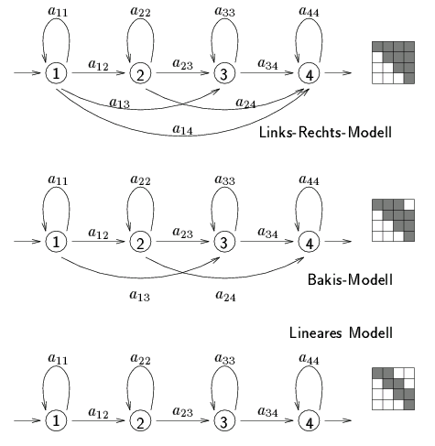
Applications of HMMs I: Language Technology
Part of Speech tagging: coming up next!
Speech-to-text: observe sequence of phonemes
some HMM topologies for speech recognition
08.05.19
Language Technology Group – Chris Biemann

Slide 32
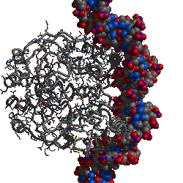
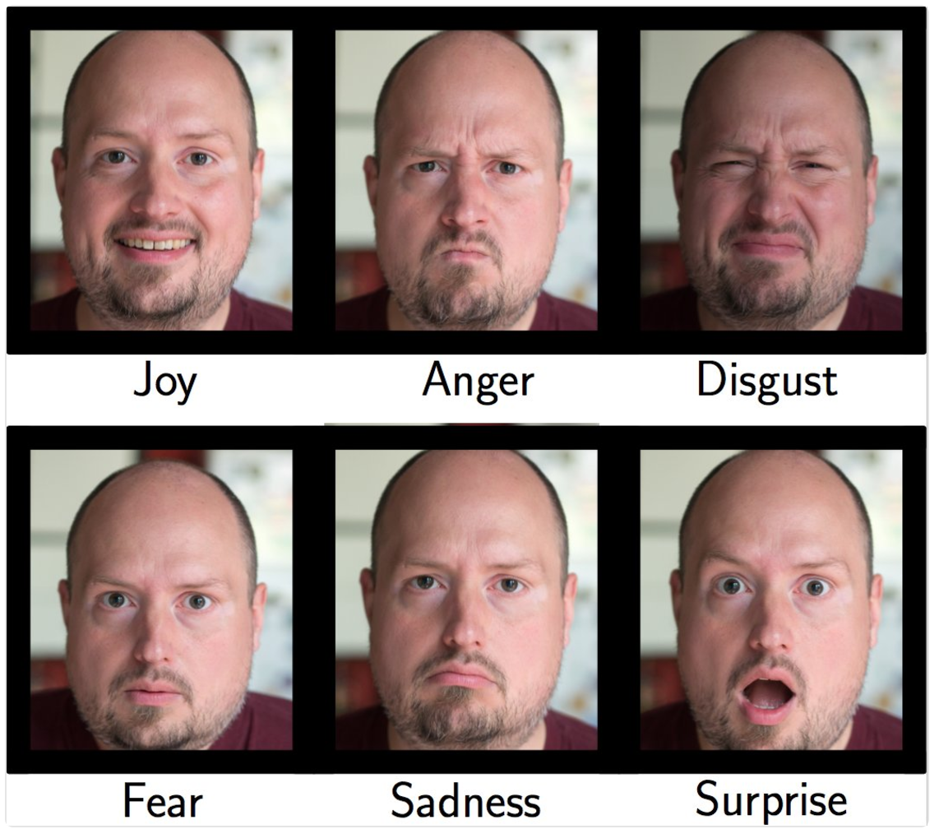
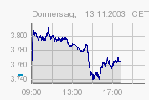
Applications of HMMs II: Other
Molecule Folding: Prediction of structure based on sequence
Pattern recognition, e.g. face emotion recognition
Prediction tasks, e.g. stock market
08.05.19
Language Technology Group – Chris Biemann

Slide 33
sEQUENCE TAGGING
coming up next
HMM, MEMM, CRF, LSTM
08.05.19
Language Technology Group – Chris Biemann

