Slide 1
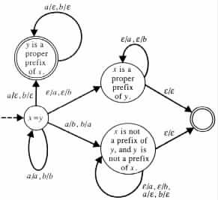
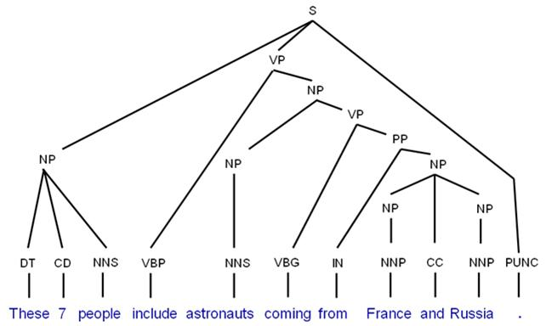
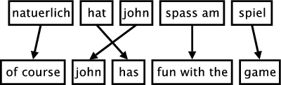
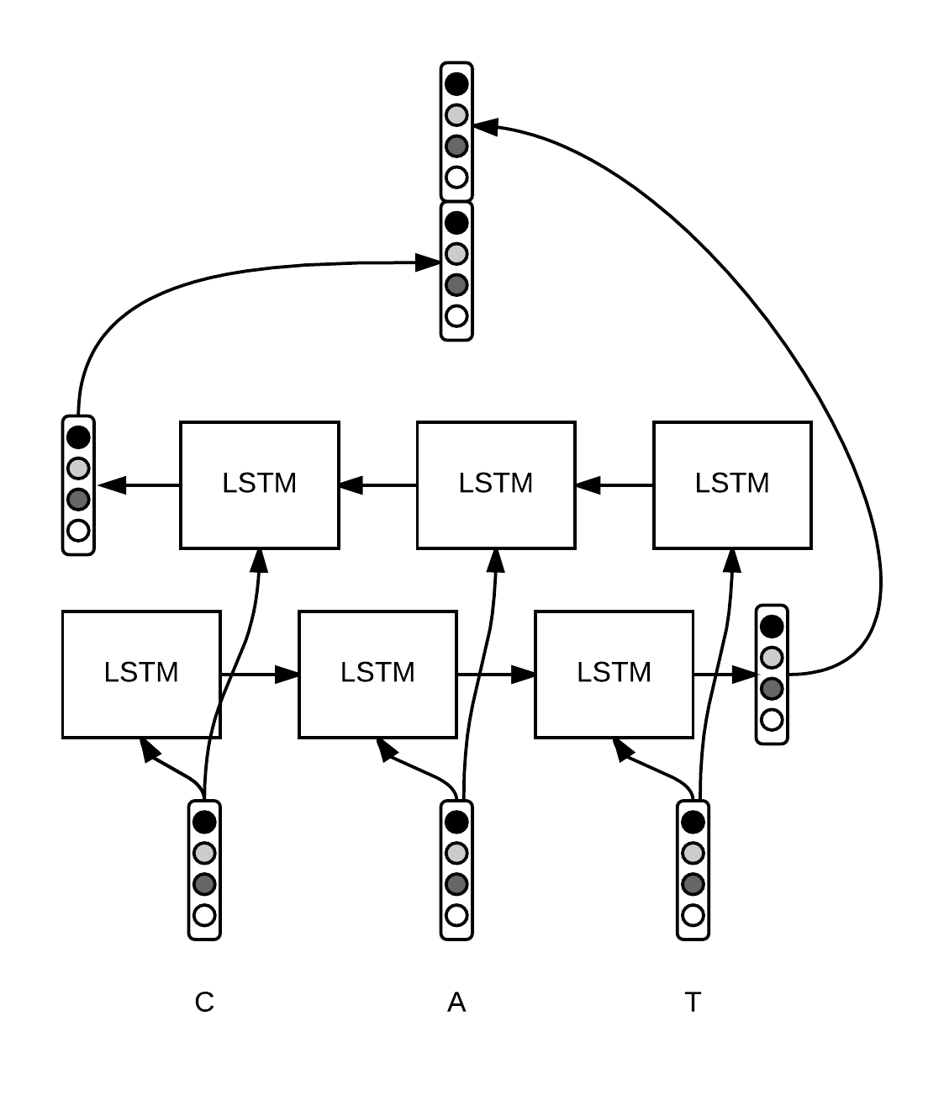
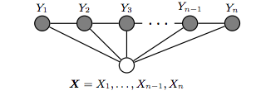
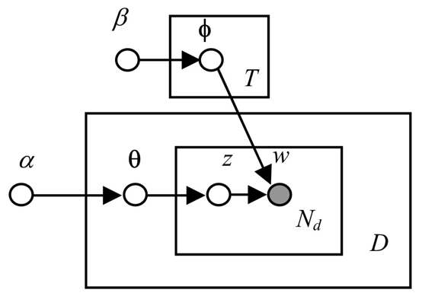
Master Studies Informatics
Universität Hamburg, SS 2019
Chomsky-Hierarchy
Phrase Alignment
Syntax Rules
Transducers for Morphology
Sequence Labeling
Topic Models
Neural Architectures
Machine Learning
Chris Biemann, Eugen Ruppert
Semantic Methods
Statistical Methods of Language Technology
31/03/19
Language Technology Group – Chris Biemann

Slide 2


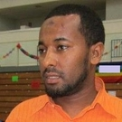
LEcturers
d
Prof. Dr. Chris Biemann
biemann@informatik.uni-hamburg.de
Informatikum Stellingen,
Office: F429
Appointment: by email
Eugen Ruppert, M. Sc.
ruppert@informatik.uni-hamburg.de
Informatikum Stellingen,
Office: G010
Appointment: by email
Dr. des. Seid Muhie Yimam, yimam@informatik.uni-hamburg.de
Informatikum Stellingen,
Office: F415
Appointment: by email
31/03/19
Language Technology Group – Chris Biemann

Slide 3
Short Intro of the LT Group
http://lt.informatik.uni-hamburg.de/
Established in October 2016 at UHH, MIN-Faculty, Comp.Sci. Dept.
Key Research Areas
Statistical Semantics: capture word meaning with big-data methods
Structure Discovery: unsupervised-knowledge-free methods for language processing
Cognitive Computing: human in the loop, interactive systems
Open Source Software and Open Data: committed to the most lenient licenses possible
Currently: 1 Prof, 4 PostDocs, 6 PhD students, 1 office assistant
31/03/19
Language Technology Group – Chris Biemann

Slide 4
Language Technology
Natural Language:
Naturally grown
Constantly changing
No well-defined semantics
Many layers of interpretation
Meaning dependent on context
…
Technologies coping with this
Formal languages?
Programming Languages?
Here:
Natural Languages
31/03/19
Language Technology Group – Chris Biemann

Slide 5



Why Language is HARD ..
polysemous
synonymous
Concept Layer
Lexical Layer
He sat on the river bank and counted his dough.
She went to the bank and took out some money.
31/03/19
Language Technology Group – Chris Biemann
Notes:
Another reason why language is hard is that in opposition to programming languages, there is no 1:1 mapping from the lexical layer to the conceptual layer.

Slide 6
Recent Projects of Language Technology Group
BMBF: WebAnno: A web-based annotation platform
DFG: Joining Ontologies and Distributional Semantics
DFG: Semantic Writing Aid
DB: Aspect-based Sentiment Analysis
LFF: Forum 4.0: Analysis of User Comments
IBM: JoBimText: Linking text to Knowledge with Distributional Semantics
Telekom: Xpert Finder
VW: New/s/leak: Network of Searchable Leaks
31/03/19
Language Technology Group – Chris Biemann

Slide 7
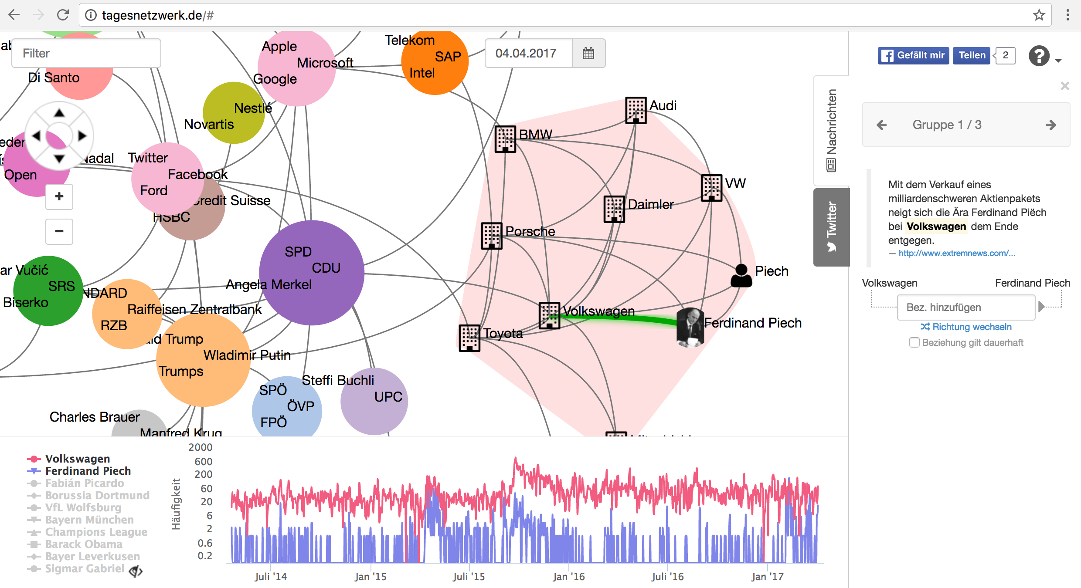
Netzwerk des Tages
www.tagesnetzwerk.de
Student project, up since 2014!

Slide 8
OVerview of this LEcture
Statistical Methods of Language Technology
focus on methods rather than applications
variety of techniques, focus on statistical methods
efficiency vs. effectiveness
Statistical Methods of Language Technology
cores of methods being used in NL systems
adaptations of generally known algorithms to language data
evaluation of techniques
Lecture: theory, concepts, algorithms
Practice class: hands-on, writing small programs, using available software
31/03/19
Language Technology Group – Chris Biemann

Slide 9
Textbooks
Jurafsky, D. and Martin, J. H. (2009): Speech and Language Processing. An Introduction to Natural Language Processing, Computational Linguistics and Speech Recognition. Second Edition. Pearson: New Jersey
Manning, C. D. and Schütze, H. (1999): Foundations of Statistical Natural Language Processing. MIT Press: Cambridge, Massachusetts
Carstensen, K.U., Ebert, Ch., Endriss, C., Jekat, S., Klabunde, R. and Langer, H. (Editors) (2004): Computerlinguistik und Sprachtechnologie. Eine Einführung. 2. Auflage. Spektrum: Heidelberg
Literature for specialized topics will be given in-place.
31/03/19
Language Technology Group – Chris Biemann

Slide 10
Learning Goals
understand statistical methods for language processing in detail
feeling for language tech applications, avoiding pitfalls
ability to plan technology requirements for a language tech project
analyze and evaluate the use of NLP in applications
see the beauty of language technology, be ready to write your thesis in language tech
31/03/19
Language Technology Group – Chris Biemann

Slide 11
Practice Class Information
In the practice classes you will work on weekly assignments, which will give you some practical experience in NLP
The assignments will be graded on a binary scale (“ok”/”not ok”)
You need 50% of points to pass the course
The practice classes are supervised by Eugen Ruppert and Seid Muhie Yimam
Depending on nature of the topic, assignments will be
theoretical, i.e. paper-and-pencil
practical, i.e. writing a program and applying it to data
hands-on, i.e. applying a third-party program to data
31/03/19
Language Technology Group – Chris Biemann

Slide 12
Organisational Information
The lecture slides, handouts, readings etc. can all be found on the Moodle e-Learning platform: https://lernen.min.uni-hamburg.de/moodle/course/view.php?id=27
The required enrolment key is: SMOLT2019
We use the Participant’s Forum there for discussion and Q&A (encouraged!)
31/03/19
Language Technology Group – Chris Biemann

Slide 13
Final Exam
How: Written exam 2h
When:
25. Jul. 2019 09:30-11:30 ESA C
17. Sep. 2019 09:30-11:30 Hörs Pharmazie (gr)
Content:
Lecture
Exercises
Reading
31/03/19
Language Technology Group – Chris Biemann

Slide 14
Time SLots For Classes 2018
time\day | MONDAY | TUESDAY | WEDNESDAY
11-12
12-13
13-14
14-15
15-16
16-17
17-18
18-19
12:15-13:45 F334 Lecture
14:15 – 15:45 F334 Practice Class I
16:15 – 17:45 G 203 Practice Class II
31/03/19
Language Technology Group – Chris Biemann

Slide 15
Topics of this Lecture
Formal Languages and Automata
Computational Morphology
Sequence Tagging
Topic Modelling
Statistical Machine Translation
Graph-Based Methods
Distributional Semantics
Word Senses and their Disambiguation
31/03/19
Language Technology Group – Chris Biemann

Slide 16
CHOMSKY HIERARCHY OF FORMAL LANGUAGES
Chomsky, Noam (1959). "On certain formal properties of grammars". Information and Control 2 (2): 137–167
Klabunde, R. (2004): Automatentheorie und Formale Sprachen. In: Carstensen, K.U., Ebert, Ch., Endriss, C., Jekat, S., Klabunde, R. and Langer, H. (Editors): Computerlinguistik und Sprachtechnologie. Eine Einführung. 2. Auflage. Spektrum: Heidelberg
Hopcroft, J.E., Motwani, R. and Ullman, J.D. (2006): Introduction to Automata Theory, Languages, and Computation. Third Edition. Pearson: New Jersey
FORMAL LANGUAGES AND AUTOMATA
31/03/19
31/03/19
Language Technology Group – Chris Biemann

Slide 17
Recap: Formal Languages and Automata
Automata theory and theory of formal languages are a part of theoretical computer science
Their concepts originate in theoretical linguistics: Noam Chomsky is the originator of the Chomsky hierarchy of formal languages
Why talk about it?
complexity of sub-systems of natural language informs complexity of automatic processing machinery
Fundamental results from theoretical computer science have direct implications on implementations for language technology applications
31/03/19
Language Technology Group – Chris Biemann

Slide 18
DEFINITIONS
A LANGUAGE is a collection of sentences of finite length all constructed from a finite alphabet of symbols
A GRAMMAR can be regarded as a device that enumerates the sentence of a language
A grammar of language L can be regarded as a function whose range is exactly L
31/03/19
Language Technology Group – Chris Biemann

Slide 19
Formal Grammar
A formal grammar is a quad-tuple G = (Φ,Σ,R,S) where
Φ is a finite set of non-terminals
Σ a finite set of terminals, disjoint from Φ
R a finite set of production rules of the form
S, Element of Φ : start symbol
31/03/19
Language Technology Group – Chris Biemann

Slide 20
Derivation, Formal Language, Automaton
Let G = (Φ,Σ,R,S) be a formal grammar and let u,v ∈ (Φ∪Σ)*.
v is directly derivable from u, noted , if u = awb, v=azb and w→z is a production rule in R.
v is derivable from u, noted , if there are words w₀..w_{k}, such that u⇒w₀, w_{n-1}⇒w_{n} for all 0<n≤k and w_{n}⇒v .
Let G = (Φ,Σ,R,S) be a formal grammar. Then, is the formal language generated by G.
An automaton is a device that decides, whether a given sentence belongs to a formal language.
31/03/19
Language Technology Group – Chris Biemann

Slide 21
Generation and Acceptance
Grammar
generates
Language
is accepted by
Automaton
The complexity of the generating grammar influences the complexity of the accepting automaton
31/03/19
Language Technology Group – Chris Biemann

Slide 22
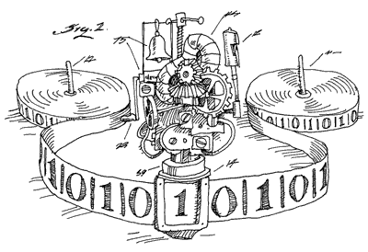
Type-0 grammar: unrestricted
The mechanism of unrestricted grammars allows the definition of very complex languages that in turn need very complex automata. Restrictions on the form of production rules lead to different types of grammars.
An unrestricted formal grammar is called Type-0 grammar and can be accepted by a Turing Machine. It produces recursively enumerable languages.
31/03/19
Language Technology Group – Chris Biemann

Slide 23
Type-1-grammar: context-sensitive
A grammar G = (Φ,Σ,R,S) is context-sensitive, iff all production rules in R obey the form
either αAγ→αβγ with α,β,γ ∈ (Φ∪Σ)*, A∈Φ, β≠ε
or S→ε.
If S→ε, then S cannot appear in the righthand side of rules in R.
The language of a type-1 grammar is accepted by a linear bounded automaton (a nondeterministic Turing machine whose tape is bounded by a constant times the length of the input).
31/03/19
Language Technology Group – Chris Biemann

Slide 24
Type-2 grammar: context-free
A grammar G = (Φ,Σ,R,S) is context-free, iff all production rules in R obey the form A→α with A∈Φ, α ∈ (Φ∪Σ)*.
Context free grammars are also called phrase structure grammars.
Context-free languages are closed under the following operations:
Union: if F and G are context-free, so is F∪G
Concatenation: if F and G are context-free, so is F•G
Kleene Star: if G is context-free, so is G*
Context-free languages are not closed under the following operations:
Intersection: from F and G are context-free does not follow that F∩G is.
Complement: from G context-free does not follow that ¬G is.
Difference: from F and G are context-free does not follow that F\G is.
31/03/19
Language Technology Group – Chris Biemann

Slide 25
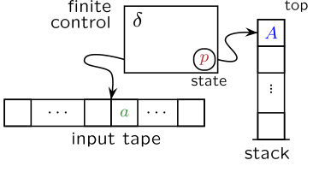
Pushdown automaton
Context-free grammars are accepted by non-deterministic pushdown automata.
A non-deterministic push-down automaton PDA=(Φ,Σ,Δ,☐,δ,S,F) consists of
Alphabet Φ of states
Alphabet Σ of input symbols, disjunct with Φ
Alphabet Δ of stack symbols, disjunct with Φ
initial stack symbol ☐
transition relaton δ: Φ×Σ×(Δ∪☐)→ρ(Φ×Δ*)
start state S ∈ Φ
set of final states F⊂Φ
31/03/19
Language Technology Group – Chris Biemann

Slide 26
Context-free Syntax Trees with phrase structure grammars
S → NP VP
NP → N | D N | NP PP
VP → V NP | V NP PP
PP → P NP
N → I | elephant | pajamas
V → shot
P → in
D → my | an | a | the
Syntax trees can (almost) be modeled with context-free languages
S
NP
VP
PP
NP
NP
N
V
D
N
P
D
N
I
shot
an
elephant
in
my
pajamas
31/03/19
Language Technology Group – Chris Biemann

Slide 27

Context-free Syntax Trees with phrase structure grammars
S → NP VP
NP → N | D N | NP PP
VP → V NP | V NP PP
PP → P NP
N → I | elephant | pajamas
V → shot
P → in
D → my | an | a | the
Syntax trees can (almost) be modeled with context-free languages
one surface sentence can have several derivations
S
How he got into my pajamas I'll never know! - Groucho Marx
VP
NP
NP
PP
NP
NP
N
V
D
N
P
D
N
I
shot
an
elephant
in
my
pajamas
31/03/19
Language Technology Group – Chris Biemann

Slide 28
Type-3 grammar: regular, left/right linear
A grammar G = (Φ,Σ,R,S) is right linear (left linear), iff all the production rules in R obey the forms
A→w
A→wB (left linear: A→Bw )
with A,B∈Φ and w∈Σ*.
Left (right) linear grammars generate regular languages:
∅ is regular
{a_{i}} is regular for a_{i} ∈ alphabet Σ
if the sets L₁ and L₂ are regular, then (L₁∩L₂) is regular
if the sets L₁ and L₂ are regular, then (L₁•L₂) is regular
if set L is regular, then also L*.
These languages can be described through regular expressions.
31/03/19
Language Technology Group – Chris Biemann

Slide 29
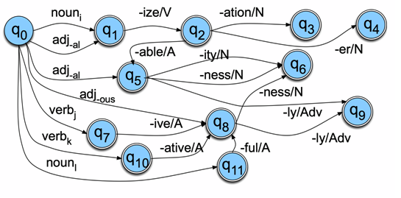
Finite State Automaton
Regular grammars are accepted by finite state automata.
A (deterministic) finite state automaton FSA=(Φ,Σ,δ,S,F) consists of:
set of states Φ
input alphabet Σ, disjunct with Φ
transition function δ: Φ×Σ→Φ
one start state S∈Φ
set of final states F⊂Φ
Regular languages cover sub-systems of language, such as morphology and chunk parsing.
31/03/19
Language Technology Group – Chris Biemann

Slide 30
The Chomsky Hierarchy of Formal Languages
type 0: recursively enumerable
Turing Machine (TM)
type 1: context-sensitive
linearly bounded TM
type 2: context-free
Pushdown Automaton (PDA)
type 3: regular
Finite State Automaton (FSA)
The different classes are proper subsets of each other: the expressivity of type-(n) grammars is truly smaller than type-(n-1) grammars.
Several other classes are known, e.g. corresponding to deterministic context-free grammars, tree adjoining grammars …
31/03/19
Language Technology Group – Chris Biemann

Slide 31
Programming Language vs. Natural Language
Grammar of Programming languages
by design: deterministic context free (in most cases)
which allows efficient parsing
without ambiguities.
clearly defined semantics
Grammar of Natural Languages
somewhere between type-1 and type-2
many possible parses for a single sentence
inherent ambiguities
semantics yet another layer
31/03/19
Language Technology Group – Chris Biemann

Slide 32
Finite state Morphology
Jurafsky, D. and Martin, J. H. (2009): Speech and Language Processing. An Introduction to Natural Language Processing, Computational Linguistics and Speech Recognition. Second Edition. Pearson: New Jersey: Chapter 3.2
Carstensen, K.U., Ebert, Ch., Endriss, C., Jekat, S., Klabunde, R. and Langer, H. (Editors) (2004): Computerlinguistik und Sprachtechnologie. Eine Einführung. 2. Auflage. Spektrum: Heidelberg, pages 198-205
G. Heyer, U. Quasthoff, T. Wittig (Eds.) (2006): Wissensrohstoff Text, Bochum, w3L. Kapitel 3.4
coming up next
Transducers, Compact Patricia Tries and DAWGs
31/03/19
Language Technology Group – Chris Biemann

