Slide 1
Finite state Morphology
Jurafsky, D. and Martin, J. H. (2009): Speech and Language Processing. An Introduction to Natural Language Processing, Computational Linguistics and Speech Recognition. Second Edition. Pearson: New Jersey: Chapter 3.2
Carstensen, K.U., Ebert, Ch., Endriss, C., Jekat, S., Klabunde, R. and Langer, H. (Editors) (2004): Computerlinguistik und Sprachtechnologie. Eine Einführung. 2. Auflage. Spektrum: Heidelberg, pages 198-205
G. Heyer, U. Quasthoff, T. Wittig (Eds.) (2006): Wissensrohstoff Text, Bochum, w3L. Kapitel 3.4
Transducers, Compact Patricia Tries and DAWGs
29/04/20
Language Technology Group – Chris Biemann

Slide 2
Morphology with FSAs
Morphology works fairly regular, so FSAs are an appropriate machinery for morphological analysis
Tasks for automated morphology:
analyze a given word into its morphemes
generate a full form from a base form + morphological information
Plain word lists are a possibility, but redundancies are not utilized and access can be slow. Further, no generalization properties: cannot utilize regularities from inflection classes, cannot guess for unseen words
Surface | Lexical
runs | run+Verb+Present+3sg run+Noun+Pl
largest | large+Adj+Sup
better | good+Adj+Comp
Surface | Lexical
Boote | boot+Nomen+Plural
verlangsamte | verlangsam+Verb +Imperf+3sg verlangsamt+Adj +NomAkk
29/04/20
Language Technology Group – Chris Biemann

Slide 3
Finite State Transducer
A finite state transducer is a 6-tuple FST=(Φ,Σ,Γ,δ,S,F) and consists of
set of states Φ
input alphabet Σ, disjunct with Φ
output alphabet Γ, disjunct with Φ
set of start states S⊂Φ
set of final states F⊂Φ
transition function δ⊆Φ×(Σ∪{ε})×(Γ∪{ε})×Φ
An FST is essentially an FSA with two tapes. It is useful to think about them as input tape and output tape, or upper tape and lower tape.
An FST transduces an input string x to an output string y if there is a sequence of transitions that starts with a start state and ends with a final state and has x as its input and y as its output string.
FSTs accept regular relations.
29/04/20
Language Technology Group – Chris Biemann

Slide 4
Regular Relations, closure
The set of regular relations is defined as follows:
For all (x,y) ∈ Σ×Γ, {(x, y)} is a regular relation
The empty set ∅ is a regular relation
If Q, R are regular relations, so are Q•R={(x₁x₂,y₁y₂)|(x₁,y₁)∈Q, (x₂,y₂)∈R}, Q∪R and Q*.
Nothing else is a regular relation.
Like regular languages, regular relations are closed under
union
concatenation
Kleene closure
Unlike regular languages, regular relations are NOT closed under
intersection
difference
complementation
29/04/20
Language Technology Group – Chris Biemann

Slide 5
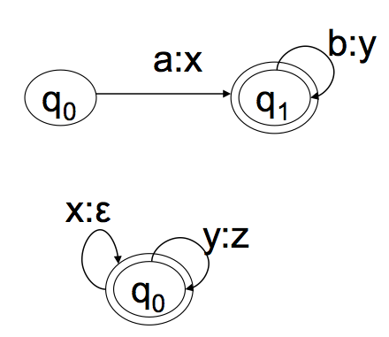
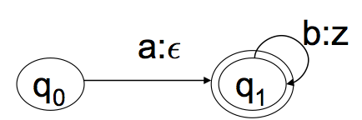
Closure of regular relations (ctd.)
New operations for regular relations:
Composition: Q°R: {(x,z) | ∃y: (x,y) ∈Q and (y,z) ∈R}
Projection: {x | ∃y, (x,y)∈R}
Inversion: {(y,x) | (x,y)∈R}
From regular language L to identity regular relation: {(x,x) | x∈L}
From two regular languages L and M, create the cross product relation: {(x,y) | x∈L, y∈M}
°
=
composition example
29/04/20
Language Technology Group – Chris Biemann

Slide 6
Examples for Morphology FSTs
en:3pl
wat:V
en:1pl
0
rast:V
1
et:impf
2
et:2pl
3
et:3sg
hast:V
ε
e:1sg
Sch:Sch
est:2sg
Tr:Tr
B:B
a:ä
u:u
m:m
ε:e
Note that FSTs can be non-deterministic and can have ε-transitions.
29/04/20
Language Technology Group – Chris Biemann
Notes:
!! 3rd person singular is NOT correct. how to fix it?

Slide 7
Handling nondeterminism and ambiguities
Since language is ambiguous on many levels, we embrace nondeterminism as a mechanism to reflect that
As long as we do not know how to resolve ambiguities, we carry along several possibilities
Nondeterminism for FSA: we don’t know which path we took
Nondeterminism for FST: different paths produce different output strings
Nondeterminism requires to keep track of a set of current states
A nondeterministic automaton accepts if there is at least one path to a final state
29/04/20
Language Technology Group – Chris Biemann

Slide 8
Running Example
s:+3p
6
4
ε:+V
7
r:r
u:u
n:n
ε:+n3p
0
1
2
3
s:+Pl
8
ε:+N
5
9
ε:+Sg
input string
 | r | u | n | s
29/04/20
Language Technology Group – Chris Biemann

Slide 9
Running Example
s:+3p
6
4
ε:+V
7
r:r
u:u
n:n
ε:+n3p
0
1
2
3
s:+Pl
8
ε:+N
5
9
ε:+Sg
 | r | u | n | s
Dots: Keep track current state and output generated so far.
29/04/20
Language Technology Group – Chris Biemann

Slide 10
Running Example
s:+3p
6
4
ε:+V
7
r:r
u:u
n:n
ε:+n3p
0
1
2
3
s:+Pl
8
ε:+N
5
9
ε:+Sg
 | r
 | r | u | n | s
Transition: dot moves on input tape and to next state, generating output
29/04/20
Language Technology Group – Chris Biemann

Slide 11
Running Example
s:+3p
6
4
ε:+V
7
r:r
u:u
n:n
ε:+n3p
0
1
2
3
s:+Pl
8
ε:+N
5
9
ε:+Sg
 | r | u
 | r | u | n | s
Transition: dot moves on input tape and to next state, generating output
29/04/20
Language Technology Group – Chris Biemann

Slide 12
Running Example
s:+3p
6
4
ε:+V
7
r:r
u:u
n:n
ε:+n3p
0
1
2
3
s:+Pl
8
ε:+N
5
9
ε:+Sg
 | r | u | n
 | r | u | n | s
Transition: dot moves on input tape and to next state, generating output
29/04/20
Language Technology Group – Chris Biemann

Slide 13
Running Example
s:+3p
6
4
ε:+V
7
r:r
u:u
n:n
ε:+n3p
0
1
2
3
s:+Pl
8
ε:+N
5
9
ε:+Sg
 | r | u | n | +V
 | r | u | n | +N
 | r | u | n | s
Non-determinism: Dot splits. Output tape is copied.
29/04/20
Language Technology Group – Chris Biemann

Slide 14
Running Example
s:+3p
6
4
ε:+V
7
r:r
u:u
n:n
ε:+n3p
0
1
2
3
s:+Pl
8
 | r | u | n | +V | +n3p
ε:+N
5
 | r | u | n | +N | +Sg
9
ε:+Sg
 | r | u | n | +V
 | r | u | n | +N
 | r | u | n | s
ε-transitions are also non-determinisms.
29/04/20
Language Technology Group – Chris Biemann

Slide 15
Running Example
s:+3p
6
4
ε:+V
7
r:r
u:u
n:n
ε:+n3p
0
1
2
3
s:+Pl
8
ε:+N
5
9
ε:+Sg
 | r | u | n | +V | +3p
 | r | u | n | +N | +Pl
 | r | u | n | s
Dots that do not have a follow-up state are abandoned.
29/04/20
Language Technology Group – Chris Biemann

Slide 16
Running Example
s:+3p
6
4
ε:+V
7
r:r
u:u
n:n
ε:+n3p
0
1
2
3
s:+Pl
8
ε:+N
5
9
ε:+Sg
output strings
 | r | u | n | +V | +3p
 | r | u | n | +N | +Pl
 | r | u | n | s
End of input is reached. All dots at final states have successfully transduced.
29/04/20
Language Technology Group – Chris Biemann

Slide 17
Two level Morphology
Single morphology FSTs get very complex when accommodating large word lists in a large number of different flexion classes
need to express word lists and spelling rules separately: use concatenation
two-level morphology works by introducing an intermediate level: use composition and intersection
surface to intermediate level: from surface form to morphemes
intermediate to lexical level: from morphemes to morphological analysis
The introduction of levels is here guided by linguistic intuition and merely a way to make writing and maintaining of FST morphological components simpler. In practice, all together is compiled into one big FST.
29/04/20
Language Technology Group – Chris Biemann

Slide 18
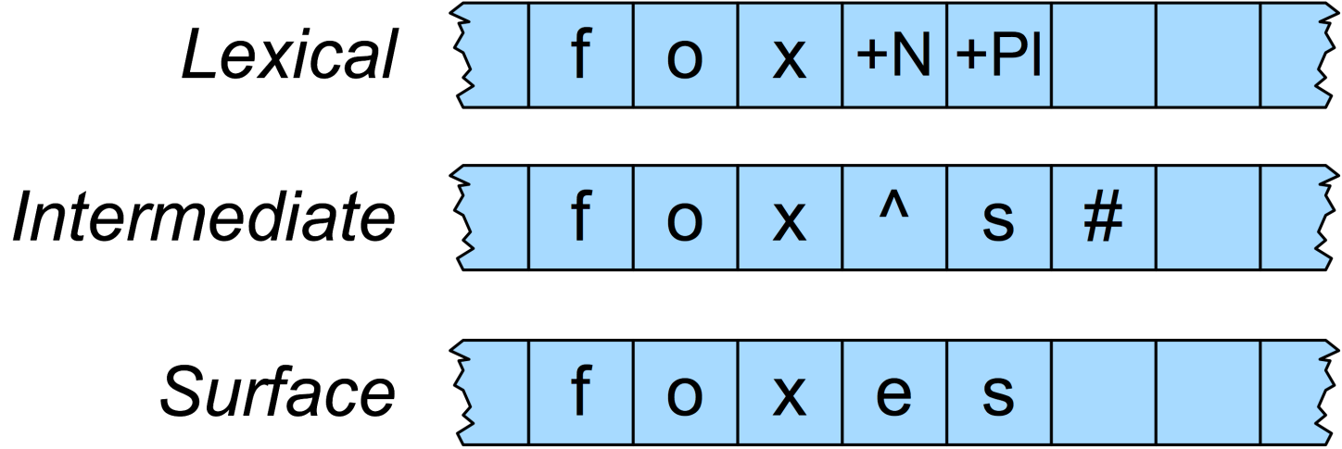
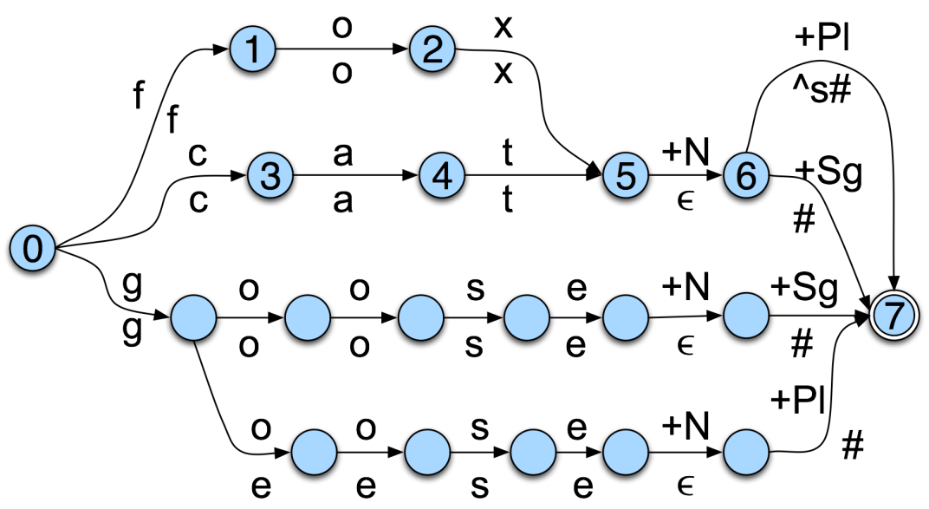
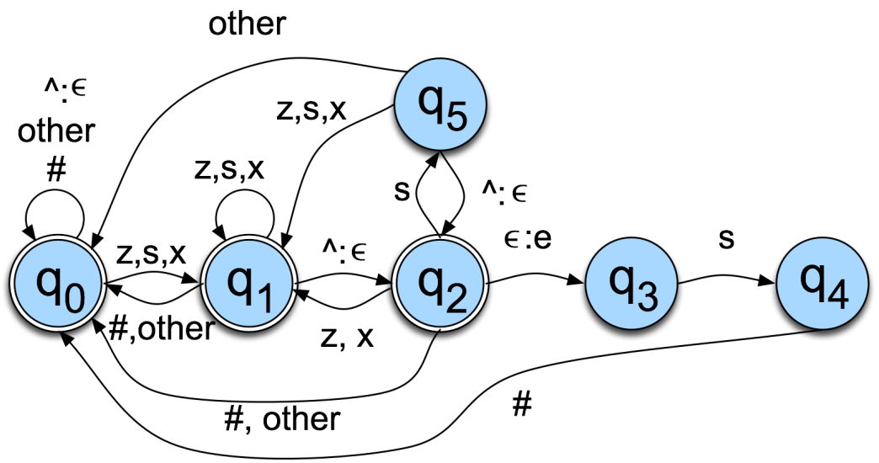
The foxes example (I)
Synthesis/Analysis of “foxes”:
29/04/20
Language Technology Group – Chris Biemann

Slide 19
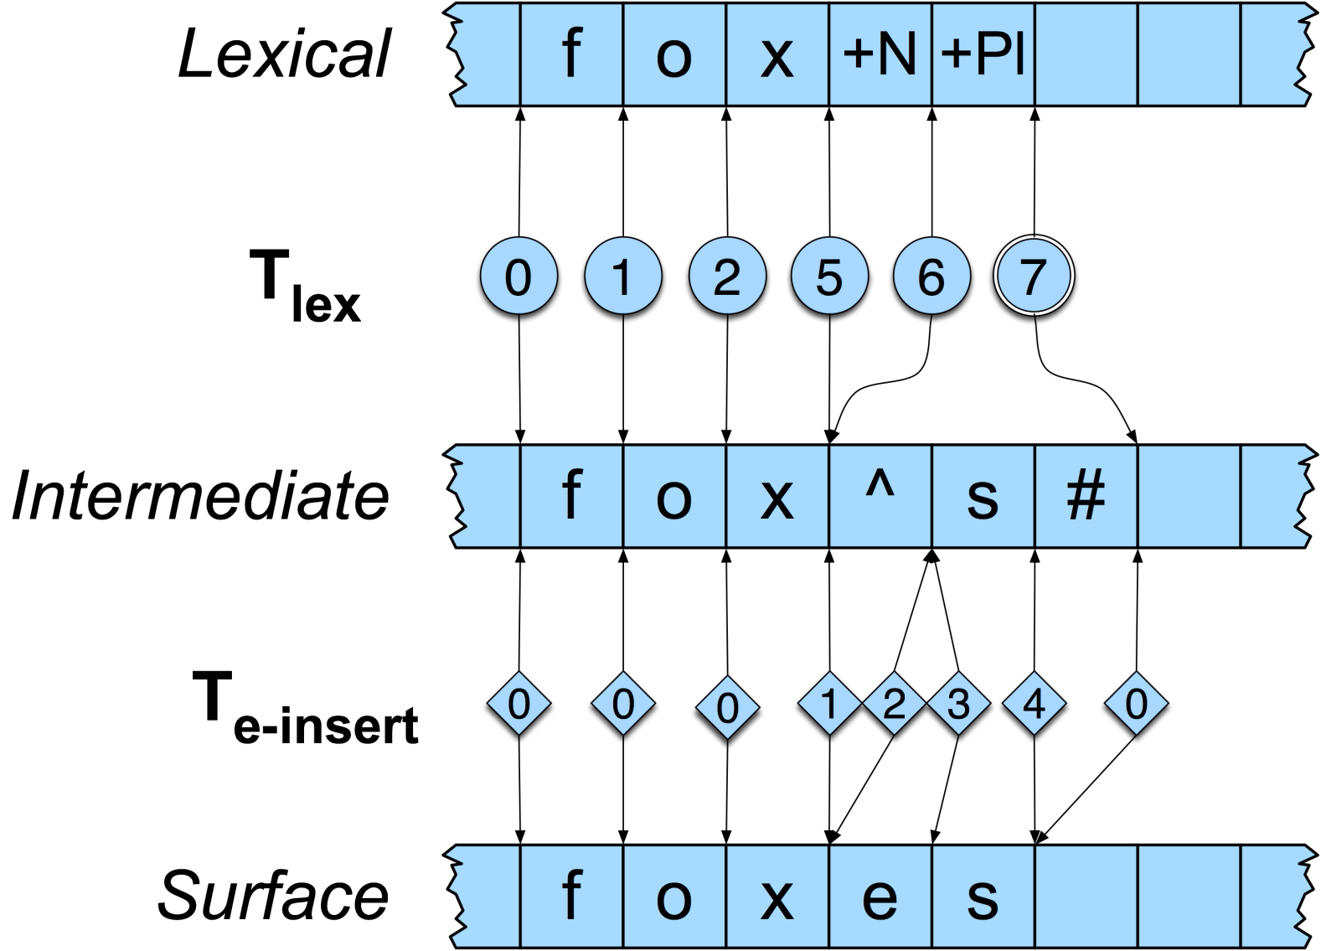
The foxes example (II)
29/04/20
Language Technology Group – Chris Biemann

Slide 20
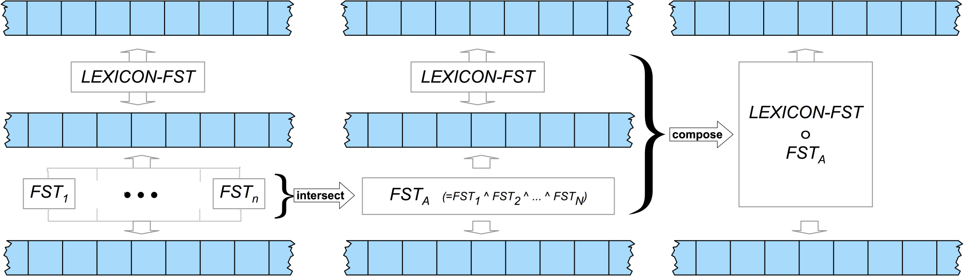
Overall Scheme
Why intersection?
spelling rules are constraints, capturing each some phenomenon of spelling while not constraining cases where they do not apply
spelling is correct if all constrains are satisfied
intersection handles the parallel checking if all con-straints are satisfied, i.e. no spelling rule is violated
declaration
intersection of spelling rules
composition
For intersection, the rules have to be modified to treat ε as part of the alphabet to ensure equal length
29/04/20
Language Technology Group – Chris Biemann

Slide 21
Applications of FSTs in language technology
Lexicon data structure for e.g. speller
Morphology analysis and synthesis
Segmentation
Tokenization
Sentence boundary detection
Chunk parsing (cascaded)
decoding in speech recognition
29/04/20
Language Technology Group – Chris Biemann

Slide 23
Motivation for Search Trees
Tasks:
memory-efficient storage of word lists
classification on the word level, e.g. lemmatization
generalization capabilities: e.g. lemmatize “googled / googelte” even it it is not in the list of known/given words
In applications, full FSTs are too complex. Simpler structures: Tries and DAWGs
deterministic: only one path per input
no output tape
compressing word lists
generalization capabilities
Prerequisite: Search Trees
29/04/20
Language Technology Group – Chris Biemann

Slide 24
Tries (a.k.a. Prefix Tree): combine common prefixes
A trie is a tree structure. The nodes have 0 to N daughters (N number of possible characters in alphabet).
Example for Markus, Maria, Jutta, Malte
(root)
17 nodes with 16 characters, 16 edges
M
J
a
u
l
r
t
t
k
i
t
e
u
a
a
s
29/04/20
Language Technology Group – Chris Biemann
Notes:
Defnition vom Baum: A tree data structure can be defined recursively (locally) as a collection of nodes (starting at a root node), where each node is a data structure consisting of a value, together with a list of references to nodes (the ”daughters”2), with the constraints that no reference is duplicated, and none points to the root.
deterministischer FSA ohne Schleifen

Slide 25
Patricia Trie (PT) (a.k.a. Radix Tree)
Decrease number of edges by putting several characters in one node
Example for Markus, Maria, Jutta, Malte
(root)
7 nodes, 16 characters, 6 edges.
"<" designates end-of-word
Ma
Jutta<
lte<
r
kus<
ia<
29/04/20
Language Technology Group – Chris Biemann

Slide 26
Search in PTs
Recursively walk down, search word gets eaten up
Return last reached node.
If remaining search word is empty: exact match, otherwise partial match
Maria<
(root)
Julia<
ria<
Ma
Jutta<
lia<
partial match
lte<
r
ia<
kus<
ia<
exact match
29/04/20
Language Technology Group – Chris Biemann

Slide 27
Insert in PTs
Insert of w:
Search for w returns appropriate node k
if exact match: Word was in PT already
if partial match: Split string contained in k, attach daughter nodes.
In k holds: k: w=uv, k.string=ux
Manuela<
(root)
Johannes<
nuela<
Ma
J
Jutta<
ohannes<
nuela<
lte<
r
utta<
ohannes<
Case 1: k.string=u, |x|=0
Insert one node with string v as daughter of k
Case 2: k.string=ux,|x|>0
Insert two nodes with strings v and x as daughters of k
kus<
ia<
29/04/20
Language Technology Group – Chris Biemann

Slide 28
Storing additional information in PTs
Nodes are extended: An additional field stores some information
Example: Storing the gender of names:
(root) m(3), f(2)
The classes can be found in the leaves.
In intermediate nodes, the additional field stores the sum of the classes in the subtree.
Ma m(3), f(1)
Jutta< f(1)
lte< m(1)
r m(2),f(1)
kus< m(1)
ia< m(1), f(1)
29/04/20
Language Technology Group – Chris Biemann

Slide 29
Application: Base form reduction (Lemmatization)
Given: List of words with reduction rules
Haus 0
Hauses 2
Häuser 5aus
Maus 0
Mäuse 4aus
Bau 0
Baus 1
Aus 0
Reduction: integer n and (possible empty) string x.
read: cut n characters (bytes) from behind and attach x.
ambiguous cases: multiple instructions: Fang 0; 0en
inflection removal for verbs (German-specific): remove first string occurrence after operator # geschienen 5einen#ge
29/04/20
Language Technology Group – Chris Biemann

Slide 30
Base form reduction II
PT is built from reversed words, the reduction rules are stored in the nodes. "<" denotes start-of-word.
(root) 5aus(1), 4aus(1), 2(1),1(1),0(4)
uab< 0(1)
s 2(1),1(1),0(3)
resuäh< 5aus(1)
esuäm< 4aus(1)
ua 1(1),0(3)
esuah< 2(1)
Haus 0
Hauses 2
Häuser 5aus
Maus 0
Mäuse 4aus
Bau 0
Baus 1
Aus 0
h< 0(1)
m< 0(1)
b< 1(1)
< 0(1)
29/04/20
Language Technology Group – Chris Biemann

Slide 31
Base form reduction III
For base form reduction, a search with the reversed word is performed, this returns some node (leaf or intermediate node).
The rule in this node will be applied. If there are several rules, take the one with the highest score and above some threshold
Under the threshold, return ‘undecided‘
Unknown words receive a morphologically motivated guess
all known words are fully represented: 100% correct on training
s 2(1),1(1),0(3)
ua 1(1),0(3)
esuah< 2(1)
Hochhaus → 0
Spass → 0
Unterbaus → 1
h< 0(1)
m< 0(1)
b< 1(1)
< 0(1)
29/04/20
Language Technology Group – Chris Biemann

Slide 32
Pruning to CPT: Memory reduction
If the PT serves merely as classifier and not for storing word lists:
class-redundant subtrees can be deleted.
strings in the remaining leaves can be cut to length 1
A pruned PT is called Compact Patricia Trie (CPT)
Pruning does not change any classification results.
(root) 5aus(1), 4aus(1), 2(1),1(1),0(4)
(root) 5aus(1), 4aus(1), 2(1),1(1),0(4)
uab< 0(1)
s 2(1),1(1),0(3)
resuäh< 5aus(1)
esuäm< 4aus(1)
s 2(1),1(1),0(3)
r 5aus(1)
e 4aus(1)
ua 1(1),0(3)
esuah< 2(1)
Pruning
ua 1(1),0(3)
e 2(1)
h< 0(1)
m< 0(1)
b< 1(1)
< 0(1)
b 1(1)
29/04/20
Language Technology Group – Chris Biemann

Slide 33
Summary of CPTs
Properties:
Fully reproducing a training set, yet perform educated guesses
compact data structure for string-based classification
Trained from training data: word+class
Insertion and deletion possible (before pruning) without reorganization
Applications:
morphological classification
base form reduction
compound noun decomposition: Bauhaus -> Bau - haus
context-independent word class assignment, e.g. Noun, Verb, etc.
autocomplete / type-ahead
29/04/20
Language Technology Group – Chris Biemann

Slide 34
Directed Acyclic Word Graph (DAWG)
A DAWG is a directed acyclic graph, built from the letters of words
In a DAWG, similar prefixes AND similar suffixes are used for compression
There are two kinds of edges: - child pointer - next pointer
DAWGs merely store the existence of a word and cannot be used for classification tasks
DAWGs need in average less memory than CPTs
29/04/20
Language Technology Group – Chris Biemann

Slide 35
Example DAWG
example for Wurstbrot, Wursttheke, Käsebrot, Käsetheke
(root)
W
c
u
c
r
c
s
c
t
c
b
c
r
c
o
c
t
n
n
t
h
e
k
e
c
c
c
c
K
c
ä
c
s
c
e
c
child pointer
c
n
next pointer
end-of-word
29/04/20
Language Technology Group – Chris Biemann

Slide 36
Searching a DAWG
if there is a path from the root to a node marked as EOW, the word is contained in the DAWG
child pointer eats the search word‘s characters up
next pointer serves for choosing alternatives.
Maren
(root)
aren
M
c
e
c
h
c
l
aren
n
ren
a
c
g
c
e
c
n
ren
n
en
r
n
c
29/04/20
Language Technology Group – Chris Biemann

Slide 37
Construction of DAWGs
Construction of a tree with child-next pointers (isomorphic to trie)
Search until no more match
Insert rest of search word
Combine similar subtrees, starting with subtree depth 0 and increase depth.
Example for CITIES, CITY, PITIES, PITY
C
c
I
c
T
c
I
c
E
c
S
n
After step 1 we only used common prefixes for compression
n
Y
P
c
I
c
T
c
I
c
E
c
S
n
Y
29/04/20
Language Technology Group – Chris Biemann

Slide 38
Construction of DAWGs II
C
c
I
c
T
c
I
c
E
c
S
0
n
n
At first combine leaves (depth 0) with identical content Note that only subtrees under child-pointers are combined: therefore the Y‘s stay separated.
Y
P
c
I
c
T
c
I
c
E
c
n
Y
Then combine identical subtrees with depth 1
C
c
I
c
T
c
I
c
E
c
S
1
n
n
Y
Iterate for increasing depth, until nothing can be combined any more.
P
c
I
c
T
c
I
c
n
Y
C
c
I
c
T
c
I
c
E
c
S
C
c
I
c
T
c
I
c
E
c
S
4
2
n
n
n
Y
n
Y
P
c
I
c
T
c
P
c
29/04/20
Language Technology Group – Chris Biemann

Slide 39
File Format DAWG
Every node is represented by 4 bytes (ASCII-DAWG)
2 bytes for child pointer
1 byte for flags: "1"- for End-of-word, "2" of End-of-List
1 byte for character
nr child flg chr
00 00 00 03 00 (root)
01 00 03 00 43 C
02 00 03 02 50 P
03 00 04 02 49 I
04 00 05 02 54 T
05 00 07 00 49 I
06 00 00 03 59 Y
07 00 08 02 45 E
08 00 00 03 53 S
C
c
I
c
T
c
I
c
E
c
S
n
n
Y
P
c
next pointer: next line, if not end-of-list or some child pointer points to the next line
29/04/20
Language Technology Group – Chris Biemann

Slide 40
Summary on DAWGs
DAWGs are a very compact form to store word lists, e.g. for dictionaries
DAWGs are efficient in deciding whether a word is in the word list or not
DAWGs are not suitable for classification on string sequences
Applications
Scrabble
edit distance
indexing
auto-completion
29/04/20
Language Technology Group – Chris Biemann

Slide 41
Sign up in Moodle – anyone missing?
https://lernen.min.uni-hamburg.de/enrol/instances.php?id=73
The required enrolment key is: SMOLT2019
29/04/20
Language Technology Group – Chris Biemann

Slide 42
Language Models
Manning, C. D. and Schütze, H. (1999): Foundations of Statistical Natural Language Processing. MIT Press: Cambridge, Massachusetts. Chapters 2.1, 2.2, 6.
Bengio, Y., Ducharme, R., Vincent, P., Jauvin, C. (2013): A Neural Probabilistic Language Model. Journal of Machine Learning Research 3 (2003):1137–1155
Mikolov, T., Karafiát, M., Burget, L., Cernocký, J., Khudanpur, S. (2010): Recurrent neural network based language model. Proceedings of Interspeech 2010, Makuhari, Chiba, Japan, pp. 1045-1048
coming up next
Entropy, Perplexity, Maximum Likelihood, Smoothing, Backing-off, Neural LMs
29/04/20
Language Technology Group – Chris Biemann

