Slide 1
Sequence Tagging
Jurafsky, D. and Martin, J. H. (2009): Speech and Language Processing. An Introduction to Natural Language Processing, Computational Linguistics and Speech Recognition. Second Edition. Pearson: New Jersey: Chapter 5
Lafferty, J., McCallum, A., Pereira, F. (2001). Conditional random fields: Probabilistic models for segmenting and labeling sequence data. Proc. 18th International Conf. on Machine Learning. Morgan Kaufmann. pp. 282–289. http://www.cis.upenn.edu/~pereira/papers/crf.pdf.
Lipton, Z.C., Berkowitz, J., Elkan C. (2015): A critical review of recurrent neural networks for sequence learning. arXiv preprint arXiv:1506.00019 https://arxiv.org/pdf/1506.00019.pdf
HMM, MEMM, CRF, LSTM
08.05.19
Language Technology Group – Chris Biemann

Slide 2
Sequence Tagging
We want to know properties of words for further processing, e.g. word classes, names, etc.
It is possible to learn a method that assigns these properties from labeled training text.
In Machine Learning, this is a classification task. If the sequence of events is taken into account, this is called sequence tagging
Examples for tagged text:
Part-of-Speech: I/PRO saw/V the/DET man/N with/P the/DET saw/N ./P
Name tagging: Valerie/B-PERS and/O Rose/B-PERS travel/O to/O New/B-LOC York/I-LOC ./O
08.05.19
Language Technology Group – Chris Biemann

Slide 3
no independence assumption on samples
Standard ML setups: Assumption on the independence of training resp. test examples
Can shuffle and sample training examples
Can classify test examples in parallel
Sequence Learning
Previous train/test examples are an informative context
Previous classifications/outputs are an informative context
Examples for sequential data:
Frames from video
Snippets from audio
Text: streams of words or characters
DNA
08.05.19
Language Technology Group – Chris Biemann

Slide 4
Parts-of-Speech
About 8 coarse classes: Noun, verb, adjective, preposition, adverb, article, interjection, pronoun, conjunction, etc.
Called: parts-of-speech, lexical category, word classes, morphological classes, lexical tags, POS
Lots of debate in linguistics about the number, nature, and universality of these. We ignore this debate.
Why distinctions can be tricky:
Singular and plural different POS?
Common nouns vs. proper nouns?
tense and number of verbs
domain-specific POS like in @joe: check out http://bit.ly/dflwkln #funny
08.05.19
Language Technology Group – Chris Biemann

Slide 5
Some words on POS tag sets
POS tags are linguistic categories, defined by a linguistic theory
Different linguistic theories define different POS tags
Number of tags differ within different tag sets for the same language
Number of tags differ considerably for different languages:
German: STTS 54 tags
Prague Treebank (Czech): 1300+ tags
Some tag sets are hierarchical: e.g. NOUN-Plural vs. NOUN-Singular etc.
POS tagging is not an end application, but a preprocessing step
POS tags are commonly used as features for higher level tasks, e.g. name tagging or chunking
08.05.19
Language Technology Group – Chris Biemann

Slide 6
The POS tagging problem: Ambiguity, as usual
Words often have more than one POS: back
The back door = JJ
On my back = NN
Win the voters back = RB
Promised to back the bill = VB
The POS tagging problem is to determine the POS tag label sequence L for a particular sequence of words W:
08.05.19
Language Technology Group – Chris Biemann

Slide 7
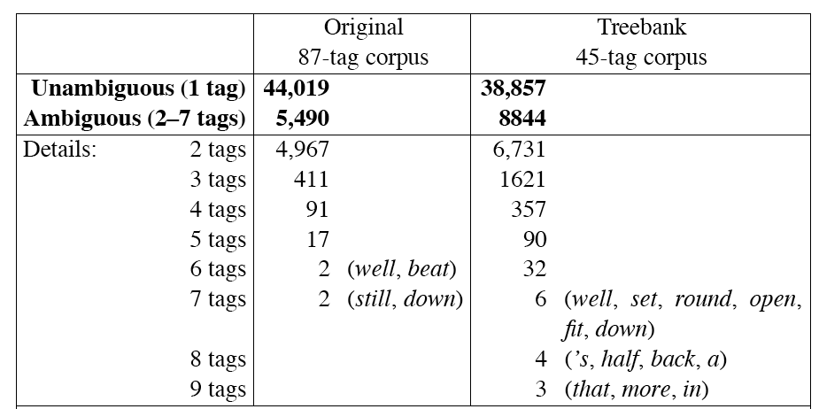
How hard is POS tagging? Measuring ambiguity in the Brown corpus
Brown corpus: 1 Million tokens of English, manually tagged and annotated with grammar structure
08.05.19
Language Technology Group – Chris Biemann

Slide 8
Tags can be viewed as hidden states!
<s>
PRON
AUX
V
DET
N
</s>
I
can
see
the
can
08.05.19
Language Technology Group – Chris Biemann

Slide 9
Tags: States of the HMM
Hidden States: l_{i}∈Tagset
<s>
PRON
AUX
V
DET
N
</s>
I
can
see
the
can
Transition between POS-states: local dependencies of word classes
08.05.19
Language Technology Group – Chris Biemann

Slide 10
Words: Emission from states
Hidden States: l_{i}∈Tagset
<s>
PRON
AUX
V
DET
N
</s>
Observations: w_{i}∈Vocabulary
I
can
see
the
can
States have possible words with probabilities
08.05.19
Language Technology Group – Chris Biemann

Slide 11
State transitions
N
DET
V
AUX
08.05.19
Language Technology Group – Chris Biemann

Slide 12
State transitions and observations
dog
bark
bark
can
N
run
the
bite
DET
V
a
that
AUX
did
can
will
08.05.19
Language Technology Group – Chris Biemann

Slide 13
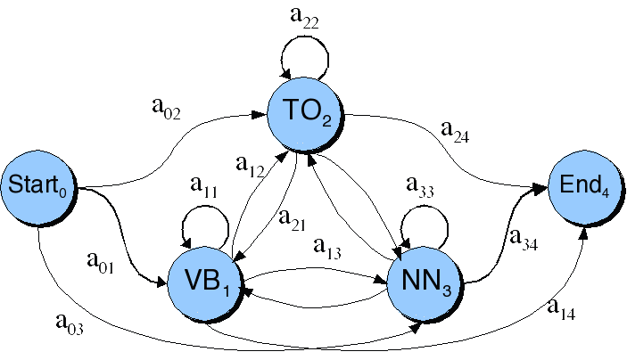
Transitions between states, with probabilities
08.05.19
Language Technology Group – Chris Biemann

Slide 14
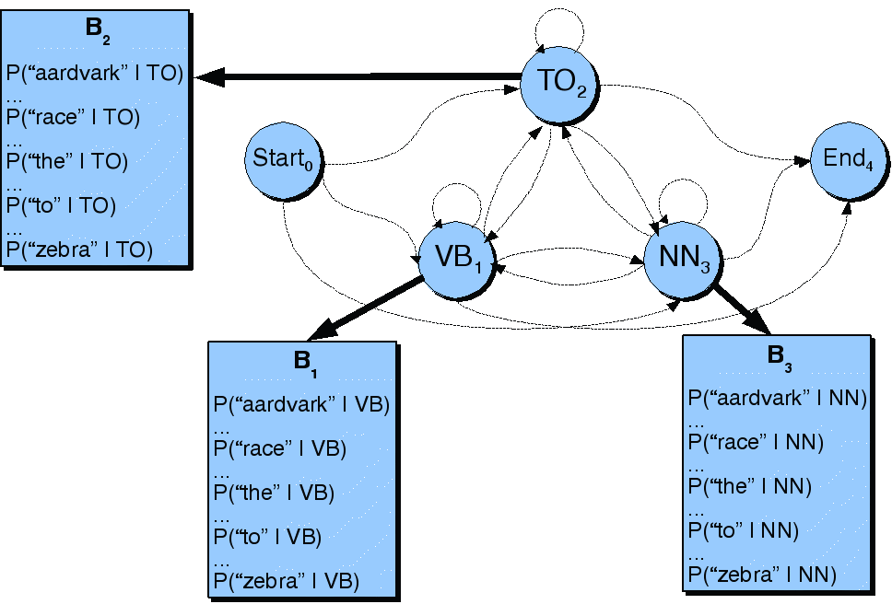
Observation likelihoods: other probabilities
08.05.19
Language Technology Group – Chris Biemann

Slide 15
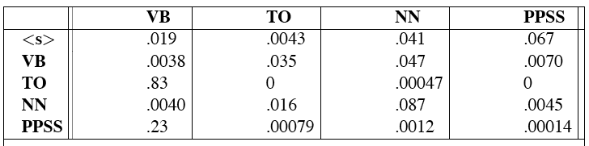
state transition Matrix for the POS HMM
Tag transition probabilities p(l_{i} | l_{j}) computed from the 87-tag Brown corpus, without smoothing. Rows: Conditioning event, thus P(PPSS|VB) is 0.0070.
This matrix is not sparse! Is smoothing necessary?
08.05.19
Language Technology Group – Chris Biemann

Slide 16
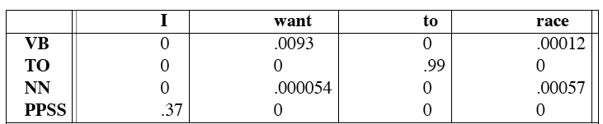
Tag-to-word probabilities for the POS HMM
Observation likelihoods computed from the 87-tag Brown corpus without smoothing.
This matrix is sparse. What do zeros mean?
08.05.19
Language Technology Group – Chris Biemann
Notes:
zeroes mean that they cannot used but are subject to smoothing

Slide 17
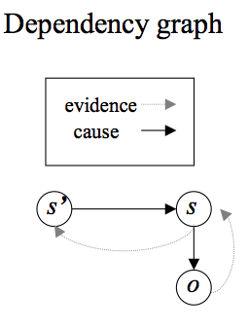
The POS HMM
We are looking for the most probable tag label sequence L_{max}, given observable words w¹,…,w^{T} and a POS HMM of order n:
This a generative model: We were looking for labels, given words, and compute these labels using probabilities for words, given labels and the probability for the label sequence.
is called the likelihood,
is called the prior.
Generative: we are reasoning ‘backwards’ from models that could have produced such an output.
08.05.19
Language Technology Group – Chris Biemann

Slide 18
POS HMM training and application
Training:
The POS HMM is trained from POS-annotated training text
Thus, the transitions between ‘hidden’ states are observable during training
no need for EM training: we can simply count and smooth MLE values using any of the smoothing methods if we have fully labeled training text
we can use EM training if we have unlabeled text and a tag distribution per word
Application:
for unlabeled text, label state transitions are hidden
we compute the most likely state sequence using a modification of the Viterbi algorithm that accounts for likelihoods
08.05.19
Language Technology Group – Chris Biemann

Slide 19
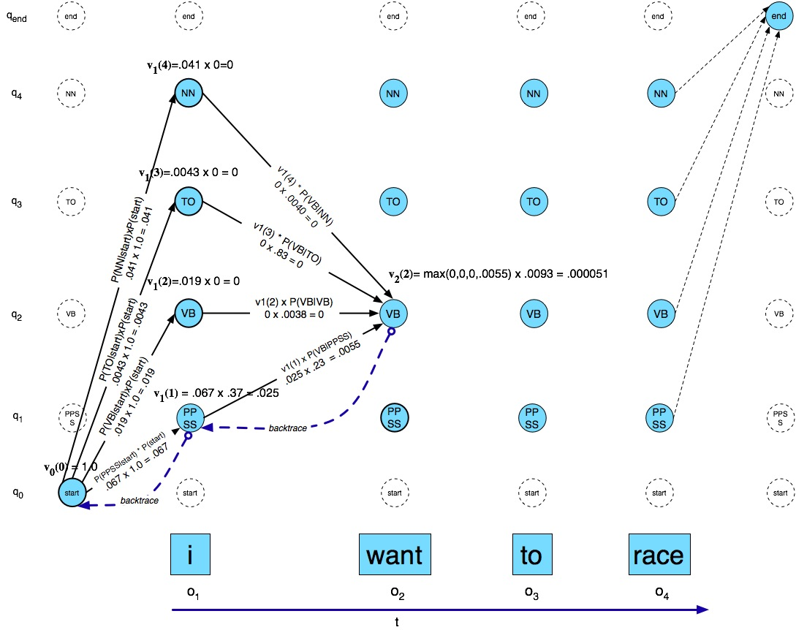
Viterbi example with likelihoods and priors
08.05.19
Language Technology Group – Chris Biemann

Slide 20
Disambiguation: Find the most probable tag sequence
Structural zeros on p(w|l) give rise to optimization techniques
08.05.19
Language Technology Group – Chris Biemann

Slide 21
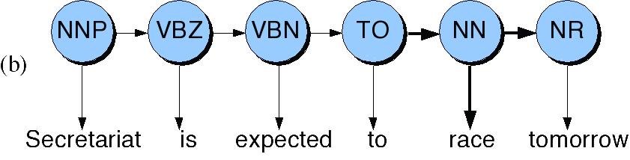
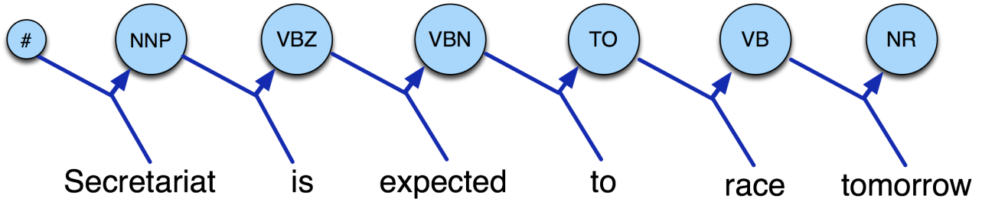
Generative vs. Discriminative models
We want:
Generative models: Bayes rule is used to turn the dependencies around:
what we model is the joint probability of labels and observations P(L,W).
Discriminative models: Why not directly optimize P(L|W)?
08.05.19
Language Technology Group – Chris Biemann

Slide 22
Difficulties with HMMs
Need a richer representation of words: Describe words with features instead of enumerating
Example features:
capitalization
word ending
word length
hyphenation
Split states to account for features, e.g. NN -> (NN,Cap) and (NN,noCap) ? Introduce layers? All this increases the number of parameters.
Since we have given fixed word observations for tagging, why model the joint probability of observations and labels instead of P(L|W)?
tag
len
Cap?
suffix
hyph
08.05.19
Language Technology Group – Chris Biemann

Slide 23
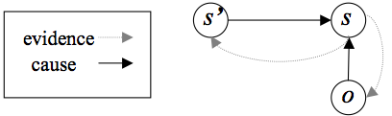
Conditional Markov Model (CMM), Maximum Entropy Markov Model (MEMM)
CMM: Attempt to turn the HMM into a discriminative model by conditioning the label on the observation o, which subsumes current and surrounding words, as well as features computed on them.
MEMM: use a MaxEnt classifier (Logistic regression) on current and previous observations
08.05.19
Language Technology Group – Chris Biemann

Slide 24
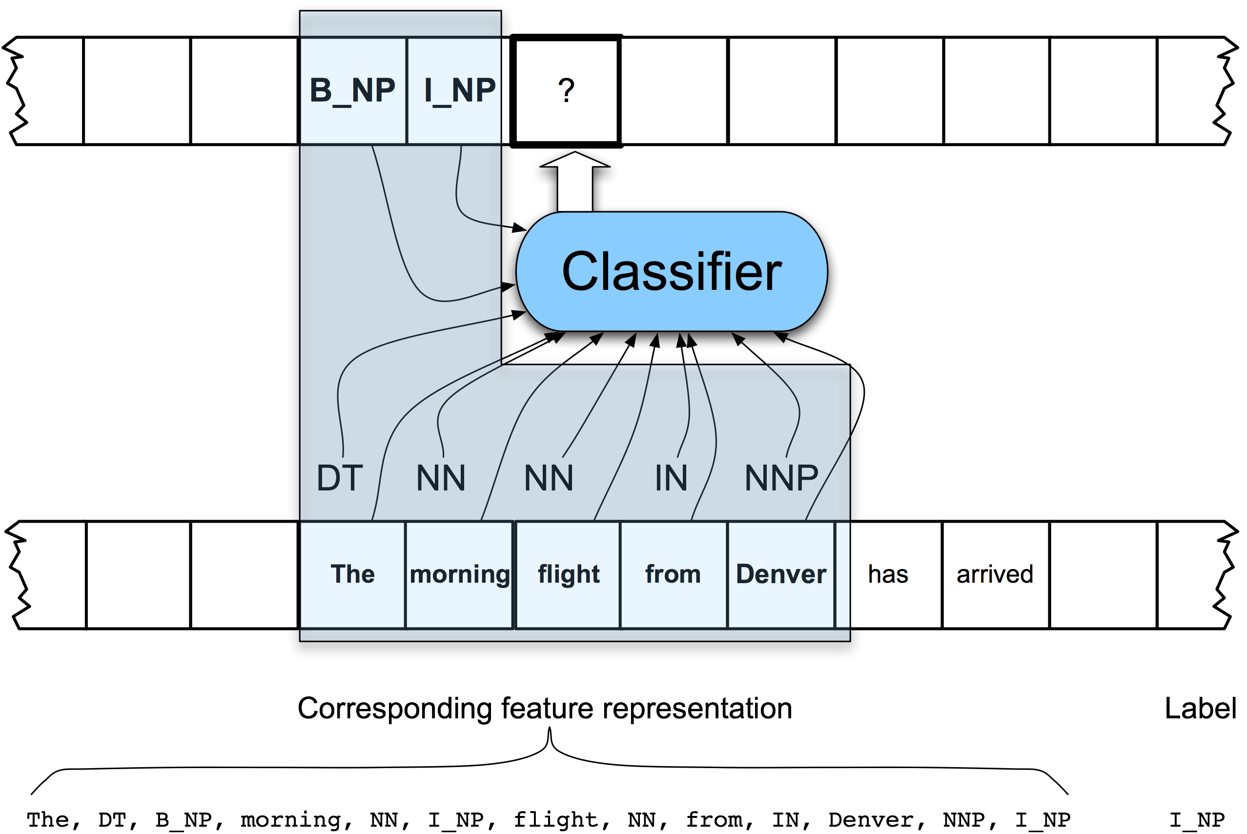
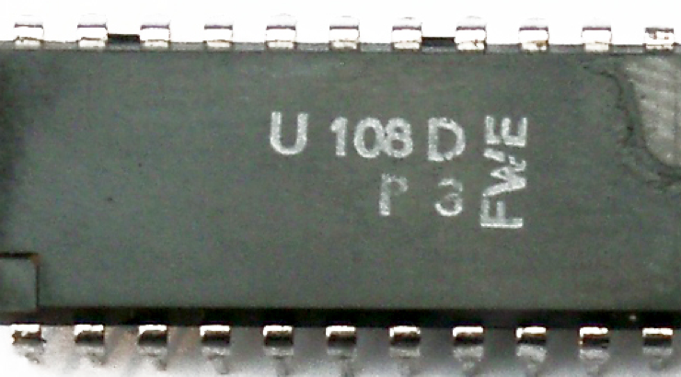
Sequence classification with MEMMs
CLASSIFIER
08.05.19
Language Technology Group – Chris Biemann

Slide 25

How to read the MEMM definition
w^{T}: transposed vector of feature weights λ_{i}
f: feature vector
f_{i}: function that computes feature i from observations and new label
o^{t}: observation at time t
Z: normalization factor
λ_{i}: parameters for lin. combination
Σ: this is a linear combination of features, weighted by λ_{i}
exp(): this linear combination is performed in exponential space
The MEMM is normalized per state.
08.05.19
Language Technology Group – Chris Biemann

Slide 26
Problem with MEMMs: Label Bias
Observation 1
Observation 2
Observation 3
Observation 4
State 1
0.4
0.45
0.5
0.2
0.6
0.2
0.55
0.1
0.5
State 2
0.2
0.3
0.3
0.2
0.1
0.2
State 3
0.2
0.1
0.2
State 4
0.2
0.3
0.2
State 5
What the local transition probabilities say:
State 1 almost always prefers to go to state 2
State 2 almost always prefers to stay in state 2
08.05.19
Language Technology Group – Chris Biemann

Slide 27
Label Bias Problem
Observation 1
Observation 2
Observation 3
Observation 4
State 1
0.4
0.45
0.5
0.2
0.6
0.2
0.55
0.1
0.5
State 2
0.2
0.3
0.3
0.2
0.1
0.2
State 3
0.2
0.1
0.2
State 4
0.2
0.3
0.2
State 5
Probability of path 1-> 1-> 1-> 1:
0.4 x 0.45 x 0.5 = 0.09
08.05.19
Language Technology Group – Chris Biemann

Slide 28
Label Bias Problem
Observation 1
Observation 2
Observation 3
Observation 4
State 1
0.4
0.45
0.5
0.2
0.6
0.2
0.55
0.1
0.5
State 2
0.2
0.3
0.3
0.2
0.1
0.2
State 3
0.2
0.1
0.2
State 4
0.2
0.3
0.2
State 5
Probability of path 2-> 2-> 2-> 2:
0.2 x 0.3 x 0.3 = 0.018
Other paths:
1->1->1->1: 0.09
08.05.19
Language Technology Group – Chris Biemann

Slide 29
Label Bias Problem
Observation 1
Observation 2
Observation 3
Observation 4
State 1
0.4
0.45
0.5
0.2
0.6
0.2
0.55
0.1
0.5
State 2
0.2
0.3
0.3
0.2
0.1
0.2
State 3
0.2
0.1
0.2
State 4
0.2
0.3
0.2
State 5
Probability of path 1-> 2-> 1-> 2:
0.6 x 0.2 x 0.5 = 0.06
Other paths:
1->1->1->1: 0.09
2->2->2->2: 0.018
08.05.19
Language Technology Group – Chris Biemann

Slide 30
Label Bias Problem
Observation 1
Observation 2
Observation 3
Observation 4
State 1
0.4
0.45
0.5
0.2
0.6
0.2
0.55
0.1
0.5
State 2
0.2
0.3
0.3
0.2
0.1
0.2
State 3
0.2
0.1
0.2
State 4
0.2
0.3
0.2
State 5
Other paths:
1->1->1->1: 0.09
2->2->2->2: 0.018
1->2->1->2: 0.06
Probability of path 1-> 1-> 2-> 2:
0.4 x 0.55 x 0.3 = 0.066
08.05.19
Language Technology Group – Chris Biemann

Slide 31
Label Bias Problem
Observation 1
Observation 2
Observation 3
Observation 4
State 1
0.4
0.45
0.5
0.2
0.6
0.2
0.55
0.1
0.5
State 2
0.2
0.3
0.3
0.2
0.1
0.2
State 3
0.2
0.1
0.2
State 4
0.2
0.3
0.2
State 5
Most likely path 1-> 1-> 1-> 1! Although it seems that state 1 wants to go to state 2 and state 2 wants to stay in state 2. Why?
08.05.19
Language Technology Group – Chris Biemann

Slide 32
Reasons for the label bias problem
In the example: state 1 has only two possible successors, state 2 has five.
This means: On average, state 2 has a lower average transition probability
Label bias problem: States with a lower entropy are preferred
This results from the per-state normalization in MEMMs as well as from the independence of labels from subsequent labels. Example: unknown word at the beginning
In theory, a dysfunctional model can stumble from state to state with high conditional probability but completely ignorant of the observation sequence…
Observation 1
Observation 2
Observation 3
Observation 4
State 1
0.4
0.45
0.5
0.2
0.6
0.2
0.55
0.1
0.5
State 2
0.2
0.3
0.3
0.2
0.1
0.2
State 3
0.2
0.1
0.2
State 4
0.2
0.3
0.2
State 5
08.05.19
Language Technology Group – Chris Biemann

Slide 33
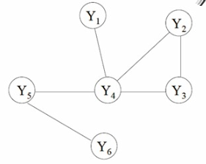
Random Fields: mutual depen-dence in undirected graphs
Let G(V,E) be a graph where each vertex Y_{v} is a random variable. Suppose P(Y_{v}|all other Y) = P(Y_{v}| neighbors(Y_{v}) ), then G is a random field.
Example:
Random fields use global normalization.
P(Y₅|all other Y) = P(Y₅|Y₄,Y₆ )
08.05.19
Language Technology Group – Chris Biemann

Slide 34
Conditional Random Field
Let X be a random variable over sequences of observations to be labeled. Let Y be a random variable over corresponding label sequences.
Let G=(V,E) be a graph such that Y=(Y_{v}), v∈V , so that Y is indexed by the vertices of G. Then (X,Y) is a conditional random field in case, when conditioned on X, the random variables Y_{v} obey the Markov property with respect to the graph: Y_{v} are only dependent on their neighbors in the graph and the corresponding X.
08.05.19
Language Technology Group – Chris Biemann

Slide 35
Properties of CRF
Idea: Allow some transitions to vote more strongly than others, depending on the observations
CRF solves the label bias problem by normalizing over the whole observation sequence
like MEMM, it is a discriminative exponential model
the marginal probability of the observation sequence is not modeled.
it is straightforward to implement features on the observation sequence, this includes modeling of dependencies on previous and future observations
08.05.19
Language Technology Group – Chris Biemann

Slide 36
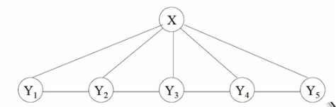
Linear Chain CRF
linear chain CRF
Simplest form of CRF: every hidden state has two neighbors
Markov property in linear chain CRFs: use a variant of Viterbi decoding for computing the optimal label sequence, conditioned on the observed features. This makes efficient decoding possible
Linear chain CRF subsumes HMM but is more expressive, since it allows arbitrary dependencies on the observation sequence
|_{S} is the operator that returns the set of components associated with S.
f and g are Boolean feature functions, λ and μ are model parameters playing a similar role as p(l^{t}|l^{t-1}) and p(w^{t}|l^{t}) in the HMM.
08.05.19
Language Technology Group – Chris Biemann

Slide 37
Graphical Representations: HMM, MEMM and CRF
l¹
l²
l³
l^{T}
HMM:
previous tag labels generate next tag label
tag label generates word
CMM/MEMM
next tag label is dependent on previous tag labels and current observation
observation: features on words
linear chain CRF
mutual dependence between labels and observations
observation: features on words
…
w¹
w²
w³
w¹
l¹
l²
l³
l^{T}
…
o¹
o²
o³
o^{T}
l¹
l²
l³
l^{T}
…
o¹
o²
o³
o^{T}
variable generated by model
observation

Slide 38
Training CRFs is hard and slow
Mutual dependence between label random variables does not allow simple counting in MLE style
Baum-Welch (as in HMMs) did not take features on observations into account and is not defined for undirected relations
Several methods for training CRFs:
iterative scaling (slow)
gradient descent (accelerated)
Conjugate Gradient method
Limited Memory Quasi-Newton Methods
08.05.19
Language Technology Group – Chris Biemann

Slide 39
Evaluating the CRF with artificial data: the label bias problem
Training data: Output of simple HMM. Each state generates its designated symbol with probability 29/32 and three other symbols with prob. 1/32 each
Experiment: Train MEMM and CRF with the same topologies and reconstruct generating state sequence
A run consists of 2’000 training examples and 500 test examples, trained to convergence using iterative scaling
CRF error: 4.6%, MEMM error: 42%
➔ MEMM fails to discriminate between branches, CRF solves label bias problem
08.05.19
Language Technology Group – Chris Biemann

Slide 40
Evaluation on POS tagging
First order models (bigrams), 45-tagset Penn Treebank, 50% train/test
With no additional features, HMM and CRF are about equal, and much better than MEMM
Using additional features, CRF is much better than MEMM.
08.05.19
Language Technology Group – Chris Biemann

Slide 42
No Limited Horizon Assumption
Reason for limited horizon: efficiency! Need a reasonably small number of discrete states for quadratic runtime of Viterbi.
Dropping this assumption requires:
Keeping the representation of states small: A binary activation layer of N neurons can represent 2^{N} discrete states, continuous activations even more
Recurrent units: State is stored in a context history, which can retain traces of the entire input
08.05.19
Language Technology Group – Chris Biemann

Slide 43
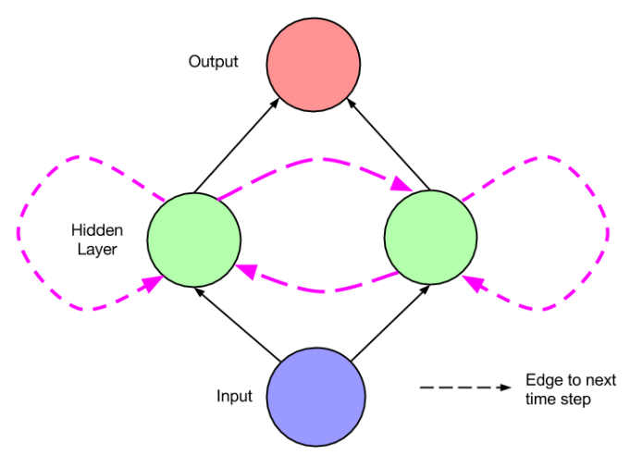
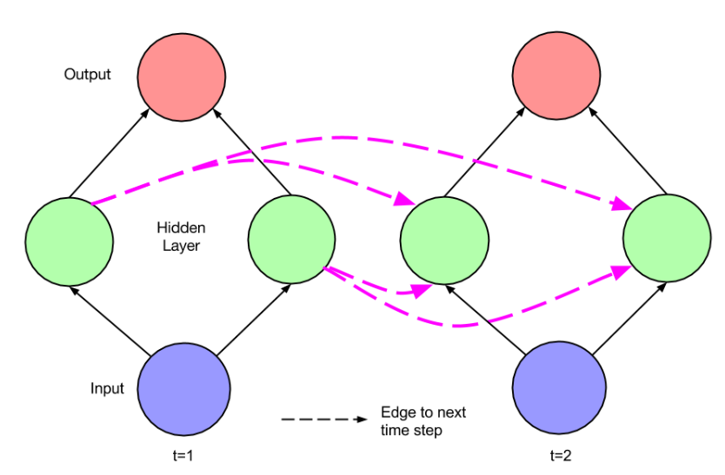
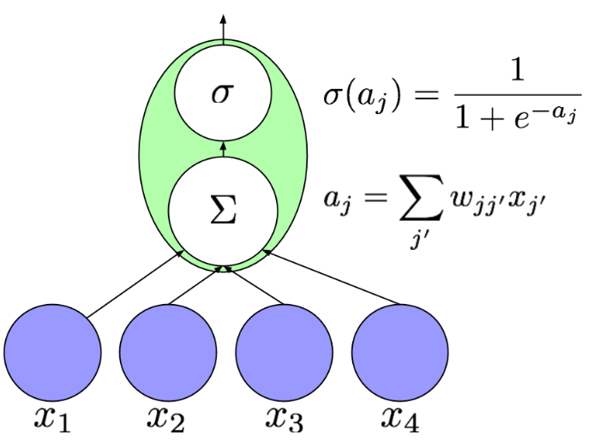
Recurrent Neural networks
Artificial neuron
Simple recurrent network with 2 hidden units
Same recurrent network unfolded over time
Recurrent connections: input at time step comes from activation at time step (t-1)
Recurrent connections introduce notion of sequence into the network
Unfolding: Can view recurrent network like a deep network, can apply gradient-based training
08.05.19
Language Technology Group – Chris Biemann

Slide 44
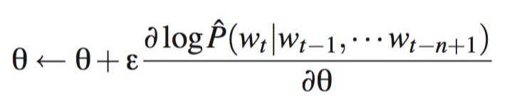
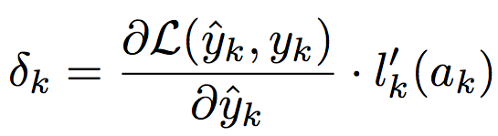
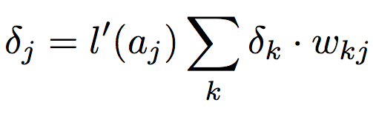
Gradient-Based Training:
Backpropagation
Remember stochastic gradient-based training from neural LM:
Backpropagation:
Propagate new training example through the network to get activations v_{i} at each node and an output value y at the topmost layer.
Compute update towards output node using loss function
Propagate loss/error through the network layers
Change weights according to learning rate
With minor adaption, can use backpropagation for training recurrent networks
^
08.05.19
Language Technology Group – Chris Biemann

Slide 45
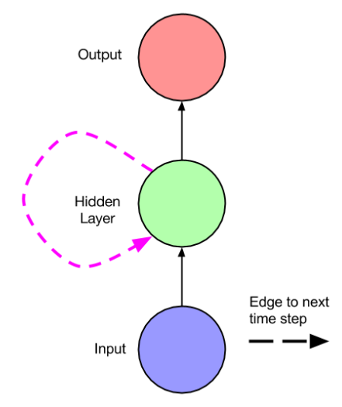
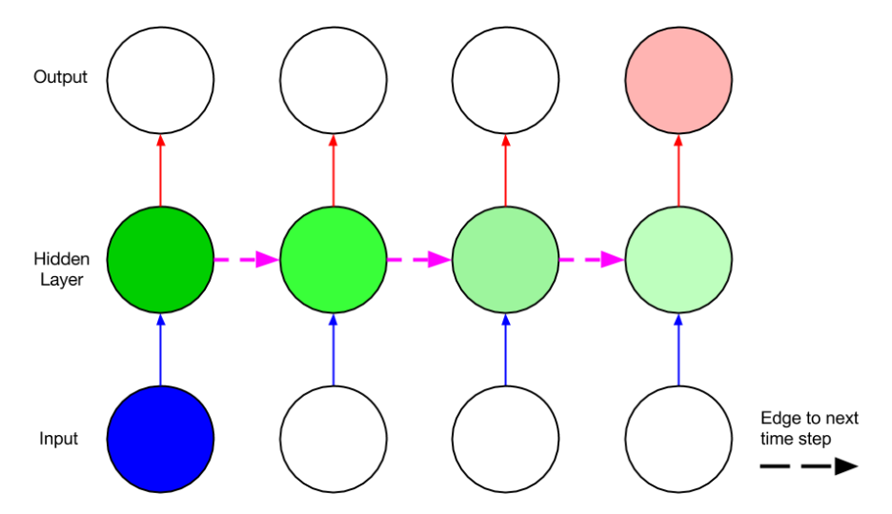
Vanishing / Exploding Gradients
Simple recurrent network
Unfolded network, visualizing the vanishing gradient
Gradients vanish (explode) exponentially across time steps when the recurrent connection is <1 (>1)
Problem is connected to the fact that it is always THE SAME connection weight
Alex Graves. Supervised sequence labelling with recurrent neural networks, Volume 385. Springer, 2012.
08.05.19
Language Technology Group – Chris Biemann

Slide 46
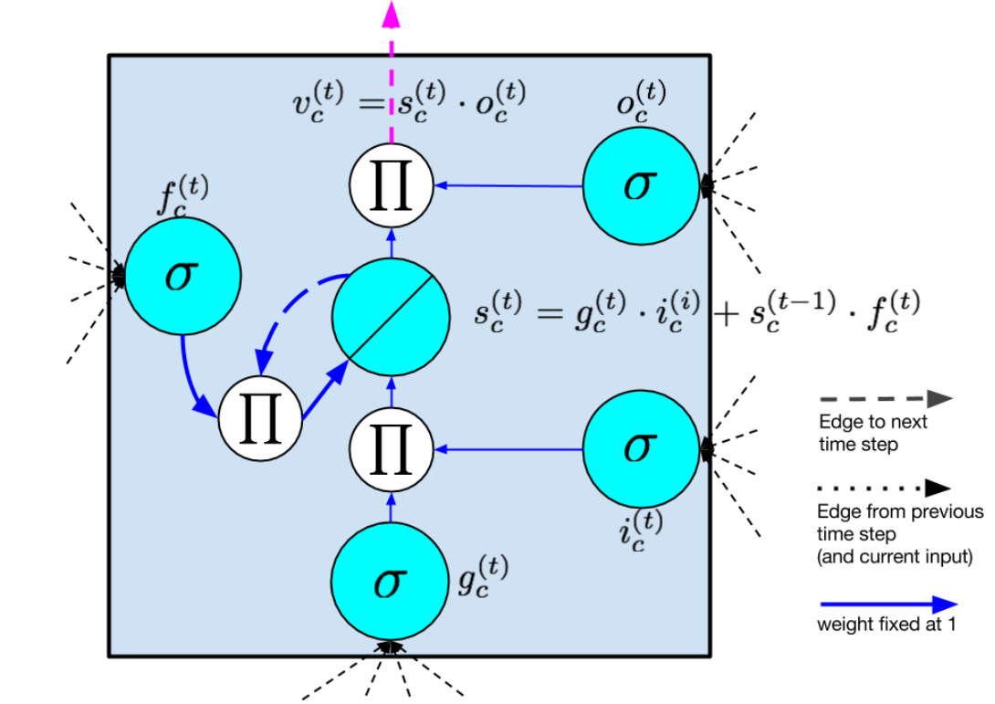
Long Short-Term Memory (LSTM)
LSTM resembles a standard recurrent neural network with a hidden layer
Nodes in the hidden layer are replaced by a memory cell
Memory cells contain a node with a self-connected recurrent edge of fixed weight 1 (no gradient issues)
vs.
Sepp Hochreiter and Jürgen Schmidhuber. Long short-term memory. Neural Computation, 9(8):1735–1780, 1997.
08.05.19
Language Technology Group – Chris Biemann

Slide 47
Memory Cell in LSTM
inputs: from sequence and from other memory cells
input gate: regulates whether to take input into account
output gate: regulates whether to output the internal state
forget gate: can flush internal state
recurrent link with weight 1: “constant error carousel”.
output
forget gate
output gate
input gate
inputs
internal state
08.05.19
Language Technology Group – Chris Biemann

Slide 48
LSTM Intuitions
“long short-term memory”: standard NNs have
long-term memory in the weights
short-term memory in the activations
LSTM mixes both notions
Gate: pointwise multiplication regulates how much is passed through, based on inputs
Internal state serves as a memory
Recurrent connection of weight 1: error can flow across time steps without vanishing or exploding
LSTM can learn:
when to let the input (and error) in e.g. set the new grammatical subject
when to let the output (and error) out e.g. predict verb that takes the subject
when to reset its memory e.g. remove old subject once its taken
08.05.19
Language Technology Group – Chris Biemann

Slide 49
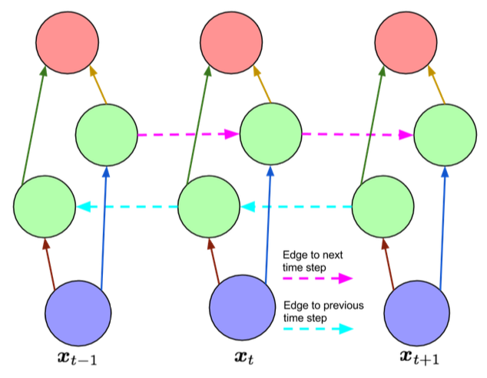
Bidirectional LSTMs
Idea: if we are tagging whole sentences, we can use context representations from the ‘past’ and from the ‘future’ to predict the ‘current’ label
Not applicable in an online incremental setting.
LSTM cells and bidirectional networks can be combined into Bi-LSTMs
Bidirectional recurrent network, unfolded in time
08.05.19
Language Technology Group – Chris Biemann

Slide 50
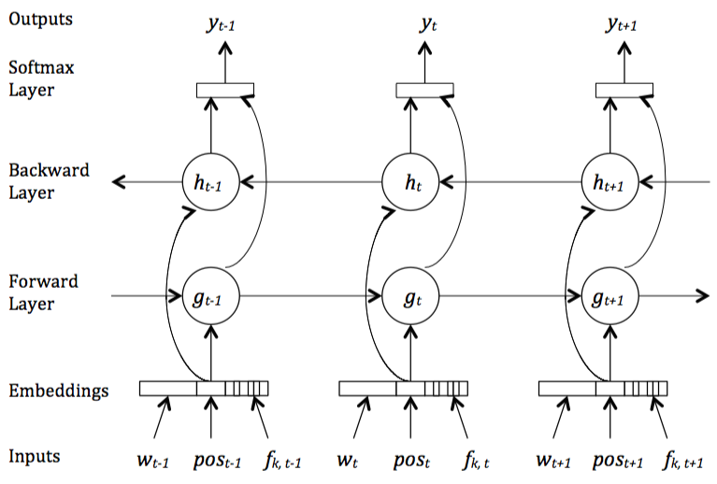
Bi-LSTM for Sequence Tagging
Input: Word embeddings, additional word features
Combine two directions: usually concatenation
Output: 1-hot-encoding over labels (softmax)
Fig. from: Zayats, V., Ostendorf, M., Hajishirzi, H. (2016): Disfluency Detection using a Bidirectional LSTM. Proceedings of Interspeech 2016
Note:
State size: there are many ‘parallel’ LSTM cells in each layer
LSTM layers can be stacked for deeper networks
08.05.19
Language Technology Group – Chris Biemann

Slide 51
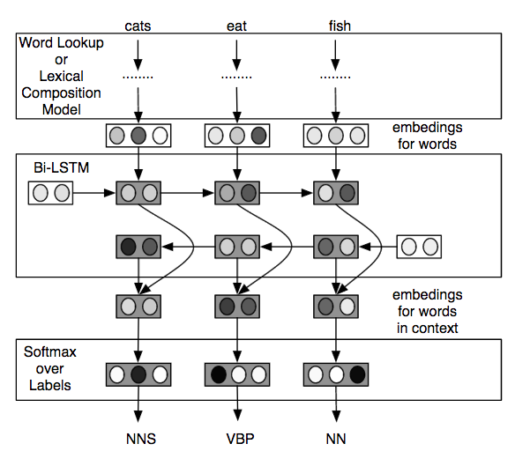
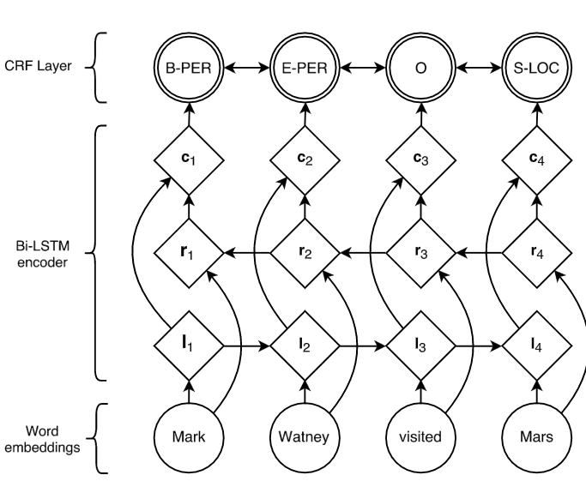
Bi-LSTM for POS Tagging - Variants
Compose words from character embeddings to address unseen words
Use combined outputs as features in CRF layer, better making use of neighboring labels
Ling, W., Dyer, C., Black, A.W., Trancoso, I., Fermandez, R., Amir, S., Marujo, L. and Luis, T. (2015): Finding Function in Form: Compositional Character Models for Open Vocabulary Word Representation, Proceedings of EMNLP, pp. 1520-1530, Lisbon, Portugal.
Lample, G., Ballesteros, M., Subramanian, S., Kawakami, K. and Dyer, C. (2016): Neural Architectures for Named Entity Recognition. Proceedings of NAACL, San Diego, CA, USA.

Slide 52
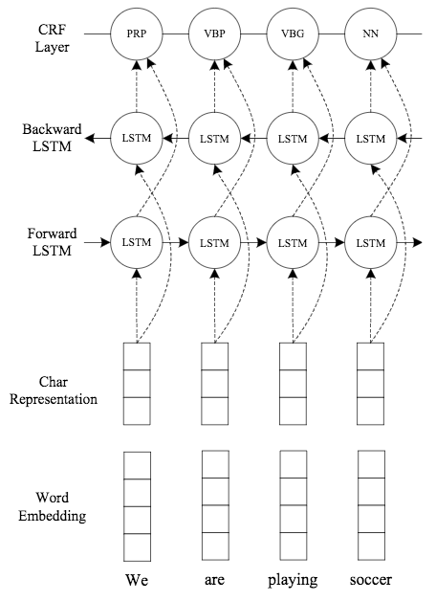
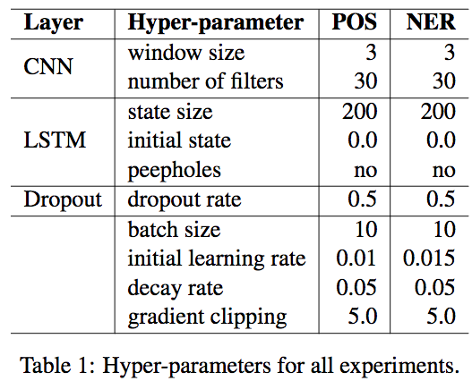
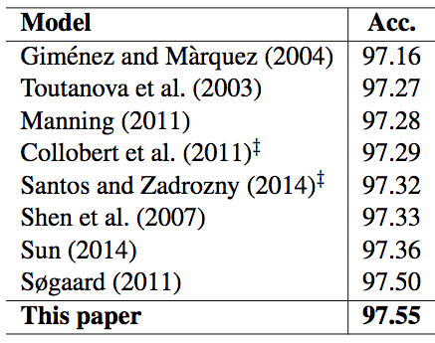
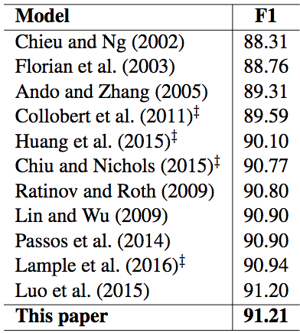
2016 State of the Art in POS tagging and NAMED ENTITY RECOGNITION
Further parameters:
which kind of word embeddings
early stopping after 50 epochs
One of the first papers that has state-of-the-art performance with end-to-end approach on standard text processing
Ma, X. and Hovy, E. (2016): End-to-end Sequence Labeling via Bi-directional LSTM-CNNs-CRF. Proceedings of ACL 2016, pp. 1064-1074, Berlin, Germany
08.05.19
Language Technology Group – Chris Biemann

Slide 53
Summary on Statistical Sequence Tagging
HMM is the classic generative model used for sequence tagging
tag labels are modeled as hidden states
hidden states are observable for labeled training text
when applying to unlabeled text, max path through hidden state sequence is the tag sequence
CMMs are an alternative that make it easier to incorporate arbitrary features on the observations
discriminative model: can use any classifier, e.g. MaxEnt, SVM, NN etc.
per-state normalization leads to the label bias problem
CRF subsumes the advantages of HMM and CMM:
per sequence normalization: no label bias problem
discriminative: arbitrary features possible
training is slow
Bi-LSTM is a recent neural approach
Less feature engineering: induce features and representations
Operates on continuous word representations
hyperparameter tuning very costly, makes training even slower
➔ CRFs are the framework of choice for modern sequence taggers, rivaled by Bi-LSTMs. Combination of handcrafted features with neural approaches still brings best performance.
08.05.19
Language Technology Group – Chris Biemann

Slide 54
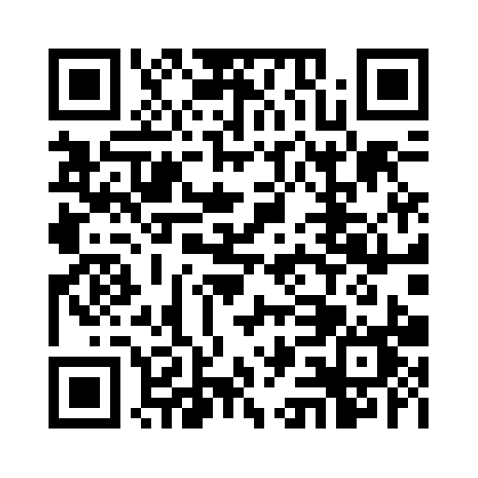
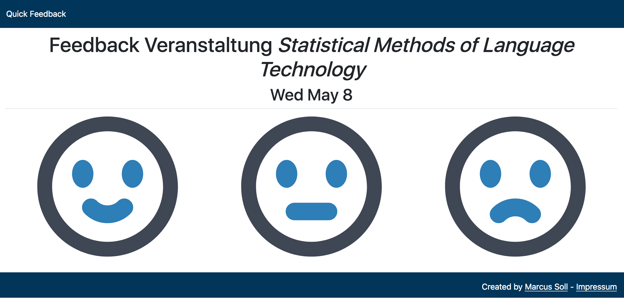
Immediate Feedback
s

Slide 55
SYNTAX PROCESSING
coming up next
Chunking, Syntax trees, Parsing, PCFGs
08.05.19
Language Technology Group – Chris Biemann

