Slide 1
Syntax Processing
Jurafsky, D. and Martin, J. H. (2009): Speech and Language Processing. An Introduction to Natural Language Processing, Computational Linguistics and Speech Recognition. Second Edition. Pearson: New Jersey: Chapter 13
Chunking, Syntax trees, Context-Free Grammar parsing
14.05.19
Language Technology Group – Chris Biemann

Slide 2
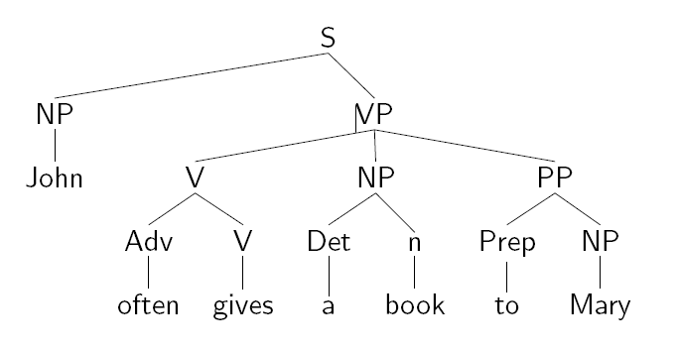
Syntax, Grammars, Parsing
Syntax captures structural relationships between words and phrases, i.e. describes the constituent structure of NL expressions
Constituents: Noun Phrase, Verb Phrase, Determiners....
Grammars are used to describe the syntax of a language, cf. Context Free Grammars in Lecture 1
Syntactic analyzers assign a syntactic structure to a string on the basis of a grammar
A syntactic analyzer is also called a parser
14.05.19
Language Technology Group – Chris Biemann

Slide 3
Motivation for syntax processing
Natural language is more than trigrams
For ‘understanding’ language better, we want to be able to recognize syntactic structures
These are again just another layer of processing
For now: we ignore meaning and simply look at syntax. I.e. “colorless green ideas sleep furiously” is syntactically correct
What level of syntactic processing is ‘right’? Depends on the goal.
Chunking / partial parsing: only continuous chunks
dependency parsing
phrase structure grammars
constituency
attribute value grammars
14.05.19
Language Technology Group – Chris Biemann

Slide 4
Chunking (partial parsing)
[I begin] [with an intuition]: [when I read] [a sentence], [I read it] [a chunk] [at a time] (Example from S. Abney, Parsing by Chunks)
chunks correspond to prosodic patterns – where to put the breaks when reading the sentence aloud
chunks are typically subsequences of grammatical constituents: noun groups and verb groups
chunks are non-overlapping, non-nested regions of text
chunking is a kind of higher level label segmentation
Usually, chunks contain a head, with the possible addition of modifiers and function words [quickly walk ] [straight past ] [the lake ]
Most interesting for applicatons: NP chunks
14.05.19
Language Technology Group – Chris Biemann

Slide 5
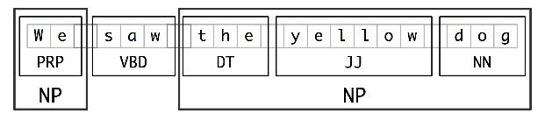
Chunking viewed as segmentation
Segmentation and labeling of multi-token sequences
Smaller boxes: word-level segmentation and labeling
Large boxes: higher-level segmentation and labeling
14.05.19
Language Technology Group – Chris Biemann

Slide 6
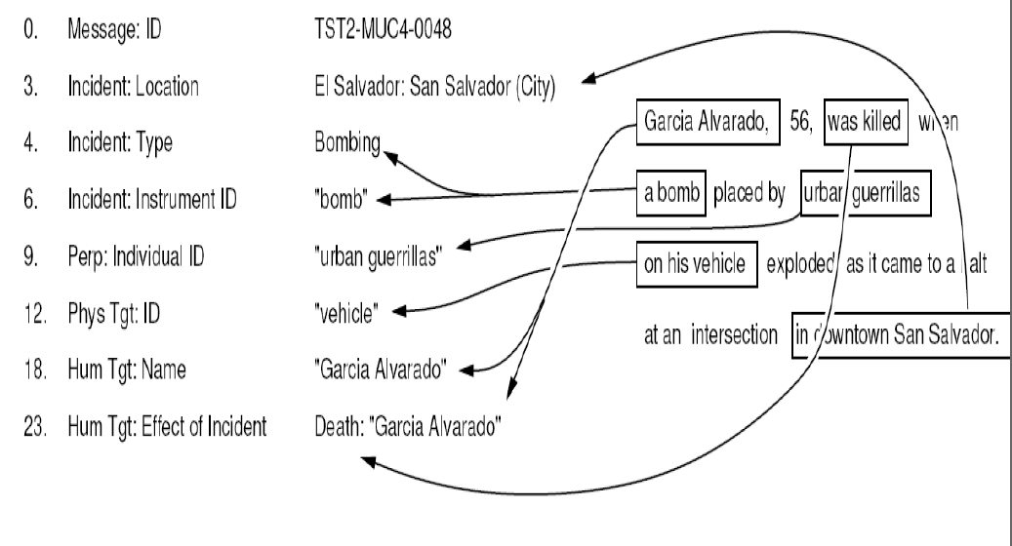
Applications of Chunking
Information Extraction
Question Answering
Extracting subcat frames
providing additional features for ML methods
14.05.19
Language Technology Group – Chris Biemann

Slide 7
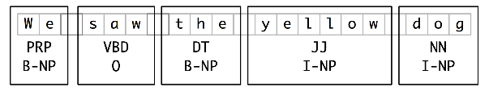
Representing Chunks: IOB tags
Each token is tagged with one of three special chunk tags : I (inside), O (outside), B (begin)
This format permits to represent more than one chunk type, so long as the chunks do not overlap.
A token is tagged as B if it marks the beginning of a chunk.
Subsequent tokens within the chunk are tagged I.
All other tokens are tagged O.
The B and I tags are suffixed with the chunk type, e.g. B-NP, I-NP.
Is not necessary to specify a chunk type for tokens that appear outside a chunk, so these are just labeled O
14.05.19
Language Technology Group – Chris Biemann

Slide 8
Chunking with regular expressions
Assume input is POS-tagged. announce any new policy measures in his ...
VB DT JJ NN NNS IN PRP$
Identify chunks by sequences of tags
announce any new policy measures in his ...
VB DT JJ NN NNS IN PRP$
Define rules in terms of tag patterns
NP: {<DT><JJ><NN><NNS>}
….
14.05.19
Language Technology Group – Chris Biemann

Slide 9
Rule ordering
If a tag pattern matches at multiple overlapping locations, the first match takes precedence.
For example, if we apply a rule that matches two consecutive nouns to a text containing three consecutive nouns, then the first two nouns will be chunked
NP: {<NN><NN>}
money market fund ➔ [money market] fund
NN NN NN
Once we have created the chunk for money market, we have removed the context that would have permitted fund to be included in a chunk.
➔ order of rules is crucial. This is a general problem with rule-based systems
14.05.19
Language Technology Group – Chris Biemann

Slide 10
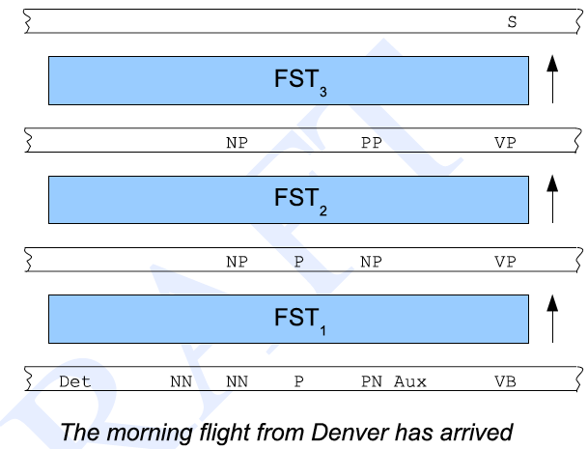
Cascaded transducers
Advantage:
fast processing!
Disadvantage
hard to define the FSTs in the right order
maintenance and transferring of projects is time-consuming
14.05.19
Language Technology Group – Chris Biemann

Slide 11
Development of rule-based systems
Development cycle: several iterations of creating/ changing rules and testing
Tracing: infrastructure to mark, which rule was applied for particular chunks. This helps to identify problematic rules
Hard to incorporate arbitrary features, need formalism to avoid inconsistencies
The more rules already exist in the system, the harder it is to grasp their complex interactions
It is much more straightforward to use machine learning for sequence labeling. Of course, this requires a labeled training corpus.
14.05.19
Language Technology Group – Chris Biemann

Slide 12
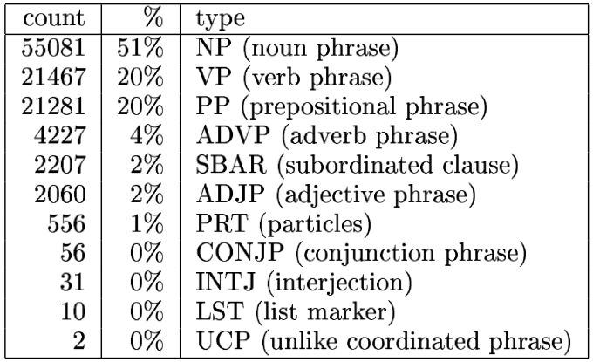
Sequence Labeling for Chunking
CoNLL-2000: Competition between systems to create the best chunker
“Shared Task” setup:
training and validation data is public
test data is only known to the organizers
official evaluation, then test data is made public
Data Format:
Trust NN B-NP
in IN B-PP
the DT B-NP
pound NN I-NP
is VBZ B-VP
widely RB I-VP
expected VBN I-VP
to TO I-VP
take VB I-VP
another DT B-NP
sharp JJ I-NP
dive NN I-NP

Slide 13
Evaluation of Chunking
With IOB-representation, we can look at
single label accuracy: Per I/O/B label
chunk precision: is an identified chunk correct?
chunk recall: how many of all chunks did the system find correctly?
IR-inspired measures:
 |  | Test Data
 |  | chunk | not chunk
System response | chunk | tp (true positive) | fp (false positive)
 | not chunk | fn (false negative) | tn (true negative)
14.05.19
Language Technology Group – Chris Biemann

Slide 14
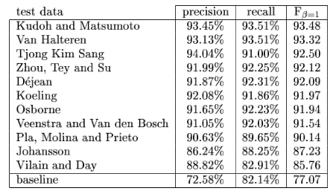
Results of CoNLL-2000 Chunking Evaluation
Baseline: Most frequent label per POS tag
Best systems now use Bi-LSTM or Bi-GRUs
14.05.19
Language Technology Group – Chris Biemann

Slide 15
Syntactic Parsing with CFGs
Recap: A grammar G = (Φ,Σ,R,S) is context-free, iff all production rules in R obey the form A→α with A∈Φ, α ∈ (Φ∪Σ)*.
Grammar Rules Lexicon
S → NP VP
S → Aux NP VP
S → VP
NP → Pronoun
NP → Proper-Noun
NP → Det Nominal
Nominal → Noun
Nominal → Nominal Noun
Nominal → Nominal PP
VP → Verb
VP → Verb NP
VP → VP PP
PP → Prep NP
Det → the | a | that | this
Noun → book | flight | meal | money
Verb → book | include | prefer
Pronoun → I | he | she | me
Proper-Noun → Houston | NWA
Aux → does
Prep → from | to | on | near | through
14.05.19
Language Technology Group – Chris Biemann

Slide 16
Sentence Generation
S → NP VP | Aux NP VP | VP
NP → Pronoun | Proper-Noun | Det Nominal
Nominal → Noun | Nominal Noun | Nominal PP
VP → Verb | Verb NP | VP PP
PP → Prep NP
Det → the | a | that | this
Noun → book | flight | meal | money
Verb → book | include | prefer
Sentences are generated by recursively rewriting the start symbol using the productions until only terminal symbols remain
S
Derivation
or
Parse Tree
VP
Verb NP
book
Det Nominal
the
Nominal PP
Noun
Prep NP
flight
through
Proper-Noun
Houston
14.05.19
Language Technology Group – Chris Biemann

Slide 17
Why can’t we use FSAs?
Language is left/right recursive:
{tall, green, slimy, calm, …}* frog
the house {with a roof, with a door, with a window, with a garden, …}*
Can process these recursions with FSAs: ADJ* NN , NN (P DET NN)*
But language has also center-embedded recursions:
the door opens
the door that uncle Henry repaired opens
the door that uncle Henry who the dog bit repaired opens
the door that uncle Henry who the dog that John owns bit repaired opens
…
(this is even more fun in German)
Center-embedding recursion is not regular, need tree structure!
Karlsson, Fred. (2007). Constraints on multiple center-embedding of clauses. Journal of Linguistics 43 (2): 365-392.
14.05.19
Language Technology Group – Chris Biemann
Notes:
Er hat den Termin, der für die Konferenz, die er besuche wollte, festgesetzt war, gekannt.

Slide 18
Parsing: bottom up vs. top-down
S → NP VP | Aux NP VP | VP
NP → Pronoun | Proper-Noun | Det Nominal
Nominal → Noun | Nominal Noun | Nominal PP
VP → Verb | Verb NP | VP PP
PP → Prep NP
Det → the | a | that | this
Noun → book | flight | meal | money
Verb → book | include | prefer
Aux→ does
Given a string of terminals and a CFG, determine if the string can be generated by the CFG.
Also return a parse tree for the string
Also return all possible parse trees for the string
Must search space of derivations for one that derives the given string.
Top-Down Parsing: Start searching space of derivations for the start symbol.
Bottom-up Parsing: Start search space of reverse derivations from the terminal symbols in the string
S
VP
Verb NP
book
Det Nominal
book that flight
that
Noun
flight
Example by Ray Mooney, UT at Austin
14.05.19
Language Technology Group – Chris Biemann

Slide 19
Top Down Parsing: book that flight
S → NP VP | Aux NP VP | VP
NP → Pronoun | Proper-Noun | Det Nominal
Nominal → Noun | Nominal Noun | Nominal PP
VP → Verb | Verb NP | VP PP
PP → Prep NP
Det → the | a | that | this
Noun → book | flight | meal | money
Verb → book | include | prefer
Aux→ does
S
S
S
S
NP VP
NP VP
NP VP
Aux NP VP
Pronoun
ProperNoun
Det Nominal
S
S
S
S
Aux NP VP
X
S
NP VP
NP VP
NP VP
book
S
S
VP
Pronoun
ProperNoun
Det Nominal
X
X
X
Verb
VP
VP
book
book
book
Verb
book
14.05.19
Language Technology Group – Chris Biemann

Slide 20
Top Down Parsing: book that flight
S → NP VP | Aux NP VP | VP
NP → Pronoun | Proper-Noun | Det Nominal
Nominal → Noun | Nominal Noun | Nominal PP
VP → Verb | Verb NP | VP PP
PP → Prep NP
Det → the | a | that | this
Noun → book | flight | meal | money
Verb → book | include | prefer
Aux→ does
S
S
S
S
VP
VP
VP
VP
Verb
Verb NP
Verb NP
X
Verb NP
book
that
book
S
book
Pronoun
S
X
book
ProperNoun
VP
VP
X
S
that
that
VP
Verb NP
Verb NP
Verb NP
book
Pronoun
book
ProperNoun
14.05.19
Language Technology Group – Chris Biemann

Slide 21
Top Down Parsing: book that flight
S → NP VP | Aux NP VP | VP
NP → Pronoun | Proper-Noun | Det Nominal
Nominal → Noun | Nominal Noun | Nominal PP
VP → Verb | Verb NP | VP PP
PP → Prep NP
Det → the | a | that | this
Noun → book | flight | meal | money
Verb → book | include | prefer
Aux→ does
S
S
S
VP
VP
Verb NP
VP
Verb NP
book
Det Nominal
book
Det Nominal
Verb NP
S
that
Noun
book
Det Nominal
VP
Verb NP
that
Noun
book
Det Nominal
flight
that
14.05.19
Language Technology Group – Chris Biemann

Slide 22
Bottom up Parsing: book that flight
S → NP VP | Aux NP VP | VP
NP → Pronoun | Proper-Noun | Det Nominal
Nominal → Noun | Nominal Noun | Nominal PP
VP → Verb | Verb NP | VP PP
PP → Prep NP
Det → the | a | that | this
Noun → book | flight | meal | money
Verb → book | include | prefer
Aux→ does
Nominal
book that flight
Nominal Noun
Noun
Noun
book that flight
book that flight
Nominal
Nominal
Nominal Noun
X
Noun
Noun
book that flight
14.05.19
Language Technology Group – Chris Biemann
book that flight

Slide 23
Bottom up Parsing: book that flight
S → NP VP | Aux NP VP | VP
NP → Pronoun | Proper-Noun | Det Nominal
Nominal → Noun | Nominal Noun | Nominal PP
VP → Verb | Verb NP | VP PP
PP → Prep NP
Det → the | a | that | this
Noun → book | flight | meal | money
Verb → book | include | prefer
Aux→ does
Nominal
Nominal PP
Nominal
Noun
S
Nominal PP
book that flight
NP
VP
Nominal
Noun
Nominal
X
Det
Nominal PP
book that
Noun
flight
Noun
Det
book that flight
14.05.19
Language Technology Group – Chris Biemann

Slide 24
Bottom up Parsing: book that flight
S → NP VP | Aux NP VP | VP
NP → Pronoun | Proper-Noun | Det Nominal
Nominal → Noun | Nominal Noun | Nominal PP
VP → Verb | Verb NP | VP PP
PP → Prep NP
Det → the | a | that | this
Noun → book | flight | meal | money
Verb → book | include | prefer
Aux→ does
Nominal
S
Nominal PP
X
X
VP
NP
NP
Noun
Det
Nominal
Verb
Det
Nominal
book that
Noun
book that
Noun
VP
S
flight
flight
VP
VP
PP
NP
X
NP
Verb
Det
Nominal
Verb
Det
Nominal
book that
Noun
book that
Noun
flight
flight
14.05.19
Language Technology Group – Chris Biemann

Slide 25
Bottom up Parsing: book that flight
S → NP VP | Aux NP VP | VP
NP → Pronoun | Proper-Noun | Det Nominal
Nominal → Noun | Nominal Noun | Nominal PP
VP → Verb | Verb NP | VP PP
PP → Prep NP
Det → the | a | that | this
Noun → book | flight | meal | money
Verb → book | include | prefer
Aux→ does
VP
NP
S
NP
S
Verb
Det
Nominal
VP
book that
VP
Noun
NP
NP
flight
Verb
Verb
Nominal
Det
Nominal
Det
book that
book that
Noun
Noun
flight
flight
14.05.19
Language Technology Group – Chris Biemann

Slide 26
Top Down vs. Bottom Up
Top down never explores options that will not lead to a full parse, but can explore many options that never connect to the actual sentence.
Bottom up never explores options that do not connect to the actual sentence but can explore options that can never lead to a full parse.
Relative amounts of wasted search depend on how much the grammar branches in each direction.
Complexity of naïve implementation: Exponential due to branching
14.05.19
Language Technology Group – Chris Biemann

Slide 27
Dynamic Programming Parsing
To avoid extensive repeated work, must cache intermediate results, i.e. completed sub-phrases.
Caching (memorizing) critical to obtaining a polynomial time parsing (recognition) algorithm for CFGs.
Dynamic programming algorithms based on both top-down and bottom-up search can achieve O(n³) recognition time where n is the length of the input string.
NB: Parsing methods for CFGs are similar for programming languages and natural language
14.05.19
Language Technology Group – Chris Biemann

Slide 28
Dynamic Programming Parsing Methods
CYK (Cocke-Younger-Kasami, 1967) algorithm based on bottom-up parsing and requires first normalizing the grammar.
Earley (1970) parser is based on top-down parsing, does not require normalizing the grammar, but is more complex.
More generally, chart parsers retain completed phrases in a chart and can combine top-down and bottom-up search.
Complexity of O(n³) can further be improved for certain grammars, i.e. unambiguous grammars – however, not for interesting grammars of natural language
14.05.19
Language Technology Group – Chris Biemann

Slide 29
Earley Parsing
Dynamic Programming solution for top-down parsing
Allows arbitrary CFGs
Fills a table in a single sweep over the input words
Table is length N+1; N is number of words
States (table entries) represent:
Completed constituents and their locations
In-progress constituents
Predicted constituents
14.05.19
Language Technology Group – Chris Biemann

Slide 30
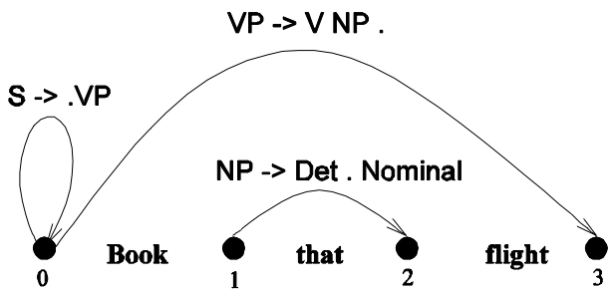
States and Locations
The table entries are called states and are represented with dotted rules:
S -> • VP A VP is predicted
NP -> Det • Nominal An NP is in progress
VP -> V NP • A VP has been found
With offsets:
S -> • VP [0,0] A VP is predicted at the start of the sentence
NP -> Det • Nominal [1,2] An NP is in progress; the Det goes from 1 to 2
VP -> V NP • [0,3] A VP has been found starting at 0 and ending at 3
14.05.19
Language Technology Group – Chris Biemann

Slide 31
Earley Parsing
Successful parse: S state in the final column that spans from 0 to n and is complete: S –> α • [0,n]
Sweep through the table from 0 to n:
New predicted states are created by starting top-down from S
New incomplete states are created by advancing existing states as new constituents are discovered
New complete states are created in the same way.
More specifically:
Predict all the states you can upfront
Read a word
Extend states based on matches
Generate new predictions
repeat until the end of the sentence
Look at n to see if you have a winner
14.05.19
Language Technology Group – Chris Biemann

Slide 32
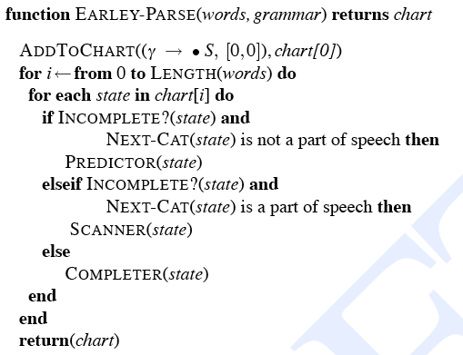
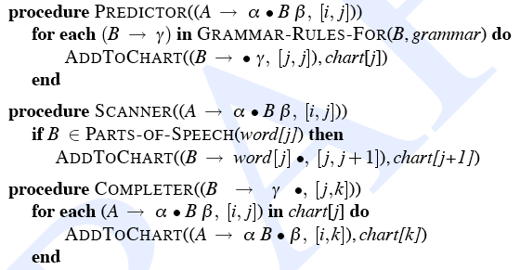
Earley Algorithm
14.05.19
Language Technology Group – Chris Biemann

Slide 33
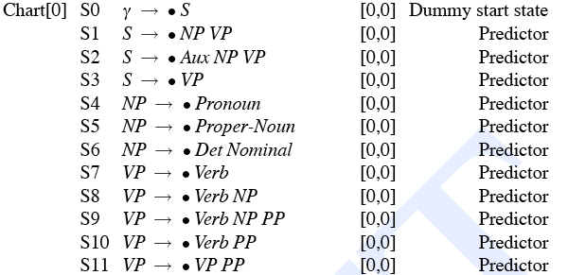
Example: book that flight
14.05.19
Language Technology Group – Chris Biemann

Slide 34
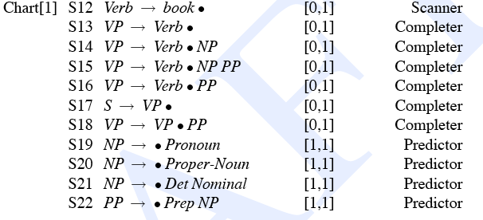
Example: book that flight
14.05.19
Language Technology Group – Chris Biemann

Slide 35
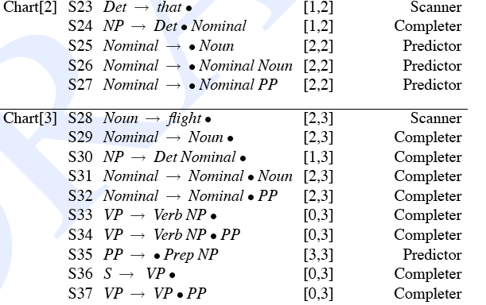
Example: book that flight
14.05.19
Language Technology Group – Chris Biemann

Slide 36
Notes on Earley
Participating states of the final parse:
For such a simple example, there is a lot of ‘useless’ steps
Earley predicts next constituents that are not consistent with the input
Possible to improve the algorithm by look-ahead strategies
14.05.19
Language Technology Group – Chris Biemann

Slide 37
CYK parsing algorithm
First, grammar must be converted to Chomsky normal form (CNF) in which productions must have either exactly 2 non-terminal symbols on the RHS or 1 terminal symbol (lexicon rules).
Parse bottom-up, storing phrases formed from all substrings in a triangular table (chart).
Parse trees are for CNF grammar, not the original grammar.
A post-process can repair the parse tree to return a parse tree for the original grammar.
14.05.19
Language Technology Group – Chris Biemann

Slide 38
Conversion to Chomsky Normal Form
Introduce a new start symbol S₀, add rule S₀→S (S=old start symbol)
Eliminate all ε rules of the form A→ε (A≠S₀): remove rule and split rules containing A on the RHS in all versions, with and without A’s. For rules B→A, replace A with ε if B has not been through this step yet, otherwise eliminate B→A.
Eliminate all unit rules A→B, by adding all B→R_{i} to A→R_{i} where R_{i} is not a unit rule. If R_{i} is a unit rule add all R_{i}→K_{i} to A (A→K_{i}) where K_{i} is not a unit rule. Continue this process for all following unit-rules, until we observe a unit rule we have seen in the cleaning step. Then eliminate A→B.
Clean up remaining rules: For A→R₁, R₂, .. R_{n} (n>2, R_{i} terminals or non-terminals), create a chain {A→R₁ A₁, A₁→R₂ A₂ … A_{n-2} → R_{n-1} R_{n}}. For all R_{i} that are terminals, create a lexicon rule and replace R_{i} with its LHS.
If S₀→C remains, set C as start symbol.
14.05.19
Language Technology Group – Chris Biemann

Slide 39
Example Conversion to CNF
Original grammar Grammar in CNF
S → NP VP
S → Aux NP VP
S → VP
NP → Pronoun
NP → Proper-Noun
NP → Det Nominal
Nominal → Noun
Nominal → Nominal Noun
Nominal → Nominal PP
VP → Verb
VP → Verb NP
VP → VP PP
PP → Prep NP
Det → the | a | that | this
Noun → book | flight | meal | money
Verb → book | include | prefer
Pronoun → I | he | she | me
Proper-Noun → Houston | NWA
Aux → does
Prep → from | to | on | near | through
S → NP VP
S → X1 VP
X1 → Aux NP
S → book | include
S → Verb NP
S → VP PP
NP → I | he | she | me
NP → Houston | NWA
NP → Det Nominal
Nominal → book | flight | meal | money
Nominal → Nominal Noun
Nominal → Nominal PP
VP → book | include | prefer
VP → Verb NP
VP → VP PP
PP → Prep NP
Det → the | a | that | this
Noun → book | flight | meal | money
Verb → book | include | prefer
Pronoun → I | he | she | me
Proper-Noun → Houston | NWA
Aux → does
Prep → from | to | on | near | through
14.05.19
Language Technology Group – Chris Biemann

Slide 40
CYK Parser
Book the flight through Houston
j= 1 2 3 4 5
i=
0
1
2
3
4
Cell[i,j]
contains all
constituents
(non-terminals)
covering words
i +1 through j
14.05.19
Language Technology Group – Chris Biemann

Slide 41
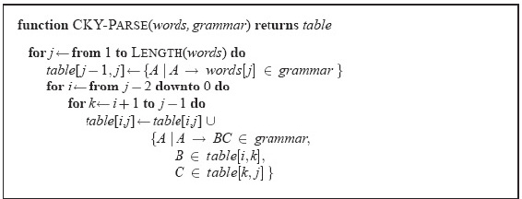
CYK Algorithm
14.05.19
Language Technology Group – Chris Biemann

Slide 42
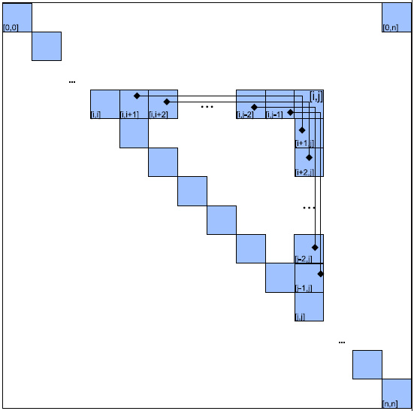
CYK search space
14.05.19
Language Technology Group – Chris Biemann

Slide 43
Chart Parsing (Kay, 1982)
combines (some) advantages of bottom-up and top-down
CYK and Earley are special cases of the more general chart parsing scheme
Both top-down and bottom-up steps are carried out in the order of an agenda, which is updated dynamically.
fundamental rule of chart parsing: when the chart contains two contiguous edges (states) where one provides the constituent for the other, then they should be combined in the next step
Chart parsing does not lower the worst-case complexity but requires lower constants on average by making smart choices about the next step.
14.05.19
Language Technology Group – Chris Biemann

Slide 44
Limits of CFGs for natural language parsing
Ambiguity resolution is not handled: just produces all possible parse trees
Addressing some grammatical constraints requires complex CFGs that do no compactly encode the given regularities.
Some aspects of natural language syntax may not be captured at all by CFGs and require context-sensitivity (productions with more than one symbol on the LHS)
Agreement handling is painful:
Subjects must agree with their verbs on person and number
gender agreement
case agreement
need to split production rules as to account for these effects
Subcategorization: Verbs take only some types of arguments, but not others
E.g. wrong subcategorization: John found. John disappeared the ring.
14.05.19
Language Technology Group – Chris Biemann

Slide 45
Conclusions on parsing with CFGs
Syntax parse trees specify the syntactic structure of a sentence that helps determine its meaning.
John ate the spaghetti with meatballs with chopsticks.
How did John eat the spaghetti? What did John eat?
CFGs can be used to define the grammar of a natural language.
Dynamic programming algorithms allow computing a single parse tree in cubic time or all parse trees in exponential time.
14.05.19
Language Technology Group – Chris Biemann

Slide 46


Immediate Feedback
s

Slide 47
STATISTICAL PARSING
Jurafsky, D. and Martin, J. H. (2009): Speech and Language Processing. An Introduction to Natural Language Processing, Computational Linguistics and Speech Recognition. Second Edition. Pearson: New Jersey: Chapter 14
Manning, C. D. and Schütze, H. (1999): Foundations of Statistical Natural Language Processing. MIT Press: Cambridge, Massachusetts. Chapters 11, 12.
with further examples by Ray Mooney, UT at Austin
coming up next
PCFGs, probabilistic CYK, dependency parsing
14.05.19
Language Technology Group – Chris Biemann

