Slide 1
STATISTICAL PARSING
Jurafsky, D. and Martin, J. H. (2009): Speech and Language Processing. An Introduction to Natural Language Processing, Computational Linguistics and Speech Recognition. Second Edition. Pearson: New Jersey: Chapter 14
Manning, C. D. and Schütze, H. (1999): Foundations of Statistical Natural Language Processing. MIT Press: Cambridge, Massachusetts. Chapters 11, 12.
with further examples by Ray Mooney, UT at Austin
PCFGs, probabilistic CYK, dependency parsing
29.05.19
Language Technology Group – Chris Biemann

Slide 2
Statistical Parsing
Statistical parsing uses a probabilistic model of syntax in order to assign probabilities to each parse tree.
Provides principled approach to resolving syntactic ambiguity.
Allows supervised learning of parsers from tree-banks of parse trees provided by human linguists.
Also allows unsupervised learning of parsers from unannotated text, but the accuracy of such parsers has been limited.
29.05.19
Language Technology Group – Chris Biemann

Slide 3
Probabilistic Context Free Grammar (PCFG)
A probabilistic context free grammar PCFG=(W,N,N₁,R,P) consists of
terminal vocabulary W={w₁,…, w_{V}}
set of non-terminals N={N₁,., N_{n}}
start symbol N₁∈N
set of rules R:{N_{i}→D_{j}}, where D_{j} is a sequence over W∪N
corresponding set of probabilities on rules P such that the sum of probabilities per LHS is 1
A PCFG is a probabilistic version of a CFG where each production has a probability.
Probabilities of all productions rewriting a given non-terminal must add to 1, defining a distribution for each non-terminal.
String generation is now probabilistic where production probabilities are used to non-deterministically select a production for rewriting a given non-terminal.
29.05.19
Language Technology Group – Chris Biemann

Slide 4
Simple PCFG for a subset of English
Grammar Prob. Lexicon
S → NP VP
S → Aux NP VP
S → VP
NP → Pronoun
NP → Proper-Noun
NP → Det Nominal
Nominal → Noun
Nominal → Nominal Noun
Nominal → Nominal PP
VP → Verb
VP → Verb NP
VP → VP PP
PP → Prep NP
0.8
0.1
0.1
0.2
0.2
0.6
0.3
0.2
0.5
0.2
0.5
0.3
1.0
Det → the | a | that | this
0.6 0.2 0.1 0.1
Noun → book | flight | meal | money
0.1 0.5 0.2 0.2
Verb → book | include | prefer
0.5 0.2 0.3
Pronoun → I | he | she | me
0.5 0.1 0.1 0.3
Proper-Noun → Houston | NWA
0.8 0.2
Aux → does
1.0
Prep → from | to | on | near | through
0.25 0.25 0.1 0.2 0.2
+
1.0
+
1.0
+
1.0
+
1.0
29.05.19
Language Technology Group – Chris Biemann

Slide 5
Derivation Probability
Assume productions for each node are chosen independently.
Probability of derivation is the product of the probabilities of its productions.
S
T₁
0.1
P(T₁) = 0.1 x 0.5 x 0.5 x 0.6 x 0.6 x
0.5 x 0.3 x 1.0 x 0.2 x 0.2 x
0.5 x 0.8
= 2.16 E-5
VP
0.5
Verb NP
0.6
0.5
book
Det Nominal
0.5
0.6
the
Nominal PP
1.0
0.3
Noun
Prep NP
0.2
0.5
0.2
flight
through
Proper-Noun
0.8
Houston
29.05.19
Language Technology Group – Chris Biemann

Slide 6
Syntactic Disambiguation
Resolve ambiguity by picking most probable parse tree.
P(T₂) = 0.1 x 0.3 x 0.5 x 0.6 x 0.5 x
0.6 x 0.3 x 1.0 x 0.5 x 0.2 x
0.2 x 0.8
= 1.296 E-5
S
T₂
0.1
VP
0.3
VP
0.5
Verb NP
0.6
0.5
PP
book
Det Nominal
1.0
0.6
0.3
the
Noun
Prep NP
0.2
0.5
0.2
flight
through
Proper-Noun
0.8
Houston
29.05.19
Language Technology Group – Chris Biemann

Slide 7
Sentence Probability
Probability of a sentence is the sum of the probabilities of all of its derivations
P(“book the flight through Houston”) = P(T₁)+P(T₂)=2.16 E-5+1.296 E-5
= 3.456 E-5
S
T₁
S
T₂
0.1
0.1
VP
VP
0.5
0.3
Verb NP
VP
0.5
0.6
0.5
book
Det Nominal
Verb NP
0.6
0.5
0.5
0.6
Nominal PP
book
Det Nominal
PP
the
1.0
0.6
1.0
0.3
0.3
Noun
Prep NP
the
Noun
Prep NP
0.2
0.5
0.2
0.2
0.5
0.2
flight
through
Proper-Noun
flight
through
Proper-Noun
0.8
0.8
Houston
Houston
29.05.19
Language Technology Group – Chris Biemann

Slide 8
Three Tasks for PCFGs
observation likelihood: how do we efficiently compute the probability of a sentence, given a PCFG?
most likely derivation: given a PCFG and a sentence, how do we find the derivation that best explains the sentence?
Given a set of sentences and a space of possible PCFGs, how do we find the PCFG parameters that best explain the observations? This is is called training of the PCFG
Sounds familiar?
29.05.19
Language Technology Group – Chris Biemann

Slide 9
Probabilistic CKY
An analog to the Viterbi algorithm to efficiently determine the most probable derivation (parse tree) for a sentence.
CKY can be modified for PCFG parsing by including in each cell a probability for each non-terminal.
Cell[i,j] must retain the most probable derivation of each constituent (non-terminal) covering words i +1 through j together with its associated probability.
When transforming the grammar to CNF, must set production probabilities to preserve the probability of derivations.
29.05.19
Language Technology Group – Chris Biemann

Slide 10
Probabilistic conversion to CNF
Original Grammar Chomsky Normal Form
S → NP VP
S → Aux NP VP
S → VP
NP → Pronoun
NP → Proper-Noun
NP → Det Nominal
Nominal → Noun
Nominal → Nominal Noun
Nominal → Nominal PP
VP → Verb
VP → Verb NP
VP → VP PP
PP → Prep NP
0.8
0.1
0.1
0.2
0.2
0.6
0.3
0.2
0.5
0.2
0.5
0.3
1.0
S → NP VP
S → X1 VP
X1 → Aux NP
S → book | include | prefer
0.01 0.004 0.006
S → Verb NP
S → VP PP
NP → I | he | she | me
0.1 0.02 0.02 0.06
NP → Houston | NWA
0.16 .04
NP → Det Nominal
Nominal → book | flight | meal | money
0.03 0.15 0.06 0.06
Nominal → Nominal Noun
Nominal → Nominal PP
VP → book | include | prefer
0.1 0.04 0.06
VP → Verb NP
VP → VP PP
PP → Prep NP
0.8
0.1
1.0
0.05
0.03
0.6
0.2
0.5
0.5
0.3
1.0
29.05.19
Language Technology Group – Chris Biemann

Slide 11
Probabilistic CYK Parsing
Book the flight through Houston
S :.01, VP:.1,
Verb:.5
Nominal:.03
Noun:.1
None
NP:.6*.6*.15
=.054
S → NP VP
S → X1 VP
X1 → Aux NP
S → book | include | prefer
0.01 0.004 0.006
S → Verb NP
S → VP PP
NP → I | he | she | me
0.1 0.02 0.02 0.06
NP → Houston | NWA
0.16 .04
NP → Det Nominal
Nominal → book | flight | meal | money
0.03 0.15 0.06 0.06
Nominal → Nominal Noun
Nominal → Nominal PP
VP → book | include | prefer
0.1 0.04 0.06
VP → Verb NP
VP → VP PP
PP → Prep NP
0.8
0.1
1.0
0.05
0.03
0.6
0.2
0.5
0.5
0.3
1.0
Det:.6
Nominal:.15
Noun:.5
Aux → does
1.0
Det → the | a | that | this
0.6 0.2 0.1 0.1
Pronoun → I | he | she | me
0.5 0.1 0.1 0.3
Verb → book | include | prefer
0.5 0.2 0.3
Noun → book | flight | meal | money
0.1 0.5 0.2 0.2
Proper-Noun → Houston | NWA
0.8 0.2
Prep → from | to | on | near | through
0.25 0.25 0.1 0.2 0.2

Slide 12
Probabilistic CYK Parsing
Book the flight through Houston
S :.01, VP:.1,
Verb:.5
Nominal:.03
Noun:.1
VP:.5*.5*.054
=.0135
None
NP:.6*.6*.15
=.054
S → NP VP
S → X1 VP
X1 → Aux NP
S → book | include | prefer
0.01 0.004 0.006
S → Verb NP
S → VP PP
NP → I | he | she | me
0.1 0.02 0.02 0.06
NP → Houston | NWA
0.16 .04
NP → Det Nominal
Nominal → book | flight | meal | money
0.03 0.15 0.06 0.06
Nominal → Nominal Noun
Nominal → Nominal PP
VP → book | include | prefer
0.1 0.04 0.06
VP → Verb NP
VP → VP PP
PP → Prep NP
0.8
0.1
1.0
0.05
0.03
0.6
0.2
0.5
0.5
0.3
1.0
Det:.6
Nominal:.15
Noun:.5
Aux → does
1.0
Det → the | a | that | this
0.6 0.2 0.1 0.1
Pronoun → I | he | she | me
0.5 0.1 0.1 0.3
Verb → book | include | prefer
0.5 0.2 0.3
Noun → book | flight | meal | money
0.1 0.5 0.2 0.2
Proper-Noun → Houston | NWA
0.8 0.2
Prep → from | to | on | near | through
0.25 0.25 0.1 0.2 0.2

Slide 13
Probabilistic CYK Parsing
Book the flight through Houston
S :.01, VP:.1,
Verb:.5
Nominal:.03
Noun:.1
S:.05*.5*.054
=.00135
None
VP:.5*.5*.054
=.0135
NP:.6*.6*.15
=.054
S → NP VP
S → X1 VP
X1 → Aux NP
S → book | include | prefer
0.01 0.004 0.006
S → Verb NP
S → VP PP
NP → I | he | she | me
0.1 0.02 0.02 0.06
NP → Houston | NWA
0.16 .04
NP → Det Nominal
Nominal → book | flight | meal | money
0.03 0.15 0.06 0.06
Nominal → Nominal Noun
Nominal → Nominal PP
VP → book | include | prefer
0.1 0.04 0.06
VP → Verb NP
VP → VP PP
PP → Prep NP
0.8
0.1
1.0
0.05
0.03
0.6
0.2
0.5
0.5
0.3
1.0
Det:.6
Nominal:.15
Noun:.5
Aux → does
1.0
Det → the | a | that | this
0.6 0.2 0.1 0.1
Pronoun → I | he | she | me
0.5 0.1 0.1 0.3
Verb → book | include | prefer
0.5 0.2 0.3
Noun → book | flight | meal | money
0.1 0.5 0.2 0.2
Proper-Noun → Houston | NWA
0.8 0.2
Prep → from | to | on | near | through
0.25 0.25 0.1 0.2 0.2

Slide 14
Probabilistic CYK Parsing
Book the flight through Houston
S :.01, VP:.1,
Verb:.5
Nominal:.03
Noun:.1
S:.05*.5*.054
=.00135
None
VP:.5*.5*.054
=.0135
None
NP:.6*.6*.15
=.054
S → NP VP
S → X1 VP
X1 → Aux NP
S → book | include | prefer
0.01 0.004 0.006
S → Verb NP
S → VP PP
NP → I | he | she | me
0.1 0.02 0.02 0.06
NP → Houston | NWA
0.16 .04
NP → Det Nominal
Nominal → book | flight | meal | money
0.03 0.15 0.06 0.06
Nominal → Nominal Noun
Nominal → Nominal PP
VP → book | include | prefer
0.1 0.04 0.06
VP → Verb NP
VP → VP PP
PP → Prep NP
0.8
0.1
1.0
0.05
0.03
0.6
0.2
0.5
0.5
0.3
1.0
Det:.6
None
Nominal:.15
Noun:.5
None
Aux → does
1.0
Det → the | a | that | this
0.6 0.2 0.1 0.1
Pronoun → I | he | she | me
0.5 0.1 0.1 0.3
Verb → book | include | prefer
0.5 0.2 0.3
Noun → book | flight | meal | money
0.1 0.5 0.2 0.2
Proper-Noun → Houston | NWA
0.8 0.2
Prep → from | to | on | near | through
0.25 0.25 0.1 0.2 0.2
Prep:.2

Slide 15
Probabilistic CYK Parsing
Book the flight through Houston
S :.01, VP:.1,
Verb:.5
Nominal:.03
Noun:.1
S:.05*.5*.054
=.00135
None
VP:.5*.5*.054
=.0135
None
NP:.6*.6*.15
=.054
S → NP VP
S → X1 VP
X1 → Aux NP
S → book | include | prefer
0.01 0.004 0.006
S → Verb NP
S → VP PP
NP → I | he | she | me
0.1 0.02 0.02 0.06
NP → Houston | NWA
0.16 .04
NP → Det Nominal
Nominal → book | flight | meal | money
0.03 0.15 0.06 0.06
Nominal → Nominal Noun
Nominal → Nominal PP
VP → book | include | prefer
0.1 0.04 0.06
VP → Verb NP
VP → VP PP
PP → Prep NP
0.8
0.1
1.0
0.05
0.03
0.6
0.2
0.5
0.5
0.3
1.0
Det:.6
None
Nominal:.15
Noun:.5
None
Aux → does
1.0
Det → the | a | that | this
0.6 0.2 0.1 0.1
Pronoun → I | he | she | me
0.5 0.1 0.1 0.3
Verb → book | include | prefer
0.5 0.2 0.3
Noun → book | flight | meal | money
0.1 0.5 0.2 0.2
Proper-Noun → Houston | NWA
0.8 0.2
Prep → from | to | on | near | through
0.25 0.25 0.1 0.2 0.2
Prep:.2
PP:1.0*.2*.16
=.032
NP:.16
PropNoun:.8

Slide 16
Probabilistic CYK Parsing
Book the flight through Houston
S :.01, VP:.1,
Verb:.5
Nominal:.03
Noun:.1
S:.05*.5*.054
=.00135
None
VP:.5*.5*.054
=.0135
None
NP:.6*.6*.15
=.054
S → NP VP
S → X1 VP
X1 → Aux NP
S → book | include | prefer
0.01 0.004 0.006
S → Verb NP
S → VP PP
NP → I | he | she | me
0.1 0.02 0.02 0.06
NP → Houston | NWA
0.16 .04
NP → Det Nominal
Nominal → book | flight | meal | money
0.03 0.15 0.06 0.06
Nominal → Nominal Noun
Nominal → Nominal PP
VP → book | include | prefer
0.1 0.04 0.06
VP → Verb NP
VP → VP PP
PP → Prep NP
0.8
0.1
1.0
0.05
0.03
0.6
0.2
0.5
0.5
0.3
1.0
Det:.6
None
Nominal:.15
Noun:.5
Nominal:
.5*.15*.032
=.0024
None
Aux → does
1.0
Det → the | a | that | this
0.6 0.2 0.1 0.1
Pronoun → I | he | she | me
0.5 0.1 0.1 0.3
Verb → book | include | prefer
0.5 0.2 0.3
Noun → book | flight | meal | money
0.1 0.5 0.2 0.2
Proper-Noun → Houston | NWA
0.8 0.2
Prep → from | to | on | near | through
0.25 0.25 0.1 0.2 0.2
Prep:.2
PP:1.0*.2*.16
=.032
NP:.16
PropNoun:.8

Slide 17
Probabilistic CYK Parsing
Book the flight through Houston
S :.01, VP:.1,
Verb:.5
Nominal:.03
Noun:.1
S:.05*.5*.054
=.00135
None
VP:.5*.5*.054
=.0135
None
NP:.6*.6*
.0024
=.000864
NP:.6*.6*.15
=.054
S → NP VP
S → X1 VP
X1 → Aux NP
S → book | include | prefer
0.01 0.004 0.006
S → Verb NP
S → VP PP
NP → I | he | she | me
0.1 0.02 0.02 0.06
NP → Houston | NWA
0.16 .04
NP → Det Nominal
Nominal → book | flight | meal | money
0.03 0.15 0.06 0.06
Nominal → Nominal Noun
Nominal → Nominal PP
VP → book | include | prefer
0.1 0.04 0.06
VP → Verb NP
VP → VP PP
PP → Prep NP
0.8
0.1
1.0
0.05
0.03
0.6
0.2
0.5
0.5
0.3
1.0
Det:.6
None
Nominal:.15
Noun:.5
Nominal:
.5*.15*.032
=.0024
None
Aux → does
1.0
Det → the | a | that | this
0.6 0.2 0.1 0.1
Pronoun → I | he | she | me
0.5 0.1 0.1 0.3
Verb → book | include | prefer
0.5 0.2 0.3
Noun → book | flight | meal | money
0.1 0.5 0.2 0.2
Proper-Noun → Houston | NWA
0.8 0.2
Prep → from | to | on | near | through
0.25 0.25 0.1 0.2 0.2
Prep:.2
PP:1.0*.2*.16
=.032
NP:.16
PropNoun:.8

Slide 18
Probabilistic CYK Parsing
Book the flight through Houston
S :.01, VP:.1,
Verb:.5
Nominal:.03
Noun:.1
S:.05*.5*.054
=.00135
S:.05*.5*
.000864
=.0000216
None
VP:.5*.5*.054
=.0135
None
NP:.6*.6*
.0024
=.000864
NP:.6*.6*.15
=.054
S → NP VP
S → X1 VP
X1 → Aux NP
S → book | include | prefer
0.01 0.004 0.006
S → Verb NP
S → VP PP
NP → I | he | she | me
0.1 0.02 0.02 0.06
NP → Houston | NWA
0.16 .04
NP → Det Nominal
Nominal → book | flight | meal | money
0.03 0.15 0.06 0.06
Nominal → Nominal Noun
Nominal → Nominal PP
VP → book | include | prefer
0.1 0.04 0.06
VP → Verb NP
VP → VP PP
PP → Prep NP
0.8
0.1
1.0
0.05
0.03
0.6
0.2
0.5
0.5
0.3
1.0
Det:.6
None
Nominal:.15
Noun:.5
Nominal:
.5*.15*.032
=.0024
None
Aux → does
1.0
Det → the | a | that | this
0.6 0.2 0.1 0.1
Pronoun → I | he | she | me
0.5 0.1 0.1 0.3
Verb → book | include | prefer
0.5 0.2 0.3
Noun → book | flight | meal | money
0.1 0.5 0.2 0.2
Proper-Noun → Houston | NWA
0.8 0.2
Prep → from | to | on | near | through
0.25 0.25 0.1 0.2 0.2
Prep:.2
PP:1.0*.2*.16
=.032
NP:.16
PropNoun:.8

Slide 19
Probabilistic CYK Parsing
Book the flight through Houston
S :.01, VP:.1,
Verb:.5
Nominal:.03
Noun:.1
S:.05*.5*.054
=.00135
S:.03*.0135*
.032
=.00001296
None
VP:.5*.5*.054
=.0135
None
S:.0000216
NP:.6*.6*
.0024
=.000864
NP:.6*.6*.15
=.054
S → NP VP
S → X1 VP
X1 → Aux NP
S → book | include | prefer
0.01 0.004 0.006
S → Verb NP
S → VP PP
NP → I | he | she | me
0.1 0.02 0.02 0.06
NP → Houston | NWA
0.16 .04
NP → Det Nominal
Nominal → book | flight | meal | money
0.03 0.15 0.06 0.06
Nominal → Nominal Noun
Nominal → Nominal PP
VP → book | include | prefer
0.1 0.04 0.06
VP → Verb NP
VP → VP PP
PP → Prep NP
0.8
0.1
1.0
0.05
0.03
0.6
0.2
0.5
0.5
0.3
1.0
Det:.6
None
Nominal:.15
Noun:.5
Nominal:
.5*.15*.032
=.0024
None
Aux → does
1.0
Det → the | a | that | this
0.6 0.2 0.1 0.1
Pronoun → I | he | she | me
0.5 0.1 0.1 0.3
Verb → book | include | prefer
0.5 0.2 0.3
Noun → book | flight | meal | money
0.1 0.5 0.2 0.2
Proper-Noun → Houston | NWA
0.8 0.2
Prep → from | to | on | near | through
0.25 0.25 0.1 0.2 0.2
Prep:.2
PP:1.0*.2*.16
=.032
NP:.16
PropNoun:.8

Slide 20
Probabilistic CYK Parsing
Book the flight through Houston
S :.01, VP:.1,
Verb:.5
Nominal:.03
Noun:.1
S:.05*.5*.054
=.00135
Pick most probable
parse, i.e. take max to
combine probabilities
of multiple derivations
of each constituent in
each cell.
S:.0000216
None
VP:.5*.5*.054
=.0135
None
NP:.6*.6*
.0024
=.000864
NP:.6*.6*.15
=.054
S → NP VP
S → X1 VP
X1 → Aux NP
S → book | include | prefer
0.01 0.004 0.006
S → Verb NP
S → VP PP
NP → I | he | she | me
0.1 0.02 0.02 0.06
NP → Houston | NWA
0.16 .04
NP → Det Nominal
Nominal → book | flight | meal | money
0.03 0.15 0.06 0.06
Nominal → Nominal Noun
Nominal → Nominal PP
VP → book | include | prefer
0.1 0.04 0.06
VP → Verb NP
VP → VP PP
PP → Prep NP
0.8
0.1
1.0
0.05
0.03
0.6
0.2
0.5
0.5
0.3
1.0
Det:.6
None
Nominal:.15
Noun:.5
Nominal:
.5*.15*.032
=.0024
None
Aux → does
1.0
Det → the | a | that | this
0.6 0.2 0.1 0.1
Pronoun → I | he | she | me
0.5 0.1 0.1 0.3
Verb → book | include | prefer
0.5 0.2 0.3
Noun → book | flight | meal | money
0.1 0.5 0.2 0.2
Proper-Noun → Houston | NWA
0.8 0.2
Prep → from | to | on | near | through
0.25 0.25 0.1 0.2 0.2
Prep:.2
PP:1.0*.2*.16
=.032
NP:.16
PropNoun:.8
20

Slide 21
PCFG: Observation likelihood
There is an analog to Forward algorithm for HMMs called the Inside algorithm for efficiently determining how likely a string is to be produced by a PCFG.
Can use a PCFG as a syntax-based language model to choose between alternative sentences for speech recognition or machine translation.
S → NP VP
S → VP
NP → Det A N
NP → NP PP
NP → PropN
A → ε
A → Adj A
PP → Prep NP
VP → V NP
VP → VP PP
0.9
0.1
0.5
0.3
0.2
0.6
0.4
1.0
0.7
0.3
O₁
?
The dog big barked.
?
The big dog barked
O₂
P(O₂ | Grammar) > P(O₁ | Grammar) ?
Grammar
29.05.19
Language Technology Group – Chris Biemann

Slide 22
Inside Algorithm
Book the flight through Houston
S :.01, VP:.1,
Verb:.5
Nominal:.03
Noun:.1
S:.05*.5*.054
=.00135
S:.00001296
+.0000216
=.00003456
S:.00001296
None
VP:.5*.5*.054
=.0135
None
S:.0000216
NP:.6*.6*
.0024
=.000864
Sum probabilities
of multiple derivations
of each constituent in
each cell.
NP:.6*.6*.15
=.054
Det:.6
None
Nominal:.15
Noun:.5
Nominal:
.5*.15*.032
=.0024
Like CYK for PCFGs, but sum probabilities of multiple derivations per constituents instead of taking max
None
Prep:.2
PP:1.0*.2*.16
=.032
NP:.16
PropNoun:.8
29.05.19
Language Technology Group – Chris Biemann

Slide 23
PCFG: Supervised training
If parse trees are provided for training sentences, a grammar and its parameters can all be estimated directly from counts accumulated from the tree-bank (with appropriate smoothing).
Tree Bank
S
NP VP
S → NP VP
S → VP
NP → Det A N
NP → NP PP
NP → PropN
A → ε
A → Adj A
PP → Prep NP
VP → V NP
VP → VP PP
0.9
0.1
0.5
0.3
0.2
0.6
0.4
1.0
0.7
0.3
John V NP PP
put the dog in the pen
S
Supervised
PCFG
Training
NP VP
John V NP PP
put the dog in the pen
.
.
.
Grammar
29.05.19
Language Technology Group – Chris Biemann

Slide 24
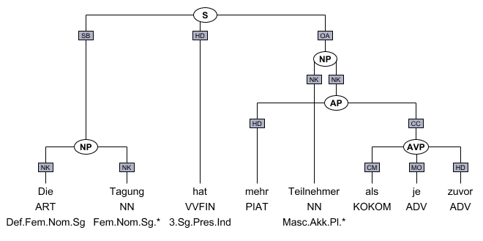
Treebanks
analog to annotated POS corpora, but for syntax trees
English Penn Treebank: Standard corpus for testing syntactic parsing consists of 1.2 M words of text from the Wall Street Journal (WSJ).
Typical to train on about 40,000 parsed sentences and test on an additional standard disjoint test set of 2,416 sentences.
German
TIGER/Negra Treebank: 900K words (50K sentences) from FrankfurterRundschau
TüBa-D/Z: 470K words, taz
29.05.19
Language Technology Group – Chris Biemann

Slide 25
Penn Treebank Bracketed Format
Every production rule is represented by
(
left hand side
sequence of right hand side symbols
non-terminals expanded by production rule
terminals
)
Traces: -NONE- and trace-number
( (S
(NP-SBJ (DT The) (NNP Illinois) (NNP Supreme) (NNP Court) )
(VP (VBD ordered)
(NP-1 (DT the) (NN commission) )
(S
(NP-SBJ (-NONE- *-1) )
(VP (TO to)
(VP
(VP (VB audit)
(NP
(NP (NNP Commonwealth) (NNP Edison) (POS 's) )
(NN construction) (NNS expenses) ))
(CC and)
(VP (VB refund)
(NP (DT any) (JJ unreasonable) (NNS expenses) ))))))
(. .) ))
29.05.19
Language Technology Group – Chris Biemann

Slide 26
Estimating Probabilities of Productions
Set of production rules can be taken directly from the set of rewrites in the treebank.
Parameters can be directly estimated from frequency counts in the treebank.
This might result in a grammar that linguists do not like:
e.g. Penn Treebank: flat, long RHSs
no recursion: will have rules like NP→Det NN, NP→Det JJ NN, NP→Det JJ JJ NN, NP→Det JJ JJ JJ NN, …
29.05.19
Language Technology Group – Chris Biemann

Slide 27
Vanilla PCFG Limitations
Independence assumptions miss structural dependencies between rules
Since probabilities of productions do not rely on specific words or concepts, only general structural disambiguation is possible.
Consequently, vanilla PCFGs cannot resolve syntactic ambiguities that require semantics to resolve, e.g. ate with fork vs. meatballs.
In order to work well, PCFGs must be lexicalized, i.e. productions must be specialized to specific words by including their head-word in their LHS non-terminals (e.g. VP-ate).
A general preference for attaching PPs to NPs rather than VPs can be learned by a vanilla PCFG - but the desired preference can depend on specific words.
John put the dog in the pen.
S
S → NP VP
S → VP
NP → Det A N
NP → NP PP
NP → PropN
A → ε
A → Adj A
PP → Prep NP
VP → V NP
VP → VP PP
0.9
0.1
0.5
0.3
0.2
0.6
0.4
1.0
0.7
0.3
NP VP
?
John V NP
PCFG
Parser
S
put the dog in the pen
NP VP
John V NP PP
put the dog in the pen

Slide 28
Unification Grammars
In order to handle agreement issues more effectively, each constituent has a list of features such as number, person, gender, etc. which may or not be specified for a given constituent.
In order for two constituents to combine to form a larger constituent, their features must unify, i.e. consistently combine into a merged set of features.
Expressive grammars and parsers (e.g. HPSG) have been developed using this approach and have been partially integrated with modern statistical models of disambiguation.
Massive optimization techniques necessary, still only rudimentary support for semantic features
29.05.19
Language Technology Group – Chris Biemann

Slide 29
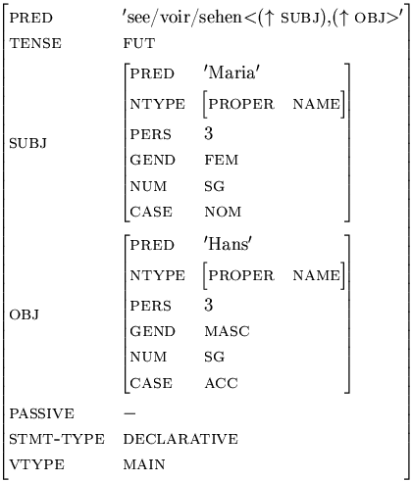
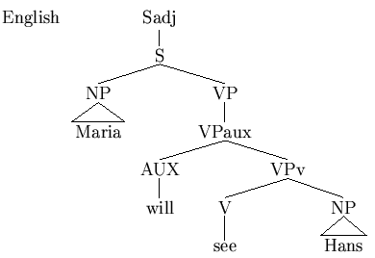
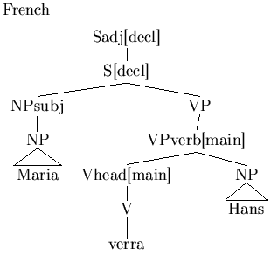
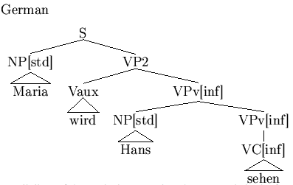
Lexical Functional Grammar (LFG)
generative grammar
separation between surface structure and deep structure makes it possible to have same representation for several languages
Constituent Structure (c-structure)
Functional Structure (f-structure)
29.05.19
Language Technology Group – Chris Biemann

Slide 30
Mildly Context-Sensitive Grammars
Some grammatical formalisms provide a degree of context-sensitivity that helps capture aspects of NL syntax that are not easily handled by CFGs.
Tree Adjoining Grammar (TAG) is based on combining tree fragments rather than individual phrases.
Combinatory Categorial Grammar (CCG) consists of:
Categorial Lexicon that associates a syntactic and semantic category with each word.
Combinatory Rules that define how categories combine to form other categories.
29.05.19
Language Technology Group – Chris Biemann

Slide 31
Dependency Parsing
Alternative to phrase-structure grammar define a parse as directed graph between words of a sentence representing dependencies between words
No nodes for phrasal structure
Can convert a phrase structure parse to a dependency tree by making the head of each non-head child of a node depend on the head of the head child
S
liked-VBD
liked
liked
NP
VP
dobj
John-NNP
liked-VBD
nsubj
John
dog
NNP
VBD NP
dog-NN
John
dog
John
liked
DT Nominal
det
in
dog-NN
the
the
Nominal PP
the
in
pen
dog-NN
in-IN
det
NN
IN NP
pen-NN
pen
the
dog
in
DT Nominal
pen-NN
labeled dependency tree
the
the
NN
unlabeled dependency tree
pen
29.05.19
Language Technology Group – Chris Biemann

Slide 32
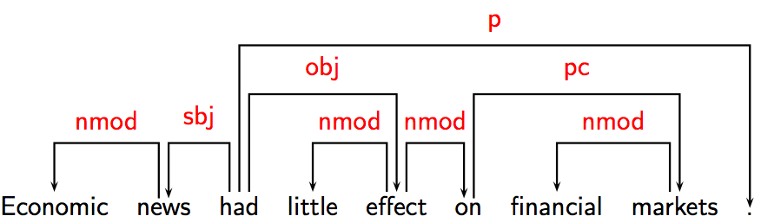
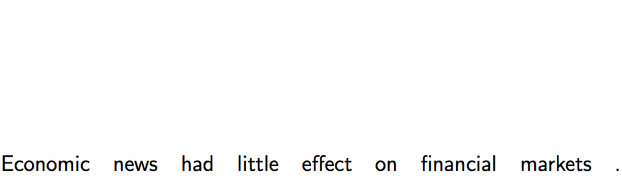
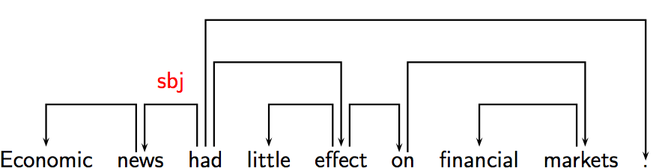
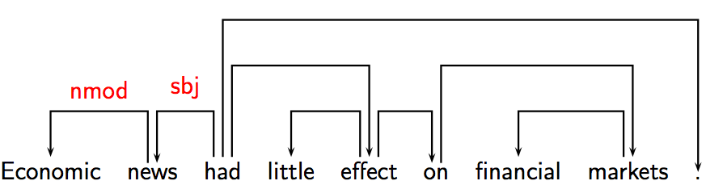
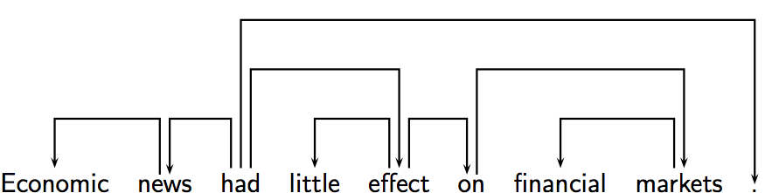
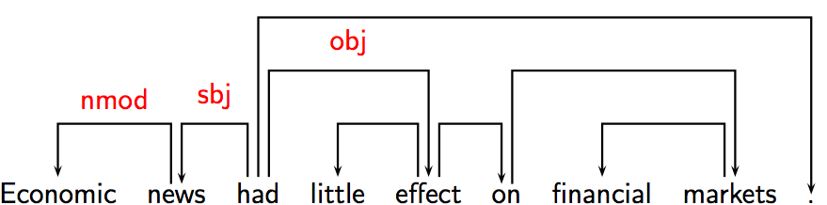
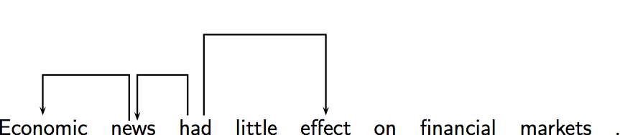
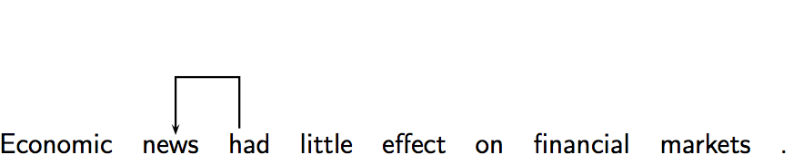
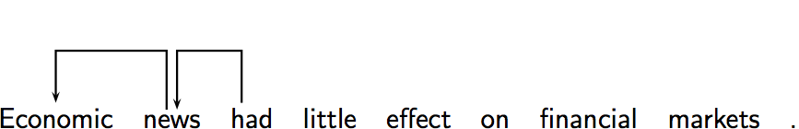
Intuition behind Dependency Parsing
Syntactic structure consists of lexical items, linked by binary asymmetric relations called dependencies.
Superior (start of arc) is called head, inferior is called dependent
Dependency grammars explicitly represent:
head-dependency relations (directed arcs)
functional categories (arc labels)
possibly structural categories like POS

Slide 33
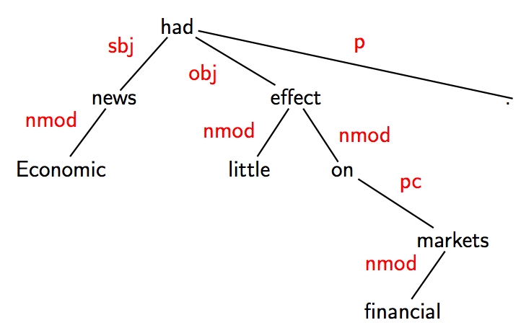
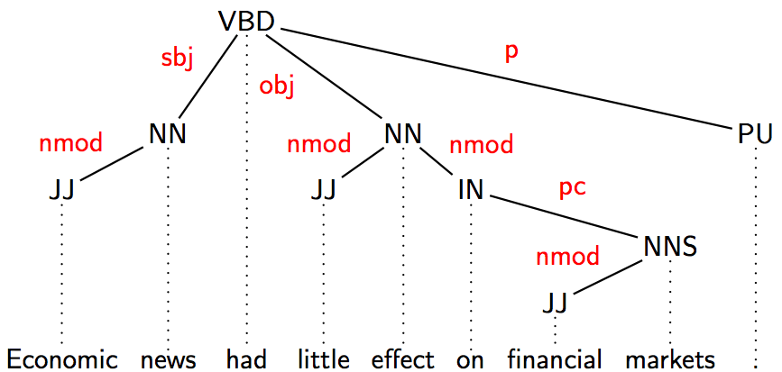
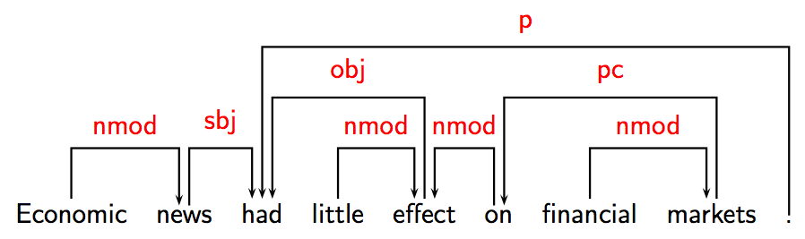
Dependency Parsing: Notational Variants
used in this lecture
x
29.05.19
Language Technology Group – Chris Biemann

Slide 34
Criteria for heads and dependents
Criteria for a syntactic relation between a head H and a dependent D in a construction C:
1. H determines the syntactic category of C ; H can replace C .
2. H determines the semantic category of C ; D specifies H .
3. H is obligatory; D may be optional.
4. H selects D and determines whether D is obligatory.
5. The form of D depends on H (agreement or government).
6. The linear position of D is specified with reference to H .
Issues:
Syntactic (and morphological) versus semantic criteria
Exocentric versus endocentric constructions
29.05.19
Language Technology Group – Chris Biemann

Slide 35
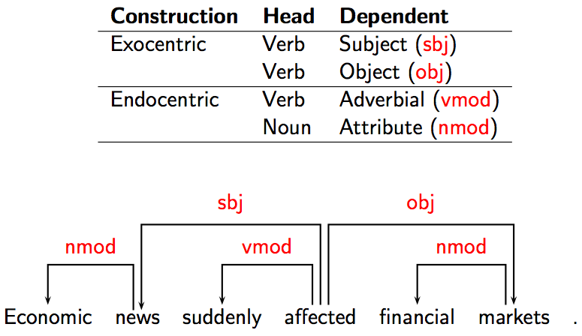
Some clear cases
29.05.19
Language Technology Group – Chris Biemann
Notes:
An exocentric construction consists of two or more parts, whereby the one or the other of the parts cannot be viewed as providing the bulk of the semantic content of the whole.
An endocentric construction consists of an obligatory head and one or more dependents, whose presence serves to narrow the meaning of the head

Slide 36
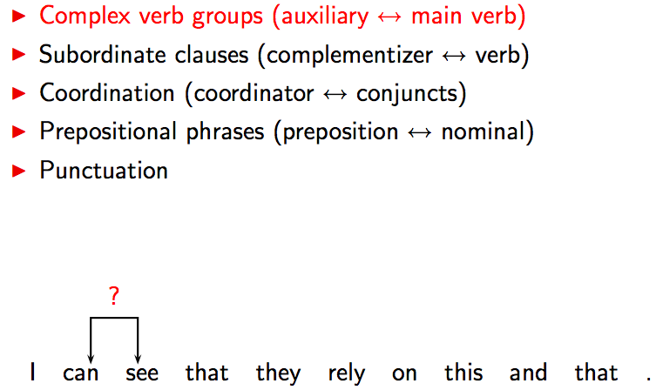
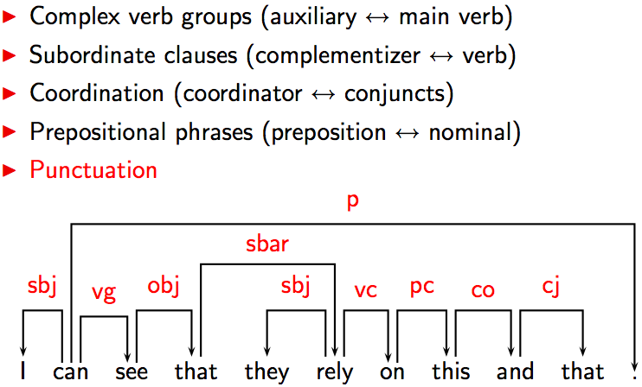
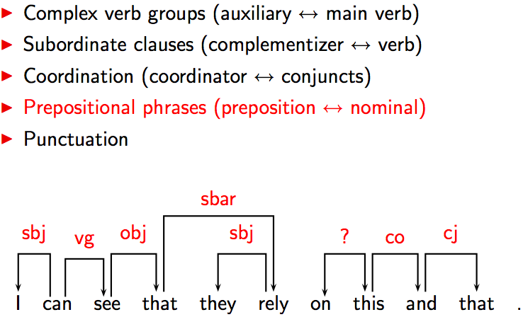
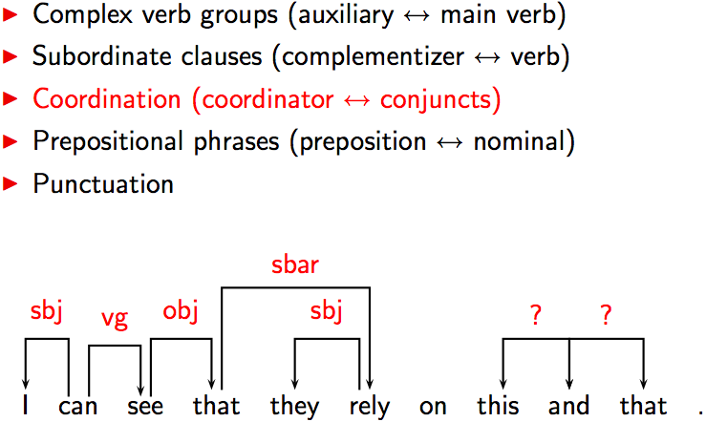
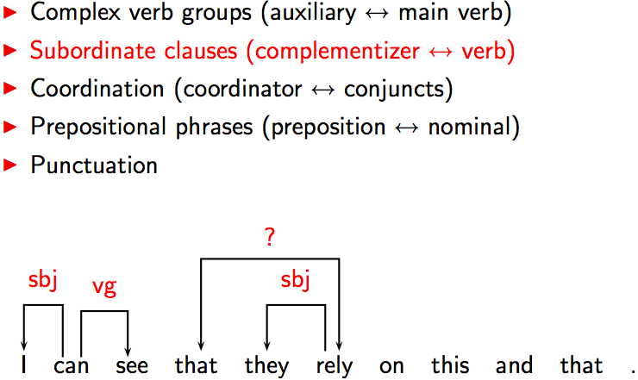
Some tricky cases: conventions
29.05.19
Language Technology Group – Chris Biemann

Slide 37
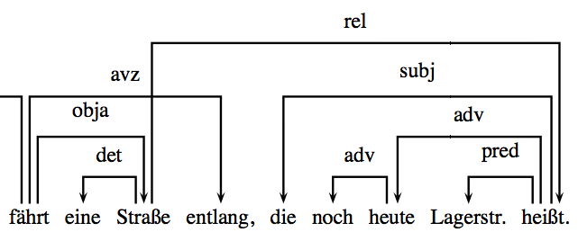
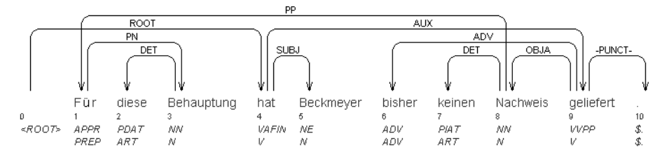
Properties of the dependency graph
Dependency graph G(V,E) with V: word nodes, E: directed edges
Connected: All words in a sentence are connected to the root node (complete structure)
Acyclic: The syntactic structure is hierarchical
Single-head: every word has only one head; a word can be the head of several other words
Projective: no crossing edges. This condition does not hold for all languages, e.g. with free word order
29.05.19
Language Technology Group – Chris Biemann

Slide 38
Deterministic Dependency Parsing
Basic idea
derive a single syntactic representation through a deterministic sequence of elementary parsing actions
possibly combine with a light amount of backtracking for alternatives
Motivation
psycholinguistic plausibility
efficiency
simplicity
Incremental algorithm with O(n²):
Conditions like projectivity, single head can be incorporated in the LINK operation
{
PARSE(w¹…w^{n}): for i=1 to n for j=i-1 downto 1 LINK(w^{i}…w^{j})
E:=E∪(i,j) if w^{j} is dependent of w^{i}
LINK(w^{i},w^{j} )= E:=E∪(j,i) if w^{i} is dependent of w^{j}
E:=E otherwise
29.05.19
Language Technology Group – Chris Biemann

Slide 39
Transition-based: Nivre’s Algorithm (2003)
Four parsing actions:
Characteristics
labeled dependencies as different arc operations
arc-eager processing of right dependents
Stack contains tokens that did not get assigned a head yet
Single pass over the input, time O(n): max operations is 2n
S^{t-1}:[…,w^{i}] Q^{t-1}:[w^{j},…] ¬∃w^{k}: w^{k}→w^{i}
S^{t}: […] Q^{t}: [w^{j},…] w^{i}←w^{j}
S^{t-1}:[…] Q^{t-1}:[w^{i},…]
S^{t}: […,w^{i}] Q^{t}: […]
^{l}
shift
Left-Arc_{r}
S^{t-1}:[…,w^{i}] Q^{t-1}:[…] ∃w^{k}: w^{k}→w^{i}
S^{t}: […] Q^{t}: […]
S^{t-1}:[…,w^{i}] Q^{t-1}:[w^{j},…] ¬∃w^{k}: w^{k}→w^{j}
S^{t}: […,w^{i},w^{j},] Q^{t}: […] w^{i}→w^{j}
^{r}
reduce
Right-Arc_{r}
Nivre, J. (2003) An Efficient Algorithm for Projective Dependency Parsing. In Proceedings of the 8th International Workshop on Parsing Technologies (IWPT 03), Nancy, France, 23-25 April 2003, pp. 149-160.
29.05.19
Language Technology Group – Chris Biemann

Slide 40
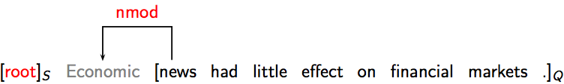
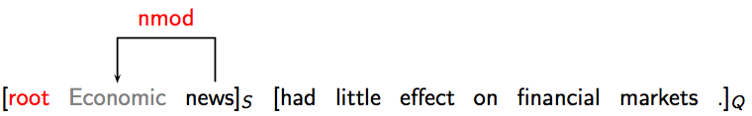
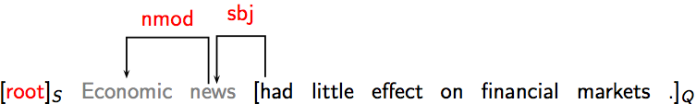
Example: Nivre’s Algorithm
shift
Left-Arc_{r}
S^{t-1}:[…] Q^{t-1}:[w^{i},…]
S^{t}: […,w^{i}] Q^{t}: […]
S^{t-1}:[…,w^{i}] Q^{t-1}:[w^{j},…] ¬∃w^{k}: w^{k}→w^{i}
S^{t}: […] Q^{t}: [w^{j},…] w^{i}←w^{j}
^{l}
reduce
Right-Arc_{r}
S^{t-1}:[…,w^{i}] Q^{t-1}:[…] ∃w^{k}: w^{k}→w^{i}
S^{t}: […] Q^{t}: […]
S^{t-1}:[…,w^{i}] Q^{t-1}:[w^{j},…] ¬∃w^{k}: w^{k}→w^{j}
S^{t}: […,w^{i},w^{j},] Q^{t}: […] w^{i}→w^{j}
^{r}
shift
Left-Arc_{nmod}
shift
Left-Arc_{sbj}
29.05.19
Language Technology Group – Chris Biemann

Slide 41
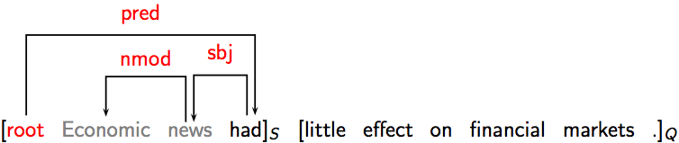
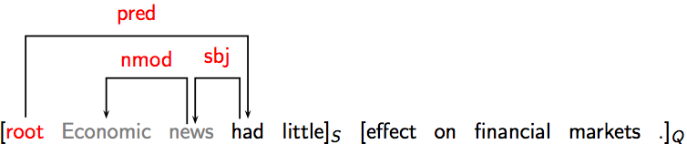
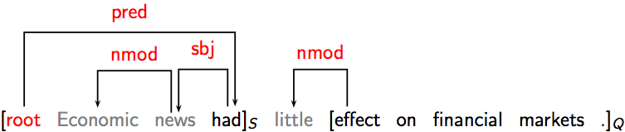
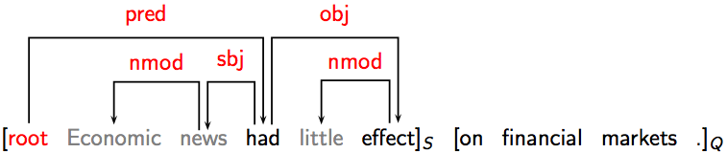
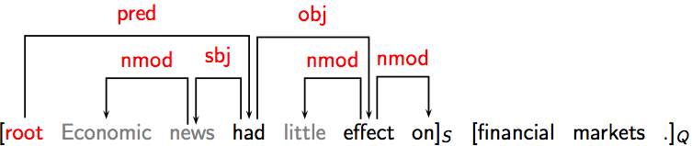
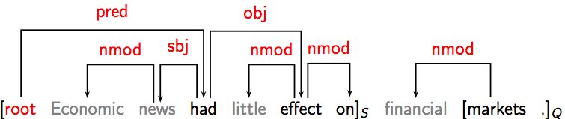
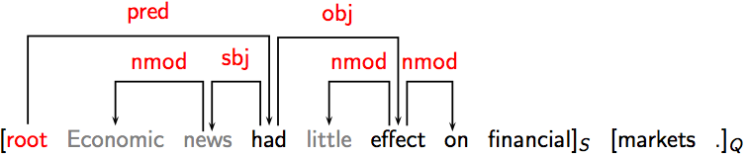
Example: Nivre’s Algorithm
shift
Left-Arc_{r}
S^{t-1}:[…] Q^{t-1}:[w^{i},…]
S^{t}: […,w^{i}] Q^{t}: […]
S^{t-1}:[…,w^{i}] Q^{t-1}:[w^{j},…] ¬∃w^{k}: w^{k}→w^{i}
S^{t}: […] Q^{t}: [w^{j},…] w^{i}←w^{j}
^{r}
reduce
Right-Arc_{r}
S^{t-1}:[…,w^{i}] Q^{t-1}:[…] ∃w^{k}: w^{k}→w^{i}
S^{t}: […] Q^{t}: […]
S^{t-1}:[…,w^{i}] Q^{t-1}:[w^{j},…] ¬∃w^{k}: w^{k}→w^{j}
S^{t}: […,w^{i},w^{j},] Q^{t}: […] w^{i}→w^{j}
^{r}
Right-Arc_{pred}
shift
Left-Arc_{nmod}
Right-Arc_{obj}
Right-Arc_{nmod}
shift
Left-Arc_{nmod}
s
29.05.19
Language Technology Group – Chris Biemann

Slide 42
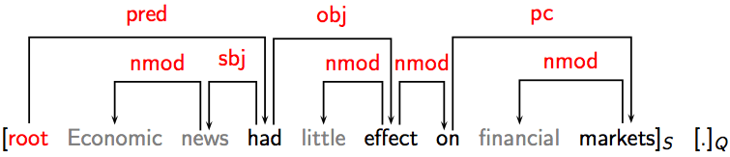
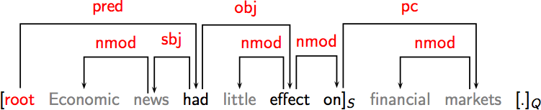
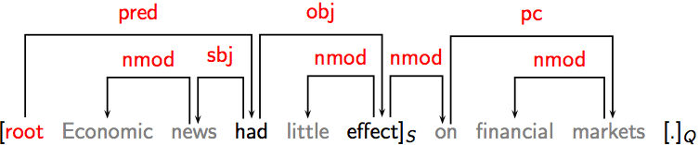
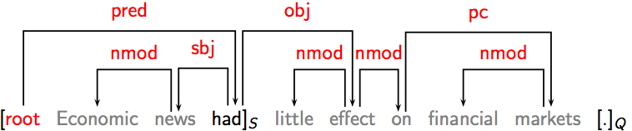
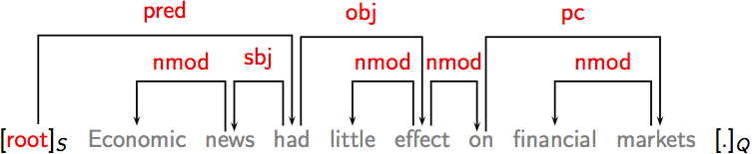
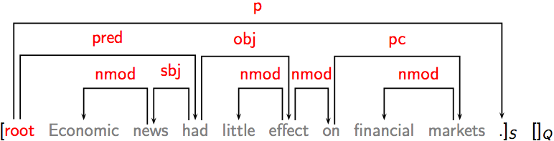
Example: Nivre’s Algorithm
shift
Left-Arc_{r}
S^{t-1}:[…] Q^{t-1}:[w^{i},…]
S^{t}: […,w^{i}] Q^{t}: […]
S^{t-1}:[…,w^{i}] Q^{t-1}:[w^{j},…] ¬∃w^{k}: w^{k}→w^{i}
S^{t}: […] Q^{t}: [w^{j},…] w^{i}←w^{j}
^{r}
reduce
Right-Arc_{r}
S^{t-1}:[…,w^{i}] Q^{t-1}:[…] ∃w^{k}: w^{k}→w^{i}
S^{t}: […] Q^{t}: […]
S^{t-1}:[…,w^{i}] Q^{t-1}:[w^{j},…] ¬∃w^{k}: w^{k}→w^{j}
S^{t}: […,w^{i},w^{j},] Q^{t}: […] w^{i}→w^{j}
^{r}
Right-Arc_{pc}
reduce
reduce
reduce
reduce
Right-Arc_{p}
29.05.19
Language Technology Group – Chris Biemann

Slide 43
Oracle Approximation by Machine Learning
Data-driven deterministic parsing
deterministic parsing needs an oracle that tells us which of the possible steps to take
an oracle can be approximated by a classifier
the classifier can be trained from treebank data
Learning method for dependency parsing: Approximate a function from parser state to parser action. Classifiers used:
Support Vector Machines
Memory-based learning
Maximum Entropy modeling
Typical features:
word and POS of tokens on top of stack and next in queue
word and POS of tokens in certain distances and in structural relations
dependency types of heads, left/right children, siblings of tokens
Results come very close to PCFG-based parsing, are obtained much faster
29.05.19
Language Technology Group – Chris Biemann

Slide 44
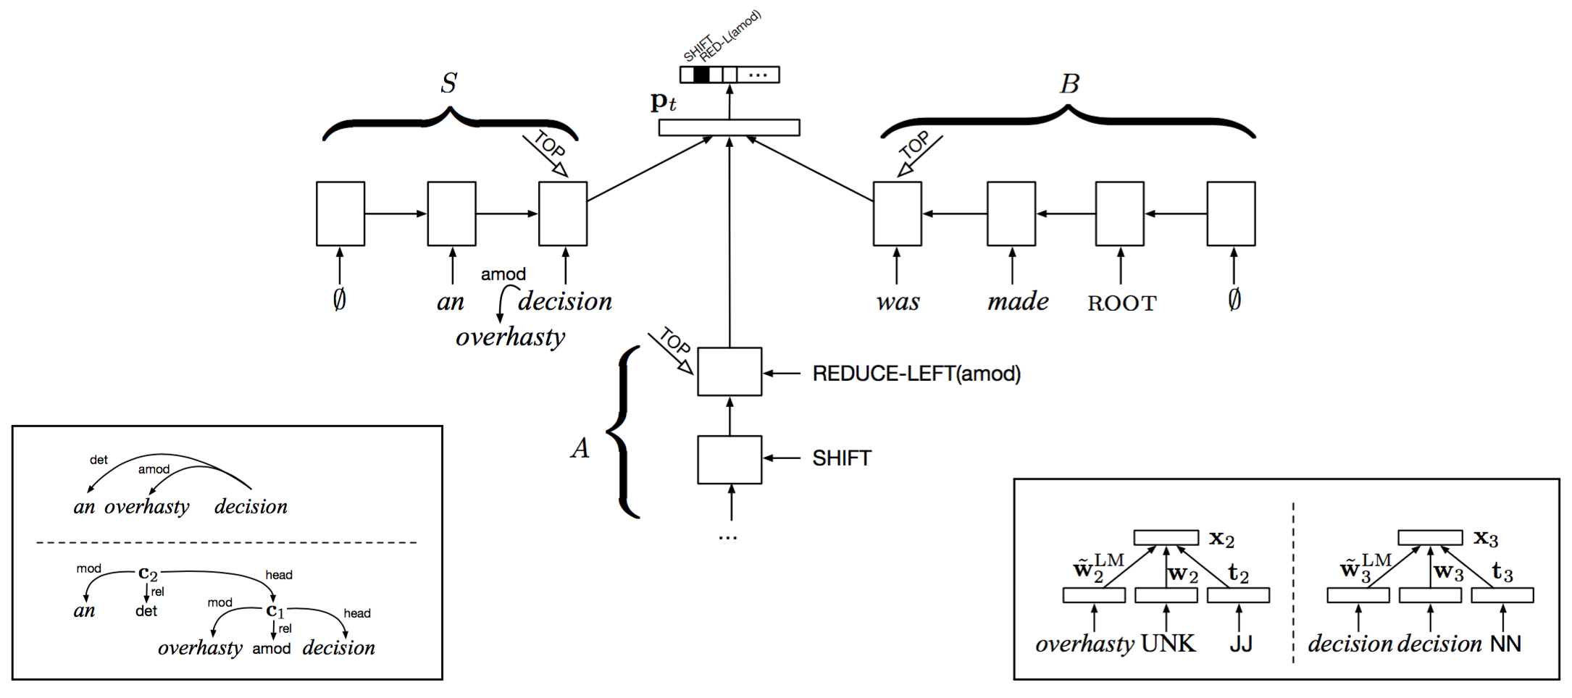
Neural Dependency Parsing
S: stack, collects parse
A: parser actions
B: buffer of words
Transitions learned by three “Stack” LSTMs:
can push/pop elements
maintains a continuous representation of the stack state
‘infinite’ history and lookahead
Chris Dyer, Miguel Ballesteros, Wang Ling, Austin Matthews, and Noah A. Smith. 2015. Transition-based dependency parsing with stack long short-term memory. In Proceedings of the 53rd Annual Meeting of the Association for Computational Linguistics, pages 334–343.
29.05.19
Language Technology Group – Chris Biemann

Slide 45
Multilingual Dependency Parsing
2006 CoNLL-X shared task: 12 languages
Data sources: dependency treebanks and phrase structure treebanks converted to dependency structures
Main evaluation metric: labeled accuracy per word
Top scores range from 91.7 (Japanese) to 65.7 (Turkish)
Top systems over all languages:
approximate second-order non-projective spanning trees with online learning
labeled deterministic pseudo-projective parsing with support vector machines
For English, phrase structure grammar parsers score slightly higher than dependency parsers. For some other languages, dependency parsers score higher. How much has parser development been influenced by English-specific phenomena?
29.05.19
Language Technology Group – Chris Biemann

Slide 46
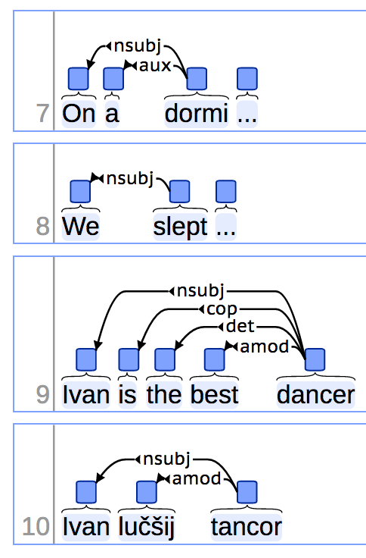
Universal Dependencies http://universaldependencies.org/
Attempt to have the same simplified set of 17 POS tags and 37 dependency types for all languages
Currently available for 83 languages, 14 more announced
guiding principles: cross-language applicability
greatly simplifies multilingual applications
29.05.19
Language Technology Group – Chris Biemann

Slide 47
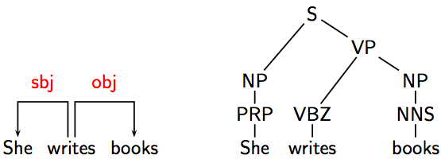
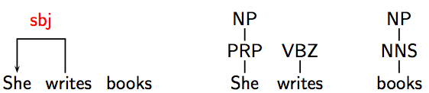
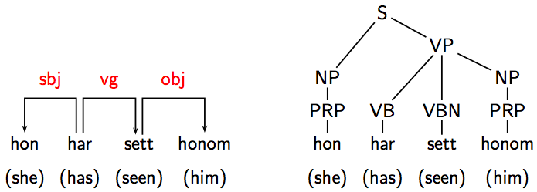
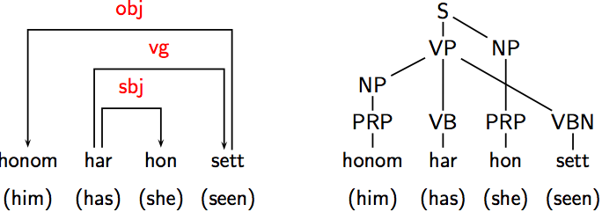
Advantages of Dependency Parsing
Complexity: Projective parsing in O(n), non-projective parsing in O(n²)
Transparency (for labeled dependency graphs):
direct encoding of argument structure
interpretability of fragments
Suitable for free word order languages (for non-projective approaches)
29.05.19
Language Technology Group – Chris Biemann

Slide 48
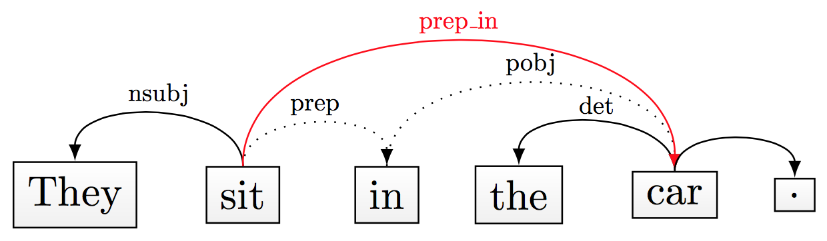
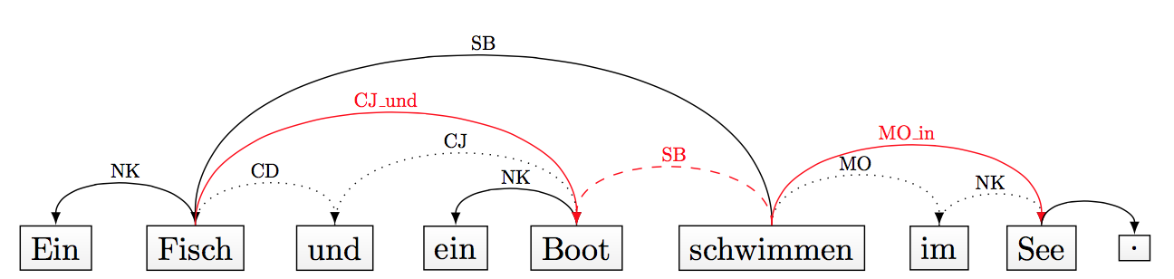
Dependency Parsing towards Semantics
Collapsing rules: Move preposition into relation
Propagation rules for conjunctions: relation applies to all conjuncts
These “collapsed and conjunction-propagated” dependency parses proved advantageous for semantic tasks.
Marie-Catherine de Marneffe, Bill MacCartney, and Christoper D. Manning. 2006. Generating typed dependency parses from phrase structure parses. In Proceedings of LREC-2006, pages 449–454, Genova, Italy.
29.05.19
Language Technology Group – Chris Biemann

Slide 49
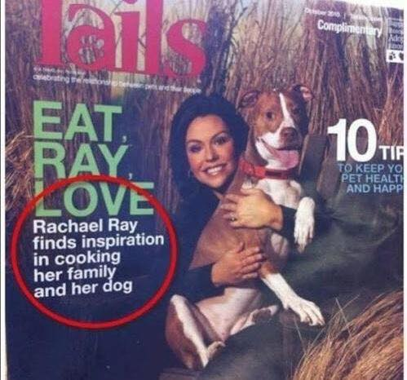

This could go wrong ... and commas save lives!
s
http://nlp.stanford.edu:8080/corenlp/process
29.05.19
Language Technology Group – Chris Biemann

Slide 50

Disadvantage of Dependency Parsing
Limited Expressivity
Every projective dependency grammar has a strongly equivalent context-free grammar, but not vice versa
In unlabeled dependency structure, it is impossible to distinguish between head modification and phrase modification
These limits are unclear for labeled, non-projective dependency structures, but this configuration sometimes lacks accuracy and efficiency
29.05.19
Language Technology Group – Chris Biemann

Slide 51
Statistical Parsing Conclusions
Statistical models such as PCFGs allow for probabilistic resolution of ambiguities.
PCFGs can be easily learned from treebanks.
Current statistical parsers are quite accurate for English but not yet at the level of human-expert agreement.
For other languages, only dependency parsers are more or less reliable
dependency parsers are faster, and contain different information than phrase structure grammar parsers, and try to stay as deterministic as possible
Recent advances in transition-based parsing using neural networks
Main challenge:
Treebanking is very expensive
29.05.19
Language Technology Group – Chris Biemann

Slide 52


Immediate Feedback
s

Slide 53
Dense Vector Representations
coming up next
LSA, LDA, word2vec
29.05.19
Language Technology Group – Chris Biemann

