Slide 1
Word Sense and MEANING
Jurafsky, D. and Martin, J. H. (2009): Speech and Language Processing. An Introduction to Natural Language Processing, Computational Linguistics and Speech Recognition. Second Edition. Pearson: New Jersey: Chapter 20
Agirre, E., Edmonds, P. (2006): Word Sense Disambiguation: Algorithms and Applications (Text, Speech and Language Technology). Springer, Heidelberg
knowledge-based, supervised, word sense induction, substitution
10.07.19
Language Technology Group – Chris Biemann

Slide 2
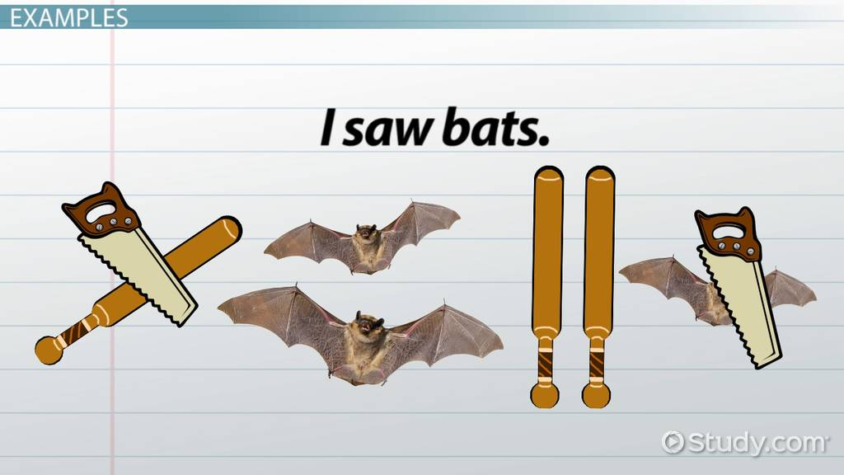
Motivating Example
http://study.com/academy/lesson/lexical-ambiguity-definition-examples.html
ambiguous words have multiple senses
Word Sense Disambiguation assigns a single (out of multiple) sense in a given context
Semantic disambiguities: assume that syntactic disambiguation has already been performed
10.07.19
Language Technology Group – Chris Biemann
2

Slide 3
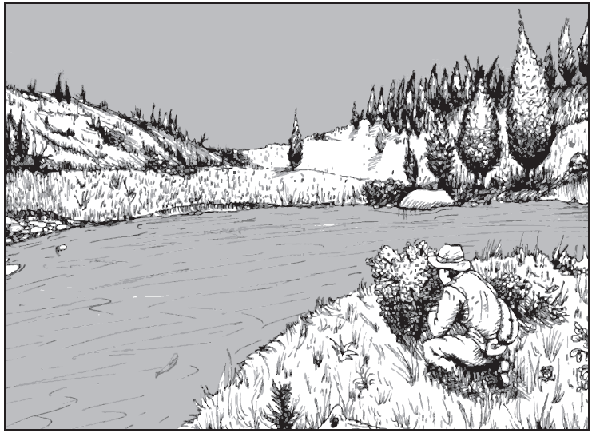
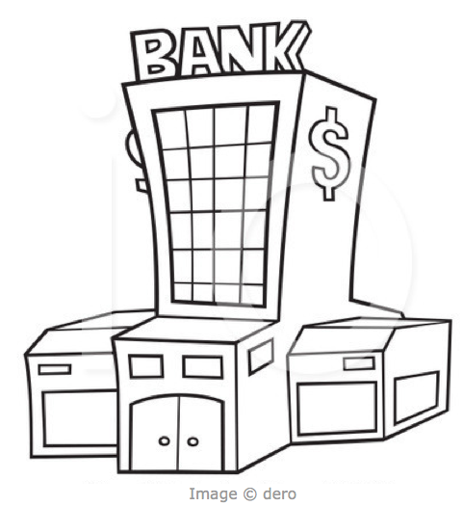

Why Language is HARD ..
polysemous
synonymous
Concept Layer
Lexical Layer
He sat on the river bank and counted his dough.
She went to the bank and took out some money.
10.07.19
Language Technology Group – Chris Biemann
3
Notes:
Another reason why language is hard is that in opposition to programming languages, there is no 1:1 mapping from the lexical layer to the conceptual layer.

Slide 4
Types of Ambiguity
Homonymy: two or more meanings happen to be expressed with the same string
withdrawing money from the bank
embark on a boat from the river bank
Polysemy: the same string has different, but related senses, stemming from the same origin
the bank was robbed by Billy the Kid
the bank was constructed by a famous architect
10.07.19
Language Technology Group – Chris Biemann
4

Slide 5
Approaches to WSD
Knowledge Based Approaches (‘unsupervised’)
Rely on knowledge resources like WordNet, Thesaurus etc.
May use grammar rules for disambiguation.
May use hand coded rules for disambiguation.
Machine Learning Based Approaches (‘supervised’)
Rely on corpus evidence.
Train a model using tagged or untagged corpus.
Probabilistic/Statistical models.
Hybrid Approaches
Use corpus evidence as well as semantic relations from WordNet.
Unsupervised, knowledge-free Approaches
induce sense inventory
disambiguate in context
10.07.19
Language Technology Group – Chris Biemann
5

Slide 6
WSD using selectional preferences and arguments
Sense 1
Sense 2
This airline serves dinner in the evening flight.
serve (Verb)
agent
object – edible
This airline serves the sector between Munich and Rome.
serve (Verb)
agent
object – sector
Requires exhaustive enumeration of:
Argument-structure of verbs.
Selectional preferences of arguments.
Description of properties of words such that meeting the selectional preference criteria can be decided.
E.g. This flight serves the “region” between Paris and Warsaw.
How do you decide if “region” is compatible with “sector”
10.07.19
Language Technology Group – Chris Biemann
6

Slide 7
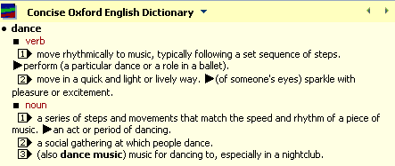
Overlap-based Approaches
Requires a Machine Readable Dictionary (MRD).
Find the overlap between the features of different senses of an ambiguous word (sense bag) and the features of the words in its context.
These features could be sense definitions, example sentences, etc.
The sense which has the maximum overlap is selected as the contextually appropriate sense.

Slide 8
Lesk (1986) Algorithm
Identify senses of words in context using definition overlap
Can do this either between gloss and context or between all sense combinations
Main problem: zero overlap for most contexts
function SimplifiedLesk(word, sentence) {
bestSense= mostFrequentSense(word);
maxOverlap =0;
context = allWords(sentence);
foreach sense in allSenses(word) {
signature=signature(sense);
overlap = overlap(signature, context);
if (overlap > maxOverlap) {
maxOverlap = overlap;
bestSense - sense
}}
return bestSense;
}
Dictionary functions
mostFrequentSense: returns most frequent / first sense identifier from dictionary
allSenses: returns all sense identifiers for a word from dictionary
signature: returns set of words from sense definition in dictionary
Lesk, M. (1986). Automatic sense disambiguation using machine readable dictionaries: how to tell a pine cone from an ice cream cone. In SIGDOC '86: Proceedings of the 5th annual international conference on Systems documentation, pages 24-26, New York, NY, USA. ACM.
10.07.19
Language Technology Group – Chris Biemann
8

Slide 9
Simplified Lesk Algoritm
Lesk algorithm relies on definitions of context words to disambiguate the senses of a target word
Simplified Lesk:
Measure the overlap between the (sentence) context of the target, and the definition of its senses
If no overlap, use most frequent sense (MFS)
1, 2 or 3 ?
“With the music, the dance started with slow movements.”
10.07.19
Language Technology Group – Chris Biemann
9
Notes:
->3, das ist aber 1

Slide 10
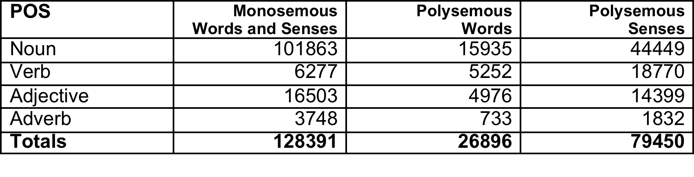
WordNet – an Online Lexical Database http://wordnet.princeton.edu/ - current version: 3.1
High coverage lexical-semantic network built by psychologists
Relations:
ISA-relation (hyponom - hypernym, taxonomic backbone)
Part-of (meronym - holonym)
Type-instance (e.g. Obama is an instance of President)
Opposite-of (antonym), mostly for adjectives
Derivative (pertainym), e.g. crime – criminal
some semantic roles between verbs and nouns, e.g. AGENT, INSTRUMENT …
10.07.19
Language Technology Group – Chris Biemann
10

Slide 11
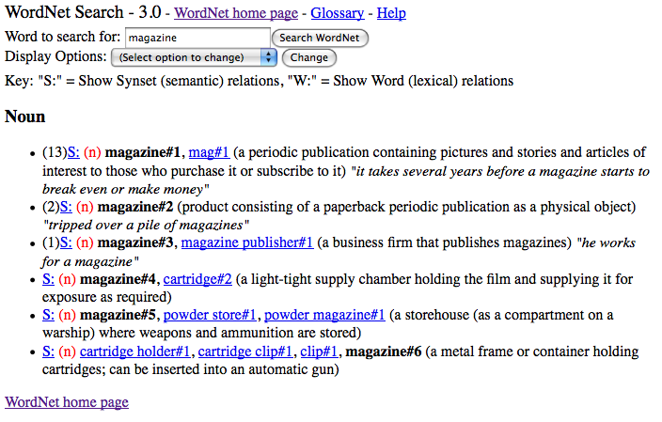
Synsets for “magazine#n”
L
Synset
sample use
gloss
Lexical members
SemCor count
10.07.19
Language Technology Group – Chris Biemann
11

Slide 12
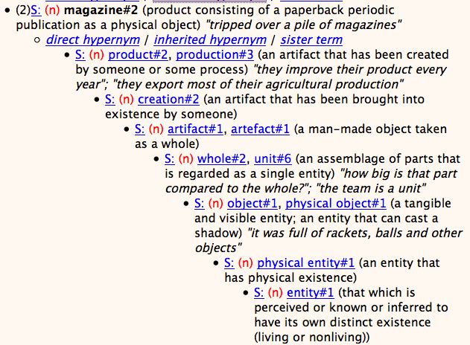
WordNet Hypernym Chain
level of
abstraction
10.07.19
Language Technology Group – Chris Biemann
12

Slide 13
Gloss Overlaps ≈ Relatedness
Lesk’s (1986) idea: Related word senses are (often) defined using the same words. E.g:
bank(1): “a financial institution”
bank(2): “sloping land beside a body of water”
lake: “a body of water surrounded by land”
Gloss overlaps = # content words common to two glosses ≈ relatedness
relatedness (bank(2), lake) = 3
relatedness (bank(1), lake) = 0
Problem: “lexical gap”: Same or similar meaning can be expressed with a large variety of words from the vocabulary. For most pairs of glosses, overlap = 0 .
10.07.19
Language Technology Group – Chris Biemann

Slide 14
Extended Lesk (Banerjee and Pedersen, 2002)
Utilize link structure of WordNet to pull in related glosses for overlap computation
Addresses the overlap sparseness issue
do this for one ambiguous word at-a-time
Reweighting: For n-gram overlaps, add a score of n²
final judgment: “a
judgment disposing of the case
before the court of law”
“the bench pronounced the sentence”
overlap score = 9
hypernym
sentence: “the
penalty meted out to one
adjudged guilty”
bench: “persons
who hear cases in a
court of law”
overlap score = 0
(Banerjee and Pedersen, 2002). Extended Gloss Overlaps as a Measure of Semantic Relatedness. Proceedings of the Eighteenth International Joint Conference on Artificial Intelligence, pp. 805-810, August 9-15, 2003, Acapulco, Mexico.
10.07.19
Language Technology Group – Chris Biemann
14

Slide 15
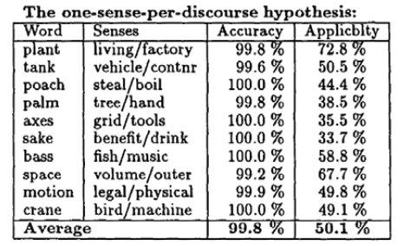
One-Sense-Per-Discourse Hypothesis
Idea: When a word is used several times in a document, it probably has the same meaning in all occurrences.
This means that we can gather evidence from all contexts per document, which reduces sparseness
holds for homonymous, not polysemous nouns, does not hold for verbs and adjectives as much
Measuring the validity of the hypothesis (Small study on 12 nouns)
Applicability: How often do we in fact observe an ambiguous word more than once in a document?
Accuracy: If we observe an ambiguous word more than once per document, how often do these occurrences have the same meaning?
Gale William, Kenneth Church, and David Yarowsky, “One Sense Per Discourse”, in Proceedings of the ARPA Workshop on Speech and Natural Language Processing, pp. 233– 237, 1992.
10.07.19
Language Technology Group – Chris Biemann
15

Slide 16
Semeval: Shared Task for Semantic Evaluations
Shared task initiative since 2001, currently preparing 2018 edition
Increasing number of tasks and systems
Core WSD tasks (for many languages):
lexical sample task: for a small set of ambiguous target words, a large number of labeled examples
all word task: every word in a short text is labeled with the appropriate sense
Other tasks include:
(cross-lingual) lexical substitution
word sense induction
semantic role annotation
Sentiment analysis
temporal relation identification
semantic text similarity
…
e.g. Semeval-2 English lex. sample
Algorithm | Precision | Recall | F1
Sval-1st | 0.402 | 0.401 | 0.401
Ext Lesk | 0.351 | 0.342 | 0.346
Sval-2nd | 0.293 | 0.293 | 0.293
Lesk | 0.183 | 0.183 | 0.183
Random | 0.141 | 0.141 | 0.141
10.07.19
Language Technology Group – Chris Biemann
16

Slide 17
Senseval/Semeval all-word task
Example annotation
Homeless
<head id="d00.s08.t01">people</head>
not
only
<head id="d00.s08.t04">lack</head>
safety
,
privacy
and
<head id="d00.s08.t09">shelter</head>
,
they
also
<head id="d00.s08.t13">lack</head>
the
elementary
<head id="d00.s08.t16">necessities</head>
of
nutrition
,
cleanliness
and
basic
health
care
.
No training data, can only use lexical resources (‘knowledge-based, unsupervised’) and sense-labeled corpora
all ambiguous words are marked and need to be assigned a sense
Fine-grained scoring: upper bound is inter-annotator-agreement, which is at about 75%
Coarse-grained scoring: inter-annotator-agreement at around 90%
Top system performances: 65% (fine-grained), 82% (coarse-grained); MFS baseline: 78% (coarse-grained)
10.07.19
Language Technology Group – Chris Biemann
17

Slide 18
Senseval/Semeval lexical sample task
Example annotation
<instance id="11:0@2@wsj/14/wsj_1404@wsj" corpus="wsj">
<answer lemma="double" pos="v" on="1" wn="1" wn-version="2.1"/>
Groupe AG 's chairman said 0 the Belgian insurer is prepared *-1 to give up some of its independence to a white knight if * necessary * to repel a raider . Amid heavy buying of shares in Belgium 's largest insurer , Maurice Lippens also warned in an interview that a white knight , in *-1 buying out a raider , could leave speculators with big losses on their AG stock . Since the beginning of the year , the stock has nearly <head> doubled </head> , * giving AG a market value of about 105 billion Belgian francs -LRB- $ 2.7 billion *U* -RRB- . The most likely white knight would be Societe Generale de Belgique S.A. , which *T*-2 already owns 18 % of AG and which *T*-3 itself is controlled *-1 by Cie . Financiere de Suez , the acquisitive French financial conglomerate . But Mr. Lippens said 0 a rescue also could involve Asahi Mutual Life Insurance Co. , which *T*-1 owns 5 % of AG .
</instance>
<instance id="8:0@37@wsj/14/wsj_1432@wsj" corpus="wsj">
<answer lemma="double" pos="v" on="1" wn="1" wn-version="2.1"/>
We 'll coordinate on this end to places like Bangkok , Singapore and Manila . '' Asian traffic , which *T*-1 currently accounts for 65 % of Cathay 's business , is expected *-2 to continue as the carrier 's mainstay . Cathay has long stated its desire * to <head> double </head> its weekly flights into China to 14 , and it is applying *-1 to restart long-canceled flights into Vietnam . Further expansion into southern Europe is also possible , says 0 *T*-1 Mr. Bell , the spokesman . While a large number of Hong Kong companies have reincorporated offshore ahead of 1997 , such a move is n't an option for Cathay because it would jeopardize its landing rights in Hong Kong .
</instance>
Training and test data: can use a supervised system in a Machine learning setup
can also use knowledge-based systems
supervised systems show about 5-7% better performance in evaluations
Performance: about 87% (coarse-grained)
variations
ML learning algorithm
features computed on the context
features computed through analysis of large background corpora
10.07.19
Language Technology Group – Chris Biemann
18

Slide 19
Local context features for Word Sense Disambiguation
Standard features for WSD
word window
lemma/baseform/stem window
morphological information, e.g. gender, number, tense
open class words in proximity, e.g. closest adjectives to target
POS of target and context
syntactic relations, e.g. headwords
Knowledge-based features (in hybrid systems)
WordNet similarity with context - “Lesk”
WordNet hypernym chains
10.07.19
Language Technology Group – Chris Biemann
19

Slide 20
Topical Features for WSD
Topical features are computed from the global context: statistics over a corpus as a whole
Structure discovered on the corpus level can be used to characterize individual instance
Topical features aim at bridging the “lexical gap”
some of the methods presented here have not been developed as WSD features, but we can treat them as such
Selection of Methods
Topic Signatures
Word Sense Induction features
Latent Semantic Analysis vector space similarity
Topic Models
Lexical Expansion
10.07.19
Language Technology Group – Chris Biemann
20

Slide 21
Topic Signatures
Idea: Get more ‘training data per word sense
if people issue an ambiguous query in a search, they add more words to narrow down the meaning of the query
can do this automatically using WordNet:
TopicSignatures(ambiguous word w):
senses=findWNConcepts(w);
foreach sense s {
query=w + findRelatedWNwords(s);
resultSet = issueQuery(query, contextCollection);
topicSignature_{s}= getRepresentation(resultSet); }
Strategies:
findRelatedWords: only monosemous vs. all, synset-only vs. neighborhood, number of related words, …
contextCollection: Sentences from Corpus vs. WWW
getRepresentation: Sig(w, resultWord), LSA vectors, …
10.07.19
Language Technology Group – Chris Biemann
21

Slide 22
Word Sense Induction as Features
Unsupervised, knowledge-free sense discovery
compute similarities of words using corpus-based methods
cluster local neighborhood of similarity graph per word
collect typical features of clusters
use these for disambiguation
Example: similarities by comparing dependencies
pistol
leg
firearm
arm
elbow
blade
limb
arm@0: thigh, spear, crest, stick, wrist, rack, throat, tip, beak, eye, mouth, mount, trunk, leg, edge, piece, fin, shoulder, back, motor, jaw, abdomen, paw, pair, face, belly, chair, claw, shaft, elbow, rib, vertebra, collar, skull, hand, blade, wing, stem, hammer, end, handle, roof, forehead, pole, neck, ankle, ton, axle, frame, cord, foot, shield, needle, fracture, knee, nose, penis, bottom, turret, slide, hook, limb, lever, chest, ear, bay, sword, head, flag, tail, half, banner, hip, joint, beam, breast, bone, backward, horn, spine, forearm, bow, badge, finger, toe, thumb, mirror (87)
arm@1: pistol, saber, grenade, firearm, launcher, weapon, rifle, ammunition, shotgun, mortar (10)
arm@2: venture, fund, boom (3)
10.07.19
Language Technology Group – Chris Biemann
22

Slide 23
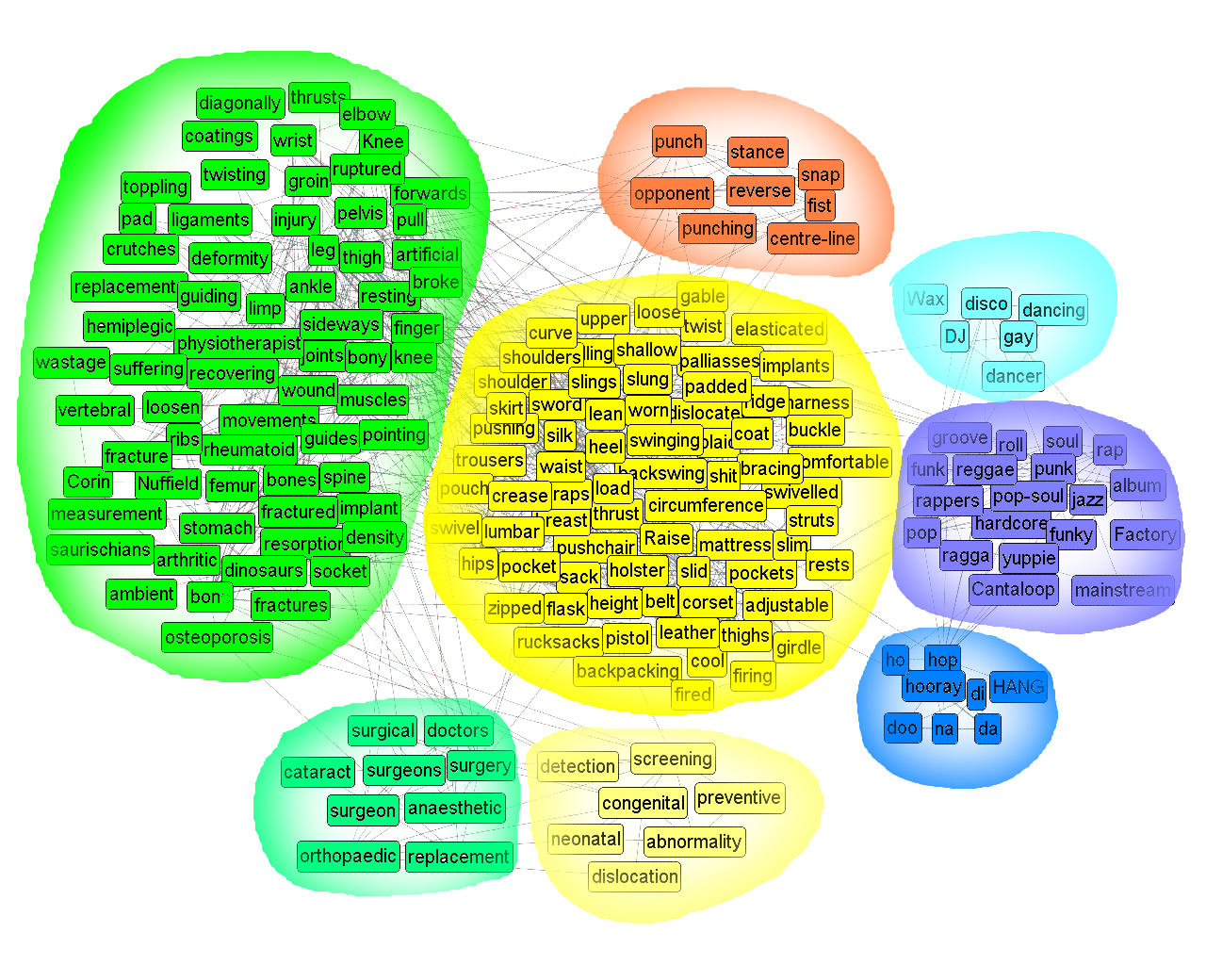
hip
10.07.19
Language Technology Group – Chris Biemann
23

Slide 24
At his hip he wore a pistol in an ancient leather holster .
This hybrid mix of reggae and hip hop follows acid jazz , Belgian New Beat ...
I had a hip replacement operation on my left side , after which I immediately broke my right leg .
Ho , hey , ho hi , ho , hey , ho , hip hop hooray , funky , get down , a-boogie , get down .
10.07.19
Language Technology Group – Chris Biemann
24

Slide 25
notorious bank Example: different clustering parameters
1. Clustering
bank0: largest, north, branches, eastern, opposite, km, east, west, branch, Thames, banks, located, Danube, town, south, situated, River, Rhine, river, western, commercial, central, southern
bank1: right, left
bank2: money, robbers, deposit, robberies, cash, currency, account, deposits, Bank, robbery, funds, financial, banking, loans, notes, robber, rob, accounts, credit, assets, teller, Banco, loan, investment, savings
2. Clustering
bank0: eastern, banks, central, river, km, western, south, southern, located, largest, east, deposits, commercial, Thames, north, west, Danube, town, situated, Rhine, River
bank1: branches, branch
bank2: robberies, robbers, robbery, robber
bank3: right, left, opposite
bank4: loans, cash, investment, teller, account, financial, loan, deposit, credit, funds, accounts, assets, savings, banking, money, rob
bank5: Banco, currency, notes, Bank
10.07.19
Language Technology Group – Chris Biemann
25

Slide 26
Combination of several cluster features
Learning curve
X axis: amount of training
Y axis: performance
Several cluster features improve performance, especially for small amounts of training
10.07.19

Slide 27
Latent Semantic Analysis And other dense vectors
Vector Space Model (VSM): represent words as vector of contexts (cf. document term matrix in Information Retrieval)
Problems with VSM
sparsity: Power law distribution of frequencies: many words occur only in few contexts
high dimensionality: large storage space, slow processing
synonymy: synonyms are represented as different words, but should be the same “concept”
LSA addresses these problems by
mapping the VSM data into an orthogonal space where different dimensions denote different concepts
reducing the space to a fixed number of dimensions to keep only the “most important” concepts
The hope is to map synonyms to the same dimensions, at this creating an abstraction level to latent concepts
10.07.19
Language Technology Group – Chris Biemann
27

Slide 28
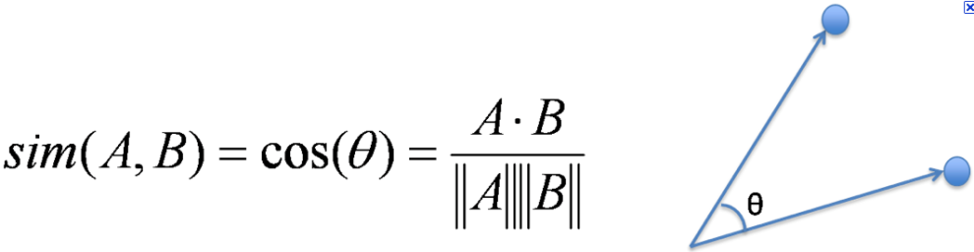
LSA for WSD
in VSM: compare aggregated vector of contexts per sense with vector of instance, e.g. with cosine similarity
in LSA, we have to project the context vector into the reduced space
comparison of instance vector and aggregated vectors per sense serve as a feature in the ML setup
Building the LSA matrices is typically done using a large background corpus, with k=100 – 1000, depending on the task
Why this works:
LSA can generalize over similar words
LSA serves as a noise reduction technique
LSA can fold in knowledge about lexical similarities beyond what is in the labeled training data
10.07.19
Language Technology Group – Chris Biemann
28

Slide 29
Current Topics
word embeddings vs. sense embeddings: whenever context is too dis-similar, spawn an new sense in word2vec-like architectures
use contextualized language models: e.g. in lexical sample task, use closest BERT embedding for target word from training to predict test label

Slide 30
Summary on Word Senses and Meaning
Formalization is less clear than in syntactic methods
Extensive semantic resources (WordNet, BabelNet), still lack of connection to text
Meaning has many facets and manifests itself in context
Sense-inventory–based WSD vs. Lexical Substitution
More semantic tasks: Semantic Role Labeling, Frame-Semantic Parsing
10.07.19
Language Technology Group – Chris Biemann

Slide 31
KLAUSUR / EXAM
Exam 1: Th, 25. Jul. 2019 09:30-11:30
Room: ESA C
Exam 2: Tue, 17. Sep. 2019 09:30-11:30
Room: Hörs Pharmazie (gr) Bu 45, Pharm
Content:
Lecture
Exercises
Reading
No materials, just bring a pen.

Slide 32
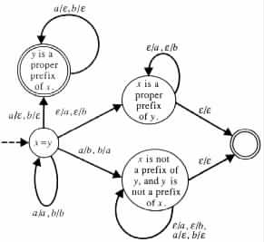
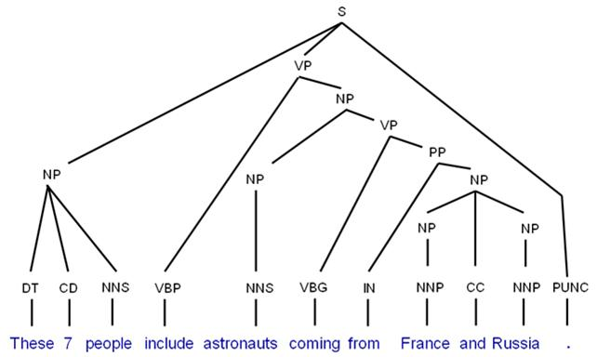
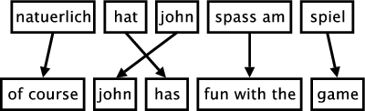
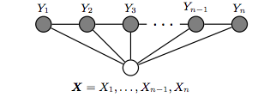
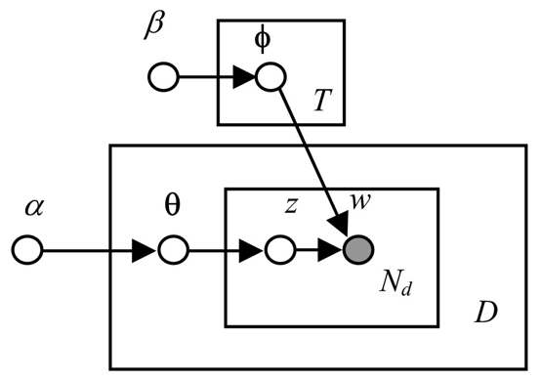
Master Studies Informatics
Universität Hamburg, SS 2017
fin
Chomsky-Hierarchy
Phrase Alignment
Syntax Rules
Transducers for Morphology
Sequence Labeling
Topic Models
Machine Learning
Semantic Search
Chris Biemann, Eugen Ruppert
Statistical Methods of Language Technology
10.07.19
Language Technology Group – Chris Biemann
Notes:
Best of success for the oral exams

Slide 33
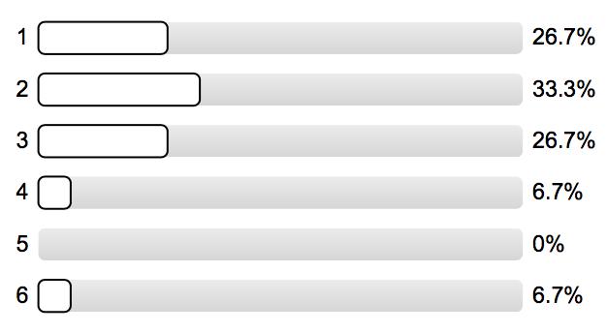
Teaching Evaluation
(summary)
Aggregated grades:
content: ~2.3
course material: ~2.1
lecturer: ~1.9
practice class: ~2.0
Positive:
feedback mechanisms
recording
interesting topics
exercises well alignend with lecture, variety of tools
Negative:
not interactive enough
too theoretical, need for more practical applications
too many tools
not always ending on time
balance of old and new methods
overall grade
one extremely negative feedback
Only 15 participants!

Slide 34
Speaking of which ..
More courses?
NLP4Web
Master Project
Hiwi Jobs / MA Theses?
sense change over time
language and structure of law
web-scale argument mining
meeting minute bot
10.07.19
Language Technology Group – Chris Biemann

