Slide 1
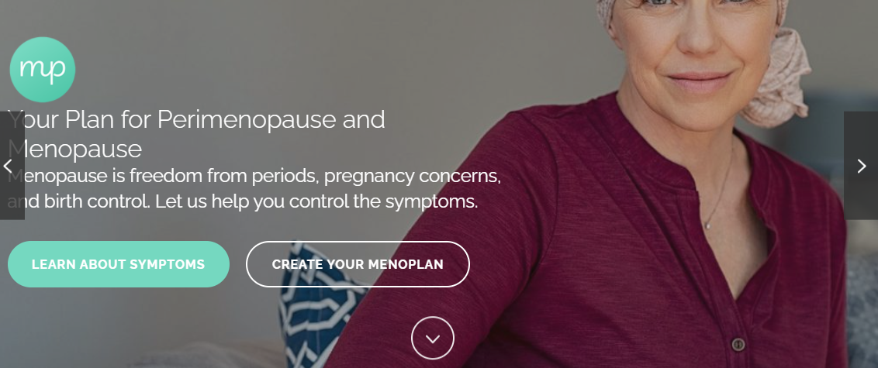
Menoplan Website Audit
Notes:
This made the content a lot more personal and I think it can win a lot of trust

