Slide 2

Why can you trust us? Give us feedback on the website here : https://uconn.co1.qualtrics.com/jfe/form/SV_4V0sjZRvoSILOdg Link in bio as well.

Slide 3
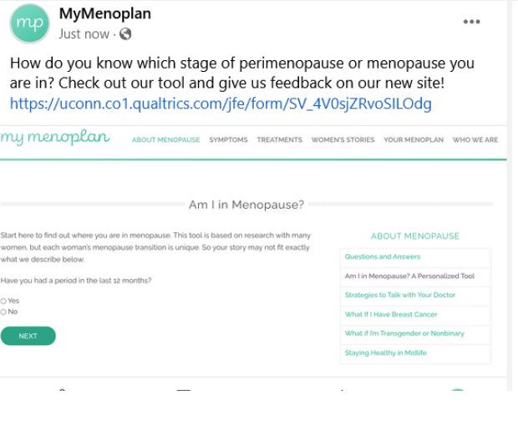
How do you know which stage of perimenopause or menopause you are in? Check out our tool and give us feedback on our new site! https://uconn.co1.qualtrics.com/jfe/form/SV_4V0sjZRvoSILOdg

Slide 4
How do you know which stage of perimenopause or menopause you are in? Check out our tool and give us feedback on our new site! https://uconn.co1.qualtrics.com/jfe/form/SV_4V0sjZRvoSILOdg

