Slide 1


Google Analytics Crash Course
Notes:
This made the content a lot more personal and I think it can win a lot of trust

Slide 2
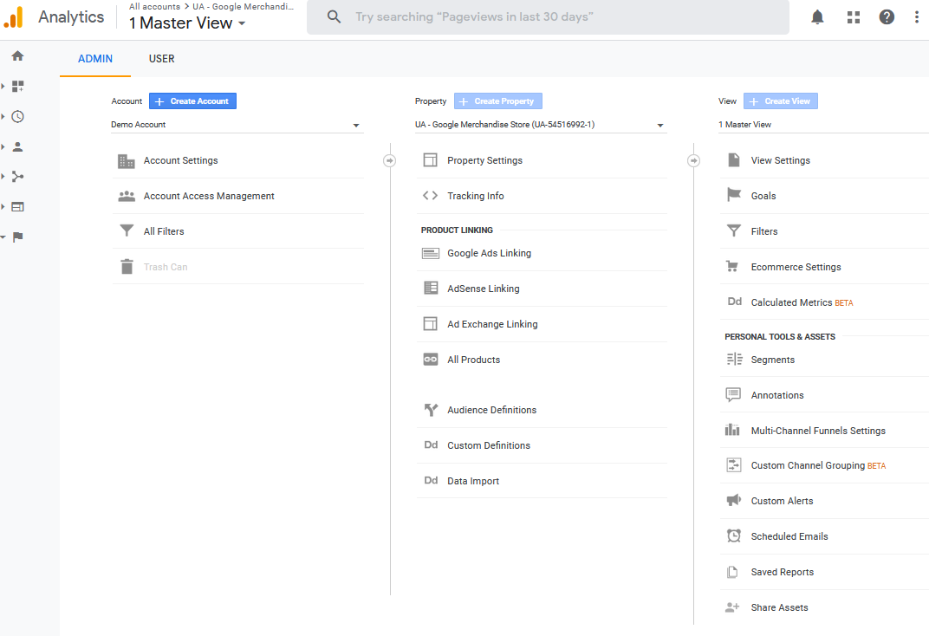
We can access different accounts, properties and views on the Admin Panel
Notes:
This made the content a lot more personal and I think it can win a lot of trust

Slide 3
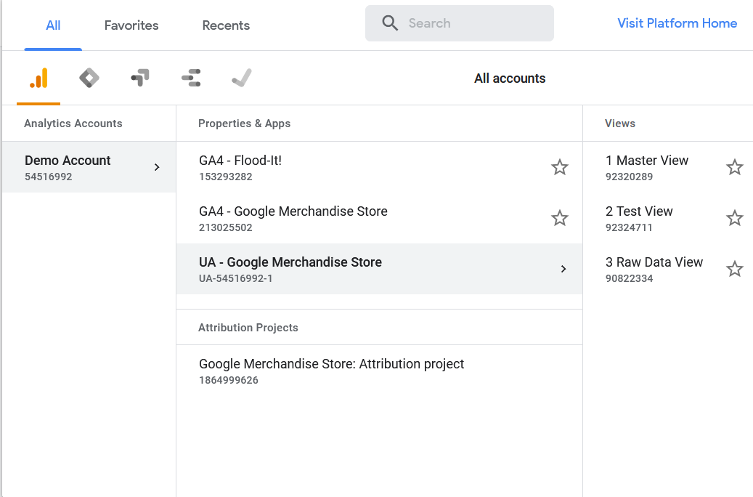
Usually, we create three different types of views
Master Views – Use this view(s) for the analysis of your data. Here you will configure the filters, goals, segments, etc.
Raw Data Views - Backup data. Use it to check the progress of the filters.
Test View (Optional) - If we want to be extra cautious, we can create a view for checking the filters before applying them to the Master View
Notes:
This made the content a lot more personal and I think it can win a lot of trust

Slide 4
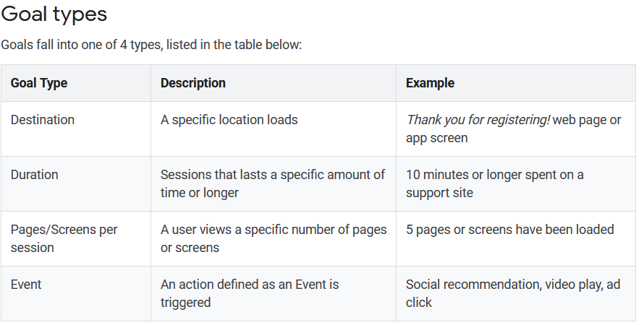
What are “Goals” and “Conversions” in the context of GA?
Goals measure how and when people complete specific actions that you want them to complete. When a goal is achieved it is called a conversion.
Example goals for the Menoplan site:
Completion of the My Menoplan tool
Using the Decision Filter tool for treatments
More than 5 pages from the Treatments section have been loaded

Slide 5
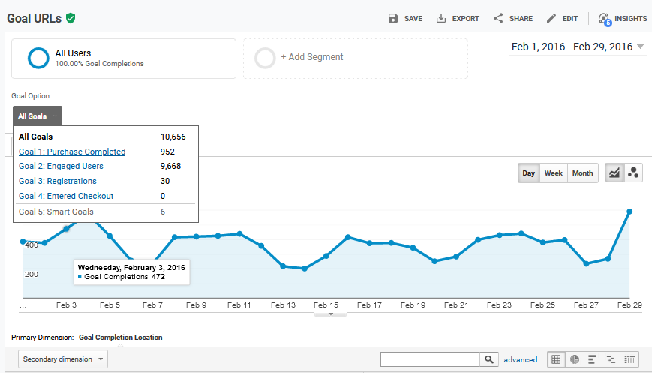
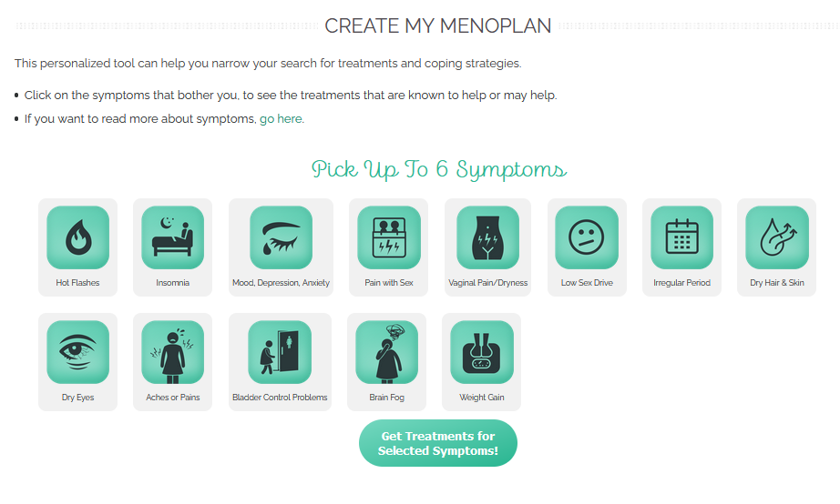
Menoplan Example “Goal”
Notes:
This made the content a lot more personal and I think it can win a lot of trust

Slide 6
How to define “Conversions”?
A conversion can be a
macro conversion
micro conversion
A macro conversion is typically a completed purchase transaction.
A micro conversion is a completed activity, such as an email signup, that indicates that the user is moving towards a macro conversion.
For Menoplan:
Macro conversion: Completing the survey we launch, using important features such as myMenoplan and Decision Filter
Micro conversion: Indicator activities such as playing the video, or clicking through at least 3 toggles on Menopause FAQ section

Slide 7

How to define “Conversions”?
A conversion can be a
macro conversion
micro conversion
A macro conversion is typically a completed purchase transaction.
A micro conversion is a completed activity, such as an email signup, that indicates that the user is moving towards a macro conversion.
For Menoplan:
Macro conversion: Completing the survey we launch, using important features such as myMenoplan and Decision Filter
Micro conversion: Indicator activities such as playing the video, or clicking through at least 3 toggles on Menopause FAQ section

Slide 8
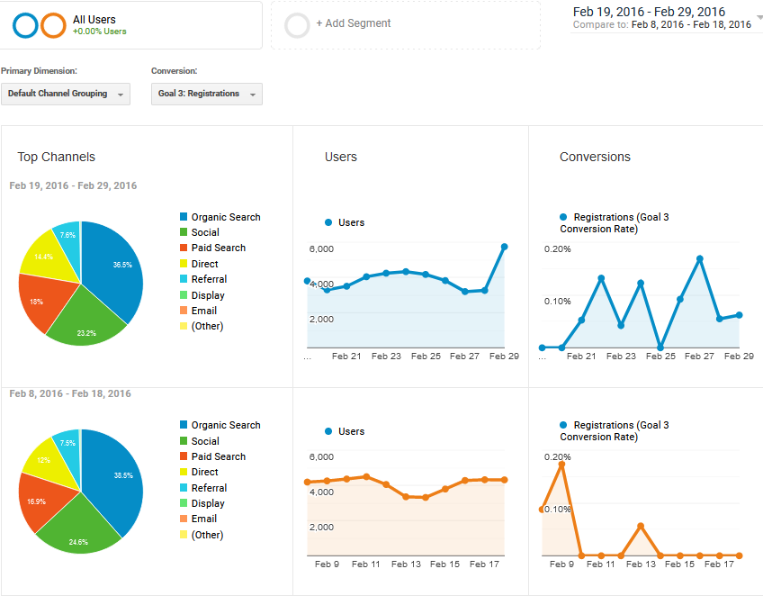
The Date Range filter allows us to compare data from different periods of time
Date range comparison best practices:
Do not include current day in date range
Use 7 days minimum for each comparison period
Consider impact of holidays on user behavior

Slide 9
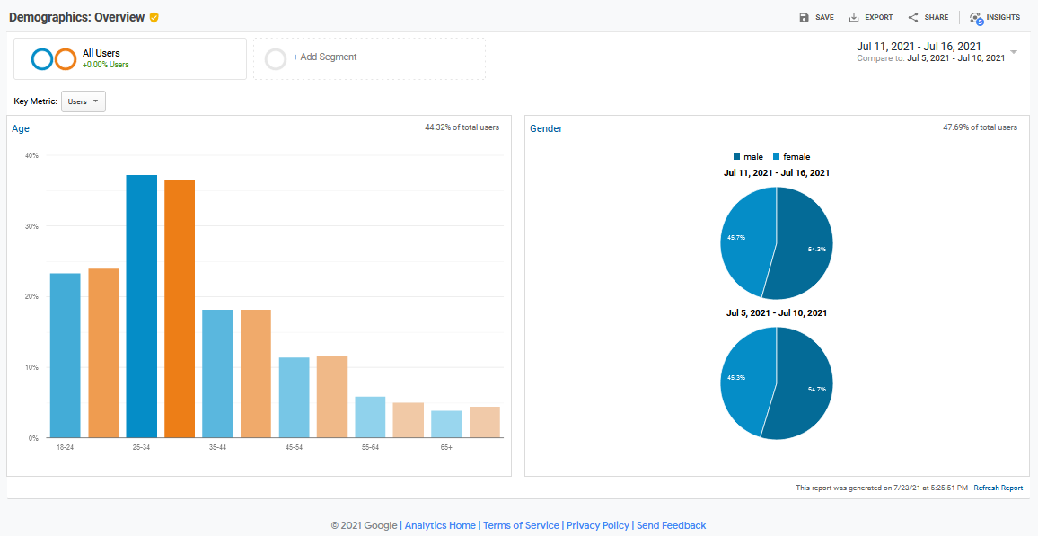
The Date Range filter results can also be sorted by demographic attributes
Date range comparisons sorted by:
Age
Gender
Help answers questions such as:
After making changes to a certain feature to this webpage, did we get more users from the targeted demographic during a certain date range?

Slide 10
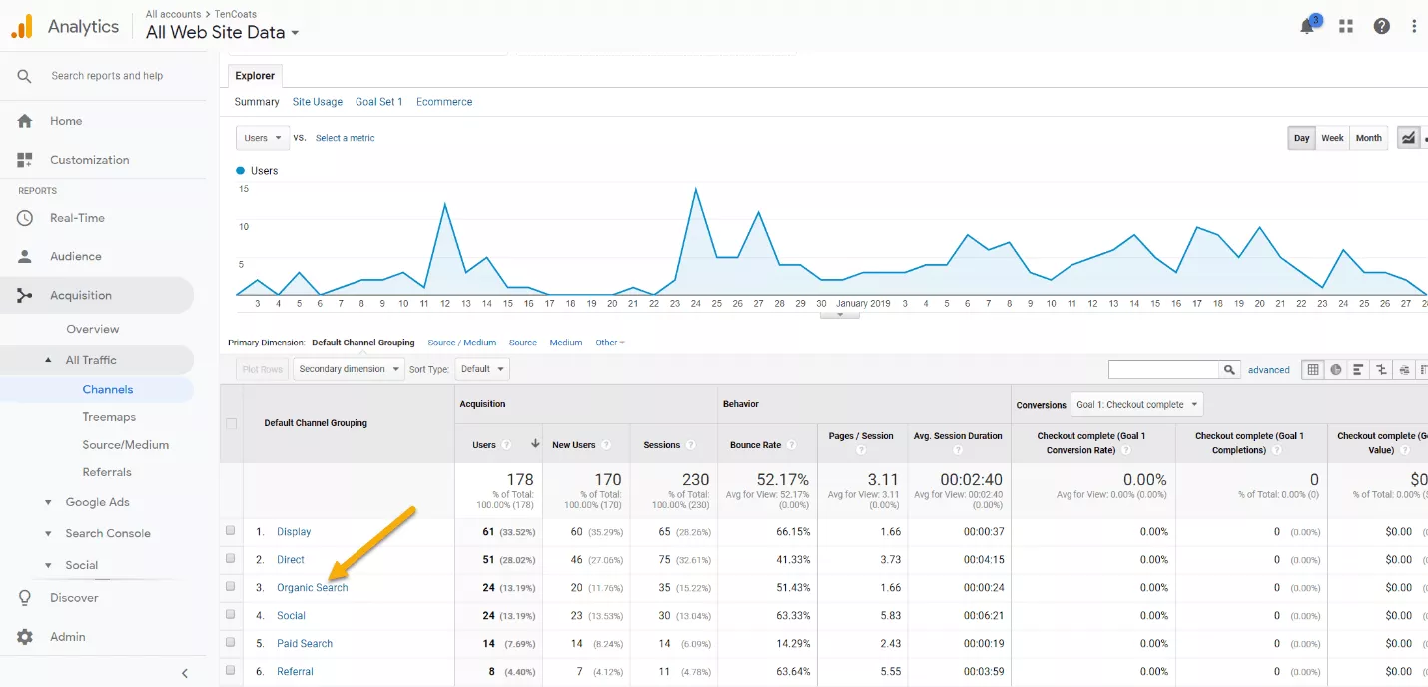
Use Channel Reports to see how much of the website traffic is coming from paid versus unpaid channels
Help answers questions such as:
How much traffic is coming from specific paid versus unpaid channels- organic, paid, direct, referral, and social media?

Slide 11
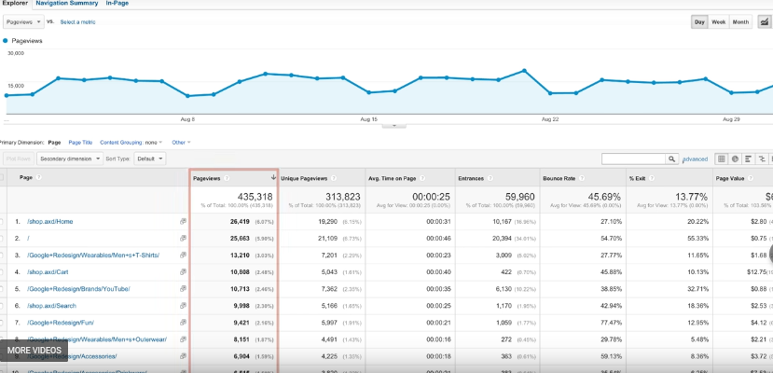
Landing pages under Behavior Reports
Help answers questions such as:
How much traffic is coming from specific paid versus unpaid channels- organic, paid, direct, referral, and social media?

Slide 12
What are reports are generally useful in GA?
Mobile Overview
If website isn’t mobile-friendly, users won’t stay long to read
Landing Pages
What page is most often accessed first and where users are coming from?
Navigation Summary
What are the most common paths users take to get to certain URLs/sections
Channels Report
What are the main sources of traffic, and which ones to optimize?
Goal Overview
Use this to track our goals. What pages are driving goal conversions, which channels are they coming from?

Slide 13
Which of these reports matter for Menoplan?
Goal Overview
We want to know if a person uses the Menoplan tool or other tools (e.g. anxiety, incontinence). These are “goals” that we set. Did they click through the tool to obtain a result?
Landing Pages
If users come from searching for terms on the search engine, which page do they land on, and how long do they spend on those pages?
Navigation Summary
On the site there are many paths to a single page. For example, treatments and symptoms pages are linked to each other based on relevancy. Is the path taken from treatments -> symptoms more common or otherwise? Another example: There are many ways to get to the Menoplan tool, which path is the most commonly taken?
Channels Report
What are the “mediums” (ad, link in email) and “sources” (specific site last visited before reaching Menoplan) of user traffic? Do Facebook ads or other channels lead to the highest conversion rates (e.g., lead to using the Menoplan tool)?

