Slide 1
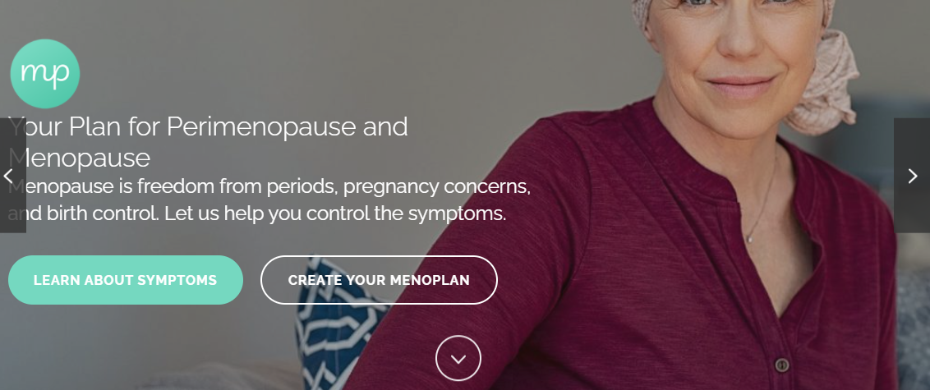
Menoplan Website Audit
Notes:
This made the content a lot more personal and I think it can win a lot of trust

Slide 2
Before beginning a website UX audit
What metrics to include in the audit?
What webpages to prioritize during the audit?
How to interpret the data collected?
How can the data provide us actionable insights?
What do we want to optimize for?
Users’ perceptions of
Notes:
This made the content a lot more personal and I think it can win a lot of trust

Slide 3
Goals of a website UX audit
Identify usability challenges
Key pieces of information are too difficult to find (e.g., SSRI treatment risks)
Key tools are too hard to use (e.g., incontinence tool)
Increase conversion rate
Achieve “goal conversions” – users use the tool
Perception of
Achieve “goal conversions” – users use the tool
Notes:
This made the content a lot more personal and I think it can win a lot of trust

Slide 4
Who is the most representative user of the Menoplan site?
Pre-menopausal, menopausal and post-menopausal women
English fluency
Other demographics
Notes:
This made the content a lot more personal and I think it can win a lot of trust

Slide 5
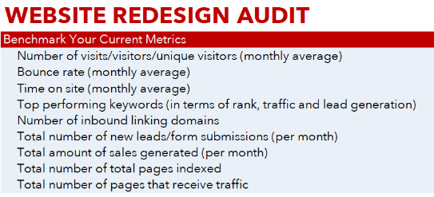
Website Audit focused on User Perceptions
Pre-menopausal, menopausal and post-menopausal women
Notes:
This made the content a lot more personal and I think it can win a lot of trust

Slide 6
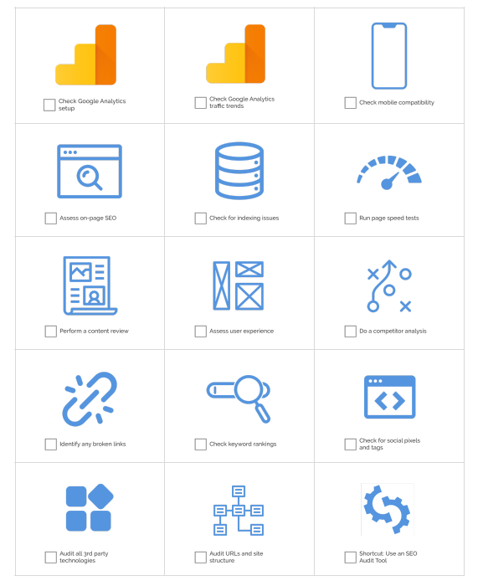




General Audit Checklist
Notes:
This made the content a lot more personal and I think it can win a lot of trust

Slide 7
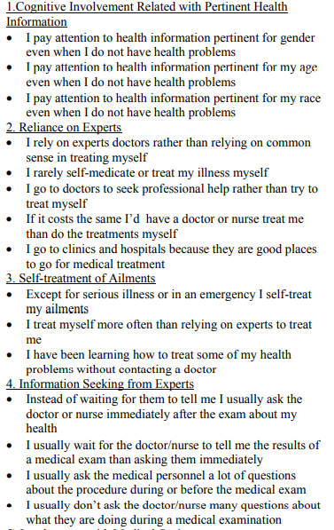
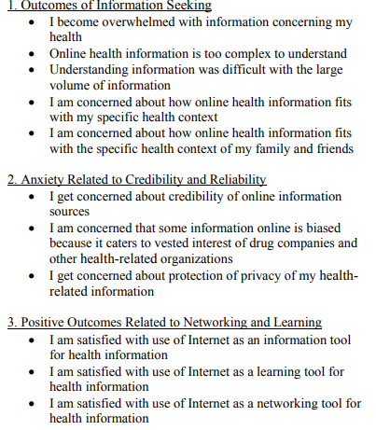
Who is the most representative user of the Menoplan site?
Notes:
This made the content a lot more personal and I think it can win a lot of trust

