Slide 2
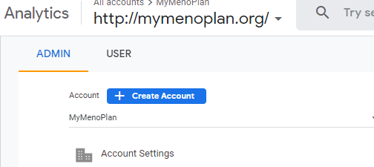
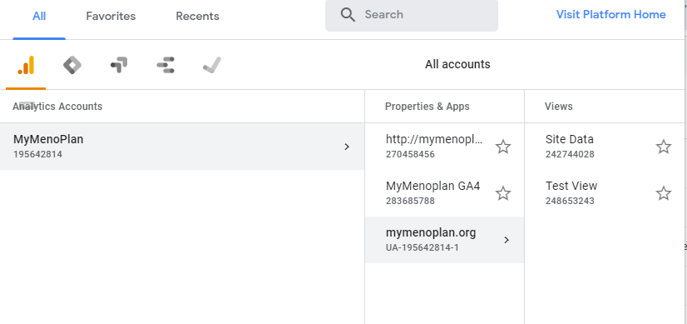
Accessing the correct Property and View in GA

Slide 3
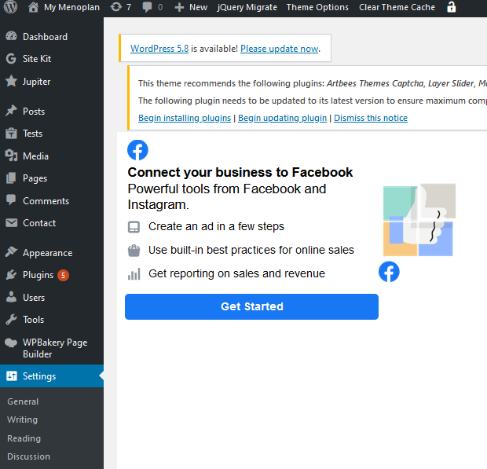
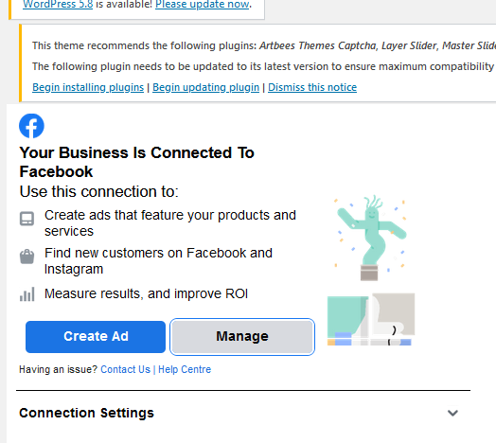
Current status of Facebook Pixel

Slide 4
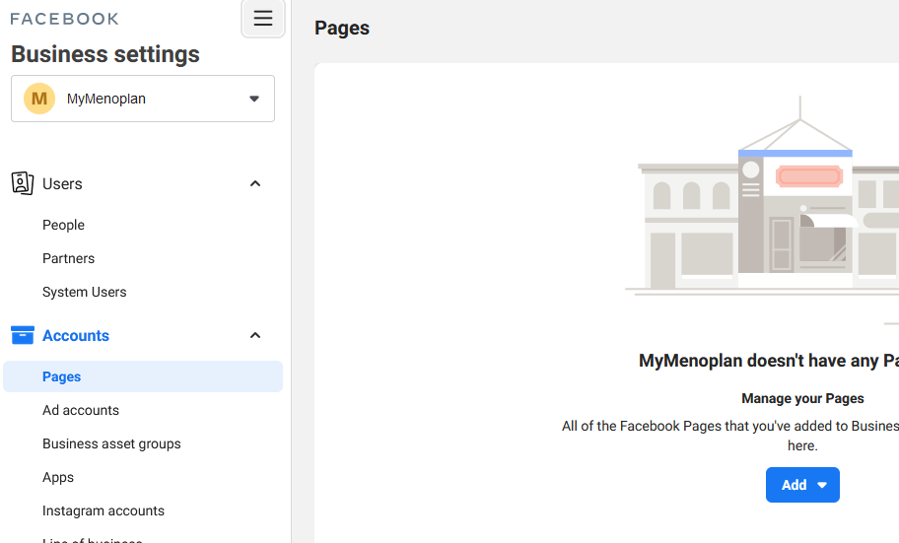
Created a Facebook Business Manager Account “MyMenoplan” using my personal account

Slide 5
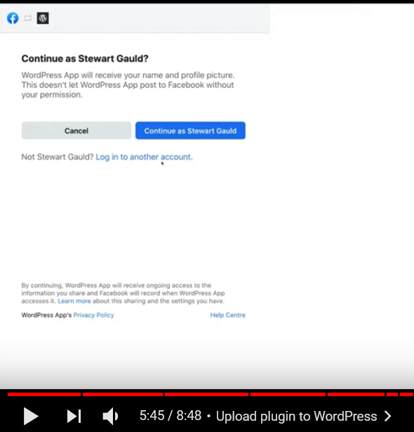
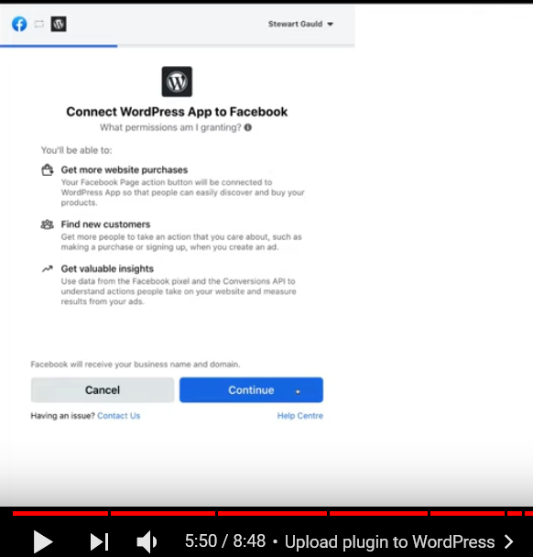
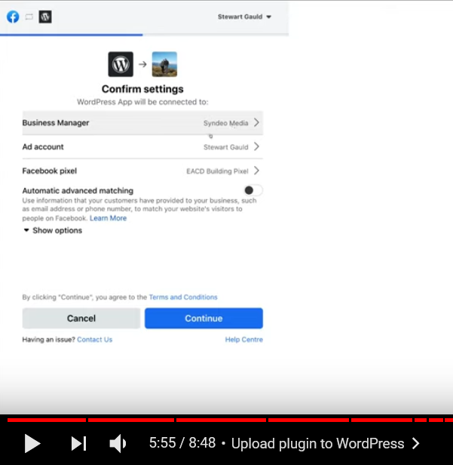
YouTube Tutorial of How to Connect FB Pixel to Wordpress

Slide 6
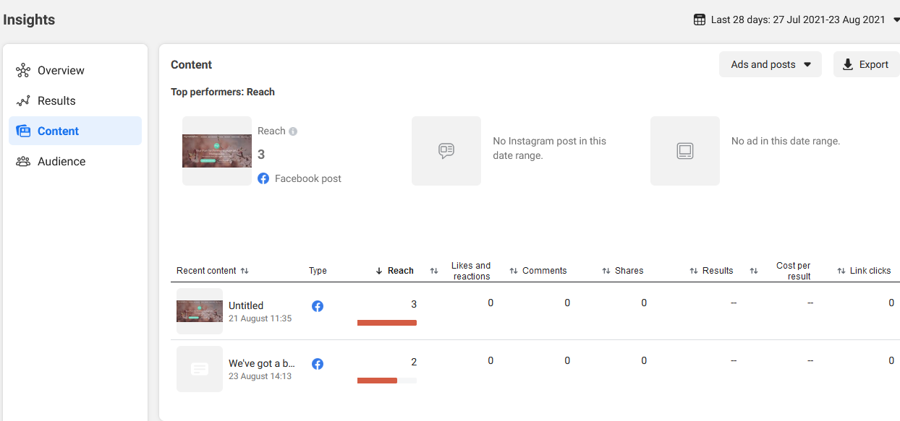
Facebook Business Suite to measure content reach. Are ads turned on?

Slide 7
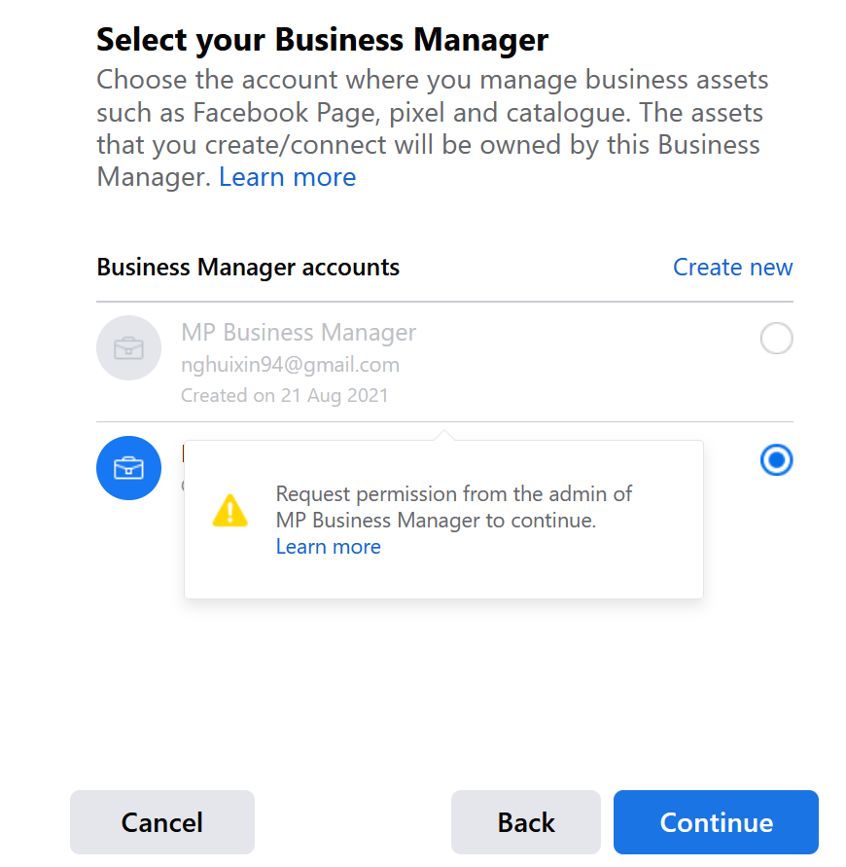
Link Business Manager to Wordpress

Slide 8
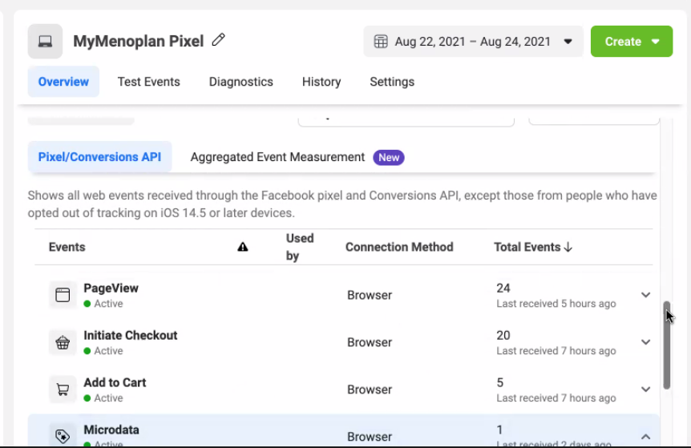
Microdata in MyMenoplan Pixel

Slide 9
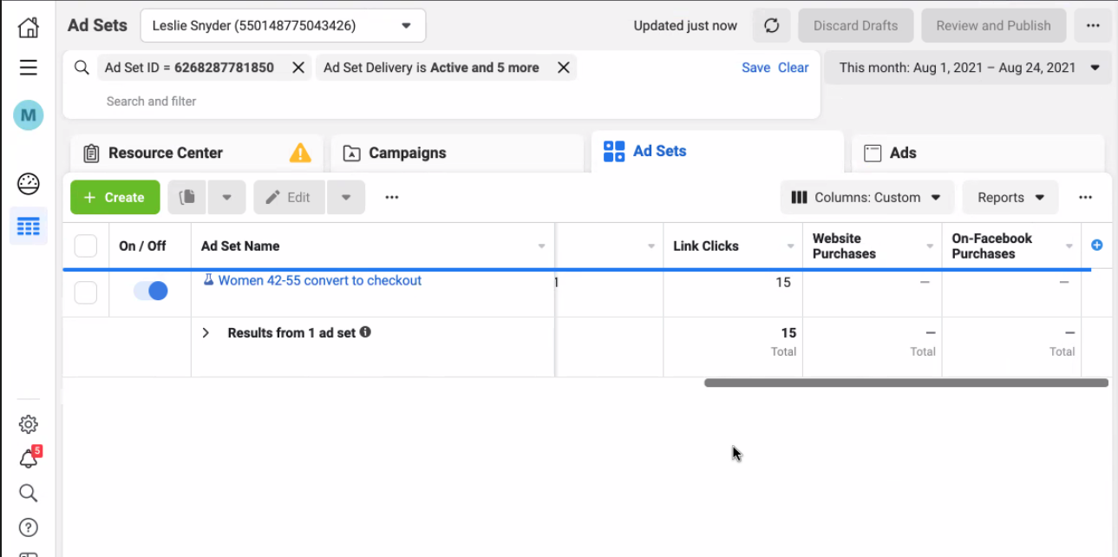
Link to Qualtrics

Slide 10
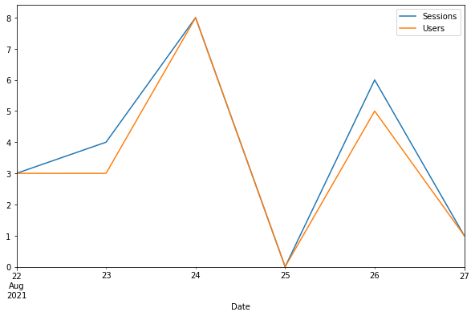
Using Google Analytics with API

Slide 11
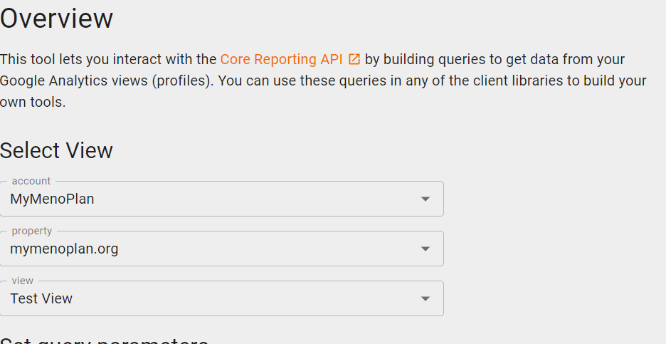
Using Google Analytics with API
Go to https://ga-dev-tools.web.app/query-explorer/ and login
Some parts are autopopulated based on your login

Slide 12
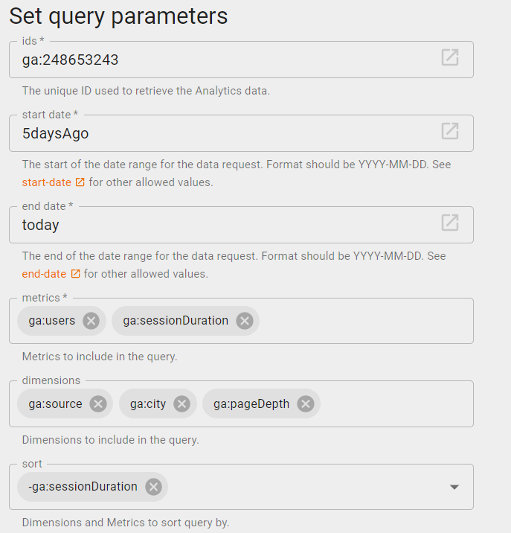
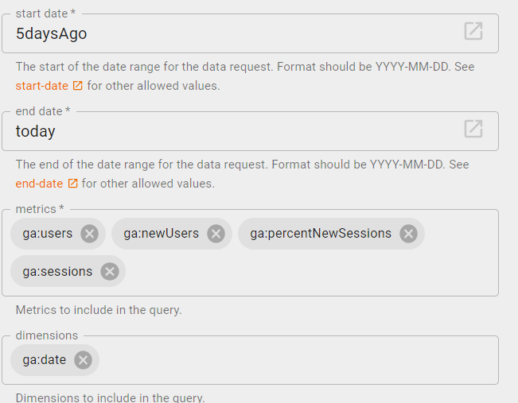
Set Query Parameters
We can set based on date as well

Slide 13
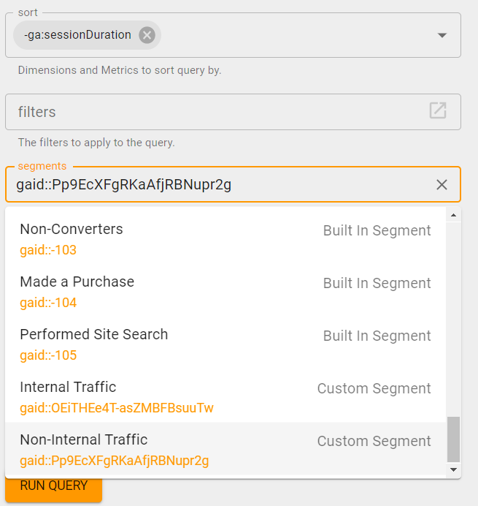
Set Query Parameters
Click on segments to search for “Non Internal Segment” , which was created in GA dashboard

Slide 14
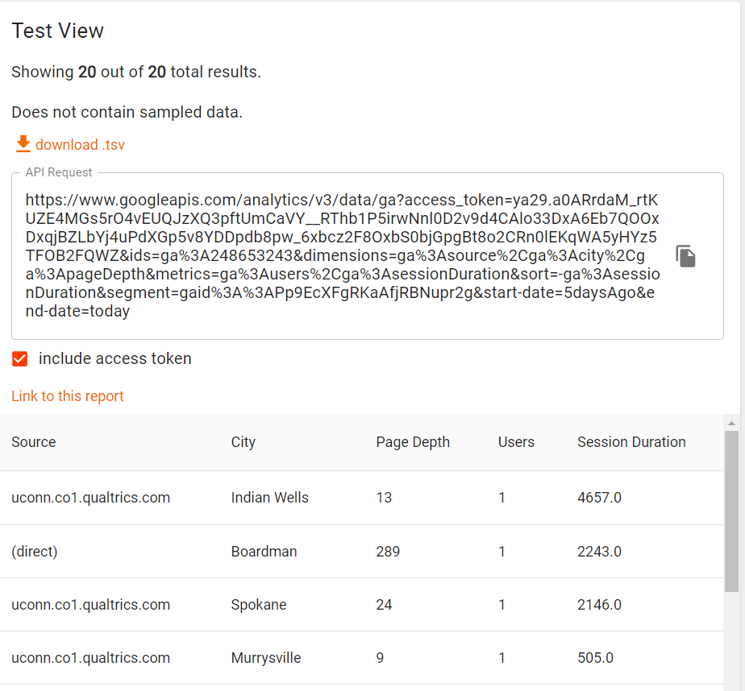
UA Query generates an API Request which you enter inside your Jupyter notebooks
It returns the API request and rows of the query result

Slide 15
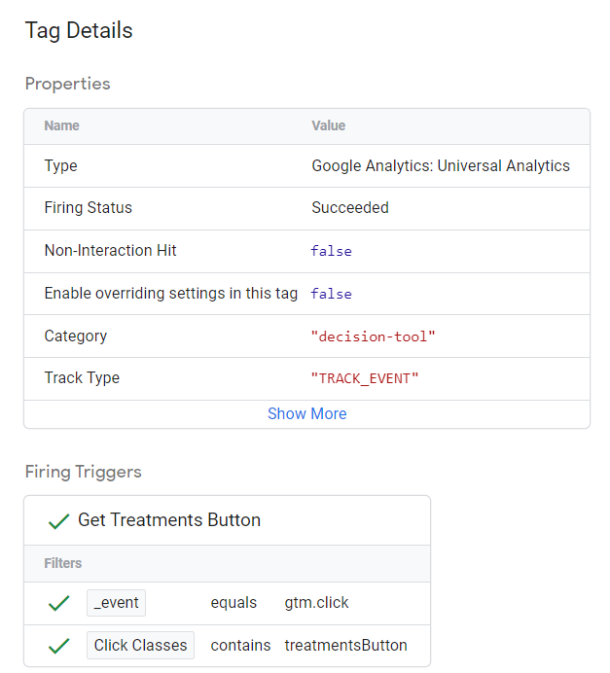
UA Query generates an API Request which you enter inside your Jupyter notebooks
It returns the API request and rows of the query result

