Slide 1
IMAGE PROCESSING TECHNIQUES
Nguyen Huu Toan

Slide 2
Overview
Histogram
Image Affine Transformation
Blur, sharpness, gamma correction, change brightness/contrast
Detecting contour
Segmentation

Slide 3
I. Histogram
Histogram
Histogram Equalization
Adaptive Histogram Equalization

Slide 4
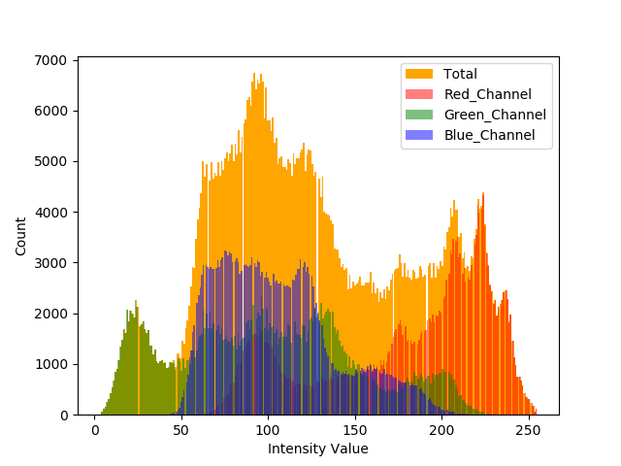
Histogram
Histogram example

Slide 5
Histogram
Image histogram is a graph which shows frequency of pixels intensity values
The horizontal axis of the graph represents the tonal variations
The vertical axis represents the total number of pixels in that particular tone

Slide 6
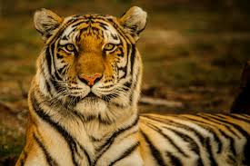
Histogram
Example Image

Slide 7
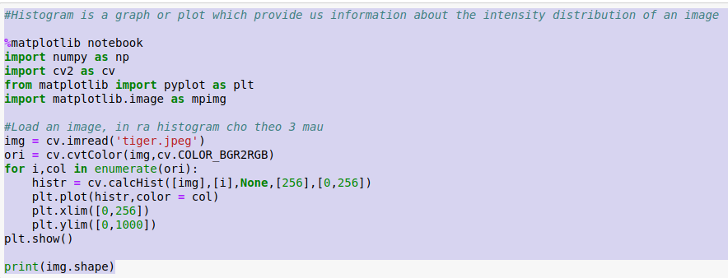
Histogram
Jupyter code

Slide 8
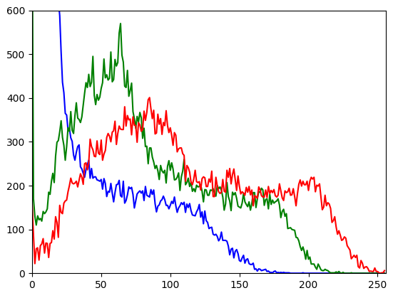
Histogram
Result

Slide 9
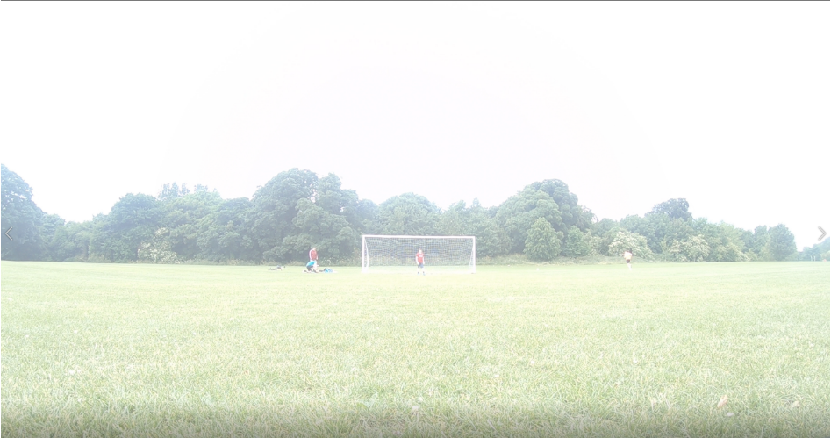
Histogram Equalization
Images may have unbalanced intensity distribution, for eg, brighter image will have all pixels confined to high values.
Over bright image

Slide 10
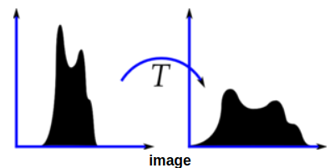
Histogram Equalization
But a good image will have pixels from all regions of the image
=> need to stretch this histogram to either ends
=> Histogram Equalization => improves the contrast of the image.
Equalize

Slide 11
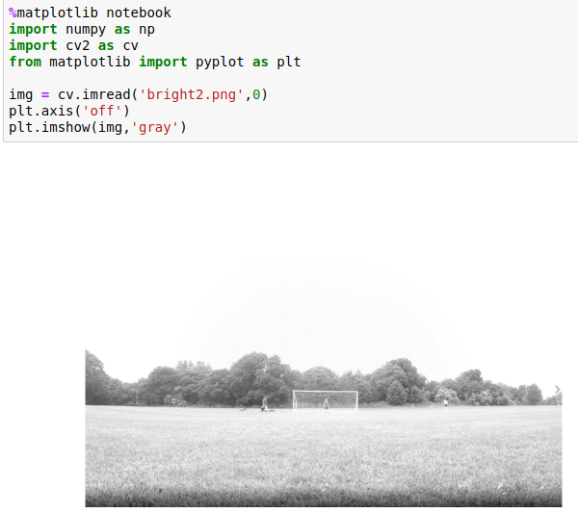
Histogram Equalization
Load image as grayscale

Slide 12
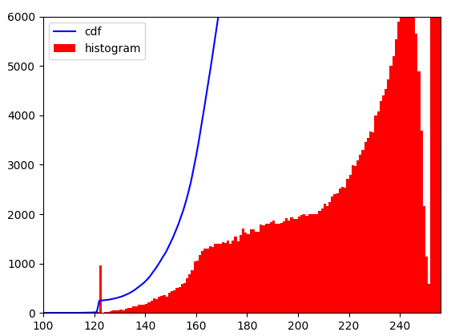
Histogram Equalization
Image histogram

Slide 13
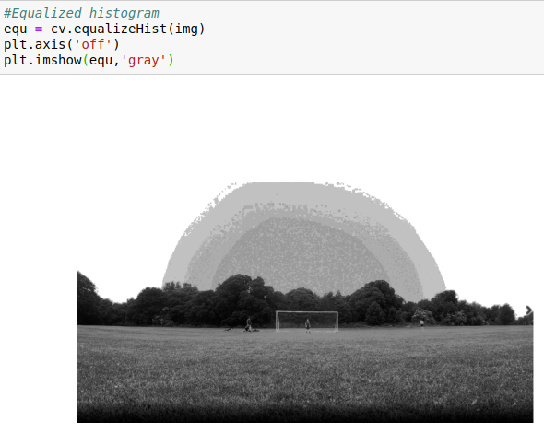
Histogram Equalization
Traditional Histogram Equalization

Slide 14
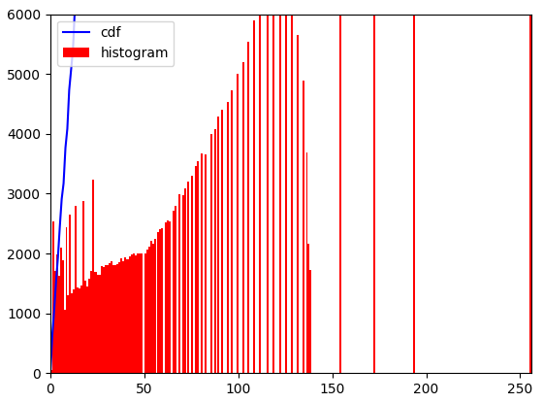
Histogram Equalization
New histogram

Slide 15
Adaptive Histogram Equalization
It is true that the background contrast has improved after histogram equalization.
But in many cases, after using traditional histogram equalization, we lost most of the information there due to over-brightness.
=> adaptive histogram equalization

Slide 16
Adaptive Histogram Equalization
How does it work:
  Image is divided into small blocks called "tiles"
  Each of these blocks are histogram equalized
  In a small area, histogram would confine to a small region

Slide 17
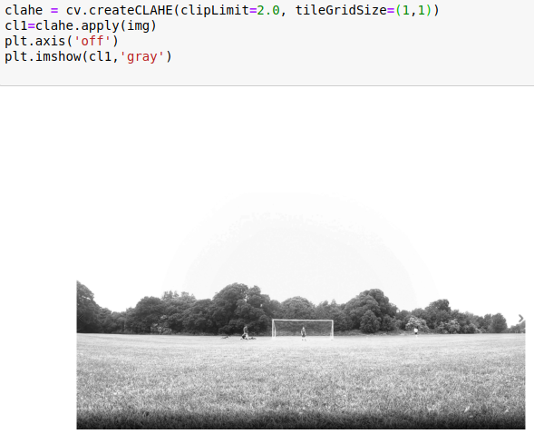
Adaptive Histogram Equalization
Adaptive histogram Equalization

Slide 18
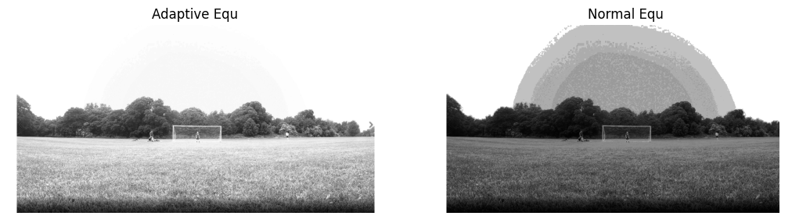
Adaptive Histogram Equalization
Compare 2 methods

Slide 19
II. Image Affine Transformation
Scaling
Translation
Rotation
Zooming

Slide 20
Scaling
Define: Re-size image
Resizing images is a critical pre-processing step in computer vision because:
  Principally, our machine learning models train faster on smaller images.
    Ex: An input image that is twice as large requires our network to learn from four times as many pixels — and that time adds up.
  Many deep learning model architectures require that our images are the same size and our raw collected images may vary in size.

Slide 21
Scaling
Scaling:
  Scale both width and height proportionally
  Change width/height to a specific number
Note:
  Downsizing larger images to match the size of smaller images is often a better bet than increasing the size of small images to be larger.
  In general, it is safer to maintain the raw image aspect ratio and resize proportionally.

Slide 22
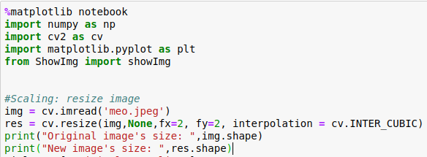

Scaling
Scale image proportionally

Slide 23

Scaling
Result of Scale image proportionally

Slide 24
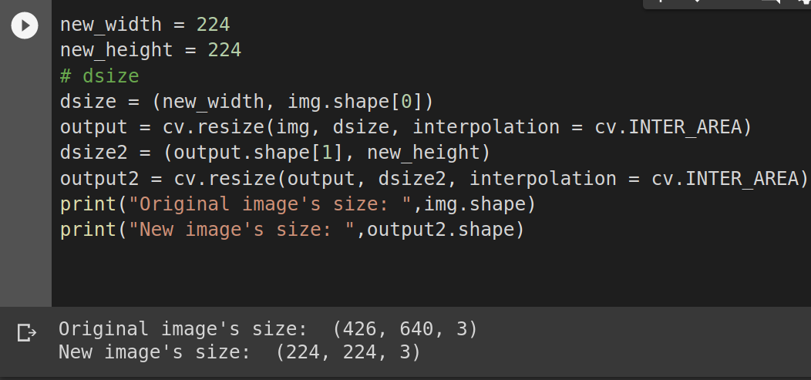
Scaling
Change both width and height to specific numbers

Slide 25
Translation
In many imaging systems, detected images are subject to geometric distortion introduced by perspective irregularities wherein the position of the camera(s) with respect to the scene alters the apparent dimensions of the scene geometry.
Applying an affine transformation to a uniformly distorted image can correct for a range of perspective distortions by transforming the measurements from the ideal coordinates to those actually used
=> Translation is used to improve visualization of an image

Slide 26
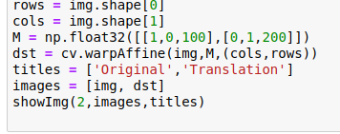
Translation
Translation

Slide 27
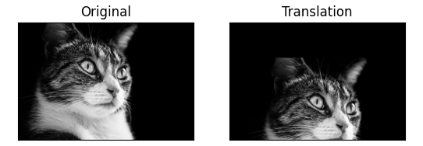
Translation
Result

Slide 28
Rotation
Rotation is most commonly used to improve the visual appearance of an image,
Used as a preprocessor in applications where directional operators are involved

Slide 29
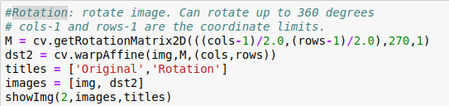
Rotation
Rotation

Slide 30
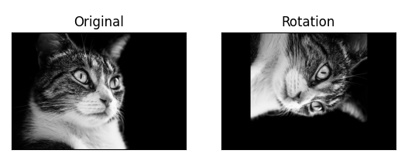
Rotation
Result

Slide 31
Zooming
Zooming is most commonly used to improve the visual appearance of an image

Slide 32
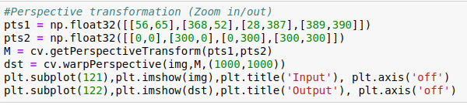
Zooming
Perspective Transformation

Slide 33
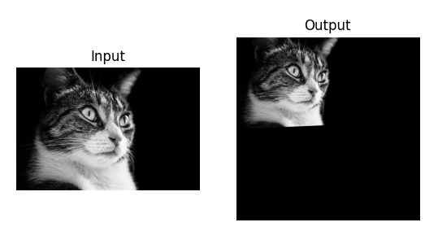
Rotation
Result

Slide 34
III. Brightness and contrast
Blur
Enhance sharpness
Change brightness/contrast
Gamma correction

Slide 35
Blur
Reducing noise in images
Reducing details in images
Types of blurring:
  Gaussian blur
  Normalized box (Average blur)
  Median blur
  Bilateral filtering

Slide 36
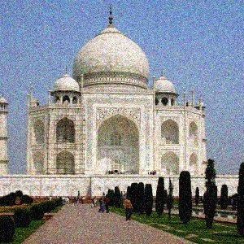
Blur
Original Image

Slide 37
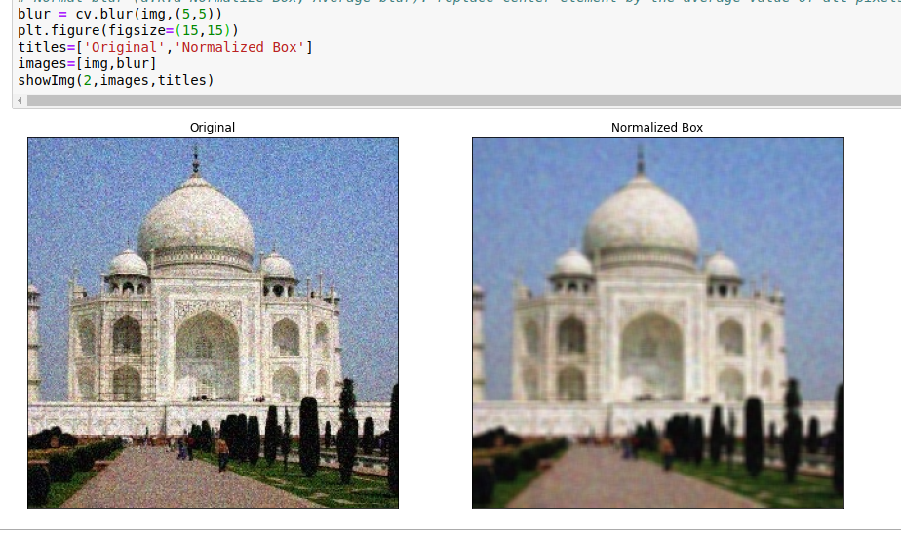
Normalized box (Average blur)
Replace center element by the average value of all pixels in kernel

Slide 38
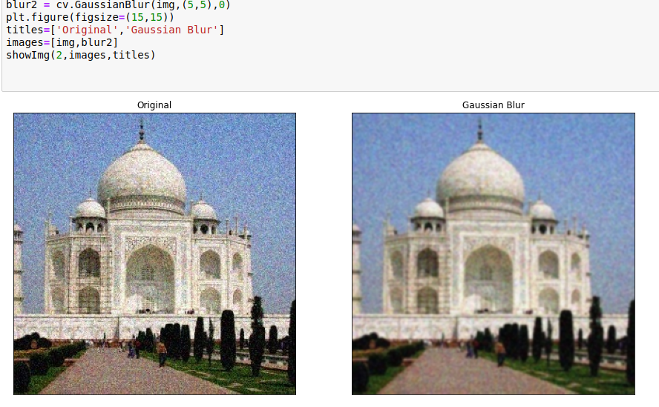
Gaussian blur
Effective in removing Gaussian noise

Slide 39
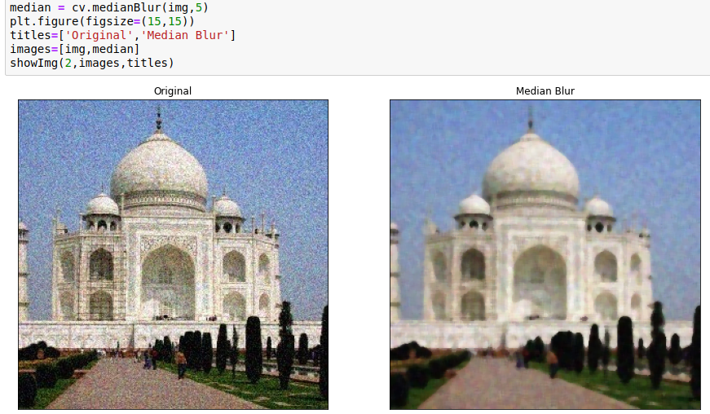
Median blur
Effective in removing Chilly-and-pepper noise

Slide 40
Bilateral filtering
Usually, blurring will case lost in edges => use bilateral filtering to keep edges
How does it work:
  This operation takes 2 Gaussian filters
  One func makes sure that only nearby pixels are considered for blurring
  The other one (Gaussian function of intensity difference) make sure only those pixels with similar intensities to the central pixel are considered for blurring

Slide 41
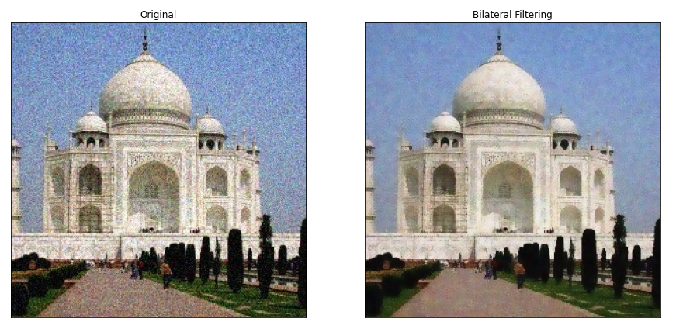
Bilateral filtering

Slide 42
Enhance Sharpness
Blurring helps removing noise in images, but also causes loss in edges
=> Enhance sharpness

Slide 43
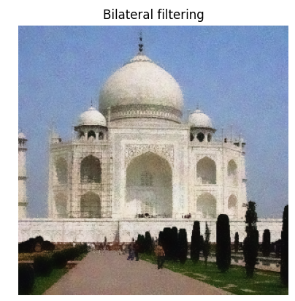
Enhance Sharpness
Blurred image

Slide 44
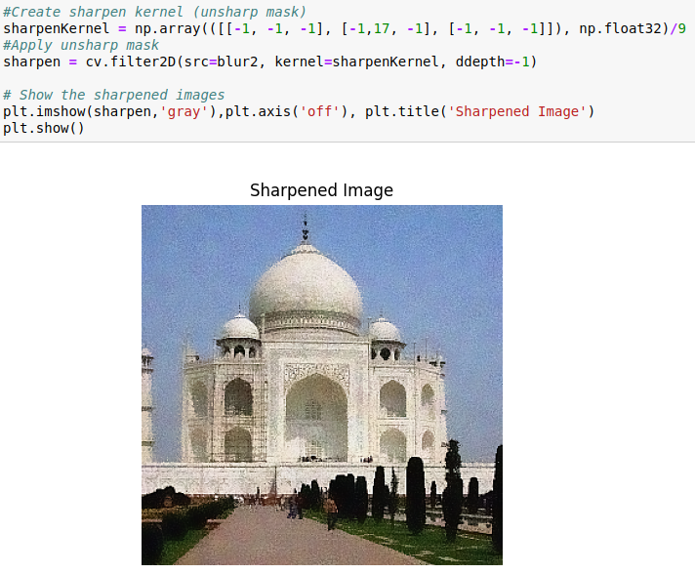
Enhance Sharpness
Sharpen and print result

Slide 45
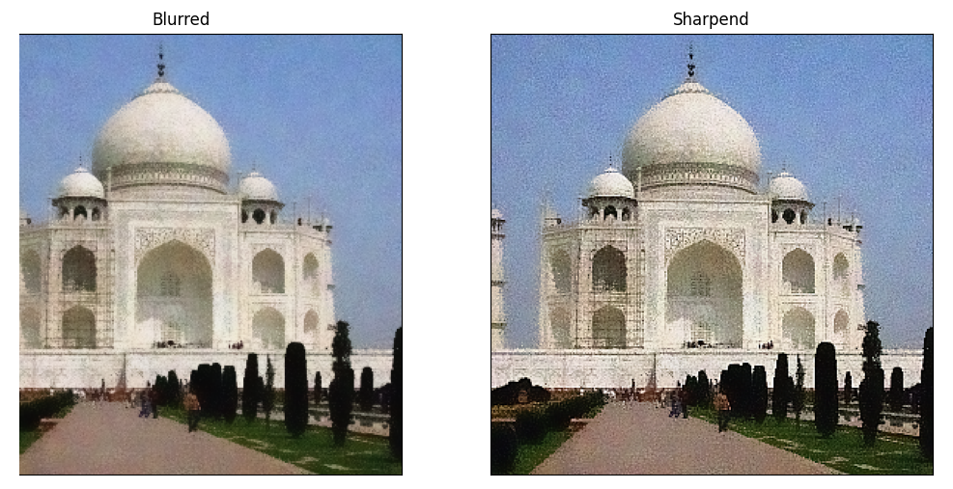
Enhance Sharpness
Result

Slide 46
Change brightness and contrast
Because of various lighting conditions of images
=> Process these problems by using:
  Change brightness and contrast
  Gamma correction
  Histogram equalization
Brightness and contrast of an image can be expressed as
y = alpha * x + beta
with: - alpha controls contrast
- beta controls brightness
=> Change alpha and beta values will change lighting condition of that image

Slide 47
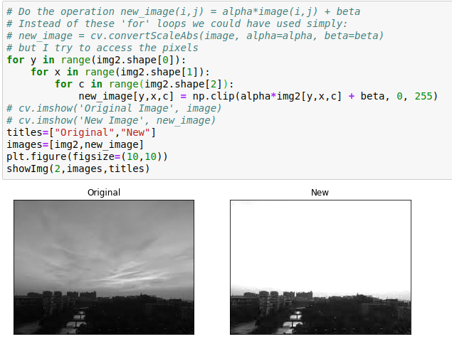
Change brightness and contrast

Slide 48
Gamma correction
Another way to change lighting condition of an image is using gamma correction
Gamma’s definition: defines the relationship between a pixel's numerical value and its actual luminance
Also know as: gamma encoding or gamma compression

Slide 49
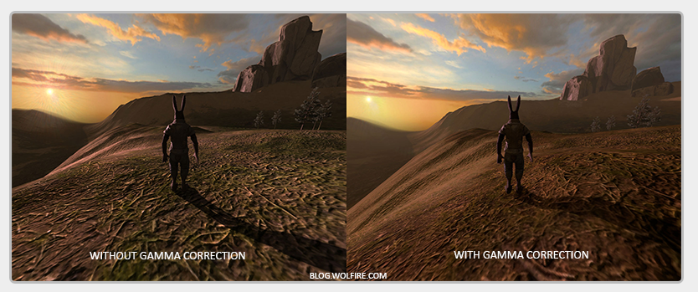
Gamma correction

Slide 50
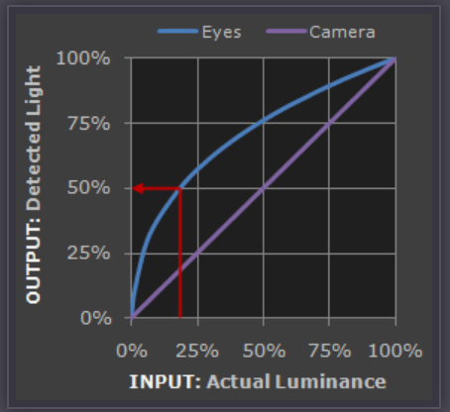
Gamma correction
Reason

Slide 51
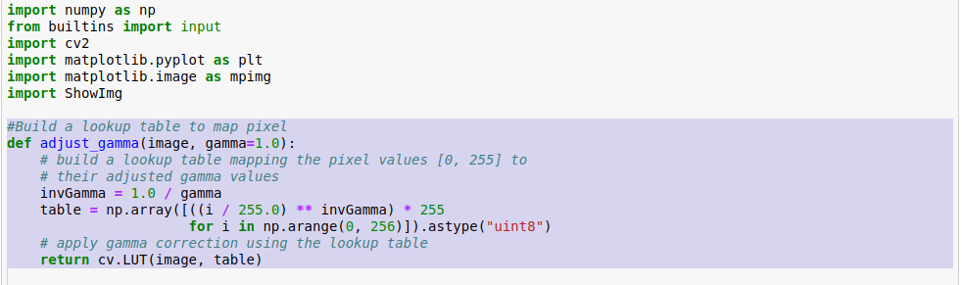
Gamma correction
Build a lookup table to convert values

Slide 52
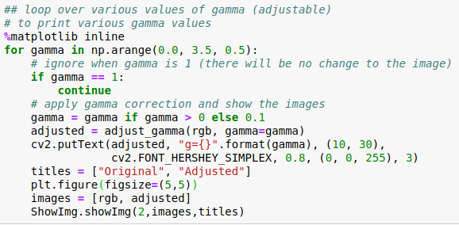
Gamma correction
Apply gamma correction and show results
with different gamma values in range (0.1 - 3)

Slide 53
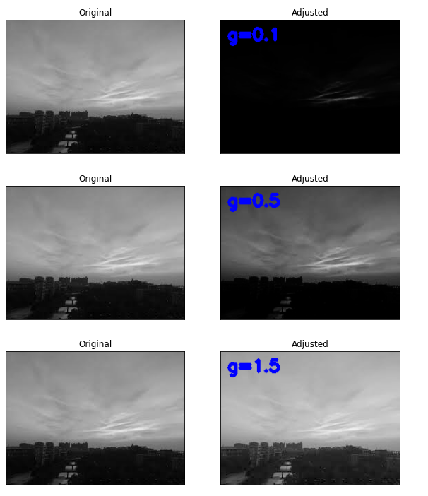
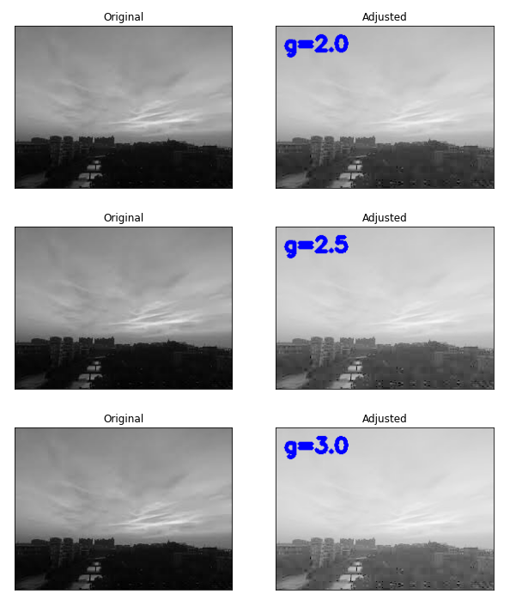
Gamma correction
Result

Slide 54
IV. Detecting contour
Thresholding
Line detection
Edge Detection
Detecting contour

Slide 55
Thresholding
Convert gray-scale image to binary image
=> make the it easier to analyze
Used as a way to select areas of interest of an image, while ignoring the parts we are not concerned with

Slide 56
Thresholding
Global thresholding
Adaptive thresholding
Otsu’s thresholding

Slide 57
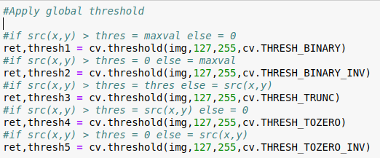
Global thresholding
Use only 1 threshold value for all of the image

Slide 58
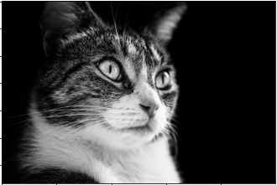
Global Thresholding
Original image

Slide 59
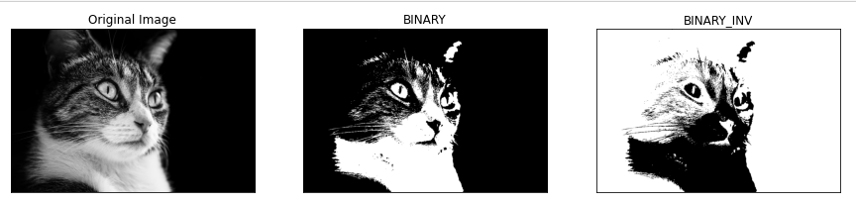
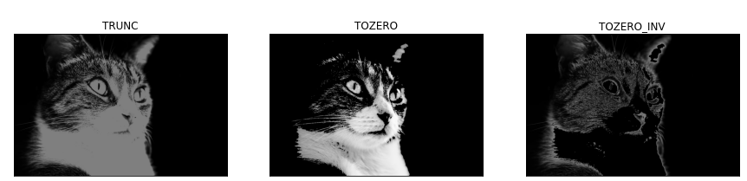
Global Thresholding
Global thresholding results

Slide 60
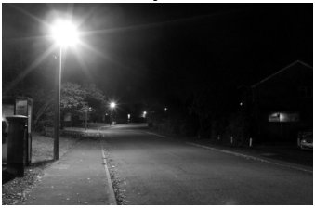
Adaptive thresholding
If an image has different lighting conditions in different areas.
Original image

Slide 61
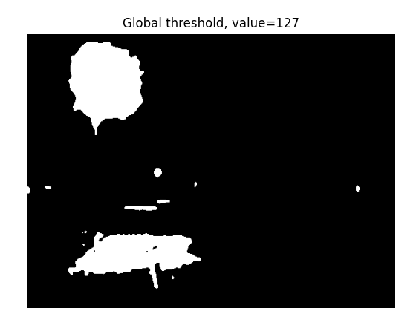
Adaptive thresholding
Apply global threshold, value = 127
Global threshold

Slide 62

Adaptive thresholding
=> Apply adaptive threshold
Adaptive threshold

Slide 63
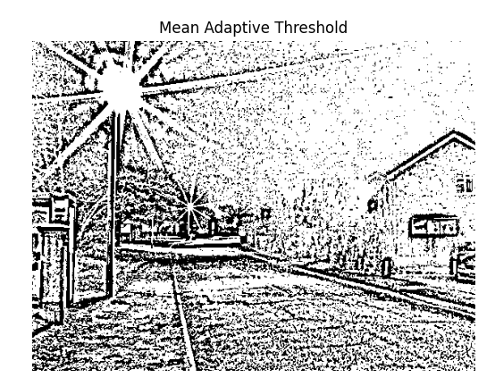
Adaptive thresholding
Mean adaptive threshold

Slide 64
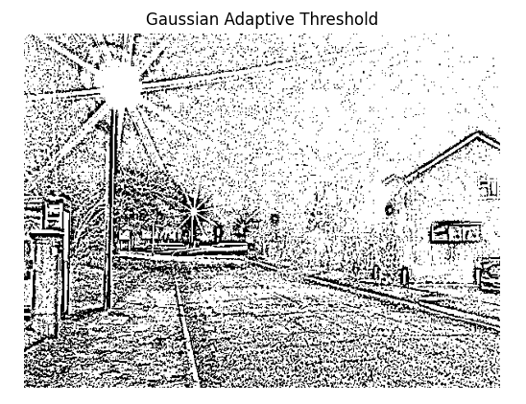
Adaptive thresholding
Gaussian adaptive threshold

Slide 65
Otsu’s thresholding
Global threshold: Chose value manually
=> Trial and error
=> Otsu 'll choose value automatically
How? Determines an optimal global threshold value from the image histogram

Slide 66
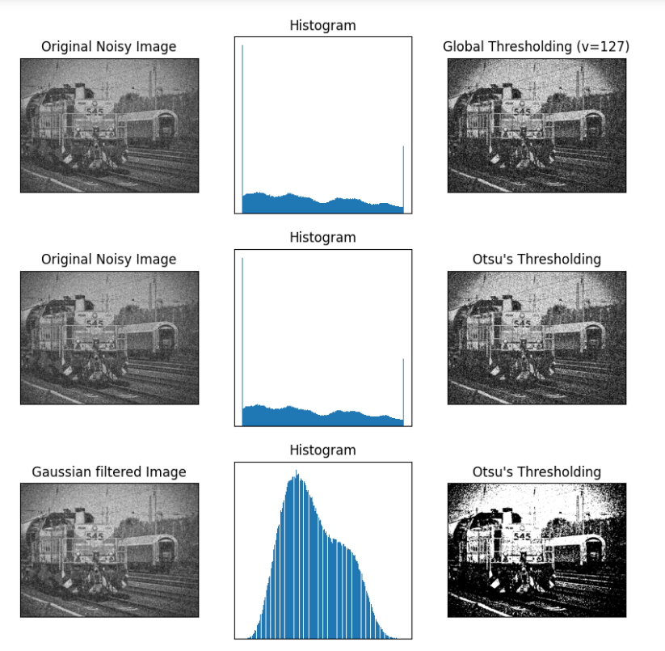
Otsu’s thresholding

Slide 67
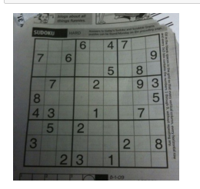
Line detection
Detecting lines in images => detect edges
Sample image

Slide 68
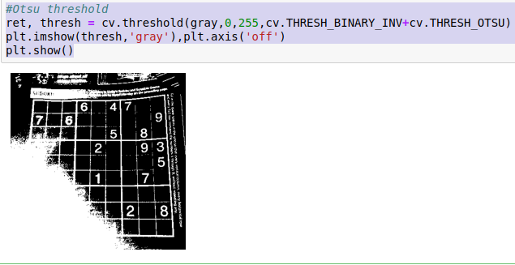
Line detection
Apply Otsu threshold => Lost a lot of image’s information => Histogram Equalization
Apply Otsu threshold

Slide 69
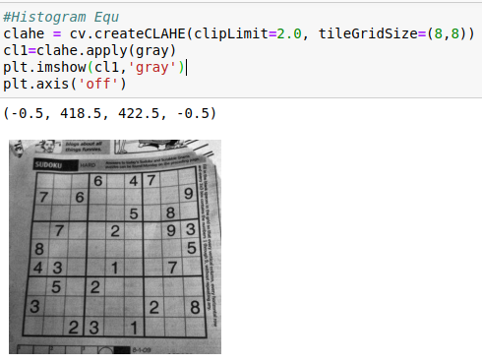
Line detection
Apply Histogram Equalization
Apply histogram equalization

Slide 70
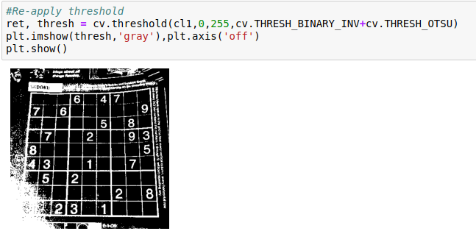
Line detection
Re-apply threshold
Re-apply threshold

Slide 71
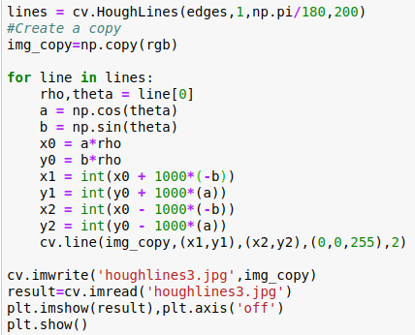
Line detection
Apply line detection => Draw found lines on a new image
Line detection

Slide 72
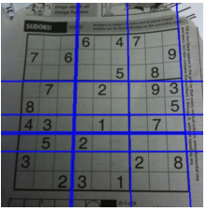
Line detection
Result

Slide 73
Edge detection
Edge detection is an image processing technique for finding the boundaries of objects and object’s features within images.
It works by detecting discontinuities in brightness

Slide 74

Edge detection
Apply Canny edge detection and result

Slide 75
Contour detection
Is a curve joining all the continuous points (along the boundary), having same color or intensity
Useful tool for shape analysis and object detection and recognition.

Slide 76

Contour detection
Original image and apply threshold

Slide 77

Contour detection
Apply Canny Edge Detection

Slide 78

Contour detection
Finding contours and draw all contours

Slide 79

Contour detection
Result

Slide 80
V. Watershed Image segmentation
Any grayscale image can be viewed as a topographic surface where high intensity denotes peaks and hills while low intensity denotes valleys
Filling every isolated valleys (local minima) with different colored water (labels) => the water rises
=> Depending on the peaks (gradients) nearby water from different valleys (different colors) will start to merge
To avoid that, build barriers in the locations where water merges.
Continue the work of filling water and building barriers
=> all the peaks are under water.
=> the barriers we created gives the segmentation result

Slide 81

Watershed Image segmentation
Original image

Slide 82

Watershed Image segmentation
Convert to gray scale then apply Otsu threshold

Slide 83

Watershed Image segmentation
Using opening to remove noise

Slide 84

Watershed Image segmentation
Determine sure background area (Black Region)

Slide 85

Watershed Image segmentation
Using distance transformation to find sure foreground objects (White objects)

Slide 86

Watershed Image segmentation
Unknown area (White region)

Slide 87

Watershed Image segmentation
Summarize

Slide 88

Watershed Image segmentation
Marker

Slide 89

Watershed Image segmentation
Apply Watershed

Slide 90

Watershed Image segmentation
After Image Segmentation

Slide 91
Summarize
Histogram
Image Affine Transformation
Blur, sharpness, gamma correction, change brightness/contrast
Detecting contour
Segmentation

Slide 92
QUESTIONS AND ANSWERS

Slide 93

THANK YOU FOR WATCHING

