Slide 1

DEEP NEURAL NETWORK
Nguyen Huu Toan

Slide 2
Overview
Deep Neural Network (DNN)
Convolutional Neural Network (CNN)
Recurrent Neural Network (RNN)

Slide 3
I. Deep Neural Network
1/ Definition
2/ Layers, nodes
3/ Different types of Deep Neural Network

Slide 4
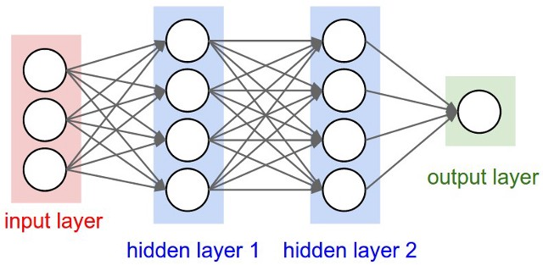
I. Deep Neural Network
1/ Neural Network

Slide 5
I. Deep Neural Network
1/ Neural Network
Is a technology built to simulate the activity of the human brain – specifically, pattern recognition and the passage of input through various layers of simulated neural connections.
Have an input layer, an output layer and AT LEAST one hidden layer in between
=> Deep Neural Network is a Neural Network that has many hidden layers

Slide 6
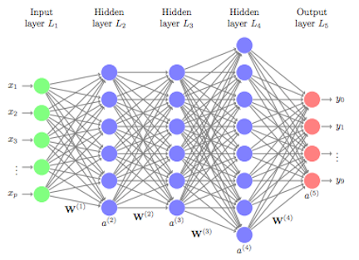
I. Deep Neural Network
1/ Deep Neural Network
Deep Neural Network is a Neural Network that has many hidden layers( > 2)

Slide 7
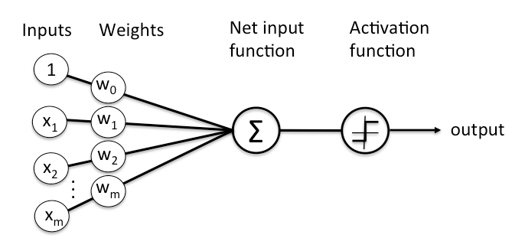
I. Deep Neural Network
2/ Layers, nodes
Layers are made of nodes

Slide 8
I. Deep Neural Network
3/ Different types of DNN’s structure
Convolutional Neural Network (CNN): image recognition
Recurrent Neural Network (RNN): sequential problem
Restricted Boltzmann Machine (RBM): find patterns in data in an unsupervised manner
Deep Belief Netwrok (DBN): invented to solve “local minima” or “vanishing gradients” problems in back-propagation
Autoencoder: Similar to DBN but with different network architecture

Slide 9
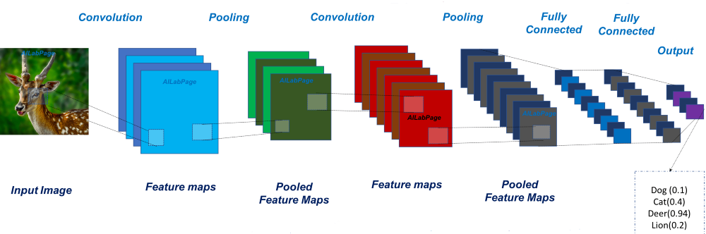
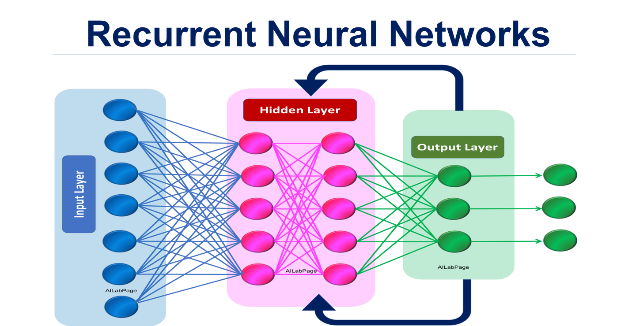
I. Deep Neural Network
3/ Different types of DNN’s structure
Recurrent Neural Network
Convolution Neural Network

Slide 10
II. Convolutional Neural Network
1/ Definition
2/ Structure
3/ Application
4/ Different Architectures

Slide 11
II. Convolutional Neural Network

Slide 12
II. Convolutional Neural Networks (CNN)
1/ What is CNN?
A neural network for recognition tasks
Key features:
  Detect and classify objects into categories
  Robust against differences in pose, scale, lighting, ...

Slide 13

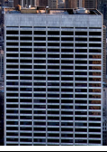
II. Convolutional Neural Networks (CNN)

Slide 14



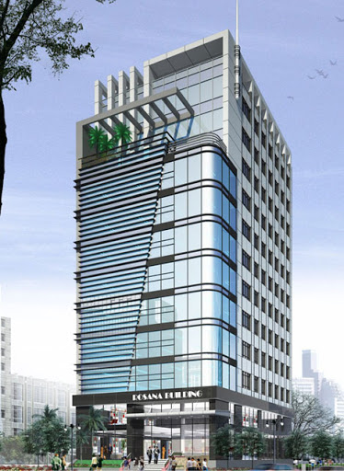


Features
BUILDINGS
Input Image
Dataset

Slide 15
II. Convolutional Neural Networks (CNN)
2/ Structure
Convolution layers
ReLU
Pooling layers
Fully-connected layers

Slide 16
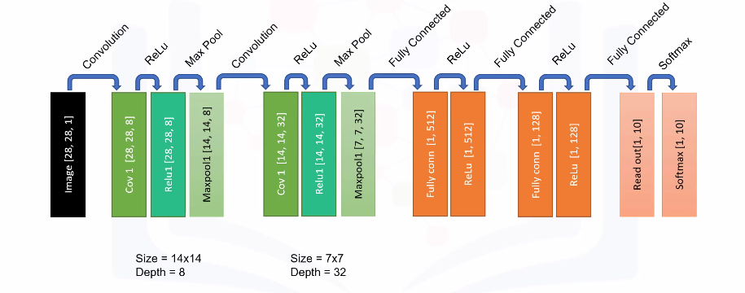
CNN’s structure

Slide 17
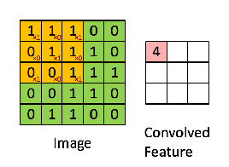
II. Convolutional Neural Networks (CNN)
* Convolution layers
A convolution converts all the pixels in its receptive field into a single value (downsampling) but also bring all the information in the field together into a single pixel.

Slide 18
II. Convolutional Neural Networks (CNN)
* Convolution layers
Detect different patterns or features from an input image: shape, edges, …
Use filter matrices
Note: In CNNs, filters are not defined. The value of each filter is learned during the training process.

Slide 19
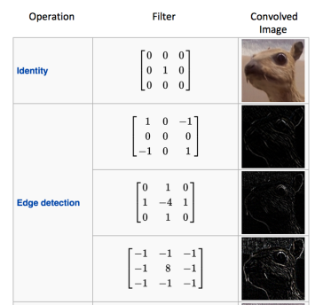
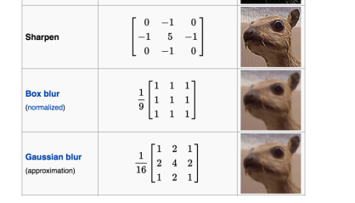
Filter matrices

Slide 20
II. Convolutional Neural Networks (CNN)
* 2D Convolution layers
The most common type of convolution that is used is the 2D convolution layer (a.k.a conv2D)
  Each filter in this layer is randomly initialized to some distribution (Normal, Gaussian, etc.)
  => each filter gets trained slightly differently => learn to detect different features in the image.

Slide 21
II. Convolutional Neural Networks (CNN)
There are different types of Convolution Layers
  In 1D CNN, kernel moves in 1 direction. Input and output data of 1D CNN is 2 dimensional. Mostly used on Time-Series data.
  In 2D CNN, kernel moves in 2 directions. Input and output data of 2D CNN is 3 dimensional. Mostly used on Image data.
  In 3D CNN, kernel moves in 3 directions. Input and output data of 3D CNN is 4 dimensional. Mostly used on 3D Image data (MRI, CT Scans).

Slide 22
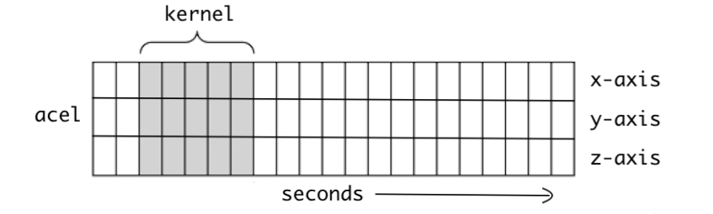
II. Convolutional Neural Networks (CNN)
1D Convolution

Slide 23
II. Convolutional Neural Networks (CNN)
2D Convolution

Slide 24
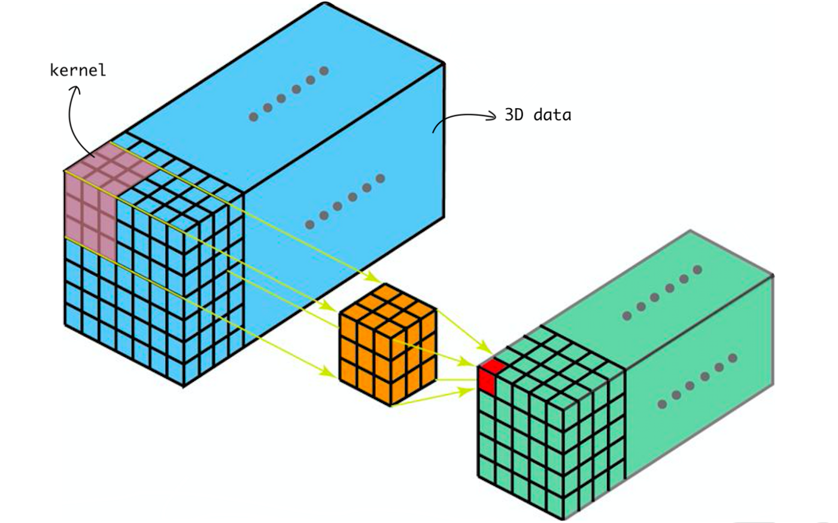
II. Convolutional Neural Networks (CNN)
3D Convolution

Slide 25
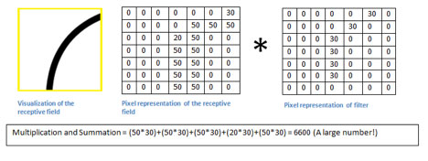

Slide 26
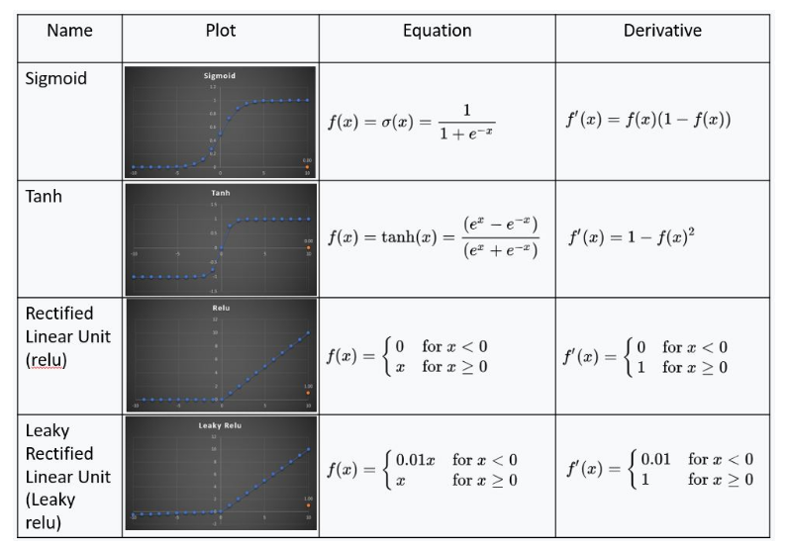
II. Convolutional Neural Networks (CNN)
* Activation functions

Slide 27
II. Convolutional Neural Networks (CNN)
* Activation functions
Function | Advantages | Disadvantages
Sigmoid | 1) Smooth Gradient => Preventing “jump” in output value 2) Output values bound between 0 and 1 => Normalizing the output of each neutron 3) Clear prediction | 1) Vanishing Gradient 2) Computationally expensive
Tanh | All of Sigmoid’s advantages | 1) Vanishing Gradient 2) Computationally expensive
ReLU | Computationally efficient | Dying ReLU problem
Leaky ReLU | Try to solve Dying ReLU problem | Inconsistent results

Slide 28
II. Convolutional Neural Networks (CNN)
* Pooling layer
Perform down sampling (reduce the amount of computation that needs to be done)
Solve sensitivity to the location of the features in the input
Send only the important data to the next layers in the CNNs.

Slide 29
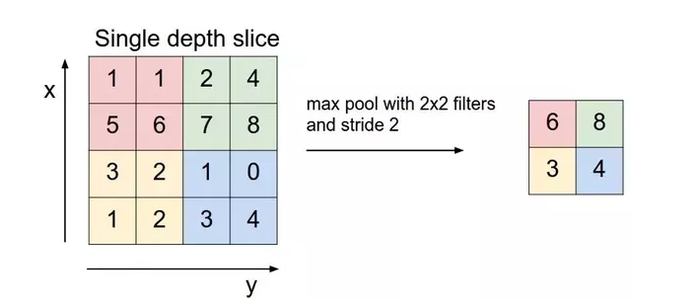
Pooling Layer

Slide 30
CNN’s structure

Slide 31
II. Convolutional Neural Networks (CNN)
* Fully-connected layers
final layer encompassing all the interior complexities
takes the final output of the layer before it (be it a ReLU or a convolutional layer) and provides an N-dimensional vector output

Slide 32
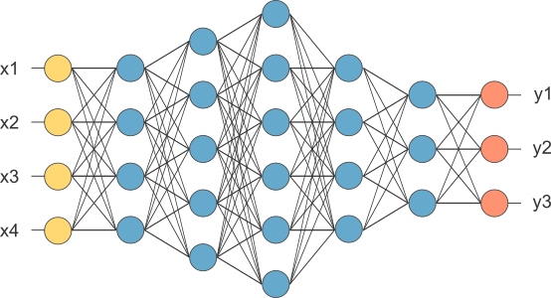
II. Convolutional Neural Networks (CNN)
* Fully-connected layers

Slide 33
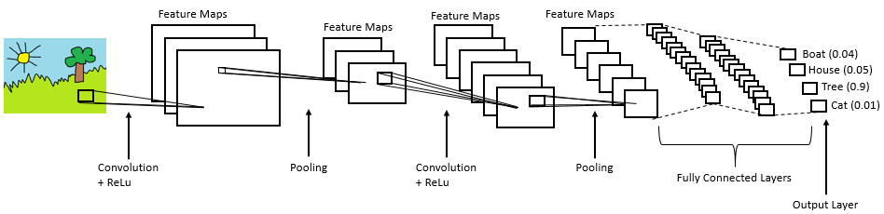
II. Convolutional Neural Networks (CNN)
* Example

Slide 34




II. Convolutional Neural Networks (CNN)
3/ Applications
3.1. In business: Image Classification - Search Engines, Recommender Systems, Social Media

Slide 35
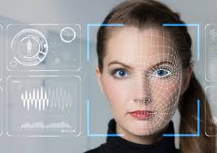
II. Convolutional Neural Networks (CNN)
3/ Applications
3.2. Face recognition

Slide 36

II. Convolutional Neural Networks (CNN)
3/ Applications
3.3. Predictive Analytics - Health Risk Assessment

Slide 37
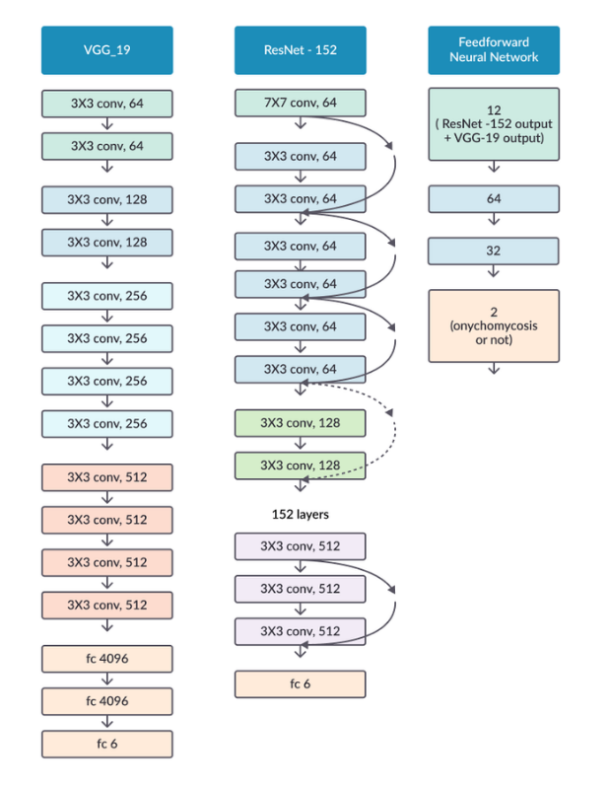
II. CNN
* Architectures:
AlexNET
LeNET
ResNET
VGG
Inception
Xception

Slide 38
II. Recurrent Neural Network
1/ Definition
2/ Structure
3/ Application
4/ Different Architectures

Slide 39
II. Recurrent Neural Network
1/ Definition
Recurrent Neural Network(RNN) are a type of Neural Network where the output from previous step are fed as input to the current step

Slide 40
II. Recurrent Neural Network
2/ Structure

Slide 41
II. Recurrent Neural Network
3/ Application
RNN text generation – Text summarization, Report generation, Conversational UI (Chatbot)
RNN machine translation
RNN Speech Recognition
...

Slide 42

II. Recurrent Neural Network
3/ Application
RNN text generation – Text summarization, Report generation, Conversational UI (Chatbot)

Slide 43

II. Recurrent Neural Network
3/ Application
              RNN machine translation

Slide 44

II. Recurrent Neural Network
3/ Application
RNN machine translation

Slide 45
II. Recurrent Neural Network
4/ Architecture
Bidirectional RNNs
Recursive Neural Networks
Encoder Decoder Sequence to Sequence RNNs
LSTMs

Slide 46
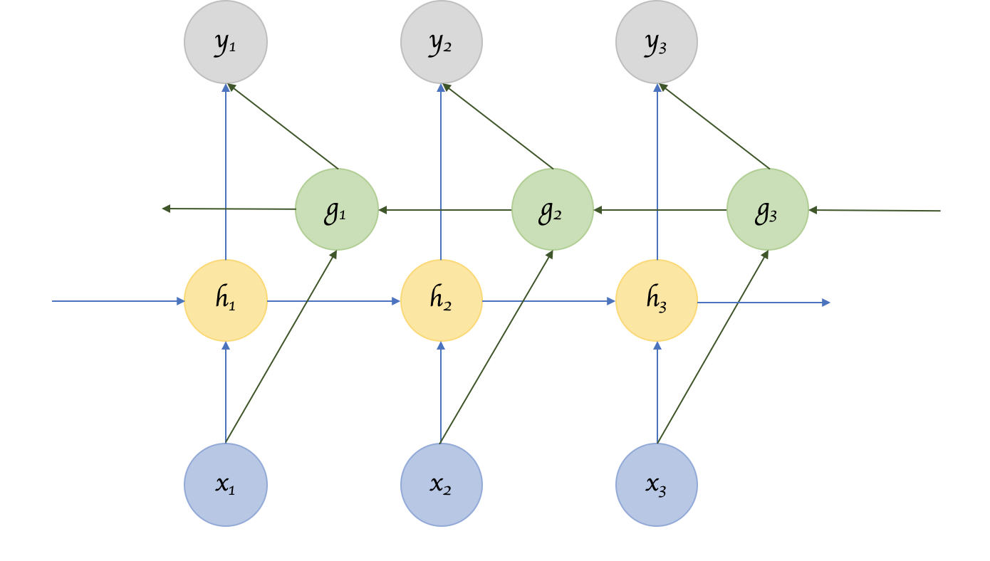
II. Recurrent Neural Network
4/ Architecture
Bidirectional RNN:

Slide 47
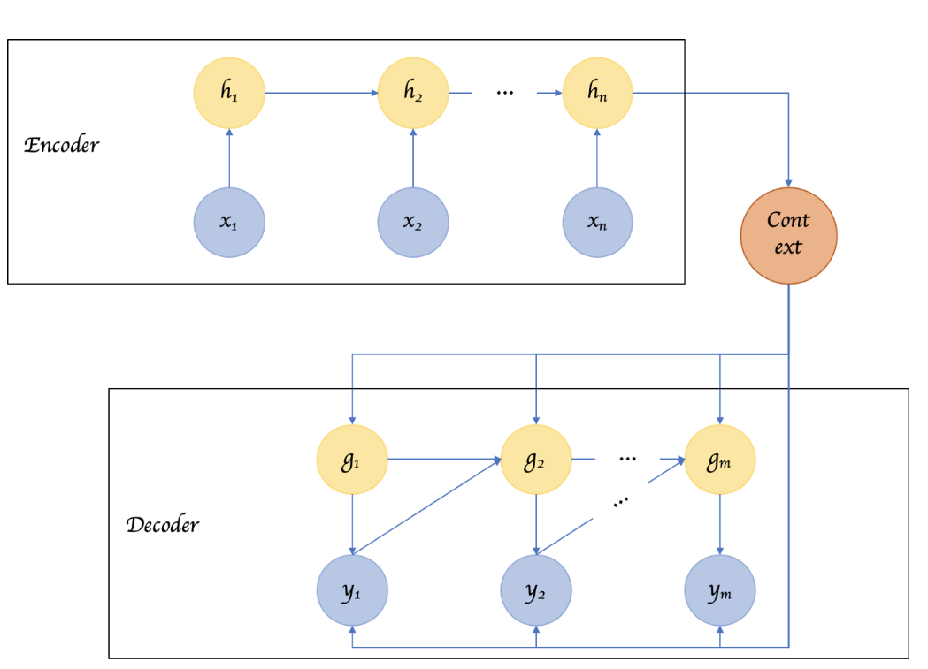
II. Recurrent Neural Network
Encoder Decoder or Sequence to Sequence RNNs

Slide 48
II. Recurrent Neural Network
4/ Architecture
Encoder Decoder or Sequence to Sequence RNNs are used a lot in translation services.
The basic idea is that there are two RNNs, one an encoder that keeps updating its hidden state and produces a final single “Context” output.
=> fed to the decoder, which translates this context to a sequence of outputs.
Another key difference in this arrangement is that the length of the input sequence and the length of the output sequence need not necessarily be the same.

Slide 49
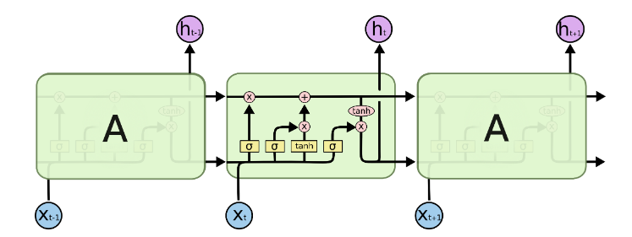
II. Recurrent Neural Network
4/ Architecture - LSTM
Long short-term memory

Slide 50
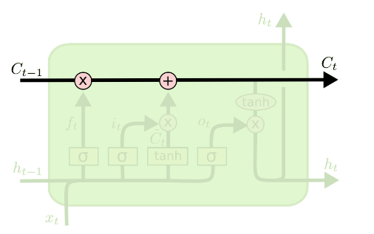
II. Recurrent Neural Network
4/ Architecture - LSTM
Key features of LSTM include: Cell state, 3 gates
  Cell state: contain information/context/pretext/…

Slide 51
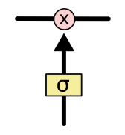
II. Recurrent Neural Network
4/ Architecture - LSTM
Gates: a way to optionally let information through
    They are composed out of a sigmoid neural net layer and a pointwise multiplication operation
    The sigmoid layer outputs numbers between zero and one, describing how much of each component should be let through

Slide 52
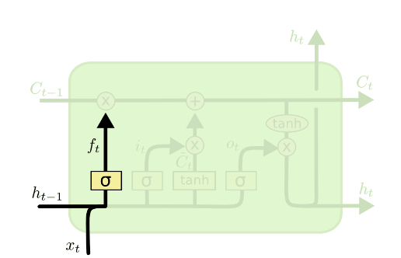
II. Recurrent Neural Network
4/ Architecture - LSTM
- The first step in our LSTM is to decide what information we’re going to throw away from the cell state. This decision is made by a sigmoid layer called the “forget gate layer.”

Slide 53
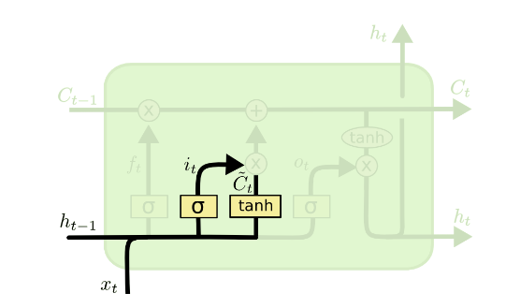
II. Recurrent Neural Network
4/ Architecture – LSTM
The next step is to decide what new information we’re going to store in the cell state.
This has two parts. First, a sigmoid layer called the “input gate layer” decides which values we’ll update.

Slide 54
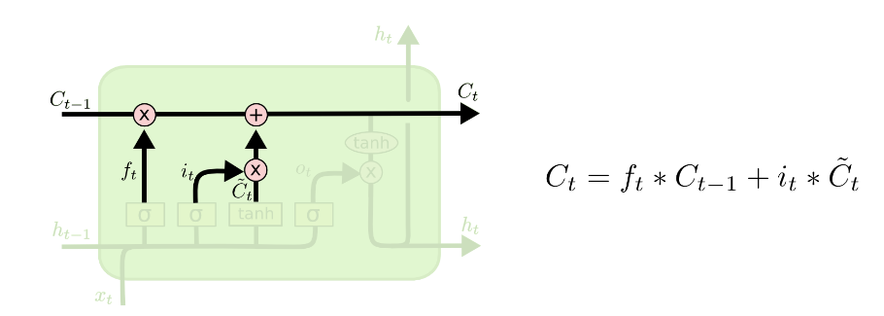
II. Recurrent Neural Network
4/ Architecture – LSTM
A tanh layer creates a vector of new candidate values, C~t, that could be added to the state. => combine these two to create an update to the state.

Slide 55
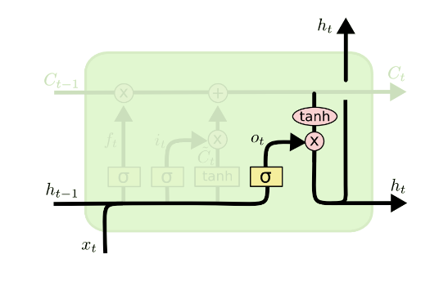
II. Recurrent Neural Network
4/ Architecture – LSTM
Finally, we need to decide what we’re going to output.
This output will be based on cell state, but will be a filtered version

Slide 56
Summarized
Deep Neural Network (DNN)
Convolutional Neural Network (CNN)
Recurrent Neural Network (RNN)

Slide 57
Questions and Answers

Slide 58


