Slide 1


ADVANCED METHODS FOR FACE RECOGNITION
Nguyễn Gia KhánH - EEIT2014 - 1148563
First supervisor: Dr. Nguyen Minh Hien
Second supervisor: M.Sc. Bien Minh Tri

Slide 2
Agenda
Introduction to Face Recognition
Introduction
Existing face recognition algorithms
Digital images
Eigenface method
Fisherface method
Implementation and evaluation
Basic system implementation
Experiments
Conclusion and future works
References

Slide 3
Introduction to Face recognition
Face recognition system was once impossible due to the complexity of the face nature and emotions.
Today, face recognition systems are used everywhere.
Advantages:
Simple to establish and maintain the database.
Natural and nonintrusive
Faces can be captured at a distance
Notes:
In many past decades, developing an accurate computational model of face recognition seemed to be impossible due to the complexity of the face nature as well as countless emotions it possesses. It is natural and not the same as sine waveform or anything which belong to the “blocks world” we have ever known and researched in the computer vision field. Face recognition is a quite simple task for our brain to perform, however, too difficult for the computer to stimulate or imitate. Today, with the advancement of technology and the existence of more and more powerful processors, we have empowered all conditions and capabilities to invent and develop our own face recognition systems. Face recognition is no longer something existing in fictional novels or movies but becomes more and more familiar with us in daily life. One of the advantages of Face Recognition compared to fingerprints, eye iris and other biometric modalities is its simplicity to establish and maintain the images database. In addition, besides being more natural and nonintrusive, faces can be captured at a distance and in a covert manner.

Slide 4
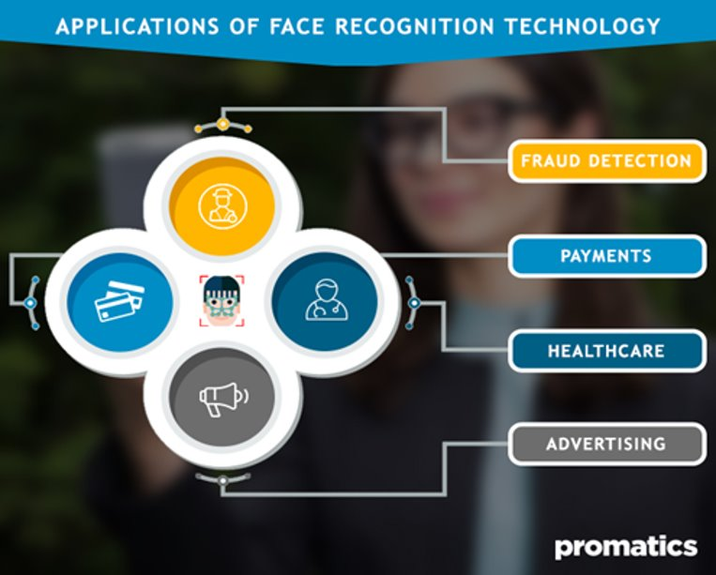
Introduction
Face Recognition applications:
Facebook People Tagging: tagging people by their faces.
Microsoft Windows Hello: logining to Windows by faces.
Google Images Search: searching by images.
Apple Face ID: unlocking iPhone by faces.
Amazon Rekognition service: Amazon Face Recognition service
Tesla Autopilot in the self-driving car: reducing accidents due to negligence and fatigue from long-term driving.
Camera, payments, healthcare, security, advertising and marketing field.

Slide 5
Existing face recognition algorithms
There are 2 main kinds of approaches for face recognition: with and without using Convolution Neural Network.
Without using Convolution Neural Network:
Principal Component Analysis (PCA).
Linear Discriminant Analysis (LDA).
Support Vector Machine (SVM).
Improved Support Vector Machine (iSVM)
With using Convolution Neural Network:
Google FaceNet.
OpenCV.
Keras.
Facebook DeepFace.

Slide 6
DIGITAL images
A digital image is a matrix of pixels. Each pixel contains information about intensity value of the image at that point - represented by a series of code
An image of size MxN has M columns in width and N rows in height.
There are 3 main groups:
One-channel image (black-white or grayscale image)
Three-channel image (RGB, YUV, HSV)
Four-channel image (RGBA, CMYK)
In this thesis, only grayscale images are considered.

Slide 7
Eigenface method
Was first proposed by Sirovich and Kirby in 1987. After that, the technique was applied to computer vision field, specifically in face recognition problem by Turk and Pentland.
Determine the characteristic features of a face such that it can be described as a linear combination of the so called “Eigenfaces”.
The first step is applying the PCA to all face images in the training dataset.
Then each of them as well as the checking image is projected into face-space to find its corresponding position. Finally, we compare the Euclidian distance between the checking image and each image in database to find the smallest one.
Compare this one to threshold to get the final result.

Slide 8

Calculation steps: Suppose we have M’ face images of size MxN
1. Prepare the training images Γ_{i}
Convert Γ_{i} into column matrix (MNx1).
2. Prepare the training data set

Slide 9


3. Compute the average face
4. Compute the mean face

Slide 10


5. Calculate covariance matrix of the mean face
where

Slide 11

6. Calculate eigenvectors and corresponding eigenvalues of AA^{T}
Direct way: The total number of eigenvectors of AA^{T} is MN with their corresponding eigenvalues.
Alternative way: Calculate M' eigenvectors and eigenvalues of A^{T}A.
Relationships between A^{T}A and AA^{T} :
Eigenvectors:
where υ_{i} : an eigenvector of AA^{T}
ν_{i} : an eigenvector of A^{T}A
Eigenvalues: same values
M' eigenvectors of A^{T}A correspond to M' eigenvectors of AA^{T} with largest corresponding eigenvalues.
7. Keep only K eigenvectors with largest eigenvalues from M' eigenvectors of A^{T}A.

Slide 12



8. Projecting training images and checking image into the face-space:
where i = 1, 2, … , M for training images and i = c for checking image
9. Find the nearest Euclidean distance
where $Ω^{T}=\left[ω_{1} ω_{2} ω_{3}…ω_{M}\right].$
10. Define and compare ε_{r} to thresholds θ_{ε1} < θ_{ε2} . If ε_{r} < θ_{ε1}, the image is recognized. If θ_{ε1} < ε_{r} < θ_{ε2} , it belongs to the unknown person. Otherwise, it is not a human face.

Slide 13
Fisherface method
Was introduced by Peter N. Belhumeur, João P. Hespanha, and David J. Kriegman in 1997 by taking use of multi-class LDA.
Upgraded version of Eigenface with the expense of more calculations and longer execution time.
Making use of LDA after PCA to enhance the performance.

Slide 14



Calculation steps:
Use Eigenface method to calculate the coordinates of each face image on the eigenface space, mean $μ_{i}$ of each class and choose $K$ largest eigenvectors to be at most $N^{′}−C$ where $C$ is the total number of classes and $N^{′}$ is the total number of face images in the database.
Arrange $K$ largest eigenvectors as a matrix $W_{pca}$ where the number of columns equals to $K$.
Calculate the mean of all class means $μ$ (total mean):
Calculate the between-class scatter matrix $S_{B}$:
where $N_{i}$ is the number of samples in class $i$.

Slide 15

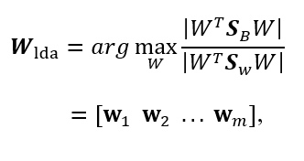


5) Calculate the within-class scatter matrix $S_{W}$:
6) If $S_{w}$ is a nonsingular matrix, the LDA projection matrix $W_{lda}$ could be defined as
where $[w_{1}{ w}_{2} ... { w}_{m}]$ is the set of $m$ largest eigenvectors of $S_{W}^{−1}S_{B}$ with corresponding eigenvalues $[λ_{1}{ λ}_{2} ... { λ}_{m}]$ found via the formula:
where$i = 1, 2, …, m$.

Slide 16



7) $W_{opt}$ is defined to be
where $W_{pca}$ is a $XY x (N^{′}−C)$ matrix which contains $N^{′}−C$ eigenvectors after performing PCA and $W_{pca}$ is a $(N^{′}−C) x m$ matrix with m eigenvectors found by implementing LDA.
8) Projecting all face images in the database and input face into the face space
9) Find the nearest Euclidean distance
10) Define and compare to threshold values $θ_{ε1}$< $θ_{ε2}$ to determine whether it is recognized, a new person or even not a human face.

Slide 17
Implementation and evaluation
Basic system implementation
IDE: Microsoft Visual Studio Code
Face database: Part of cropped Yale Face B (about 512 images of 8 different people)
Programming language: Python 3.7
Libraries:
Numpy 1.15.2: http://www.numpy.org/ (for matrix operation)
Matplotlib 3.0.0: https://matplotlib.org/ (for graphs plotting)
Pillow 5.2.0: https://pillow.readthedocs.io/en/5.2.x/ (for images reading)
Scikit-image 0.14.0: http://scikit-image.org/ (for images down sampling)
Tkinter: https://docs.python.org/3/library/tk.html/ (for GUI programming)

Slide 18

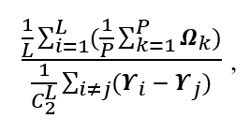

Performance criteria:
Success Rate: the ratio of the number of successful attempts to the total number of attempts in a specific experiment in percentage:
Within/Between Ratio: the ratio of the mean of all means of samples in each class to the mean of Euclidean distances between classes mean. Suppose that a specific class $S_{i}$ has $P$ samples and there are $L$ class in total:
where $Ω_{k}$: projection of a sample of class $S_{i}$ in face space,
$Υ_{i}$, $Υ_{j}$: mean projection of all samples within class $S_{i}$, $S_{j}$,
$C_{2}^{L}$: number of combinations of choosing 2 different classes out of $L$ classes.

Slide 19
Experiments
Recognizing ideal input images with only ideal training images.
Recognizing ideal input images with not only ideal training images.
Recognizing not only ideal input images with only ideal training images.
Recognizing not only ideal input images with not only ideal training images.

Slide 20
Experiment | Method | Success Rate | Within/Between Ratio | Execution time (s)
1 | Eigenface | 87.50% | 0.941 | 3.322
 | Fisherface | 100% | 0.088 | 5.388
2 | Eigenface | 0% | 5.423 | 15.759
 | Fisherface | 100% | 0.361 | 21.445
3 | Eigenface | 18.75% | 0.921 | 3.926
 | Fisherface | 56.25% | 0.087 | 5.967
4 | Eigenface | 0% | 5.033 | 16.739
 | Fisherface | 100% | 0.356 | 21.868

Slide 21
Conclusion and future works
Eigenface uses PCA to extract many important characteristics of a human face via Eigenfaces (eigenvector), which will then be filtered by their corresponding eigenvalues.
Fisherface is an upgraded version of Eigenface taking advantage of not only PCA but also LDA to achieve better results despite requiring more calculation as well as execution time.
Eigenface preserves the total variance.
Fisherface focuses on maximizing the distances among samples from different classes as well as minimizing the distances among samples within one class.
Both algorithms, especially Eigenface, were exposed to have problem when dealing with untrained faces with different lighting angles.
In future, the thesis could be extended in many directions:
Establishing a larger and more diverse database.
Directly doing a comparison with many other 2-D face recognition techniques.
Optimizing the codes to improve the processing rate.
Combining with a real-time camera system.

Slide 22
References
[1] | W. W. Bledsoe, “The model method in facial recognition,” Panoramic Research Inc., Palo Alto, CA, Rep. PRI:15, August 1966.
[2] | T. Kanade, “Picture processing system by computer complex and recognition of human faces,” Dept. of Information Science, Kyoto University, November 1973.
[3] | Kohonen Teuvo, “Self-Organized Formation of Topologically Correct Feature Maps,” Department of Technical Physics, Helsinki University of Technology, Espoo, Finland, 1982.
[4] | L. Sirovich and M. Kirby, “Low-dimensional procedure for the characterization of human faces,” Journal of the Optical Society of America A, Vol. 4, No. 3, March 1987, pp. 519-524.
[5] | Peter N. Belhumeur, João P. Hespanha and David J. Kriegman, “Eigenfaces vs. Fisherfaces: Recognition Using Class Specific Linear Projection,” IEEE Transactions on Pattern Analysis and Machine Intelligence, Vol. 19, No. 7, July 1997.

Slide 23


