Slide 1

Introduction to PyTorch
Instructor: Kevin Liang

Slide 2
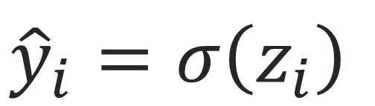


$${\hat{y}}_{i}=σ\left(z_{i}\right)$$
$$ℒ=−y_{i} log\left({\hat{y}}_{i}\right)−\left(1−y_{i}\right) log\left(1−{\hat{y}}_{i}\right)$$
A Simple
Neural Network
$$\frac{∂ℒ}{∂z_{i}}$$
z_{i}
$$z_{i}=\left(b_{1}×x_{i1}\right)+\left(b_{2}×x_{i2}\right)+…+\left(b_{J}×x_{iJ}\right)+b_{0}$$
b_{J}
b₁
$$\frac{∂z_{i}}{∂b_{j}}$$
x_{i1}
x_{i2}
x_{iJ}
features of data

Slide 3
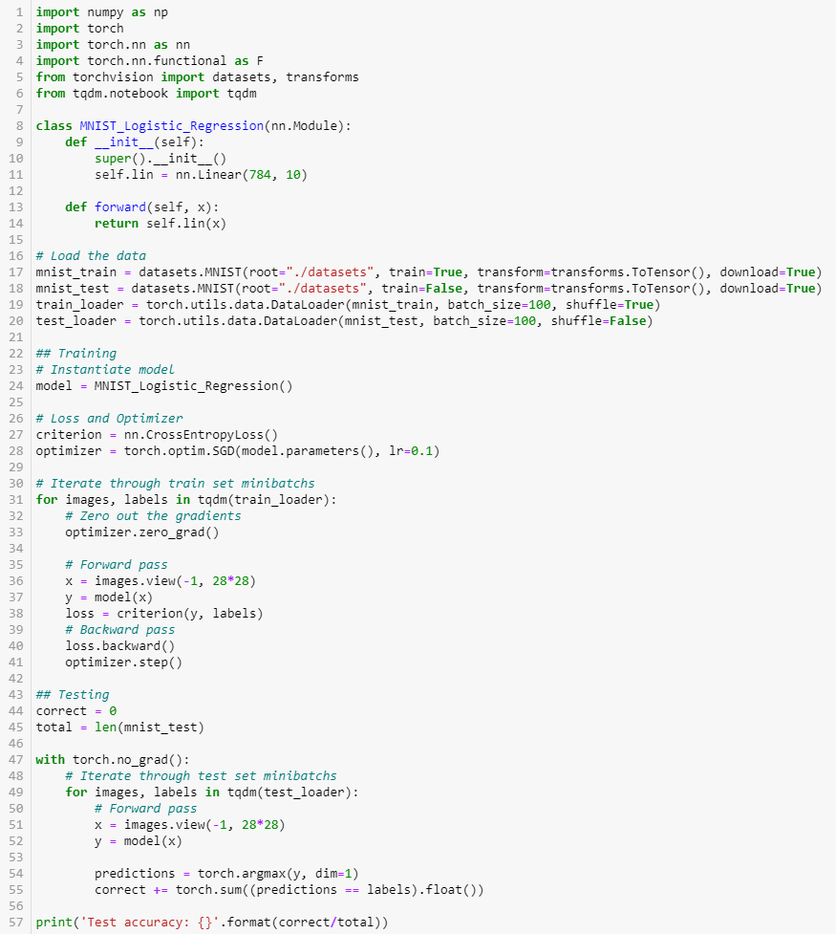




How do we actually implement this?
$${\hat{y}}_{i}=σ\left(z_{i}\right)$$
$$ℒ=−y_{i} log\left({\hat{y}}_{i}\right)−\left(1−y_{i}\right) log\left(1−{\hat{y}}_{i}\right)$$
$$\frac{∂ℒ}{∂z_{i}}$$
z_{i}
b₁
$$\frac{∂z_{i}}{∂b_{j}}$$
b_{J}
x_{i1}
x_{i2}
features of data
x_{iJ}

Slide 4


Neural networks during training
A Simple
Neural Network
For $K$ epochs:
For $M$ minibatches in dataset $𝒟$:
Sample a minibatch of data from the dataset: ${\left\{(x_{i}, y_{i})\right\}}_{i=1}^{m}\sim 𝒟$
Calculate forward pass: predictions $\hat{y}$, loss $ℒ$, etc.
Calculate backwards pass: gradients $∇_{b}ℒ$
Update weights: $b≔b−α∇_{b}ℒ$

Slide 5
Neural networks during inference
A Simple
Neural Network
Receive input example: $x$
Calculate forward pass: predictions $\hat{y}$

Slide 6


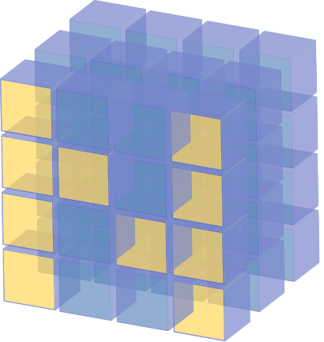
Python
High-level language, fast to write
Emphasis on readability
Supports scripting and object-oriented programming
Large community, widespread use
Free
Highly extensible, many importable libraries
+
NumPy
Python package for numerical computation
Multidimensional numerical array support with numpy.array
Provides mathematical operations, written in C to be fast

Slide 7
Neural networks during training
A Simple
Neural Network
For $K$ epochs:
For $M$ minibatches in dataset $𝒟$:
Sample a minibatch of data from the dataset: ${\left\{(x_{i}, y_{i})\right\}}_{i=1}^{m}\sim 𝒟$
Calculate forward pass: predictions $\hat{y}$, loss $ℒ$, etc.
Calculate backwards pass: gradients $∇_{b}ℒ$
Update weights: $b≔b−α∇_{b}ℒ$

Slide 8

Python
Operations run on CPU; no GPU support
No memory, no auto-differentiation
Missing common neural network operations:
Batched convolution
Sigmoid, softmax
Cross entropy
Pooling
…
+
NumPy
Must implement own high-level abstractions
Model organization
Data pipelines
….

Slide 9
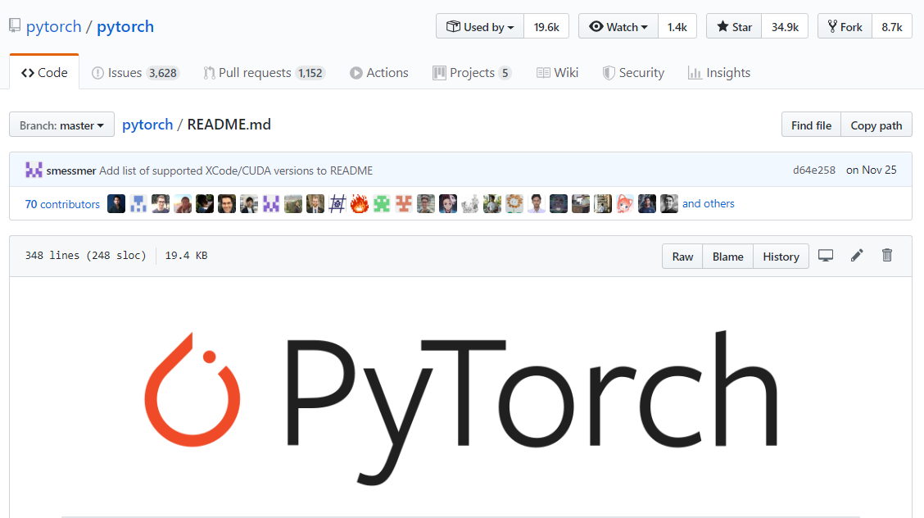
PyTorch
An open source, machine learning library
Primarily built by Facebook AI Research (FAIR)
Pythonic, imperative coding; dynamic computation graphs
Autograd engine
CPU and GPU support

Slide 10

PyTorch
An open source, machine learning library
Primarily built by Facebook AI Research (FAIR)
Pythonic, imperative coding; dynamic computation graphs
Autograd engine
CPU and GPU support

Slide 11






PyTorch
An open source, machine learning library
Primarily built by Facebook AI Research (FAIR)
Pythonic, imperative coding; dynamic computation graphs
Autograd engine
CPU and GPU support
$$x$$
$$−$$
$$⋅^{2}$$
$$y$$
$$×$$
$$0.5$$

Slide 12
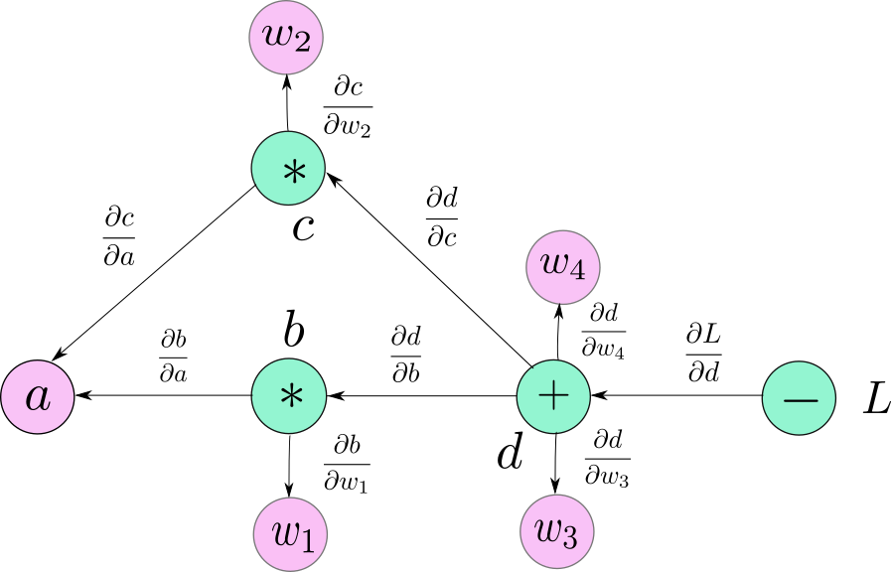
PyTorch
An open source, machine learning library
Primarily built by Facebook AI Research (FAIR)
Pythonic, imperative coding; dynamic computation graphs
Autograd engine
CPU and GPU support

Slide 13
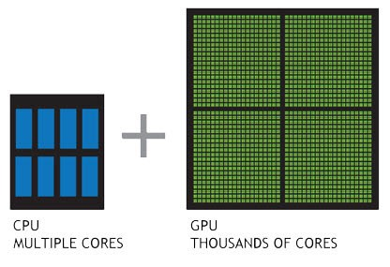
PyTorch
An open source, machine learning library
Primarily built by Facebook AI Research (FAIR)
Pythonic, imperative coding; dynamic computation graphs
Autograd engine
CPU and GPU support

Slide 14








Slide 15
Plan for today:
Implement this
$${\hat{y}}_{i}=σ\left(z_{i}\right)$$
$$ℒ=−y_{i} log\left({\hat{y}}_{i}\right)−\left(1−y_{i}\right) log\left(1−{\hat{y}}_{i}\right)$$
$$\frac{∂ℒ}{∂z_{i}}$$
z_{i}
b₁
$$\frac{∂z_{i}}{∂b_{j}}$$
b_{J}
x_{i1}
x_{i2}
features of data
x_{iJ}

Slide 16
Plan for today:
Implement this
Introduce the MNIST dataset
Build a logistic regression classifier with basic PyTorch operations
Train the logistic regression classifier
Evaluate the logistic regression classifier and interpret the results
Refactor code with a higher-level API

