Slide 1
Natural Language Processing Winter School Day 1
Ricardo Henao

Slide 2
Machine Learning Basics and Introduction to the Multilayered Perceptron
Part I

Slide 3
What is happening today?
This session is focused on “Deep Learning:”
What it is
Some of its many applications
How to build your own deep networks
These algorithms learn from data to automate tasks and make predictions
Today, you will learn about what we mean by “deep learning” and build your first deep network

Slide 4
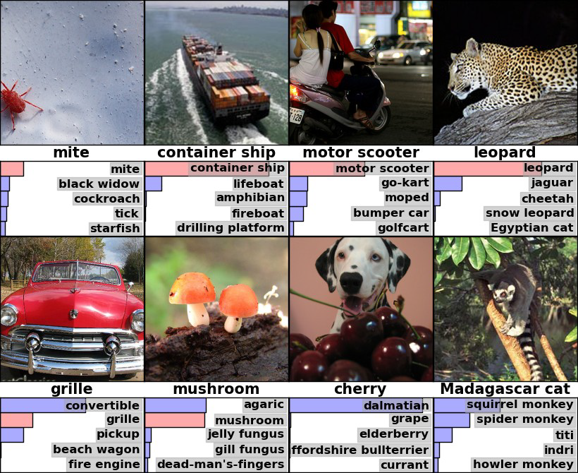
Deep Learning is state-of-the-art for many applications
Deep Learning is not new—many of the techniques go back decades
Recent resurgence due to amazing performance on benchmark tasks
One key task was the ImageNet Challenge
Want to recognize what is in an image (1 of 1000 categories)
Have ~1 million example images
Very relevant for things such as image search
Example images are shown on the right, with predicted categories beneath each image
Figure from Krizhevsky et al 2012.

Slide 5
Deep Learning can surpass human performance
Top Performing ImageNet Algorithm By Year
For ImageNet:
Deep Learning was a huge jump forward
State-of-the-art systems significantly outperform humans on the same task
These use “Convolutional Neural Networks,” which you will learn about tomorrow

Slide 6
Deep Learning beats human performance in many tasks
Famously, Google DeepMind trained “AlphaGo” to beat the world champion Go player (a complex game)
AlphaGo’s largely works by Deep Learning techniques (learned by repeatedly playing the game)
Many other examples:
Voice Recognition
Object Detection
Text Translation
Etc.
So what is Deep Learning?

Slide 7
a “Shallow” Network
We need to understand “shallow” learning before “deep” learning

Slide 8
Learning a Predictive Model Based on Labeled Data
y, associated label 0/1
x, data/features for a subject
End goal: predict y from x

Slide 9








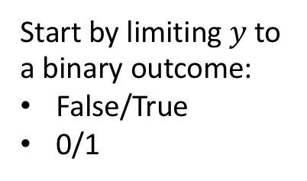




Training Set (Historical Data)
$$x_{1}$$
$$y_{1}$$
$$x_{2}$$
$$y_{2}$$
$$x_{3}$$
$$y_{3}$$
Start by limiting $y$to a binary outcome:
False/True
0/1
$$x_{4}$$
$$y_{4}$$
$$x_{N−1}$$
$$y_{N−1}$$
$$x_{N}$$
$$y_{N}$$

Slide 10

Making Predictions
$$x_{1}$$
$$y_{1}$$
$$x_{2}$$
$$y_{2}$$
$$x_{3}$$
$$y_{3}$$
Start by limiting $y$to a binary outcome:
False/True
0/1
$$x_{4}$$
$$y_{4}$$
$$x_{N−1}$$
$$y_{N−1}$$
$$x_{N}$$
$$y_{N}$$
New Data
$$x_{N+1}$$
?
Want to learn how to predict outcome

Slide 11






Linear Predictive Model
$$z_{i}$$
$$b_{1}$$
$$b_{M}$$
$$x_{i1}$$
$$x_{iM}$$
$$z_{i}=(b_{1}×x_{i1})+\left(b_{2}×x_{i2}\right)+⋯+\left(b_{M}×x_{iM}\right)$$

Slide 12
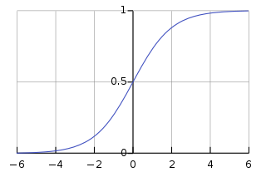



Convert to a Probability
$$z_{i}=(b_{1}×x_{i1})+{\left(b_{2}×x_{i2}\right)+⋯+\left(b_{M}×x_{iM}\right)+b}_{0}$$
$p\left(y_{i}=1 | x_{i}\right)=σ(z_{i}$)
Extra Constant
$σ(z_{i}$)

Slide 13
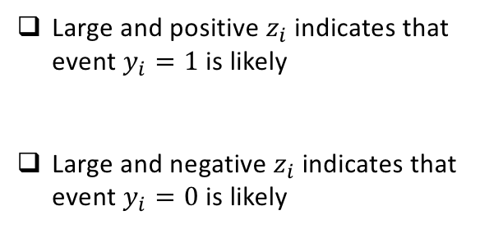
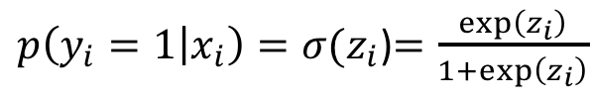
Convert to a Probability
$$z_{i}=(b_{1}×x_{i1})+{\left(b_{2}×x_{i2}\right)+⋯+\left(b_{M}×x_{iM}\right)+b}_{0}$$
$p\left(y_{i}=1 | x_{i}\right)=σ(z_{i}$)$=\frac{\exp\left(z_{i}\right)}{1+\exp\left(z_{i}\right)}$
Large and positive $z_{i}$ indicates that event $y_{i}=1$ is likely
Large and negative $z_{i}$ indicates that event $y_{i}=0$ is likely

Slide 14





Logistic Regression
$${σ(z}_{i})$$
$$z_{i}$$
$$b_{1}$$
$$b_{M}$$
$$x_{i1}$$
$$x_{iM}$$

Slide 15
Logistic Regression
$${σ(z}_{i})$$
$$z_{i}$$
Linear Model
$$b_{1}$$
$$b_{M}$$
$$x_{i1}$$
$$x_{iM}$$

Slide 16
Logistic Regression
Convert to Probability
$${σ(z}_{i})$$
$$z_{i}$$
Linear Model
$$b_{1}$$
$$b_{M}$$
$$x_{i1}$$
$$x_{iM}$$

Slide 17
An example
What do the parameters and model mean?

Slide 18
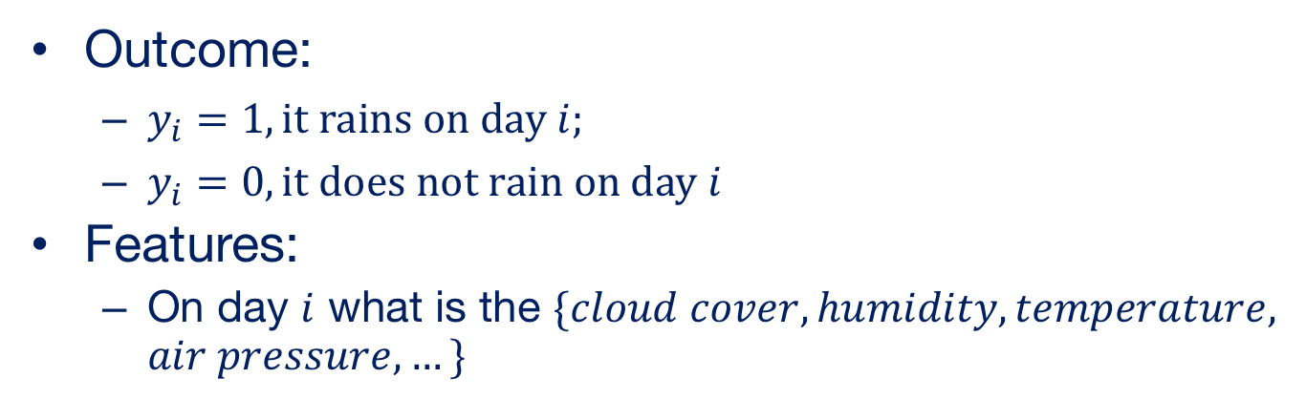


Example
Outcome:
$y_{i}=1, it rains on day i;$
$y_{i}=0, it does not rain on day i$
Features:
On day $i$ what is the $\{cloud cover, humidity, temperature, air pressure,…\}$
$y_{i}$, did it rain on day $i$
$x_{i}$, features for day $i$

Slide 19
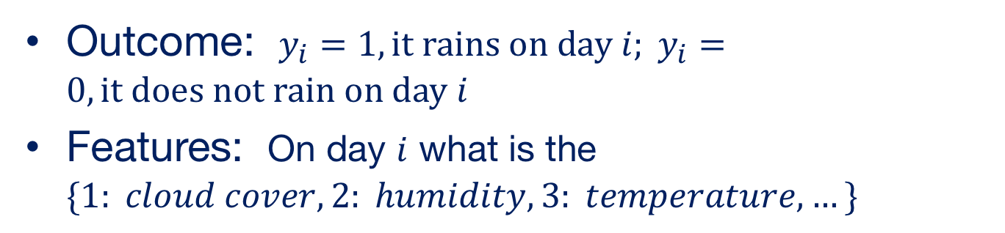
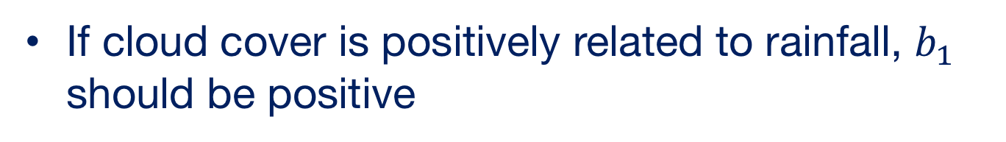
Example
Outcome: $y_{i}=1, it rains on day i; y_{i}=0, it does not rain on day i$
Features: On day $i$ what is the $\{1: cloud cover, 2: humidity, 3: temperature, …\}$
$$z_{i}=(b_{1}×x_{i1})+{\left(b_{2}×x_{i2}\right)+⋯+\left(b_{M}×x_{iM}\right)+b}_{0}$$
Cloud Cover
Humidity
If cloud cover is positively related to rainfall, $b_{1}$ should be positive

Slide 20
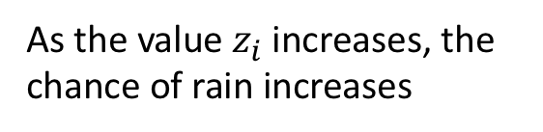
Impact on the Sigmoid Function
$$z_{i}=(b_{1}×x_{i1})+{\left(b_{2}×x_{i2}\right)+⋯+\left(b_{M}×x_{iM}\right)+b}_{0}$$
Humidity
$p\left(y_{i}=1 | x_{i}\right)=σ(z_{i}$)
Cloud Cover
Chance of Rain
As the value $z_{i}$ increases, the chance of rain increases

Slide 21


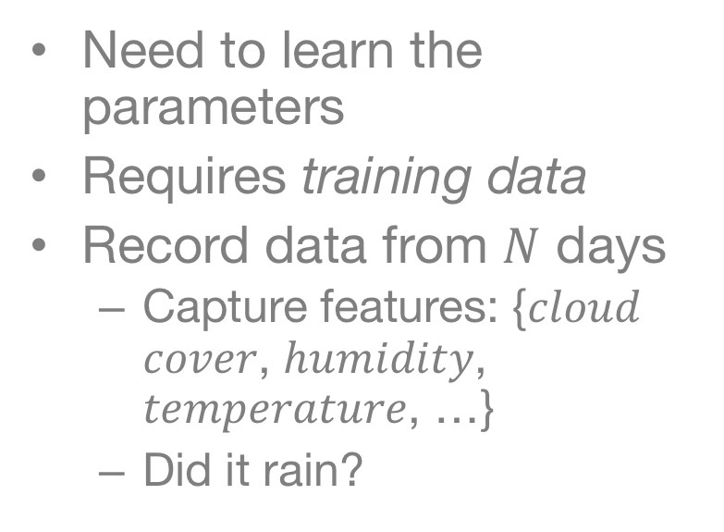









Building the Training Set
Need to learn the parameters
Requires training data
Record data from $N$ days
Capture features: {𝑐𝑙𝑜𝑢𝑑 𝑐𝑜𝑣𝑒𝑟, ℎ𝑢𝑚𝑖𝑑𝑖𝑡𝑦, 𝑡𝑒𝑚𝑝𝑒𝑟𝑎𝑡𝑢𝑟𝑒, …}
Did it rain?
$$x_{1}$$
$$y_{1}$$
$$x_{2}$$
$$y_{2}$$
$$x_{3}$$
$$y_{3}$$
$$x_{4}$$
$$y_{4}$$
$$x_{N−1}$$
$$x_{N}$$
$$y_{N}$$

Slide 22

















Learning Model Parameters
$${σ(z}_{i})$$
$$z_{i}=(b_{1}×x_{i1})+{\left(b_{2}×x_{i2}\right)+⋯+\left(b_{M}×x_{iM}\right)+b}_{0}$$
$$x_{1}$$
$$y_{1}$$
$$z_{i}$$
$$x_{2}$$
$$y_{2}$$
$$x_{3}$$
$$y_{3}$$
$$x_{4}$$
$$y_{4}$$
$$b_{1}$$
$$b_{M}$$
$$x_{N−1}$$
$$x_{N}$$
$$y_{N}$$
$$x_{i1}$$
$$x_{iM}$$
Training Set
Logistic Regression Model (or “Network”)
Learned Parameters
$({b_{0},b}_{1},…b_{N})$

Slide 23











Interpretation of Logistic Regression
$$z_{i}=(b_{1}×x_{i1})+\left(b_{2}×x_{i2}\right)+⋯+\left(b_{M}×x_{iM}\right)$$
$$x_{i1}$$
$$x_{i2}$$
$$…$$
$$…$$
$$x_{iM}$$
$$x_{i}$$
$$\sum_{m=1}^{M}{x_{im}b_{m}}$$
$$×$$
$$×$$
$$…$$
$$…$$
$$×$$
$$b$$
$$b_{1}$$
$$b_{2}$$
$$…$$
$$…$$
$$b_{M}$$

Slide 24

Interpretation of Logistic Regression
$$z_{i}=(b_{1}×x_{i1})+\left(b_{2}×x_{i2}\right)+⋯+\left(b_{M}×x_{iM}\right)$$
$$x_{i1}$$
$$x_{i2}$$
$$…$$
$$…$$
$$x_{iM}$$
$$x_{i}$$
$$\sum_{m=1}^{M}{x_{im}b_{m}}$$
$$×$$
$$×$$
$$…$$
$$…$$
$$×$$
$$b$$
$$b_{1}$$
$$b_{2}$$
$$…$$
$$…$$
$$b_{M}$$
Compact Notation: $x_{i}⊙b$ (or “inner product”)

Slide 25
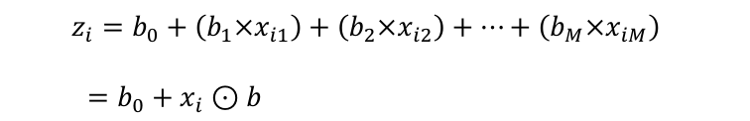

Interpretation of Logistic Regression
$$z_{i}=b_{0}+\left(b_{1}×x_{i1}\right)+{\left(b_{2}×x_{i2}\right)+⋯+\left(b_{M}×x_{iM}\right)}_{}$$
$=b_{0}+x_{i}⊙b$
$p\left(y_{i}=1 | x_{i}\right)=σ(z_{i}$)

Slide 26
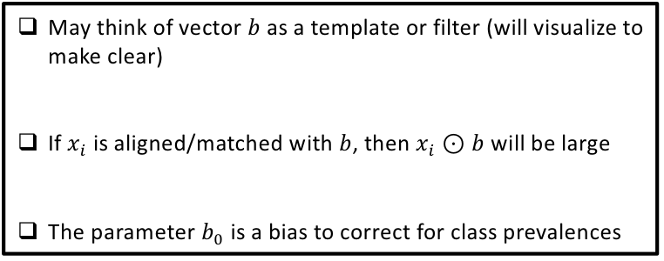

Interpretation of Logistic Regression
$$z_{i}=b_{0}+\left(b_{1}×x_{i1}\right)+{\left(b_{2}×x_{i2}\right)+⋯+\left(b_{M}×x_{iM}\right)}_{}$$
$=b_{0}+x_{i}⊙b$
$p\left(y_{i}=1 | x_{i}\right)=σ(z_{i}$)
May think of vector $b$ as a template or filter (will visualize to make clear)
If $x_{i}$ is aligned/matched with $b$, then $x_{i}⊙b$ will be large
The parameter $b_{0}$ is a bias to correct for class prevalences

Slide 27
Recognizing Numerical Digits

Slide 28
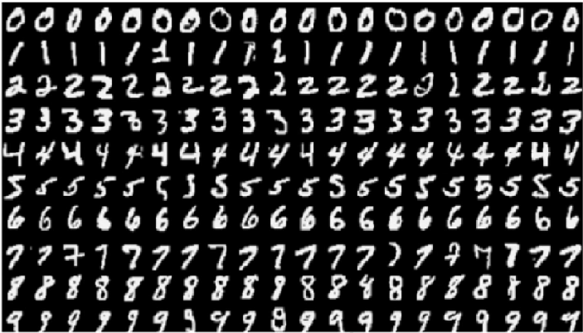
The MNIST Dataset
The Modified National Institute of Standards and Technology (MNIST) contains pictures of handwritten digits (0,1,2,…)
Want to be able to tell what digit each image is (e.g. optical character recognition)

Slide 29
Images are Encoded as Numbers

Slide 30
Vectorization
We will start talking about deep learning without using the structure of the image
We will return to this in a future lecture
To convert an image into an unstructured set of numbers, we vectorize it
vectorization

Slide 31
Start With The Binary Case
Zeros
Ones

Slide 32
Learning on MNIST
$${σ(z}_{i})$$
$$z_{i}=(b_{1}×x_{i1})+{\left(b_{2}×x_{i2}\right)+⋯+\left(b_{M}×x_{iM}\right)}_{}$$
$$z_{i}$$
Vectorization
$$b_{1}$$
$$b_{M}$$
$$x_{i1}$$
$$x_{iM}$$
Logistic Regression Model (or “Network”)
Learned Parameters
$({b_{0},b}_{1},…b_{N})$

Slide 33

Zooming in on 0/1
$$σ\left( × \right)$$

Slide 34

Zooming in on 0/1
Negative Sections
$$σ\left( \right)=0.006$$

Slide 35

Zooming in on 0/1
Positive Section
$$σ\left( \right)=.991$$

Slide 36
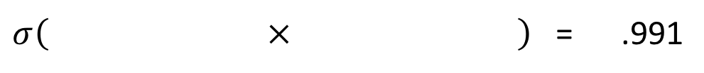

Learned Weights for 0/1
We think that this is a “zero” (.6% chance it is a “one”)
$σ\left( × \right)$ = .006
We think that this is a “one” (99.1% chance it is a “one”)
$σ\left( × \right)$ = .991

Slide 37
Generalizing Logistic Regression
From Shallow to Deep Learning

Slide 38
Logistic Regression is a “Linear” Classifier
Also referred to as a generalized linear model
Can only split data by linear trends

Slide 39
Non-linear classifier
Linear classifiers can only represent limited relationships
Often want to use a classifier that can handle non-linearities.
Many different ways of creating non-linear classifiers

Slide 40





Can we modify Logistic Regression to learn complex structures?
Probability of a single outcome
$${σ(z}_{i})$$
$$z_{i}=(b_{1}×x_{i1})+{\left(b_{2}×x_{i2}\right)+⋯+\left(b_{M}×x_{iM}\right)}_{}$$
$$z_{i}$$
$$b_{1}$$
$$b_{M}$$
$$x_{i1}$$
$$x_{iM}$$

Slide 41






Generalization of Logistic Regression: Learned Features
Probability of K
latent processes/features
$$σ(z_{i1})$$
$$σ(z_{iK})$$
$$z_{i1}$$
$$z_{iK}$$
$$x_{i1}$$
$$x_{iM}$$

Slide 42








Extended Logistic Regression
$$σ(ζ_{i})$$
Probability of
particular outcome
$$ζ_{i}$$
Probability of K
latent processes
$$σ(z_{i1})$$
$$σ(z_{iK})$$
$$z_{i1}$$
$$z_{iK}$$
$$x_{i1}$$
$$x_{iM}$$

Slide 43
Extended Logistic Regression
$$σ(ζ_{i})$$
Probability of
particular outcome
$$ζ_{i}$$
Probability of K
latent processes
$$σ(z_{i1})$$
$$σ(z_{iK})$$
$$z_{i1}$$
$$z_{iK}$$
May be viewed as logistic regression on K latent features, rather than directly on the M components of raw data
$$x_{i1}$$
$$x_{iM}$$

Slide 44

Recall Logistic Regression
$$z_{i}=b_{0}+\left(b_{1}×x_{i1}\right)+{\left(b_{2}×x_{i2}\right)+⋯+\left(b_{M}×x_{iM}\right)}_{}$$
$=b_{0}+x_{i}⊙b$
$p\left(y_{i}=1 | x_{i}\right)=σ(z_{i}$)

Slide 45
Why Limit Ourselves to Only One Filter?
$$σ\left( × \right)$$

Slide 46
Return to MNIST: Many ways of writing “4”

Slide 47
Return to MNIST: Many ways of writing “4”
Single Filter (e.g. Logistic Regression/ “Shallow Learning”) only uses one filter, looks for the average shape

Slide 48
Return to MNIST: Many ways of writing “4”
Multiple filters can look for subtypes indicative of different ways of writing “4”

Slide 49


Why Limit Ourselves to Only One Filter?
Introduce K Filters
$$z_{i1}=b_{01}+x_{i}⊙b_{1}$$
$z_{i2}=b_{02}+x_{i}⊙b_{2}$
$z_{iK}=b_{0K}+x_{i}⊙b_{K}$
Project data $x_{i}$ onto K filters: $b_{1}, …, b_{K}$

Slide 50





Why Limit Ourselves to Only One Filter?
Introduce K Filters
$$z_{i1}=b_{01}+x_{i}⊙b_{1}$$
$z_{i2}=b_{02}+x_{i}⊙b_{2}$
$z_{iK}=b_{0K}+x_{i}⊙b_{K}$
Project data $x_{i}$ onto K filters: $b_{1}, …, b_{K}$
$$σ(z_{i1})$$
$$σ(z_{iK})$$
$$z_{i1}$$
$$z_{iK}$$
$$x_{i1}$$
$$x_{iM}$$

Slide 51

Extended Logistic Regression
$$σ(ζ_{i})$$
$$ζ_{i}$$
$$σ(z_{i1})$$
$$σ(z_{iK})$$
$$z_{i1}$$
$$z_{iK}$$
$$x_{iM}$$
$$x_{i1}$$

Slide 52


Extended Logistic Regression
$$σ(ζ_{i})$$
$$ζ_{i}$$
$$σ(z_{i1})$$
$$σ(z_{iK})$$
$$z_{i1}$$
$$z_{iK}$$
$$z_{i1}=b_{01}+x_{i}⊙b_{1}$$
$z_{i2}=b_{02}+x_{i}⊙b_{2}$
$z_{iK}=b_{0K}+x_{i}⊙b_{K}$
$$x_{i1}$$
$$x_{iM}$$
K Features output from Layer-1
K Layer-1 filters

Slide 53


Extended Logistic Regression
Single Layer-2 Filter
$$σ(ζ_{i})$$
$$ζ_{i}$$
$$ζ_{i}=c_{0}+{σ(z}_{i})⊙c$$
K-Dimensional Feature Vector Output from Layer-1
$$σ(z_{i1})$$
$$σ(z_{iK})$$
$$z_{i1}=b_{01}+x_{i}⊙b_{1}$$
$$z_{i2}=b_{02}+x_{i}⊙b_{2}$$
$z_{iK}=b_{0K}+x_{i}⊙b_{K}$
$$z_{i1}$$
$$z_{iK}$$
$$x_{iM}$$
K Layer-1 filters
$$x_{i1}$$
K Features output from Layer-1

Slide 54










Going Deeper
$$σ(ζ_{i1})$$
$$σ(ζ_{iJ})$$
Probability of J
Layer-2 latent processes
$$ζ_{i1}$$
$$ζ_{iJ}$$
Probability of K
Layer-1 latent processes
$$σ(z_{i1})$$
$$σ(z_{iK})$$
$$z_{i1}$$
$$z_{iK}$$
$$x_{i1}$$
$$x_{iM}$$

Slide 55












$$σ(γ_{i})$$
Probability of
particular outcome
$$γ_{i}$$
$$σ(ζ_{i1})$$
$$σ(ζ_{iJ})$$
Probability of J
Layer-2 latent processes
$$ζ_{i1}$$
$$ζ_{iJ}$$
Probability of K
Layer-1 latent processes
$$σ(z_{i1})$$
$$σ(z_{iK})$$
$$z_{i1}$$
$$z_{iK}$$
$$x_{i1}$$
$$x_{iM}$$

Slide 56












$$σ(γ_{i})$$
$$γ_{i}$$
$$σ(ζ_{i1})$$
$$σ(ζ_{iJ})$$
$$ζ_{i1}$$
$$ζ_{iJ}$$
$$σ(z_{i1})$$
$$σ(z_{iK})$$
$$z_{i1}$$
$$z_{iK}$$
$$z_{i1}=b_{01}+x_{i}⊙b_{1}$$
$$z_{i2}=b_{02}+x_{i}⊙b_{2}$$
$$⋮$$
$z_{iK}=b_{0K}+x_{i}⊙b_{K}$
Features of the
Data with Layer-1
Filters
$$x_{i1}$$
$$x_{iM}$$

Slide 57

$$σ(γ_{i})$$
$$γ_{i}$$
$$σ(ζ_{i1})$$
$$σ(ζ_{iJ})$$
$$ζ_{i1}$$
$$ζ_{iJ}$$
$$ζ_{i1}=c_{01}+σ(z_{i})⊙c_{1}$$
$$ζ_{i2}=c_{02}+σ(z_{i})⊙c_{2}$$
$$⋮$$
$ζ_{iK}=c_{0J}+{σ(z}_{i})⊙c_{J}$
Features of the
Layer-1 Features,
with Layer-2 Filters
$$σ(z_{i1})$$
$$σ(z_{iK})$$
$$z_{i1}$$
$$z_{iK}$$
$$z_{i1}=b_{01}+x_{i}⊙b_{1}$$
$$z_{i2}=b_{02}+x_{i}⊙b_{2}$$
$$⋮$$
$z_{iK}=b_{0K}+x_{i}⊙b_{K}$
Features of the
Data with Layer-1
Filters
$$x_{i1}$$
$$x_{iM}$$

Slide 58

$$σ(γ_{i})$$
$$γ_{i}$$
Logistic Regression
Based on the Layer-2
Features
$$γ_{i}=d_{0}+σ\left(ζ_{i}\right)⊙d$$
$$σ(ζ_{i1})$$
$$σ(ζ_{iJ})$$
$$ζ_{i1}$$
$$ζ_{iJ}$$
$$ζ_{i1}=c_{01}+σ(z_{i})⊙c_{1}$$
$$ζ_{i2}=c_{02}+σ(z_{i})⊙c_{2}$$
$$⋮$$
$ζ_{iK}=c_{0J}+{σ(z}_{i})⊙c_{J}$
Features of the
Layer-1 Features,
with Layer-2 Filters
$$σ(z_{i1})$$
$$σ(z_{iK})$$
$$z_{i1}$$
$$z_{iK}$$
$$z_{i1}=b_{01}+x_{i}⊙b_{1}$$
$$z_{i2}=b_{02}+x_{i}⊙b_{2}$$
$$⋮$$
$z_{iK}=b_{0K}+x_{i}⊙b_{K}$
Features of the
Data with Layer-1
Filters
$$x_{i1}$$
$$x_{iM}$$

Slide 59











Multilayer Perceptron: Neural Network Deep Learning
$$σ(γ_{i})$$
$$γ_{i}$$
$$σ(ζ_{i1})$$
$$σ(ζ_{iJ})$$
$$ζ_{i1}$$
$$ζ_{iJ}$$
$$σ(z_{i1})$$
$$σ(z_{iK})$$
$$z_{i1}$$
$$z_{iK}$$
$$x_{i1}$$
$$x_{iM}$$

Slide 60
Can learn non-linear classifications
By learning multiple layers and transformation, it is possible to have a non-linear classifier capable of more accurately capturing the data.

Slide 61
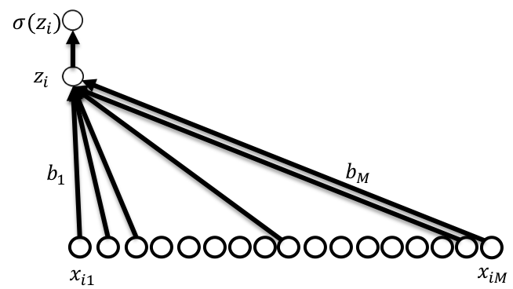
Does this work with MNIST?
~91% Accurate

Slide 62
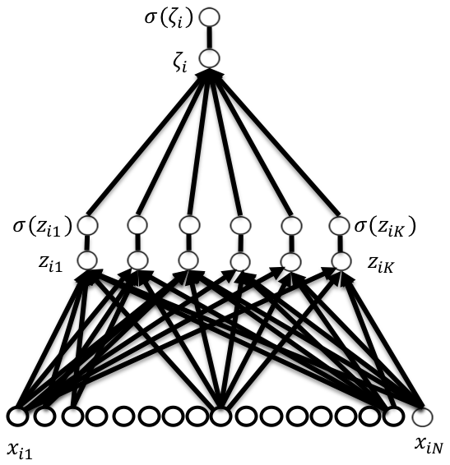
Does this work with MNIST?
~91% Accurate
~96% Accurate

Slide 63
















Do we always want to increase complexity?
$$σ(γ_{i})$$
$$γ_{i}$$
$$σ(z_{i})$$
?
$$σ(ζ_{i1})$$
$$σ(ζ_{iJ})$$
$$z_{i}$$
$$ζ_{i1}$$
$$ζ_{iJ}$$
$$b_{1}$$
$$b_{N}$$
$$σ(z_{i1})$$
$$σ(z_{iK})$$
$$x_{iN}$$
$$z_{i1}$$
$$z_{iK}$$
$$x_{i1}$$
$$x_{i1}$$
$$x_{iN}$$

Slide 64
Break; When WE return we’ll Discuss how the Network is Learned
Thanks for your attention!

