Slide 1
Natural Language Processing Winter School Day 1
Ricardo Henao

Slide 2
Model Learning, Back Propagation and Stochastic Gradient Descent
Part II

Slide 3



















(Recall) Learning Model Parameters
$${σ(z}_{i})$$
$$z_{i}=(b_{1}×x_{i1})+{\left(b_{2}×x_{i2}\right)+⋯+\left(b_{M}×x_{iM}\right)+b}_{0}$$
$$x_{1}$$
$$y_{1}$$
$$z_{i}$$
$$x_{2}$$
$$y_{2}$$
$$x_{3}$$
$$y_{3}$$
$$x_{4}$$
$$y_{4}$$
$$b_{1}$$
$$b_{M}$$
$$x_{N−1}$$
$$x_{N}$$
$$y_{N}$$
$$x_{i1}$$
$$x_{iM}$$
Training Set
Logistic Regression Model (or “Network”)
How do we actually do this?
Learned Parameters
$({b_{0},b}_{1},…b_{N})$

Slide 4
Looking Forward
This afternoon you will be implementing and learning a multilayer perceptron yourself (with help from the TAs!)
In this second lecture, we want to set up the mathematical structure to learn the network

Slide 5







Fundamental Question:
Given a large amount of data and a model/network to fit, how to efficiently and effectively learn the model parameters?
$$σ(z_{i})$$
$$z_{i}$$
$$b_{1}$$
$$b_{N}$$
$$x_{i1}$$
$$x_{iN}$$
$({b_{0},b}_{1},…b_{N})$

Slide 6
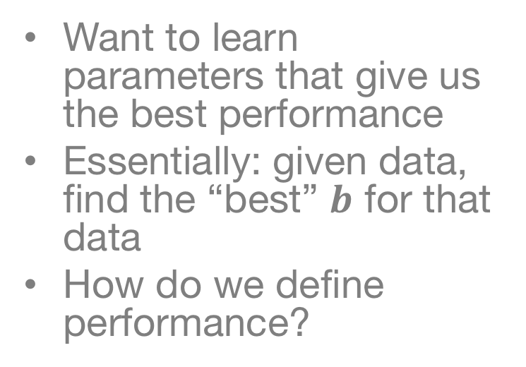
What are we trying to do?
Want to learn parameters that give us the best performance
Essentially: given data, find the “best” $b$ for that data
How do we define performance?
$$σ(z_{i})$$
$$z_{i}$$
$$b_{1}$$
$$b_{N}$$
$$x_{i1}$$
$$x_{iN}$$

Slide 7
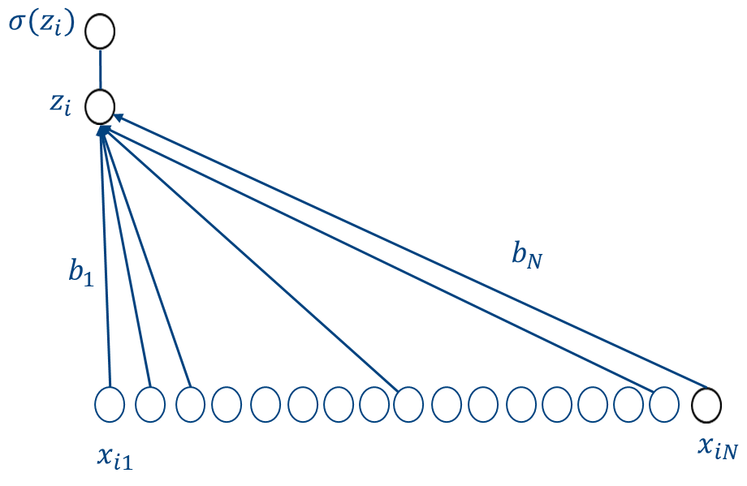




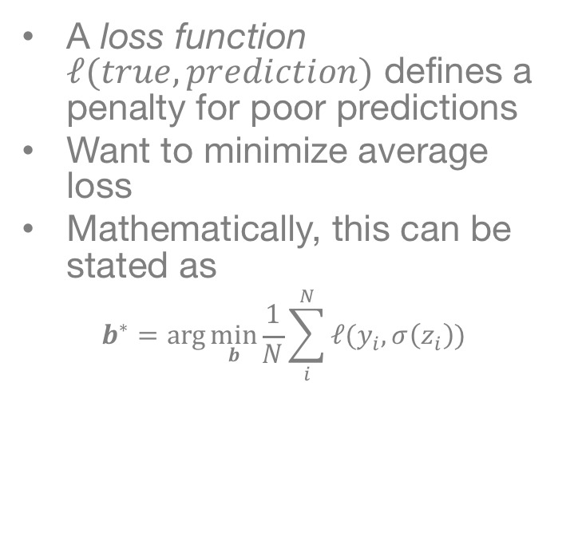







“Empirical Risk Minimization”
A loss function $ℓ(true, prediction)$ defines a penalty for poor predictions
Want to minimize average loss
Mathematically, this can be stated as
$$b^{∗}=\arg{\min_{b}{\frac{1}{N}\sum_{i}^{N}{ℓ(y_{i},σ\left(z_{i}\right))} }}$$
Loss function
$$x_{1}$$
$$y_{1}$$
$$x_{2}$$
$$y_{2}$$
$$x_{3}$$
$$y_{3}$$
$$x_{4}$$
$$y_{4}$$
Guess
True Label
$$x_{N−1}$$
$$x_{N}$$
$$y_{N}$$

Slide 8
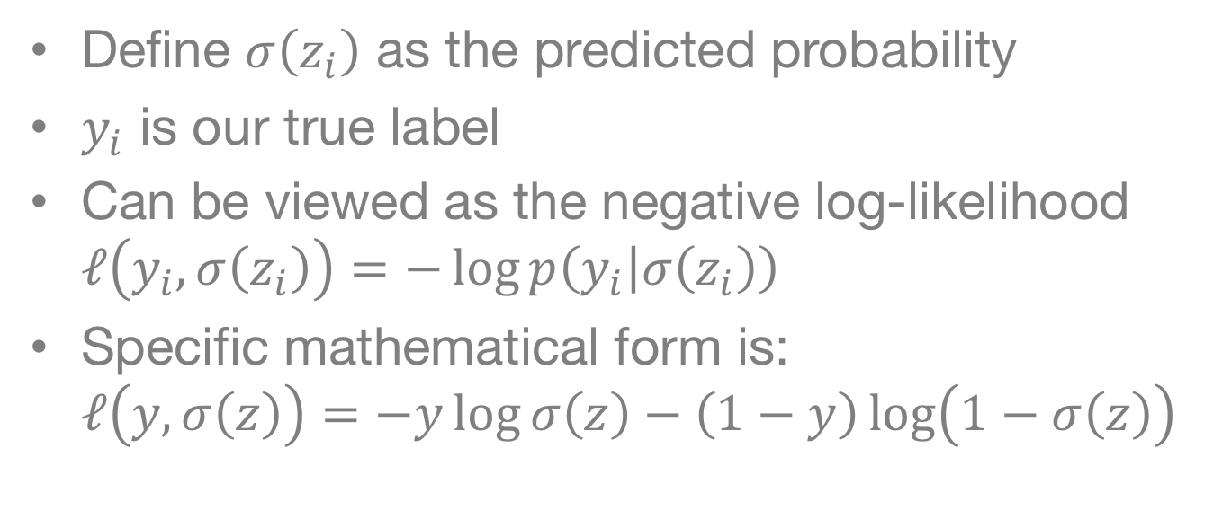
What is the Loss Function?
Define $σ\left(z_{i}\right)$ as the predicted probability
$y_{i}$ is our true label
Can be viewed as the negative log-likelihood $ℓ\left(y_{i},σ\left(z_{i}\right)\right)=−\log{p\left(y_{i} | σ\left(z_{i}\right)\right)}$
Specific mathematical form is: $ℓ\left(y,σ\left(z\right)\right)=−y\log{σ\left(z\right)}−\left(1−y\right)\log\left(1−σ\left(z\right)\right)$

Slide 9
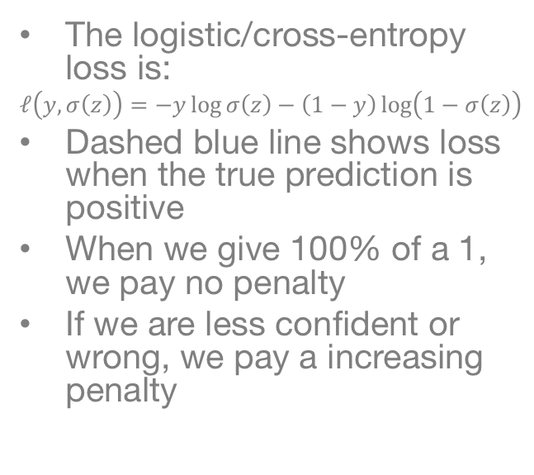
Visualization of Logistics Loss Function
The logistic/cross-entropy loss is:
$$ℓ\left(y,σ\left(z\right)\right)=−y\log{σ\left(z\right)}−\left(1−y\right)\log\left(1−σ\left(z\right)\right)$$
Dashed blue line shows loss when the true prediction is positive
When we give 100% of a 1, we pay no penalty
If we are less confident or wrong, we pay a increasing penalty
Predicted Probability of a “one”

Slide 10
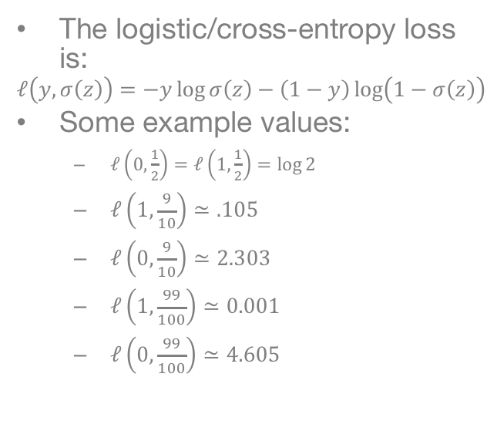
Visualization of Logistics Loss Function
The logistic/cross-entropy loss is:
$$ℓ\left(y,σ\left(z\right)\right)=−y\log{σ\left(z\right)}−\left(1−y\right)\log\left(1−σ\left(z\right)\right)$$
Some example values:
$ℓ\left(0,\frac{1}{2}\right)=ℓ\left(1,\frac{1}{2}\right)=\log{2}$
$ℓ\left(1,\frac{9}{10}\right)≃.105$
$ℓ\left(0,\frac{9}{10}\right)≃2.303$
$ℓ\left(1,\frac{99}{100}\right)≃0.001$
$ℓ\left(0,\frac{99}{100}\right)≃4.605$
Predicted Probability of a “one”

Slide 11
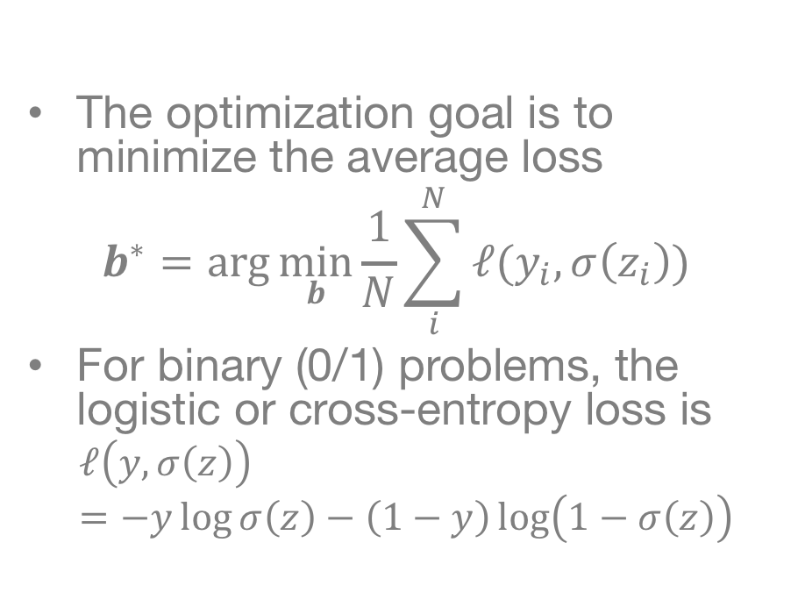
Optimization Goal for Binary Classification
The optimization goal is to minimize the average loss
$$b^{∗}=\arg{\min_{b}{\frac{1}{N}\sum_{i}^{N}{ℓ(y_{i},σ\left(z_{i}\right))} }}$$
For binary (0/1) problems, the logistic or cross-entropy loss is
$$ℓ\left(y,σ\left(z\right)\right)=−y\log{σ\left(z\right)}−\left(1−y\right)\log\left(1−σ\left(z\right)\right)$$
$$x_{1}$$
$$y_{1}$$
$$x_{2}$$
$$y_{2}$$
$$x_{3}$$
$$y_{3}$$
$$x_{4}$$
$$y_{4}$$
$$x_{N−1}$$
$$x_{N}$$
$$y_{N}$$

Slide 12
Learning the Parameters
Brief Intro to Gradient Descent

Slide 13
Visualization of Optimization Method
Current Point
We want to minimize a mathematical function (i.e., our average loss function)
One approach is to:
Find the direction pointing “down the hill” (towards a smaller value)
Move a bit in that direction
Repeat 1-2 until satisfied
Slope

Slide 14
Visualization of Optimization Method
Current Point
We want to minimize a mathematical function (i.e., our average loss function)
One approach is to:
Find the direction pointing “down the hill” (towards a smaller value)
Move a bit in that direction
Repeat 1-2 until satisfied
Update
Slope

Slide 15
Visualization of Optimization Method
We want to minimize a mathematical function (i.e., our average loss function)
One approach is to:
Find the direction pointing “down the hill” (towards a smaller value)
Move a bit in that direction
Repeat 1-2 until satisfied
This shows the first update
Current Point
Slope

Slide 16
Visualization of Optimization Method
We want to minimize a mathematical function (i.e., our average loss function)
One approach is to:
Find the direction pointing “down the hill” (towards a smaller value)
Move a bit in that direction
Repeat 1-2 until satisfied
This shows the second update
Current Point
Slope

Slide 17
Visualization of Optimization Method
We want to minimize a mathematical function (i.e., our average loss function)
One approach is to:
Find the direction pointing “down the hill” (towards a smaller value)
Move a bit in that direction
Repeat 1-2 until satisfied
This shows the third update
Current Point
Slope

Slide 18
Visualization of Optimization Method
We want to minimize a mathematical function (i.e., our average loss function)
One approach is to:
Find the direction pointing “down the hill” (towards a smaller value)
Move a bit in that direction
Repeat 1-2 until satisfied
This shows the fourth update
Current Point
Slope

Slide 19
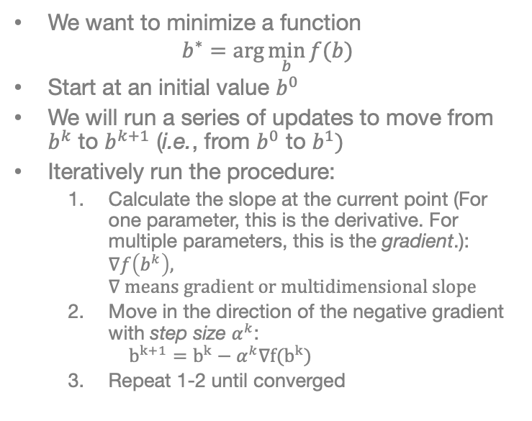
Mathematical Description of Gradient Descent
Current Point
We want to minimize a function
$$b^{∗}=\arg{\min_{b}{f(b)}}$$
Start at an initial value $b^{0}$
We will run a series of updates to move from $b^{k}$ to $b^{k+1}$ (i.e., from $b^{0}$ to $b^{1})$
Iteratively run the procedure:
Calculate the slope at the current point (For one parameter, this is the derivative. For multiple parameters, this is the gradient.): $∇f\left(b^{k}\right),$ $∇ means gradient or multidimensional slope$
Move in the direction of the negative gradient with step size $α^{k}$: $b^{k+1}=b^{k}−α^{k}∇f(b^{k})$
Repeat 1-2 until converged
Update
Slope

Slide 20
Scaling to Big Data
Brief Introduction to Stochastic Gradient Descent (SGD)

Slide 21
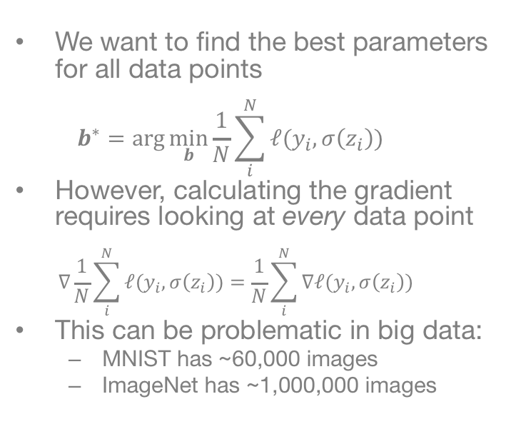
Return to our Optimization Goal
We want to find the best parameters for all data points $b^{∗}=\arg{\min_{b}{\frac{1}{N}\sum_{i}^{N}{ℓ(y_{i},σ\left(z_{i}\right))} }}$
However, calculating the gradient requires looking at every data point $∇\frac{1}{N}\sum_{i}^{N}{ℓ(y_{i},σ\left(z_{i}\right))}=\frac{1}{N}\sum_{i}^{N}{∇ℓ(y_{i},σ\left(z_{i}\right))}$
This can be problematic in big data:
MNIST has ~60,000 images
ImageNet has ~1,000,000 images
$$x_{1}$$
$$y_{1}$$
$$x_{2}$$
$$y_{2}$$
$$x_{3}$$
$$y_{3}$$
$$x_{4}$$
$$y_{4}$$
$$x_{N−1}$$
$$x_{N}$$
$$y_{N}$$

Slide 22
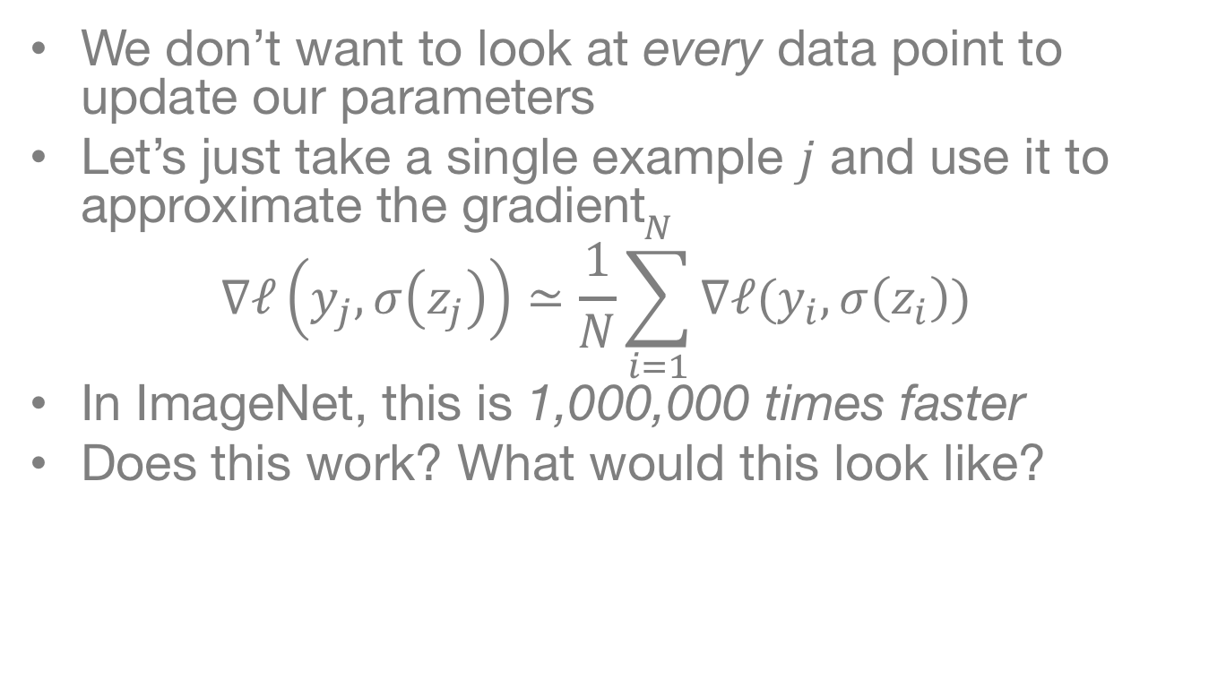
Let’s Just Approximate the Gradient
We don’t want to look at every data point to update our parameters
Let’s just take a single example $j$ and use it to approximate the gradient $∇ℓ\left(y_{j},σ\left(z_{j}\right)\right)≃\frac{1}{N}\sum_{i=1}^{N}{∇ℓ(y_{i},σ\left(z_{i}\right))}$
In ImageNet, this is 1,000,000 times faster
Does this work? What would this look like?

Slide 23
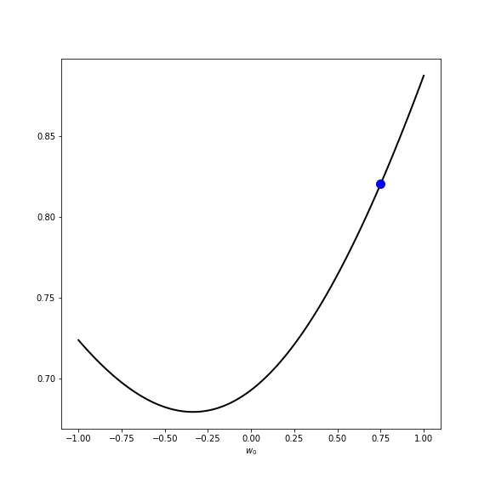

Visualizations
Gradient Descent
Stochastic Gradient Descent

Slide 24
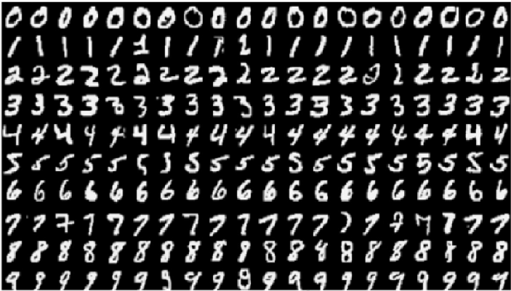
Data is Often Redundant
60,000 images, but really only 10 different types…

Slide 25
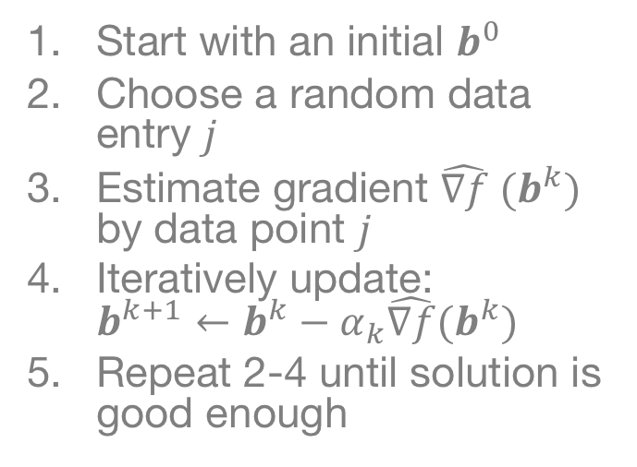
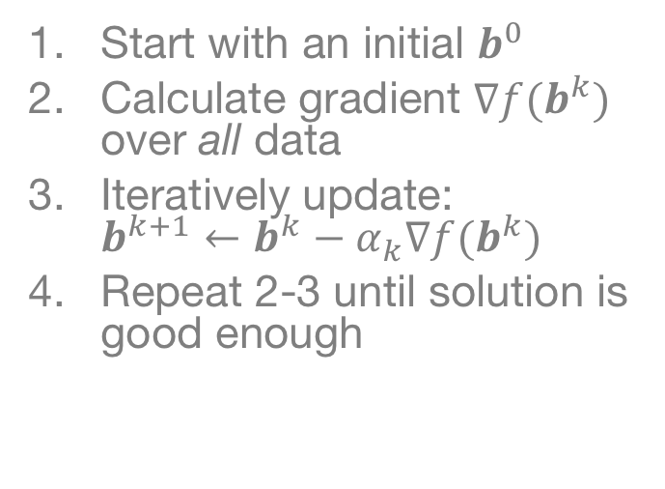
Mathematical Descriptions
Gradient Descent
Stochastic Gradient Descent
Start with an initial $b^{0}$
Calculate gradient $∇f(b^{k})$ over all data
Iteratively update: $b^{k+1}←b^{k}−α_{k}∇f(b^{k})$
Repeat 2-3 until solution is good enough
Start with an initial $b^{0}$
Choose a random data entry $j$
Estimate gradient $\hat{∇f} (b^{k})$ by data point $j$
Iteratively update: $b^{k+1}←b^{k}−α_{k}\hat{∇f}(b^{k})$
Repeat 2-4 until solution is good enough

Slide 26
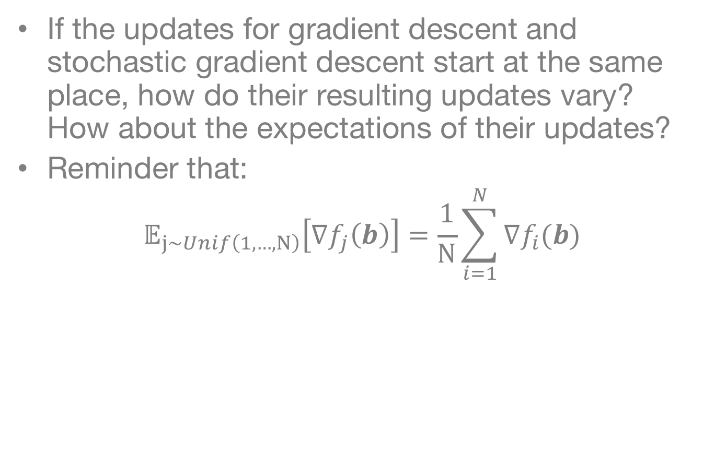
Question:
If the updates for gradient descent and stochastic gradient descent start at the same place, how do their resulting updates vary? How about the expectations of their updates?
Reminder that:
$$𝔼_{j∼Unif\left(1,…,N\right)}\left[∇f_{j}\left(b\right)\right]=\frac{1}{N}\sum_{i=1}^{N}{∇f_{i}(b)}$$

Slide 27
Initial Conclusions
Stochastic Gradient Descent can update many more times than Gradient Descent
Gets near the solution very quickly
Allows scaling to big data (update time doesn’t increase with the data size)
In practice, we often use a minibatch, which uses a few data examples to estimate the gradient

Slide 28
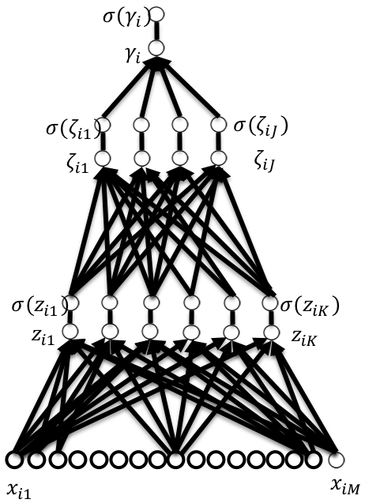
Calculating the Gradient
Calculating the gradient (multi-dimensional slope) on a multi-layer perceptron may seem daunting
Algorithms can automatically calculate the gradient (“backpropagation”)
In code, we simply have to use a “gradient” function call once the network is defined

Slide 29
Small-Scale Example of Stochastic Updates
Building Intuition

Slide 30
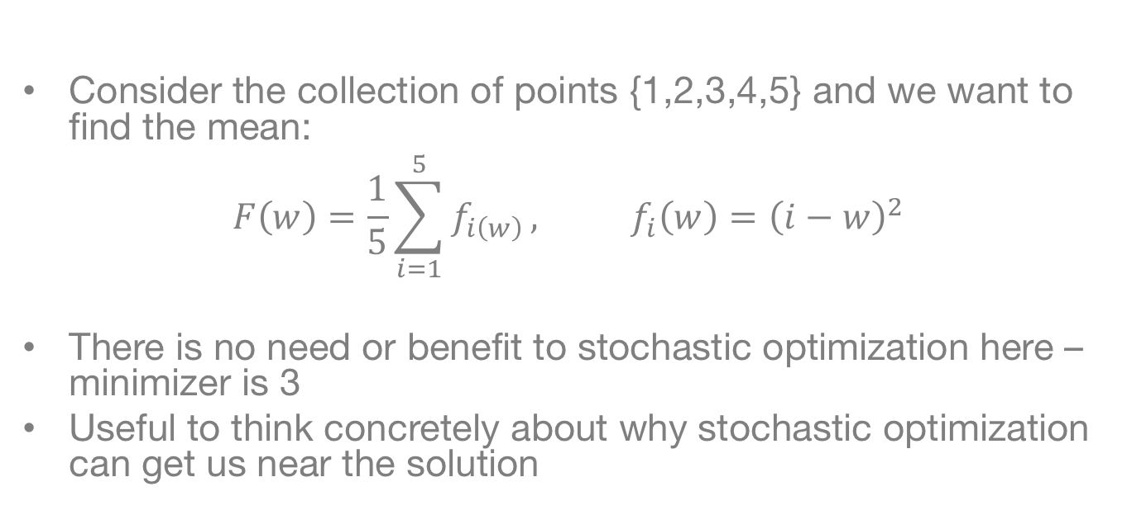
Finding the mean
Consider the collection of points {1,2,3,4,5} and we want to find the mean:
$$F\left(w\right)=\frac{1}{5}\sum_{i=1}^{5}{f_{i\left(w\right)}}, f_{i}\left(w\right)={\left(i−w\right)}^{2}$$
There is no need or benefit to stochastic optimization here – minimizer is 3
Useful to think concretely about why stochastic optimization can get us near the solution

Slide 31
Finding the mean
Simple example:
$$f_{i}\left(w\right)={\left(i−w\right)}^{2}$$
Can we find the mean with stochastic gradient descent?
What happens when $w_{0}=−100$?
What happens when $w_{0}=0$?
What happens when $w_{0}=2$?
What happens when $w_{0}=3$?

Slide 32
Revisiting our Visualization
When the starting point is “far away” from the optimal, then we typically move in the right direction
When the current point is near the optimal value, it is very random whether we move in the correct direction or not

Slide 33
Learning Model Parameters (Recap)
$${σ(z}_{i})$$
$$z_{i}=\left(b_{1}×x_{i1}\right)+\left(b_{2}×x_{i2}\right)+⋯+\left(b_{M}×x_{iM}\right)$$
$$x_{1}$$
$$y_{1}$$
$$z_{i}$$
$$x_{2}$$
$$y_{2}$$
$$x_{3}$$
$$y_{3}$$
$$x_{4}$$
$$y_{4}$$
$$b_{1}$$
$$b_{M}$$
$$x_{N−1}$$
$$x_{N}$$
$$y_{N}$$
$$x_{i1}$$
$$x_{iM}$$
Training Set
Logistic Regression Model (or “Network”)
Stochastic Gradient Descent
Learned Parameters
$({b_{0},b}_{1},…b_{N})$

Slide 34
Estimating Performance
An Introduction to Model Validation

Slide 35


















Do we always want to increase complexity?
$$σ(γ_{i})$$
$$γ_{i}$$
$$σ(z_{i})$$
?
$$σ(ζ_{i1})$$
$$σ(ζ_{iJ})$$
$$z_{i}$$
$$ζ_{i1}$$
$$ζ_{iJ}$$
$$b_{1}$$
$$b_{N}$$
$$σ(z_{i1})$$
$$σ(z_{iK})$$
$$x_{iN}$$
$$z_{i1}$$
$$z_{iK}$$
$$x_{i1}$$
$$x_{i1}$$
$$x_{iN}$$

Slide 36
Creating deep models can help us learn complex relationships
My learning multiple layers and transformation, it is possible to have a non-linear classifier capable of more accurately capturing the data.
However, a deep model can also give “perfect” performance on the training dataset and fail completely in the real world
We need to validate the performance

Slide 37
Overfitting
“Overfitting” is when the learned model increases complexity to fit the observed training data too well – will not work to predict future data!
What would we want to use to fit these example data points?

Slide 38
Classic Example: Increasing Polynomial Order
Increasing complexity visually looks ridiculous…

Slide 39

What happens in overfitting?
$$x_{1}$$
$$y_{1}$$
We are increasing the number of parameters in the model, which means:
More parameters to estimate (all of their errors add up)
Can learn complex relationships, maybe too complex for reality
When we overfit, this means that we will not generalize
We want our models and analysis to generalize, or provide accurate predictions on newly collected data
$$x_{2}$$
$$y_{2}$$
$$x_{3}$$
$$y_{3}$$
$$x_{4}$$
$$y_{4}$$
$$x_{N−1}$$
$$x_{N}$$
$$y_{N}$$
Training Set
$({b_{0},b}_{1},…b_{N})$
Performance in the Real World??

Slide 40











Standard Validation Strategy
$$x_{1}$$
$$y_{1}$$
In the end, we want to know how the network will perform in the real world
Standard approach: actually try it in the real world
This is costly; instead, can we use existing data to estimate performance?
$$x_{2}$$
$$y_{2}$$
$$x_{3}$$
$$y_{3}$$
$$x_{4}$$
$$y_{4}$$
$$x_{N−1}$$
$$x_{N}$$
$$y_{N}$$
Training Set
$$x_{1}$$
$$y_{1}$$
$$x_{2}$$
$$y_{2}$$
$$x_{3}$$
$$y_{3}$$
$$x_{4}$$
$$y_{4}$$
$$x_{N−1}$$
$$y_{N−1}$$
$({b_{0},b}_{1},…b_{N})$
$$x_{N}$$
$$y_{N}$$
“New” Real-World Data
Estimate Real-World Performance

Slide 41


































Split Data into Separate Groups
Train, Validation, Test
$$x_{1}$$
$$y_{1}$$
$$x_{1}$$
$$y_{1}$$
$$x_{2}$$
$$y_{2}$$
$$x_{2}$$
$$y_{2}$$
$$x_{3}$$
$$y_{3}$$
$$x_{3}$$
$$y_{3}$$
$$x_{4}$$
$$y_{4}$$
$$x_{4}$$
$$y_{4}$$
$$x_{5}$$
$$y_{5}$$
$$x_{5}$$
$$y_{5}$$
$$x_{6}$$
$$y_{6}$$
Random Assignment
$$x_{6}$$
$$y_{6}$$
$$x_{7}$$
$$y_{7}$$
$$x_{7}$$
$$y_{7}$$
$$x_{N−1}$$
$$y_{N−1}$$
$$x_{N−1}$$
$$y_{N−1}$$
$$x_{N}$$
$$y_{N}$$
$$x_{N}$$
$$y_{N}$$
All Available Data

Slide 42


















































Split Data into Separate Groups
Train
$$x_{1}$$
$$y_{1}$$
$$x_{2}$$
$$y_{2}$$
$$x_{1}$$
$$y_{1}$$
$$x_{3}$$
$$y_{3}$$
$$x_{4}$$
$$y_{4}$$
$$x_{2}$$
$$y_{2}$$
$$x_{3}$$
$$y_{3}$$
$$x_{N−1}$$
$$y_{N−1}$$
$$x_{4}$$
$$y_{4}$$
$$x_{N}$$
$$y_{N}$$
$$y_{5}$$
$$x_{1}$$
$$y_{1}$$
$$x_{5}$$
$$x_{2}$$
$$y_{2}$$
$$x_{6}$$
$$y_{6}$$
$$x_{3}$$
$$y_{3}$$
$$x_{4}$$
$$y_{4}$$
$$x_{7}$$
$$y_{7}$$
$$x_{1}$$
$$y_{1}$$
$$x_{N−1}$$
$$y_{N−1}$$
$$x_{2}$$
$$y_{2}$$
$$x_{N}$$
$$y_{N}$$
$$x_{3}$$
$$y_{3}$$
Test
$$y_{N−1}$$
$$x_{4}$$
$$y_{4}$$
$$x_{N−1}$$
$$x_{N}$$
$$y_{N}$$
$$x_{N−1}$$
$$y_{N−1}$$
All Available Data
$$x_{N}$$
$$y_{N}$$
Validation

Slide 43
Test set
Standard practice to create prior to any analysis—will not be used to learn or fit any parameters
After learning the network, can evaluate its performance on the test set
This data was not included in the training/fitting, so it is analogous to running a new synthetic experiment
Ideally, the test set will be used once.
Reusing the test set leads to bias; performance estimates will be optimistic

Slide 44
Validation Set
Want to be able to compare which approach is best
Problematic if we only want to use a test set once
Can create a second held-out dataset
The validation data is not used for learning parameters, but can be used repeatedly to estimate performance of a model
We can pick the model with the best performance on the validation set, and run a final evaluation on the test data

Slide 45




















Refine Model
$$x_{1}$$
$$y_{1}$$
$$x_{1}$$
$$y_{1}$$
$$x_{2}$$
$$y_{2}$$
$$x_{2}$$
$$y_{2}$$
$$x_{3}$$
$$y_{3}$$
$$x_{3}$$
$$y_{3}$$
$$x_{4}$$
$$y_{4}$$
$$x_{4}$$
$$y_{4}$$
$$x_{1}$$
$$y_{1}$$
$$x_{N−1}$$
$$x_{2}$$
$$y_{2}$$
$$x_{N−1}$$
$$y_{N−1}$$
$$x_{N}$$
$$y_{N}$$
$$x_{3}$$
$$y_{3}$$
$$x_{N}$$
$$y_{N}$$
Training Set
$$x_{4}$$
$$y_{4}$$
Test
$$x_{N−1}$$
$$y_{N−1}$$
$$x_{N}$$
$$y_{N}$$
$({b_{0},b}_{1},…b_{N})$
Validation
Estimate Performance on Validation Set
Final Performance Evaluation

Slide 46
Validation During Optimization
We want to maximize the generalization of the network, not our previous optimization goal
In practice, can we validate the model while running the optimization loop?

Slide 47
Early Stopping
During optimization, we can check the validation loss as we go.
Instead of optimizing to convergence, we can optimize until the validation loss stops improving
Saves computational cost
Performs better on validation (and test) sets
Widely used technique in the field
Best Validation (and Generalization) Here
Training Loss Keeps Improving

Slide 48
Learning Model Parameters (Recap)
$${σ(z}_{i})$$
$$z_{i}=\left(b_{1}×x_{i1}\right)+\left(b_{2}×x_{i2}\right)+⋯+\left(b_{M}×x_{iM}\right)$$
$$x_{1}$$
$$y_{1}$$
$$z_{i}$$
$$x_{2}$$
$$y_{2}$$
$$x_{3}$$
$$y_{3}$$
$$x_{4}$$
$$y_{4}$$
$$b_{1}$$
$$b_{M}$$
$$x_{N−1}$$
$$x_{N}$$
$$y_{N}$$
$$x_{i1}$$
$$x_{iM}$$
Training Set
Logistic Regression Model (or “Network”)
Stochastic Gradient Descent
Learned Parameters
$({b_{0},b}_{1},…b_{N})$

Slide 49
Conclusions/Next Steps
Stochastic Gradient methods are the modus operandi of learning deep networks
Many extensions such as momentum, preconditioning (will use in hands-on sessions)
Proper model validation is critical to estimate real-world performance
Hands on section you will implement stochastic gradient descent and a multi-layer perceptron

Slide 50
Wrapping Up
Thanks for your attention!

