Slide 1
An Introduction to Recurrent Neural Networks
David Carlson
Duke University

Slide 2
Making Sense of Sequences
In the first lecture we discussed:
Bag-of-words representations (word counting)
Word embeddings
How do we go to evaluating words as sequences?

Slide 3
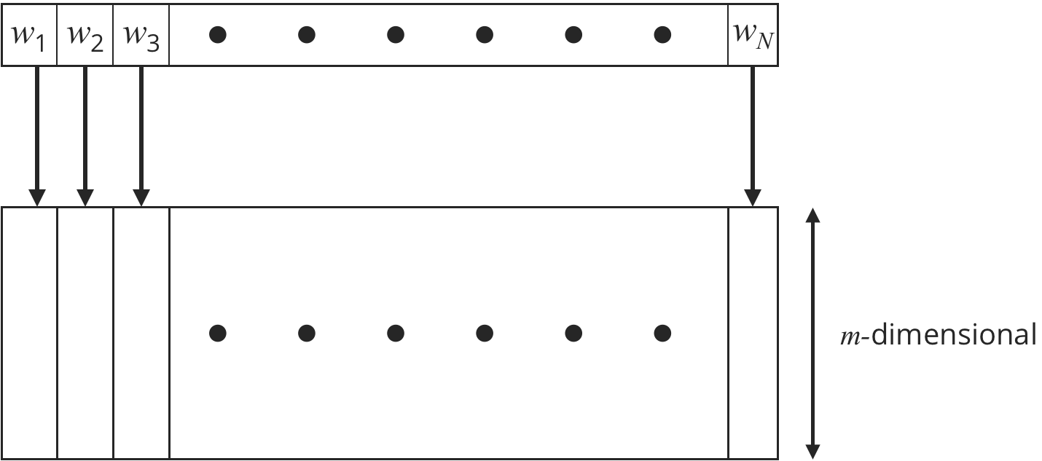
Using Word Embeddings
Our representation depends on the number of words
Not a constant number of features!

Slide 4











Recall Our MLP Word Prediction
$$U$$
$$y_{1}$$
$$y_{2}$$
$$W$$
$$y_{3}$$
$$C_{1}$$
$$C_{2}$$
$$C_{3}$$
$$C_{m}$$
$$h$$
$$y_{V}$$

Slide 5



Simplified View
Current Word
Embedding
Model-Predicted
Next Word
Neural Network
$$h_{n}$$
Softmax
$$w_{n−1}$$
$$w_{n}$$
Could predict a sentence by choosing the first word, and then predicting the next word each time given the current word.
Doesn’t use any history, but we want to use all available information.

Slide 6
Simplified View
Summary of the past
Current Word
Embedding
Model-Predicted
Next Word
Neural Network
$$h_{n}$$
Softmax
$$w_{n−1}$$
$$w_{n}$$
Could predict a sentence by choosing the first word, and then predicting the next word each time given the current word.
Doesn’t use any history, but we want to use all available information.
Can we add in a summary of what happened in the past?

Slide 7













Recurrent Neural Network
Sequence of Word
Embeddings (sentence)
Model-Predicted
Next Word
$$h_{n−1}$$
Neural
Network
$$h_{n}$$
$$w_{n−1}$$
Softmax
$$w_{n}$$
$$h_{n}$$
Neural
Network
$$h_{n+1}$$
$$w_{n}$$
Softmax
$$w_{n+1}$$
$$h_{n+1}$$
Neural
Network
$$w_{n+1}$$
Softmax
$$w_{n+2}$$
$$h_{n+2}$$

Slide 8






Recurrent Neural Network
Sequence of Word
Embeddings (sentence)
Model-Predicted
Next Word
$$h_{n−1}$$
Neural
Network
$$h_{n}$$
$$w_{n−1}$$
Softmax
$$w_{n}$$
$$h_{n}$$
Neural
Network
$$h_{n+1}$$
$$w_{n}$$
Softmax
$$w_{n+1}$$
$$h_{n+1}$$
Neural
Network
$$w_{n+1}$$
Softmax
$$w_{n+2}$$
$$h_{n+2}$$

Slide 9
Recurrent Neural Network
Sequence of Word
Embeddings (sentence)
Model-Predicted
Next Word
$$h_{n−1}$$
Neural
Network
$$h_{n}$$
$$w_{n−1}$$
Softmax
$$w_{n}$$
$$h_{n}$$

Slide 10
Recurrent Neural Network
Sequence of Word
Embeddings (sentence)
Model-Predicted
Next Word
$$h_{n−1}$$
Neural
Network
$$h_{n}$$
$$w_{n−1}$$
Softmax
$$w_{n}$$
$$h_{n}$$

Slide 11


Recurrent Neural Network
Sequence of Word
Embeddings (sentence)
Model-Predicted
Next Word
$$h_{n−1}$$
Neural
Network
$$h_{n}$$
$$w_{n−1}$$
Softmax
$$w_{n}$$
$$h_{n}$$
Concatenate
$$Vector for w_{n−1}$$
$$h_{n−1}$$

Slide 12




Recurrent Neural Network
Sequence of Word
Embeddings (sentence)
Model-Predicted
Next Word
$$h_{n−1}$$
Neural
Network
$$h_{n}$$
$$w_{n−1}$$
Softmax
$$w_{n}$$
$$h_{n}$$
Concatenate
$$W$$
$$Vector for w_{n−1}$$
$$h_{n−1}$$
$$h_{n}$$

Slide 13



Recurrent Neural Network
Sequence of Word
Embeddings (sentence)
Model-Predicted
Next Word
$$h_{n−1}$$
Neural
Network
$$h_{n}$$
$$w_{n−1}$$
Softmax
$$w_{n}$$
$$h_{n}$$
$$W$$
$$Vector for w_{n−1}$$
$$h_{n−1}$$
$$h_{n}$$

Slide 14









Recurrent Neural Network
Sequence of Word
Embeddings (sentence)
Model-Predicted
Next Word
$$h_{n−1}$$
Neural
Network
$$h_{n}$$
$$w_{n−1}$$
Softmax
$$w_{n}$$
$$h_{n}$$
$$U$$
$$y_{1}$$
$$y_{2}$$
$$W$$
$$y_{3}$$
Softmax
$$Vector for w_{n−1}$$
$$h_{n−1}$$
$$h_{n}$$
$$y_{V−1}$$

Slide 15










Introduce Notation
$$U$$
$$y_{1}$$
$$y_{2}$$
$$W$$
$$y_{3}$$
Softmax
$$Vector for w_{n−1}$$
$$h_{n−1}$$
$$h_{n}$$
$$y_{V−1}$$
$$x_{n−1}$$
$$h_{n}=tanh(W⋅x_{n−1}+b)$$
$$p(w_{n}|w_{n−1},h_{n−1})=softmax(U⋅h_{n}+β)$$
Notes:
Passes along the most important information
Theoretically there is no gain in passing in Hn-2 in addition to the Hn-1

Slide 16



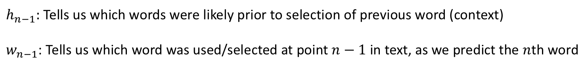







Intuition on Model for Predicting nth Word
$$U$$
$$y_{1}$$
$$y_{2}$$
$$W$$
$$y_{3}$$
Softmax
$$Vector for w_{n−1}$$
$$h_{n−1}$$
$$h_{n}$$
$$y_{V−1}$$
$$x_{n−1}$$
$h_{n−1}:$Tells us which words were likely prior to selection of previous word (context)
$w_{n−1}$: Tells us which word was used/selected at point $n−1$ in text, as we predict the $n$th word

Slide 17
Recurrent Neural Network
Sequence of Word
Embeddings (sentence)
Model-Predicted
Next Word
$$h_{n−1}$$
Neural
Network
$$h_{n}$$
$$w_{n−1}$$
Softmax
$$w_{n}$$
$$h_{n}$$
Neural
Network
$$h_{n+1}$$
$$w_{n}$$
Softmax
$$w_{n+1}$$
$$h_{n+1}$$
Neural
Network
$$w_{n+1}$$
Softmax
$$w_{n+2}$$
$$h_{n+2}$$

Slide 18
Generating Text
Sequence of Word
Embeddings (sentence)
Model-Predicted
Next Word
$$h_{n−1}$$
Neural
Network
$$h_{n}$$
$$w_{n−1}$$
Softmax
$$w_{n}$$
$$h_{n}$$
Neural
Network
$$h_{n+1}$$
$$w_{n}$$
Softmax
$$w_{n+1}$$
$$h_{n+1}$$
Neural
Network
$$w_{n+1}$$
Softmax
$$w_{n+2}$$
$$h_{n+2}$$

Slide 19



Predicting a Single Output
Sequence of Word
Embeddings (sentence)
$$h_{n−1}$$
$$w_{n−1}$$
Neural
Network
$$h_{n}$$
Neural
Network
$$w_{n}$$
$$h_{n+1}$$
Neural
Network
$$<EOS>$$
Sigmoid
Predict at the end of the text.
Notes:
Note that it might make more sense to predict without using all of the data. For instance, read all of the book and ask what happened on page 57 as opposed to reading up to page 57 and then asking

Slide 20
Comments
Word embeddings and recurrent neural networks are currently the cornerstones of natural language processing
This version is called the “simple recurrent unit”
Nearly all text systems are based on these techniques (e.g. google translate, chatbots, etc.)
Many more versions of Recurrent Neural Networks
Long-Short Term Memory (LSTM) to build a “memory”
Stacking recurrent units to make deep recurrent networks
Can combine with CNNs to analyze text and images

Slide 21
LONG-Short TERM MEMORY
Jump to next slide deck.

