Slide 1
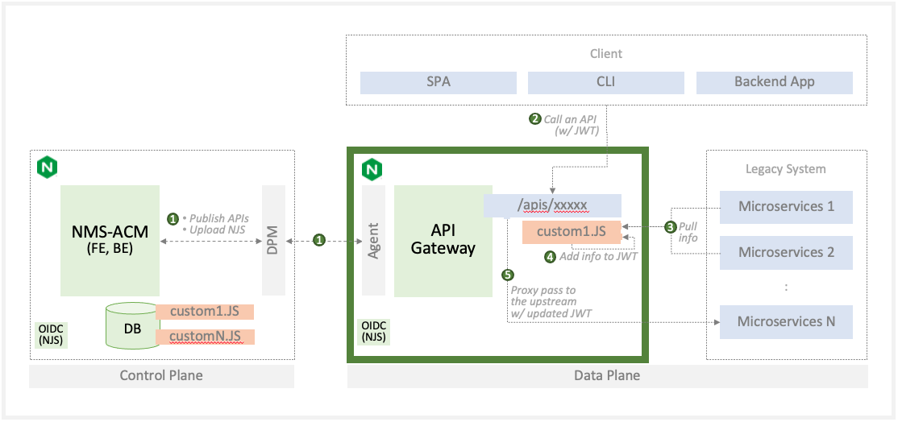
Solution Engineer
Product Manager
I’ve got a customer who is using N+ w/ NJS to enrich (?not sure if that’s the right term) but when it gets a JWT from client it will reach out to a number of other microservices to pull information and then add information to the JWT to send on to an upstream service. Is that something that would likely always stay as a custom NJS on plus or could that potentially be managed/controlled via ACM/NIM?
Bring your own custom policy
(We have this on our plate as Bring your own custom policy where scriptExtensions can be included.)
Initial Approach
(Next Page)
Custom NJS (C-NJS) gets a JWT from a client.
The C-NJS pulls information from the number of Microservices.
The C-NJS add information to the JWT.
The C-NJS send the JWT to an upstream service.

Slide 2

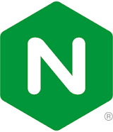
Client
Server Computing (EC2)
Serverless Computing
SPA
CLI
Backend App
2
Call an API
(w/ JWT)
N/A
NMS-ACM
(FE, BE)
API
Gateway
Legacy System
:
/apis/xxxxx
/apis/yyyy
Microservices 1
1
Publish APIs
Upload NJS
DPM
Agent
custom1.JS
3
Pull info
1
/apis/zzzz
Microservices 2
5
4
Add info to JWT
Proxy pass to the upstream w/ updated JWT
DB
custom1.JS
Microservices N
OIDC
(NJS)
customN.JS
OIDC
(NJS)
Control Plane
Data Plane

