Slide 1



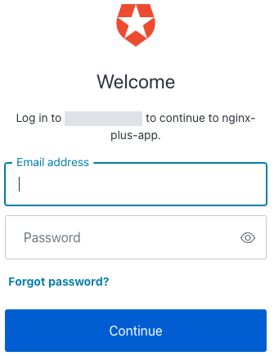

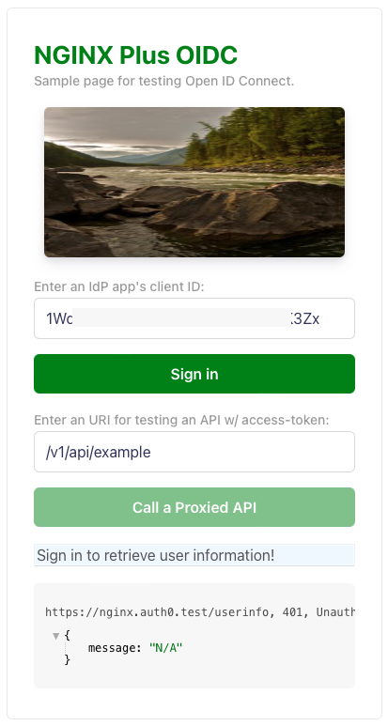

Frontend App
NGINX PLUS OIDC
(3) (13) NGINX Plus exchanges authorization code for ID / access token
IdP
(1) (11)
Login request
/login
(4) (14)
Redirect to original URI
(2) (12) Auth request
OIDC workflow
Backend App
(5) (15) Request /response
user info
/userinfo
(w/ access token)
(6) (16) Request /response
user info
(7) (17) Call APIs
(8) (18) Token validation
Session/token
validation
API 1
(10) invalid?
(9) (19)
valid?
:
(20) Logout request
/logout
API n
(21) Logout

