Slide 1



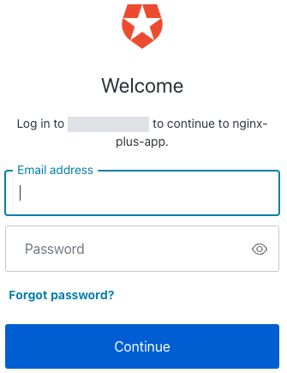

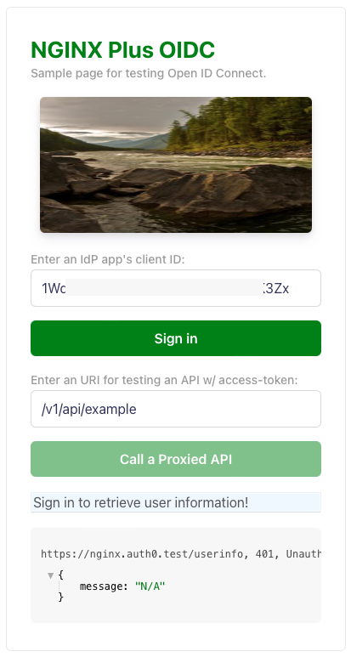

Frontend App
NGINX PLUS OIDC
(3) (11) NGINX Plus exchanges authorization code for ID / access token
IdP
(1) Login request
/login
(4) Redirect to original URI
(2) Auth request
OIDC workflow
Backend App
(6) Request /response
user info
(5) Request /response
user info
/userinfo
(w/ access token)
(10) invalid?
(8) Token validation
(7) Call APIs
Session/token
validation
API 1
(9) valid?
:
(12) Logout request
/logout
API n
(13) Logout

