Slide 1
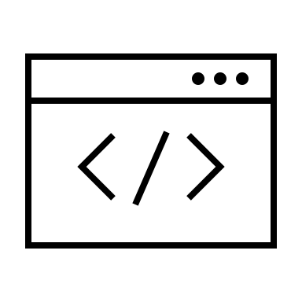
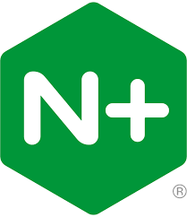
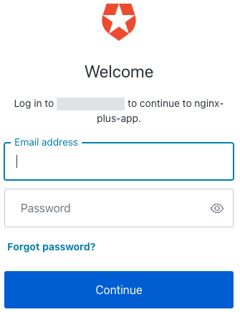


User-Agent
OIDC Client: Relying Party (RP)
OIDC Provider (OP)
Frontend App
1
Request
GET /login
NMS-OIDC
Request auth, and UI based
code exchange for getting tokens
IdP
2
4
Receive
session cookie
Amazon Cognito
Auth0
Azure AD
Cloudentity
Keycloak
Okta
OneLogin
Ping Identity
API request
w/ cookie
5
Logout req
6
/login
Authorization Code Flow
3
Get and store
ID / access /
refresh tokens
K/V Store
Postman, CURL
1
Request
POST /login
4
Receive
session cookie
Client Credentials Flow
3
Get and store
an access token
2
Request a token
Protected Resources
API request
w/ cookie
5
5
access token
per cookie
/apis/xx
Backend App
Access Token,
Session Cookie
Validation
5.1
Validate a token
1
N
Y
5.2
Call protected APIs
w/ Bearer access token
Proxy Pass Backend App
Automation
API 1
1
Request
POST /login
6
/logout
5.3
Extract access token,
validate claims such as
aud, group, role
4
Receive
session cookie
Logout IdP Session
7
Request OIDC end session
:
API request
w/ cookie
5
Clean Session Cookie, K/V
API n

Slide 2

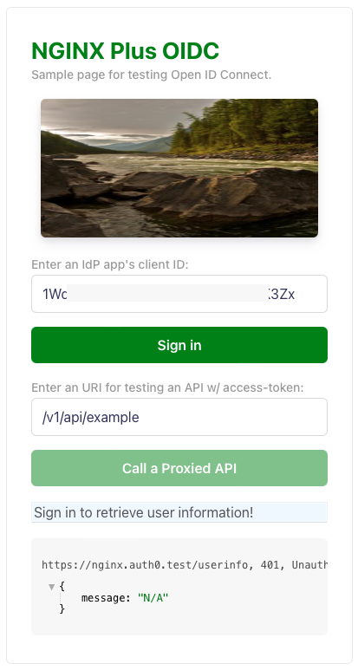
Frontend App
NGINX Plus OIDC
(3) (13) NGINX Plus exchanges authorization code for ID / access token
IdP
Amazon Cognito
Auth0
Azure AD
Keycloak
Okta
OneLogin
Ping Identity
(1) (11)
Login request
/login
(4) (14)
Redirect to original URI
(2) (12) Auth request
OIDC workflow
Backend App
(5) (15) Request /response
user info
/userinfo
(w/ access token)
(6) (16) Request /response
user info
(7) (17) Call APIs
(8) (18) Token validation
Session/token
validation
API 1
(10) invalid?
(9) (19)
valid?
:
(20) Logout request
/logout
API n
(21) Logout

