Slide 1
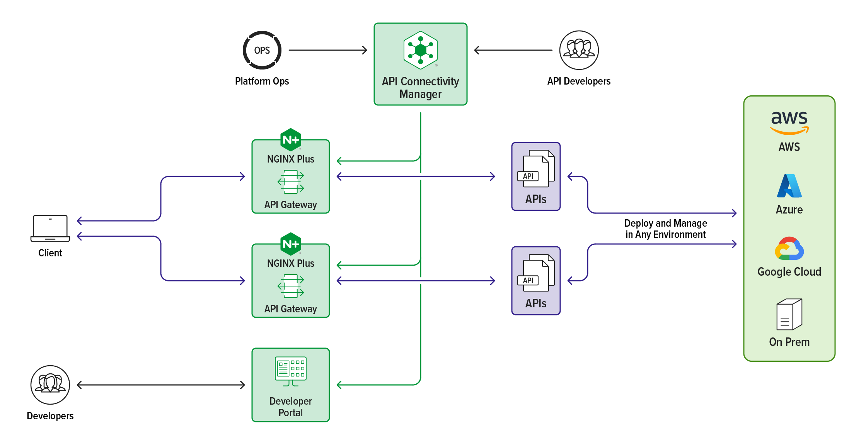
1
Set quota meta data
products
quotas /api
quotas /user
42
metrics mgmt.
API Owners
quota products
quota/user/api
quota analytics
2
Config meta data and key/val store
quota meta quota status
Quota
Remain?
Y
Quota NJS
3
Validate quota
decrement quota
quota meta
quota status
Quota
Remain?
Y
Quota NJS
Y
Purchased
Quota?
Payment NJS
External Payment Gateway
Quota Module
Payment
Module

Slide 2

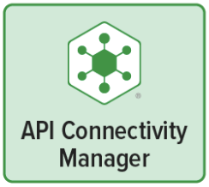
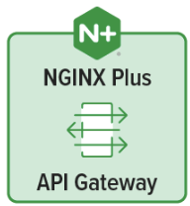
API Owner

