Slide 1
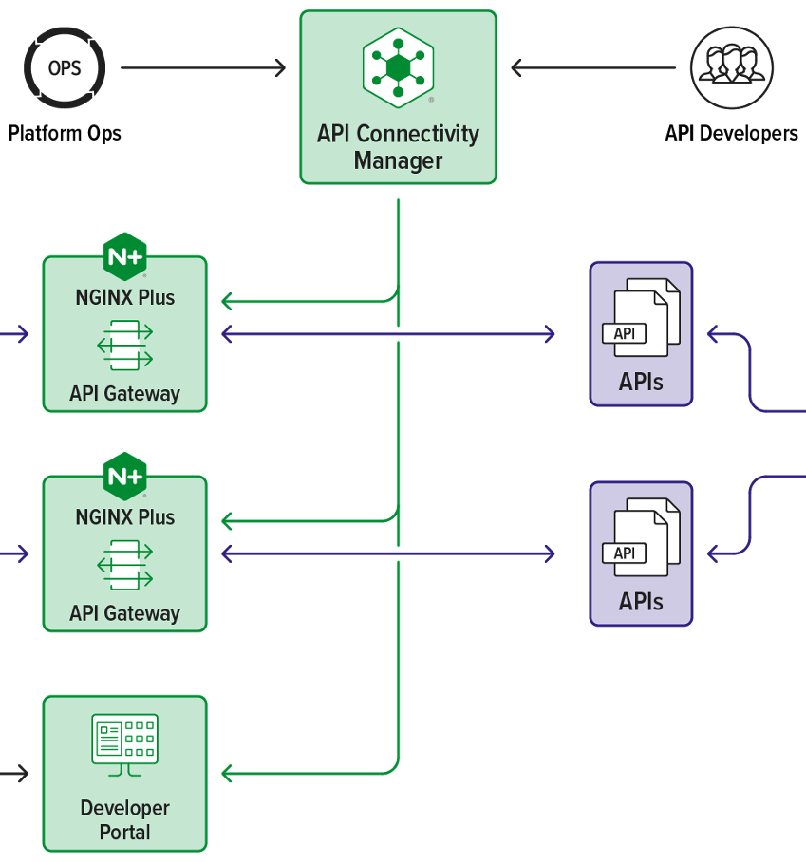
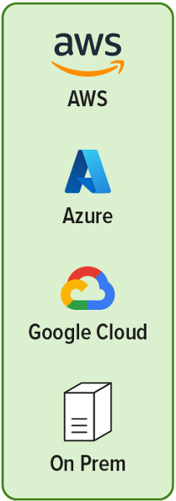


NGINX API Quotas Flow
1
Set quota meta data
quota policy
quotas /api / user
price model
8
Analyze
API Usage
42
Policy metrics
mgmt.
API Owners
quota policies
quota/user/api
quota analytics
7
Monitor
API Billing Data
2
Config meta data and key/val store
quota meta
quota status
Quota
Remain?
Y
Quota NJS
3
Validate quota
decrement quota
Client
quota meta
quota status
Quota
Remain?
Y
Quota NJS
1
config request
(quotas /user/api)
1
Y
External Payment Gateway
a
Create API
Product
&Pricing
Model
Purchased
Quota?
API products
API pricing model
API subscription
5
Subscribe
API
Developers
Payment NJS
b
Create API Products & pricing model
Quota Module
Payment
Module
6
API Subscription

Slide 2
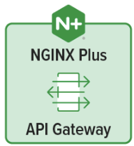
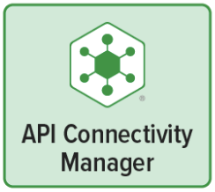
Setting Quotas at API Proxy Level
32
config quota meta-data and k/v store
1
Create a quota policy and set quotas / proxy
DPM
2
quota config request
Nginx Agent
nginx.conf
(quota meta)
2
ACM API
42
set quotas per proxy
Quota NJS
API Owners
quota limit
quota remaining
start/expiry time
ACM DB
K/V Store
update config status
/quotas/{name}/proxies/{name}
6
5
set quotas per proxy per API key
Quota Policies Table
Quota Metadata (nginx.conf)
Quota Name | Policy Type | Proxy ID | API Method | Pay Method | Quota Limit | Limit Per
API:image-api:R:G | Proxy | 1 | GET | Free | 5000 | r/M
API:image-api:W:G | Proxy | 1 | POST | Gold | 6000 | r/M
map $api_quota_policy_name $limit_per {
"API:image-api:R:F" "5000r/M";
"API:image-api:W:G" "6000r/M";
}
map $apikey_proxy_method $quota_pay_method {
"api-key-01:image-api:R" "F"; # Free
"api-key-02:image-api:W" "G"; # Gold
}
keyval_zone zone=q_limit:1M state=ql.json sync;
keyval_zone zone=q_status:1M state=qs.json sync timeout=32d;
keyval $quota_key $q_limit zone=$q_limit;
keyval $quota_key $q_status zone=$q_status;
server {
include conf.d/quota_apis.conf;
location /images {
if ( $request_method = GET ) {
set $quota_enable_per_apikey_proxy_read 1;
}
if ( $request_method = POST) {
set $quota_enable_per_apikey_proxy_write 1;
} auth_request /_quota_validation;
mirror /_quota_decrement;
error_page 403 = @too_many_requests;
proxy_pass https://my_image_svc/images;
}
}
Quota Name = policy-type:proxy-name:api-method:pay-method
Quota Limit (Permanent K/V Store)
{ "api-key-01:API:image-api:R:F": 5000,
"api-key-02:API:image-api:W:G": 6000}
Quota Status (K/V Store w/ timeout)
{ "api-key-01:API:image-api:R:F": {
"remaining": 5000, "st”: 1678936439, "et”: 1681528439
},
"api-key-02:API:image-api:W:G": {
"remaining": 6000, "st”: 1678936439, "et”: 1681528439
}
}
* If map size is too big, then (local/remote) key/val store might be used.

Slide 3
Setting Quotas per User Level
32
config quota meta-data and k/v store
1
Create a quota policy and set quotas / user
DPM
2
quota config request
Nginx Agent
nginx.conf
(quota meta)
2
ACM API
42
set quotas per user
Quota NJS
API Owners
quota limit
quota remaining
start/expiry time
ACM DB
K/V Store
update config status
/quotas/{name}/users/{sub}
6
5
set quotas per proxy per user
Quota Policies Table
Quota Metadata (nginx.conf)
Quota Name | Policy Type | Proxy ID | API Method | Pay Method | Quota Limit | Limit Per
USR:image-api:R:F | User | 1 | GET | Free | 1000 | r/M
USR:image-api:W:B | User | 1 | PUT | Bronze | 2000 | r/M
USR:image-api:A:S | User | 1 | All | Silver | 3000 | r/D
map $user_quota_policy_name $limit_per {
”USR:image-api:R:F" ”1000r/M";
”USR:image-api:W:B" ”2000r/M";
”USR:image-api:A:S" ”3000r/D";
}
map $user_proxy_method $quota_pay_method {
”user-01:image-api:R" "F"; # Free
”user-02:image-api:W" ”B"; # Bronze
”user-03:image-api:A" ”S"; # Silver
}
# keyval_zone: same as proxy level configuration
server {
include conf.d/quota_apis.conf;
set $quota_enable_per_user_proxy 1;
location /images {
if ( $request_method = GET ) {
set $quota_enable_per_user_proxy_read 1;
}
if ( $request_method = PUT ) {
set $quota_enable_per_user_proxy_write 1;
} auth_request /_quota_validation;
mirror /_quota_decrement;
error_page 403 = @too_many_requests;
proxy_pass https://my_image_svc/images;
}
}
Users Quota Policies Table
Quota Limit (Permanent K/V Store)
sub | Quota Name
user-01 | USR:image-api:R:F
user-02 | USR:image-api:W:B
user-03 | USR:image-api:A:S
{”user-01:USR:image-api:R:F": 1000,
”user-02:USR:image-api:W:B": 2000,
”user-03:USR:image-api:A:S": 2000}
Quota Status (K/V Store w/ timeout)
{ ”user-01:USR:image-api:R:F": {
"remaining": 1000, "st”: 1678936439, "et”: 1681528439
},
”user-02:USR:image-api:W:B": {
"remaining": 2000, "st”: 1678936439, "et”: 1681528439
},
”user-03:USR:image-api:A:S": {
"remaining": 3000, "st”: 1678936439, "et”: 1681528439}
}
* If map size is too big, then (local/remote) key/val store might be used.

Slide 4
Setting Quotas per User Group Level
32
config quota meta-data and k/v store
1
Create a quota policy and set quotas / group
DPM
2
quota config request
Nginx Agent
nginx.conf
(quota meta)
2
ACM API
42
set quotas per group
Quota NJS
API Owners
quota limit
quota remaining
start/expiry time
ACM DB
K/V Store
update config status
/quotas/{name}/groups/{name}
6
5
set quotas per proxy per group
Quota Policies Table
Quota Metadata (nginx.conf)
Quota Name | Policy Type | Proxy ID | API Method | Pay Method | Quota Limit | Limit Per
GRP:image-api:R:F | Group | 1 | GET | Free | 1000 | r/M
GRP:chat-api:A:P | Group | 2 | All | Platinum | 3000 | r/D
map $group_quota_policy_name $limit_per {
”GRP:image-api:R:F" ”1000r/M";
”GRP:chat-api:A:P” ”3000r/D";
}
map $group_proxy_method $quota_pay_method {
”group-01:image-api:R" "F"; # Free
”group-03:chat-api:A" ”P"; # Platinum
}
# keyval_zone: same as proxy level configuration
server {
include conf.d/quota_apis.conf;
location /images {
if ( $request_method = GET ) {
set $quota_enable_per_group_proxy_read 1;
}
include conf.d/quota_decrement_request.conf;
proxy_pass https://my_image_svc/images;
}
}
server {
set $quota_enable_per_group_proxy 1;
location / {
include conf.d/quota_decrement_request.conf;
proxy_pass https://my_chatbot_svc;
}
}
Groups Quota Policies Table
Quota Limit (Permanent K/V Store)
Group | Quota Name
group-01 | GRP:image-api:R:F
group-03 | GRP:chat-api:A:P
{”group-01:GRP:image-api:R:F": 1000,
”group-03:GRP:chat-api:A:P” : 3000
}
Quota Status (K/V Store w/ timeout)
{ ”group-01:GRP:image-api:R:F": {
"remaining": 1000, "st”: 1678936439, "et”: 1681528439
},
”group-03:GR{:chat-api:A:P": {
"remaining": 3000, "st”: 1678936439, "et”: 1681528439}
}
Quota Metadata (quota_decrement_request.conf)
auth_request /_quota_validation;
mirror /_quota_decrement;
error_page 403 = @too_many_requests;
* If map size is too big, then (local/remote) key/val store might be used.

Slide 5
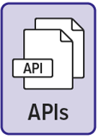
API Quota Validation & Decrement Flow (Sync)
NIGNX Proxy (nginx.conf, Cache) | Quota Module (quota NJS)
quota_enable_per_proxy
quota_enable_per_group
quota_enable_per_user
1
API
Request
Validate Quota
3
Check rate-limit
Check quota enable options
Client
Check an access-token
Generate a quota key using
sub/group, proxy-name, etc.
2
Quota validation request
auth_request /_quota_validation
Check quota remaining
sharded k/v zone
Set header out
X-Quota-Limit: xxx
X-Quota-Remaining: xxx
X-Quota-After: xxx
quota meta
quota meta
quota meta
limit
limit per
per proxy
per group
per user
remaining
start-time
expiry-time
quota status
quota status
quota status
N
strict
enforcement?
N
Remaining
> 0
return 403
Y
return 204
Y
Return 409
(too many requests)
X-Quota-Limit: xxx
X-Quota-Remaining: xxx
X-Quota-After: xxx
403
Return Code?
Notify & return 204
4
204
Quota decrement request
Decrease Quota
5
6
mirror /_quota_decrement
Quota remaining decrement
API Request to upstream
Reset quota if expired & not disabled
proxy_pass https://my-api;

Slide 6
API Quota Validation & Decrement Flow (Async)
NIGNX Proxy (nginx.conf, Cache) | Quota Module (quota NJS)
quota_enable_per_proxy
quota_enable_per_group
quota_enable_per_user
Validate Quota
3
1
API
Request
Check quota enable options
Check rate-limit
Generate a quota key using
sub/group, proxy-name, etc.
Client
Check an access-token
Check quota remaining
2
Quota validation request
Set header out
X-Quota-Limit: xxx
X-Quota-Remaining: xxx
X-Quota-After: xxx
auth_request /_quota_validation
sharded k/v zone
quota meta
quota meta
quota meta
limit
limit per
per proxy
per group
per user
N
strict
enforcement?
N
Remaining
> 0
remaining
start-time
expiry-time
quota status
quota status
quota status
return 403
Y
return 204
Y
Notification
Handler
Notification request
4.1
Return 409
(too many requests)
X-Quota-Limit: xxx
X-Quota-Remaining: xxx
X-Quota-After: xxx
4
403
Return Code?
return 204
Queue
204
Decrement
Handler
Quota decrement request
Decrement request
5
6
6.1
mirror /_quota_decrement
Queue
API Request to upstream
Quota remaining decrement
proxy_pass https://my-api;
Reset quota if expired & not disabled

Slide 7
APPENDIX

Slide 8
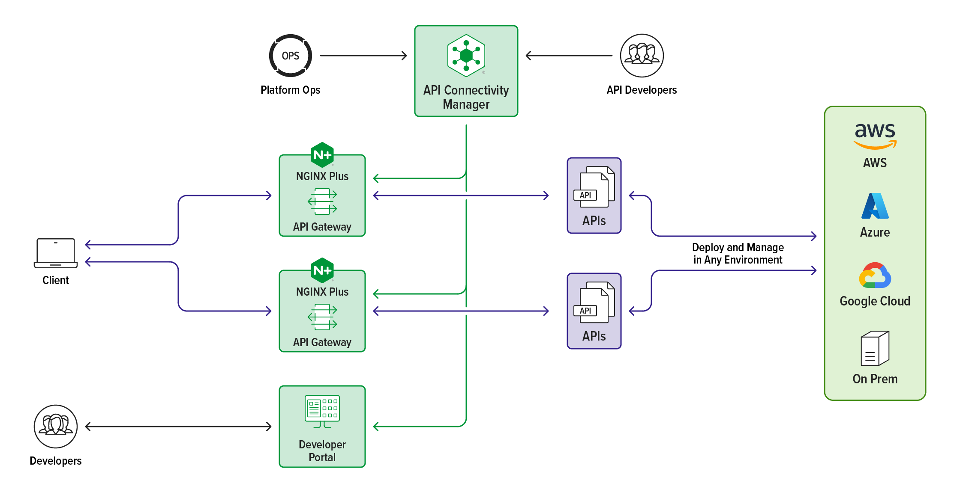
NGINX API Quotas Flow
1
Set quota meta data
quota policy
quotas /api
quotas /user
price model
42
metrics mgmt.
API Owners
quota policies
quota/user/api
quota analytics
2
Config meta data and key/val store
quota meta
quota status
Quota
Remain?
Y
Quota NJS
3
Validate quota
decrement quota
quota meta
quota status
Quota
Remain?
Y
Quota NJS
1
config request
(quotas /user/api)
1
Y
a
Create API
Product
&Pricing
Model
Purchased
Quota?
API products
API pricing model
API subscription
5
API Subscription
b
Create API Products & pricing model
Payment NJS
External Payment Gateway
Quota Module
Payment
Module
6
API Subscription

Slide 9
Setting Quotas at API Proxy Level
32
config quota meta-data and k/v store
1
Create a quota
Set quota per API
DPM
2
quota config request
Nginx Agent
nginx.conf
(quota meta)
2
ACM API
42
set quotas per proxy
Quota NJS
quota limit
quota remaining
start/expiry time
API Owners
K/V store
6
update config status
/quotas/{name}/proxies/{name}
ACM DB
(quota_policies)
5
set quotas per proxy per API key
Quota Name | Policy Type | Proxy ID | API Method | Pay Method | Quota Limit | Limit Per
USR:image-api:R:F | User | 1 | GET | Free | 1000 | r/M
USR:image-api:W:B | User | 1 | POST, PUT | Bronze | 2000 | r/M
USR:image-api:A:S | User | 1 | All | Silver | 3000 | r/D
GRP:chat-api:W:G | Group | 2 | POST | Gold | 4000 | r/D
API:image-api:R:G | Proxy | 1 | All | Free | 5000 | r/M
API:image-api:W:G | Proxy | 1 | All | Gold | 6000 | r/M
GLO::R:P | Global | N/A | N/A | Platinum | 7000 | r/M
GLO::W:G | Global | N/A | N/A | Gold | 8000 | r/M
{
"api-key-01:API:image-api:R:F": {
"limit”: 5000, "remaining": 5000,
"st”: 1678936439, "et”: 1681528439
},
"api-key-02:API:image-api:W:G": {
"limit”: 5000, "remaining": 5000,
"st”: 1678936439, "et”: 1681528439
}
}
map $api_quota_policy_name $limit_per {
"API:image-api:R:F" "5000r/M";
"API:image-api:W:G" "6000r/M";
}
map $apikey_proxy_method $quota_pay_method {
"api-key-01:image-api:R" "F"; # Free
"api-key-02:image-api:W" "G"; # Gold
}
Quota Name = policy-type:proxy-name:api-method:pay-method
* If map size is too big, then it can be moved to (local/remote) key/val store.

Slide 10
Setting Quotas at API Proxy Level
32
config quota meta-data and k/v store
1
Create a quota policy
Set quotas per API
DPM
2
quota config request
Nginx Agent
nginx.conf
(quota meta)
ACM API
Quota NJS
quota policies
quota remaining
API Owners
K/V store
quota_policies
map $api_quota_policy_name $quota_limit_per {
"API:chat-api:R:G" "5000r/M";
"API:chat-api:W:G" "6000r/M";
}
quota_policies
Quota Name | Policy Type | Proxy Name | API Method | Pay Method | Quota Limit | Limit Per | Description
USR:image-api:R:F | User | image-api | GET | Free | 1000 | r/M | Quota per image-api on a user (Free, Read only)
USR:image-api:W:B | User | image-api | POST, PUT | Bronze | 2000 | r/M | Quota per image-api on a user (Bronze, Write only)
USR:image-api:A:S | User | image-api | All | Silver | 3000 | r/D | Quota per image-api on a user (Silver, Read/Write)
GRP:chat-api:W:G | Group | chat-api | POST | Gold | 4000 | r/D | Quota per chatbot-api on a group (Gold, Write only)
API:image-api:R:G | Proxy | image-api | All | Free | 5000 | r/M | Quota per chatbot-api on a Proxy (Free, Read Only)
API:image-api:W:G | Proxy | image-api | All | Gold | 6000 | r/M | Quota per chatbot-api on a Proxy (Gold, Write Only)
GLO::R:P | Global | N/A | N/A | Platinum | 7000 | r/M | Global Policy for all proxies (Platinum, Read Only)
GLO::W:G | Global | N/A | N/A | Gold | 8000 | r/M | Global Policy for all proxies (Gold, Write Only)
{
"api-key-01:API:chat-api:W:G": 5000,
"api-key-02:API:chat-api:R:G": 6000
}

Slide 11

Create a quota policy
Set quota meta data
quota policy
quotas /api
quotas /user
Quota NJS
Payment NJS
API Owners
quota_policies
users_quota_policies
groups_policies
quota meta quota status
quota_policies
Quota Name | Policy Type | Proxy Name | API Method | Pay Method | Quota Limit | Limit Per | Description
USR:image-api:R:F | User | image-api | GET | Free | 1000 | r/M | Quota per image-api on a user (Free, Read only)
USR:image-api:W:B | User | image-api | POST, PUT | Bronze | 2000 | r/M | Quota per image-api on a user (Bronze, Write only)
USR:image-api:A:S | User | image-api | All | Silver | 3000 | r/D | Quota per image-api on a user (Silver, all APIs)
GRP:chat-api:W:G | Group | Chat-api | POST | Gold | 4000 | r/D | Quota per chatbot-api on a group (Gold, Write only)
GLO::R:P | Global | N/A | N/A | Premium | 5000 | r/M | Global Policy for all proxies (Premium, Read Only)
GLO::W:G | Global | N/A | N/A | Gold | 6000 | r/M | Global Policy for all proxies (Gold, Write Only)
users_quota_policies
groups_quota_policies
User ID (sub) | Quota Policy Name
user-01 | USR:image-api:R:F
user-01 | USR:image-api:W:F
User-02 | USR:image-api:R:B
User-02 | USR:chat-api:W:G
Group Name | Quota Policy Name
nginx-dev | USR:image-api:R:F
nginx-dev | USR:image-api:W:F
nginx-product | USR:image-api:R:B
F5-product | USR:chat-api:W:G

Slide 12

API Owner

