Slide 1
Socio-economic Impact on Education
Joyce Muthondu
Abigail Fabella
James Ng

Slide 2
Project Concept
It has been theorized for years that students that have a social and economic advantage will do better academically than students that do not have such advantages.
We wanted to review how socio-economic advantages might impact standardized test scores in the high school population.
Does economic and social advantages give students an advantage when it comes to academics?
If there is a difference, in exam scores, could the differences in be explained by race, gender or other factors?
How does one define social and economic advantages?
Can we state with 95% confidence that “advantaged” students outperform their “non-advantaged counterparts?”

Slide 3
Project Background and Challenges
Key Assumptions:
High School Student Data will be random students within the United States.
Key Academic metrics will be exam scores from some form of standardized tests.
Risks:
Dataset can be skewed due to small sample size.
The validity of the data source cannot be verified as accurate.
Data Source:
https://www.kaggle.com/spscientist/students-performance-in-exams

Slide 4
Project Methodology
The methodology of this data analysis study will the combination of using the Pandas data frame tools to sort and collect data and run the results through the statistics library to validate the hypothesis through using the t-test functions in Python to a confidence level of 95% (or P Value of .05)
Scatterplots and histograms will also be used to examine the analysis and results and present a visual representation of both the data and the analysis

Slide 5
Hypothesis Definition and Methodology
Since we want to prove from the collected data that one population has an advantage over the other, we will set the null hypothesis to equal each other:
Advantaged Students should have the same exam scores as Non-Advantaged Students.
If we have a P-Value of greater than .05, then we will accept the null hypothesis that the exam scores of advantaged students and non-advantaged students are equal to each other. If the P Value is less than .05, than we will reject the hypothesis and accept with 95% confidence that the results are not equal to each other.
The metrics provided from the dataset include:
Parent’s highest level of education, Gender, Race or Ethnicity, Standard or Reduced/Free Lunch, Exam Preparation Course taken, Writing Exam Score, Reading Exam Score, and Math Exam Score.

Slide 6
Populations Defined
Given the available data, we set the advantages for high school students to be:
Parent’s Level of Education being Bachelor’s or Master’s Degrees, Standard Lunch only, and Exam Preparation Class taken.
The rest of the population would be the student population that is not deemed to have a clear social and economic advantage.
The results would be examined by taking a mean score of the reading, writing, and mathematics exam. However, since the data is available, we can take a deeper look into each subject area if needed.

Slide 7
DatA Extraction Methodology
We had to create 4 data frames since we didn’t have a good methodology to sort out multi-variable values.
Our advantaged population was parent’s level of education was bachelor’s or master’s, standard school lunch, and a test preparation course was completed. We used the “groupby” functions to sort this population.
The main data frames were sorted by the level of parent’s education to be bachelor’s or master’s. The population without parents having the bachelor’s degree or higher was titled the disadvantaged population.
The difficulty was extracting the scores where the parent’s level of education was bachelor’s or master’s but either the student had reduced/free lunch or they did not complete the exam preparation course. We needed to create two separate dataframe to secure these populations.
We used the “concat” function to combined the three separate dataframes for the non-advantaged populations into a master non advantage population.
We used the stats library to run the t-tests to obtain the T value and P values from the data.

Slide 8
ResuLts Summary
Population Sizes:
Total Student Population: 1000
Advantaged Student Population: 37
Non-Advantaged Student Population: 963
Statistics Results:
T Test Result: 2.832838577827705
P Value Result: 0.011999426437232466

Slide 9
Results Continued:
Combined Mean Scores:
Advantaged Students: 79.52
Non-Advantages Students: 67.32
Math Mean Scores:
Advantaged Students: 77.55
Non-Advantaged Students: 64.19
Reading Mean Scores:
Advantaged Students: 81.41
Non-Advantaged Students: 68.77
Writing Mean Scores:
Advantaged Students: 82.97
Non-Advantaged Students: 67.82

Slide 10
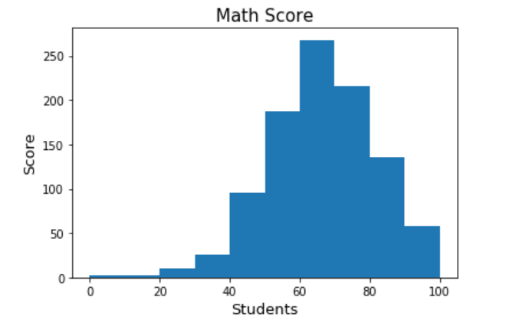
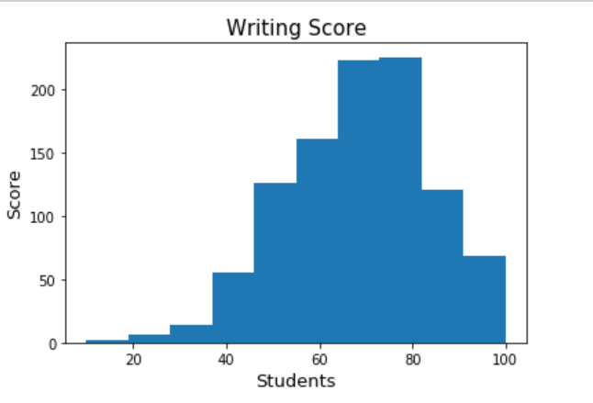
Mean Scores Histograms
Histogram Math Scores
Histogram writing scores

Slide 11
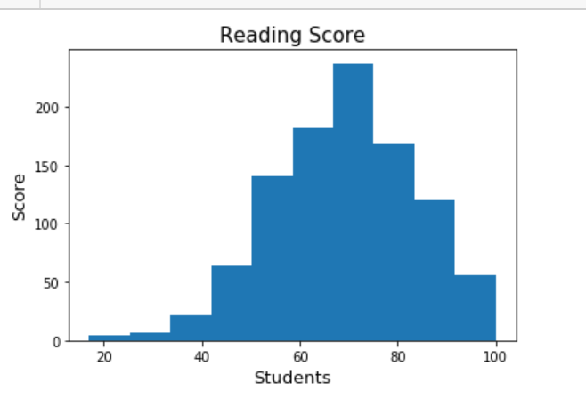
Mean Scores Histograms Continued
Histogram reading Scores

Slide 12
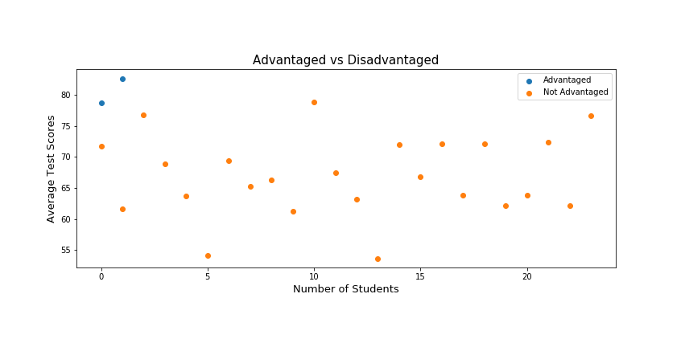
Data ScatterPlot of Mean Scores

Slide 13
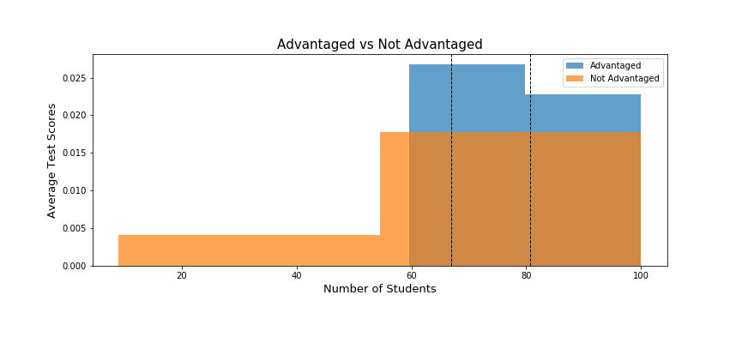
Histogram of Mean Scores

Slide 14
Post Mortem
We would have like to asked how race and gender would have compared to economic advantages. We know there are many assumptions that gender and race impact math scores. Also, if race was a major investigation topic, it would have been nice to examine if ESL would have impacted reading and writing scores.
We would have like to been more skilled to create a “No Advantage” population in one step instead of creating separate dataframes.
We would have like to have examined more datasets, with a larger population sample size.

