Slide 1
— Classify images of Colon
Review & Analysis
Karthi Narendrababu Geetha
(S3835901)
Notes:
To create Em dash above headline:
Same size and weight as the headline and set using a soft return.
PC: Em dash (—): Alt+Ctrl+ - (minus)
Mac: Em dash (—): Shift+Alt/Option+hyphen

Slide 2
Predict Cancerous Cell or Not Approach
Train/Test/Val split – 60/20/20
Image data generation & augmentation
Rescale
Model development - Convolution Neural Network – LeNet
Training & Evaluation

Slide 3
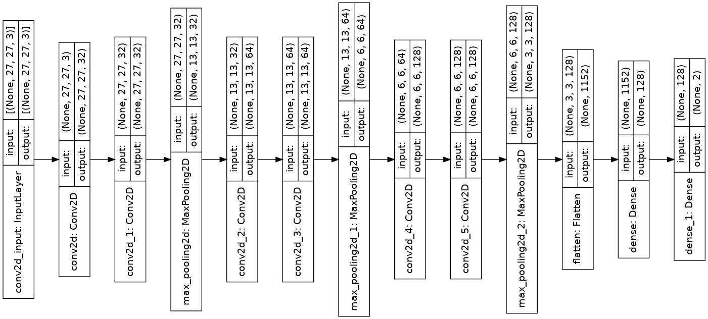
Predict Cancerous Cell or Not Model – LeNet Architecture

Slide 4
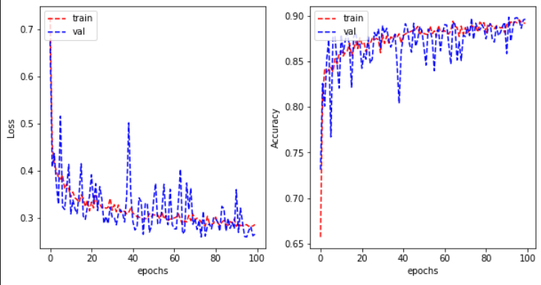
Training & Evaluation
Training parameters
Image Size | 27x27
Batch Size | 32
Epochs | 100
Convolution layer activation | Relu
Dense layer activation | Softmax

Slide 5
Classifying Cancerous Cell types Approach
Train/Test/Val split – 60/20/20
Image data generation & augmentation
Rescale
Zoom
Rotation
Width Shift
Height Shift
Model development - Convolution Neural Network – VGG
Training & Evaluation

Slide 6
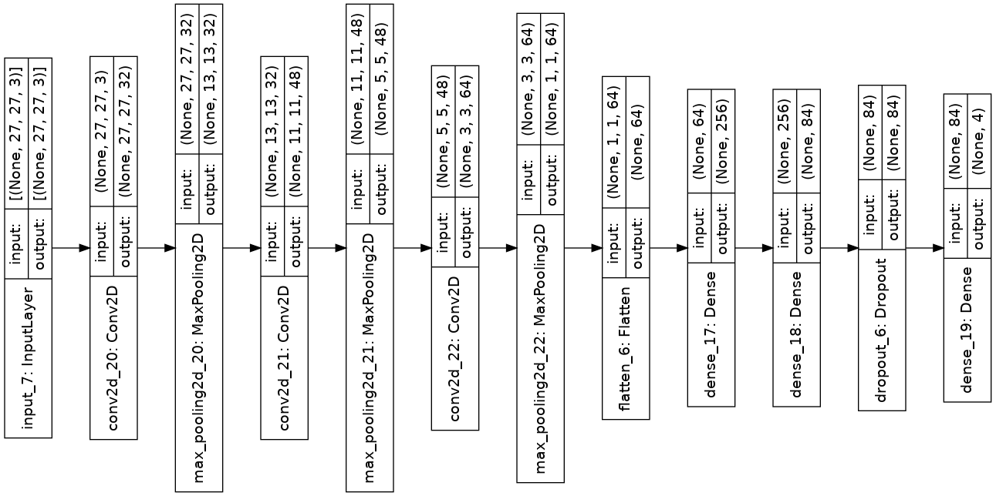
Classifying Cancerous Cell types
Model – VGG Architecture

Slide 7
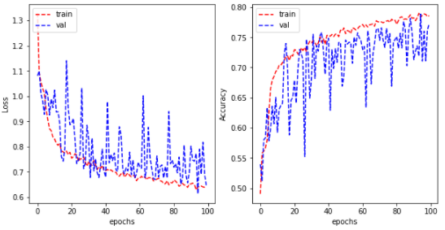
Training & Evaluation
Training parameters
Image Size | 27x27
Batch Size | 27
Epochs | 150
Convolution layer activation | Relu
Dense layer activation | Softmax

Slide 8
Review

Slide 9
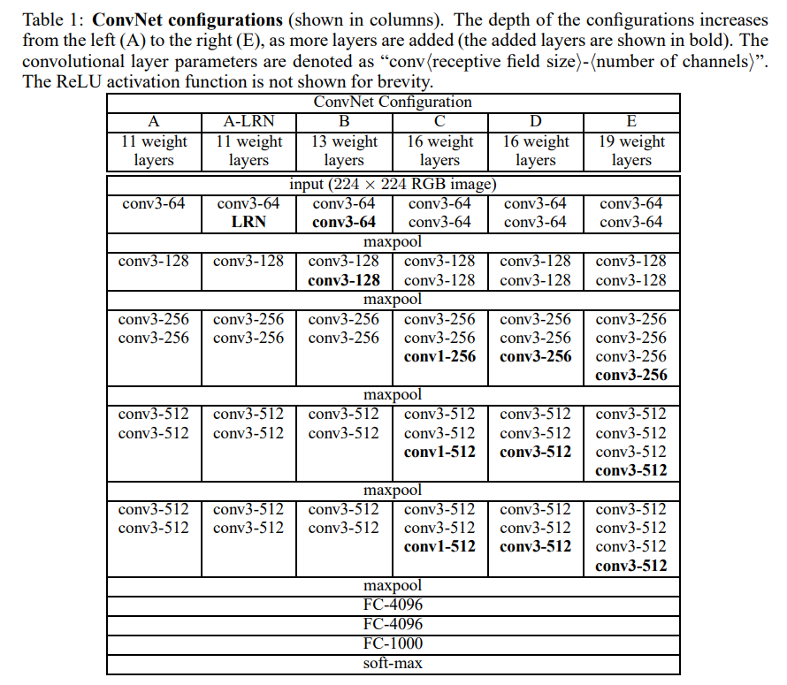
VERY DEEP CONVOLUTIONAL NETWORKS FOR LARGE-SCALE IMAGE RECOGNITION – Karen Simonyan & Andrew Zisserman
Addressed important aspect of ConvNet architecture design – its depth
Configuration:
Training:
Input size | 224 × 224
Filter size | 1x1, 3x3
Max pooling | 2x2 with stride 2
Fully connected | 3 (1,2: 4096 & 3:1000 channels)
Conv. Layers | 8 to 16 layers
Batch Size | 256
Momentum | 0.9
L2 Penalty | 5x10⁻⁴
Dropout | 0.5
Learning Rate | 10⁻²
Epochs | 74

Slide 10
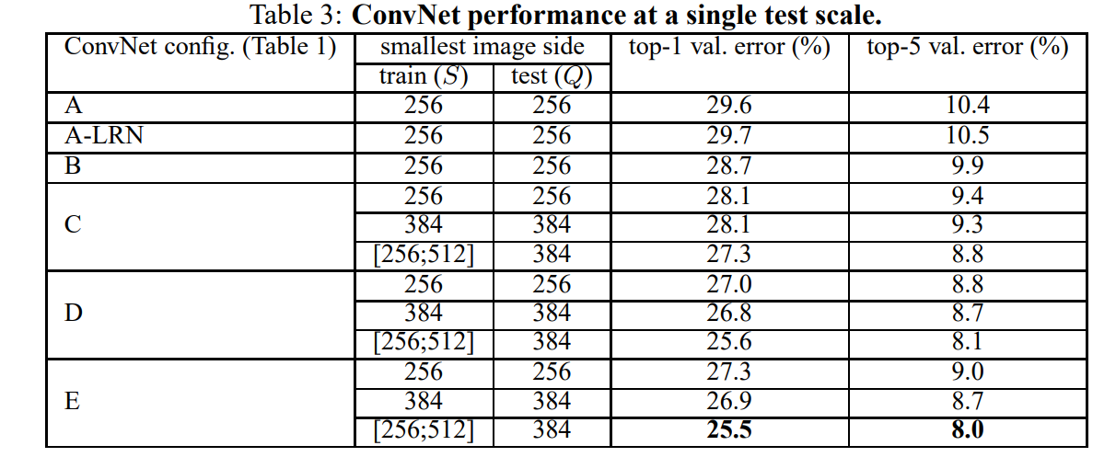
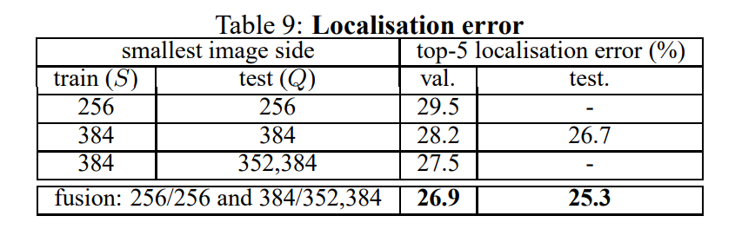
VERY DEEP CONVOLUTIONAL NETWORKS FOR LARGE-SCALE IMAGE RECOGNITION – Karen Simonyan & Andrew Zisserman
Evaluation: Localization(Detection):

Slide 11
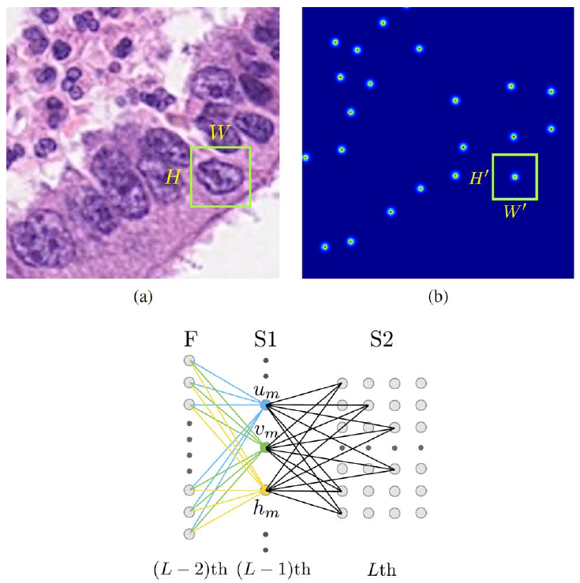
Locality Sensitive Deep Learning for Detection and Classification of Nuclei in Routine Colon Cancer Histology Images - Korsuk Sirinukunwattan
SC-CNN (Nucleus Detection):
Designed to predict centroid locations.
Provides confidence about the location of centroids.
Localize the nucleus centers with the help spatial
regression.
Higher probability values will be assigned.

Slide 12
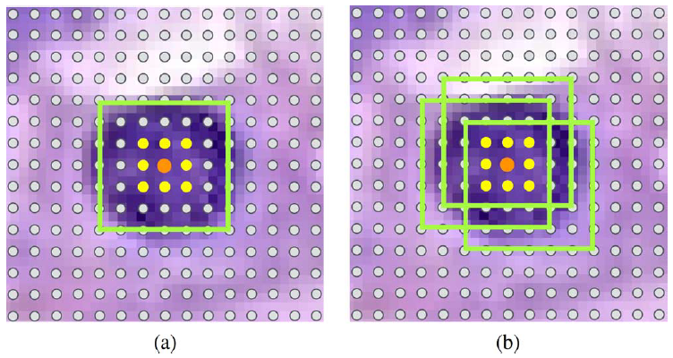
Locality Sensitive Deep Learning for Detection and Classification of Nuclei in Routine Colon Cancer Histology Images - Korsuk Sirinukunwattan
Nucleus Classification:
Patch based multi-class classification.
Train a CNN model.
Prediction is done in 2 ways.
Standard Single-Patch Predictor
Neighboring Ensemble Predictor

Slide 13
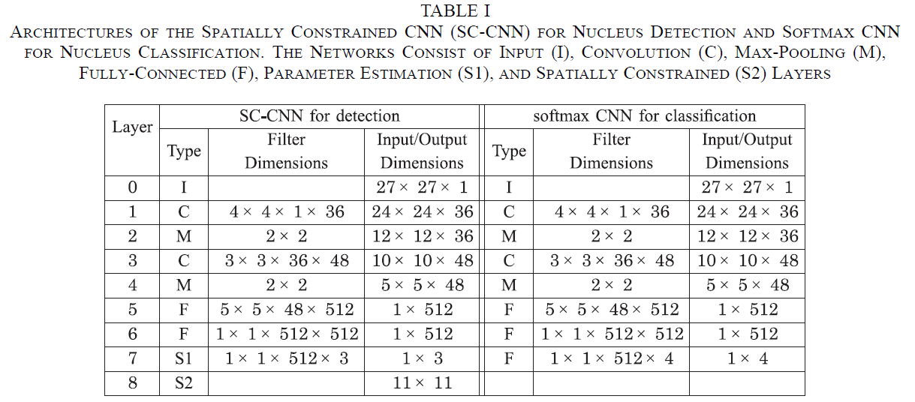
Locality Sensitive Deep Learning for Detection and Classification of Nuclei in Routine Colon Cancer Histology Images - Korsuk Sirinukunwattan
Configuration:
Training:
Input size | 27x27
Filter size | 3x3, 4x4
Max pooling | 2x2
Fully connected | 2 (512 channels)
Conv. Layers | 2 layers
Batch Size | 256
Momentum | 0.9
L2 Penalty | 5x10⁻⁴
Dropout | 0.2
Learning Rate | 10⁻⁴
Epochs | 120

Slide 14
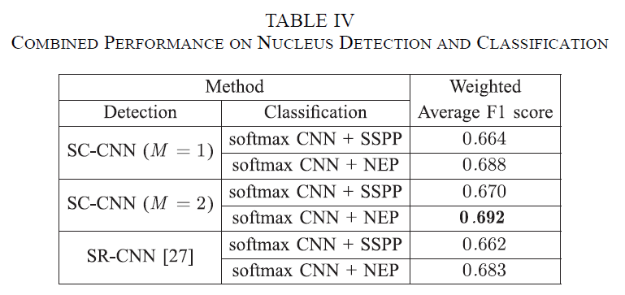
Locality Sensitive Deep Learning for Detection and Classification of Nuclei in Routine Colon Cancer Histology Images - Korsuk Sirinukunwattan
Evaluation:

Slide 15
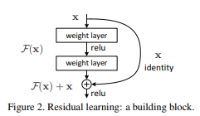
Deep Residual Learning for Image Recognition – Kaiming He, Xiangyu Zhang, Shaoqing Ren, Jian Sun
Increase in depth of network layers.
Learning network layers is as simple as stacking more layers.?
Traditional stacking of layers:
Original layers: copied from a learned shallower model
Extra layers: set as identity
At least the same training error
Current solvers were unable to find the solution if the networks gets deeper.
Residual Network:

Slide 16
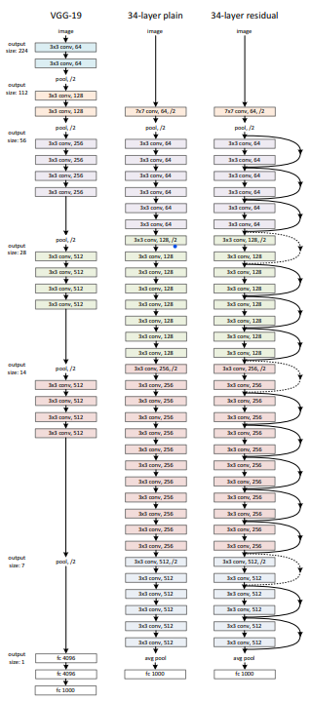
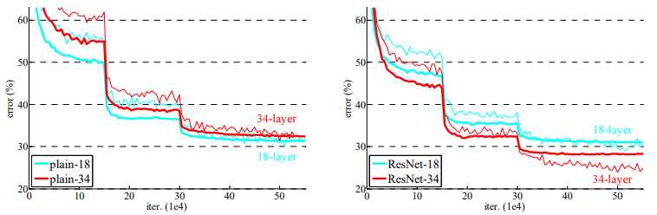
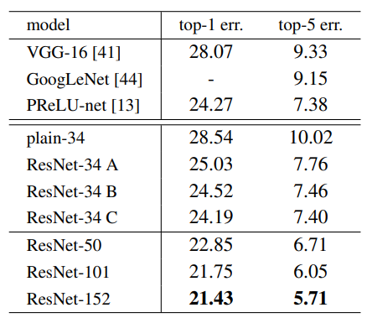
Deep Residual Learning for Image Recognition – Kaiming He, Xiangyu Zhang, Shaoqing Ren, Jian Sun

Slide 17
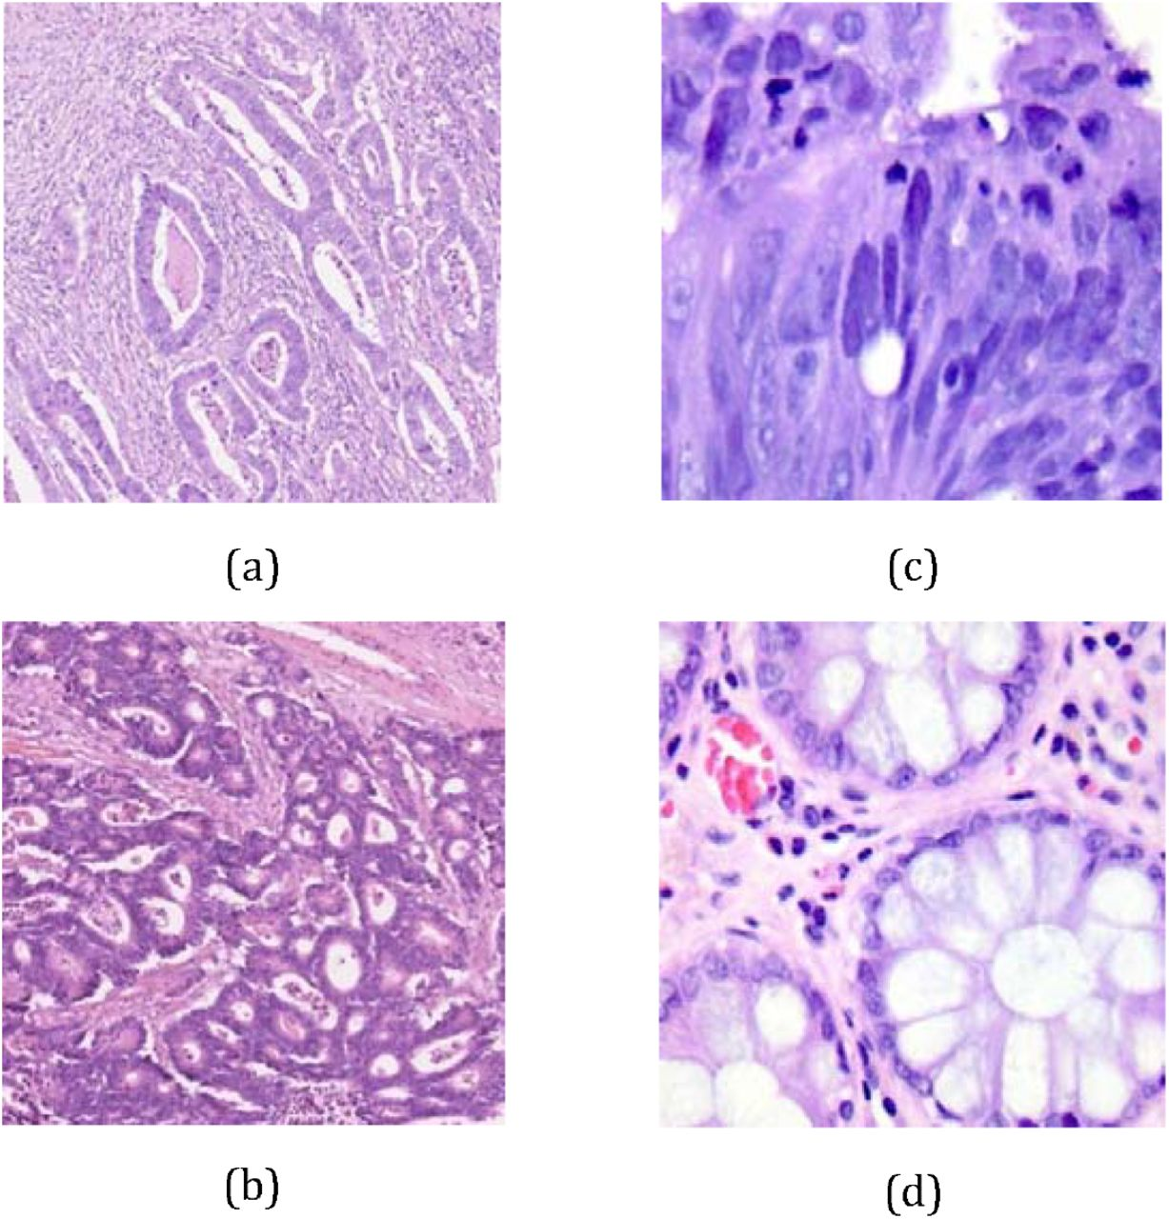
The Histological Diagnosis of Colonic Adenocarcinoma by Applying Partial Self Supervised Learning -Syed Usama Khalid Bukhari, Asmara Syed, Syed Khuzaima Arsalan Bokhari, Syed Shahzad Hussain, Syed Umar Armaghan, Syed Sajid Hussain Shah
Training Dataset:
500 total images of colon tissue taken from LC25000 datasets.
Augmented to 5000 images of each (benign colonic tissue & colon adenocarcinomas).
Test Dataset:
Colorectal Adenocarcinoma Gland (CRAG) Dataset.
45 - benign colonic tissues
148 - colonic adenocarcinoma
Method:
Step 1: Download pre-trained ResNet models
(ResNet-18, ResNet-34, and ResNet-50)
Step 2: Split the training dataset and train the ResNet models.
Step 3: Split the test dataset and retrain the models

Slide 18
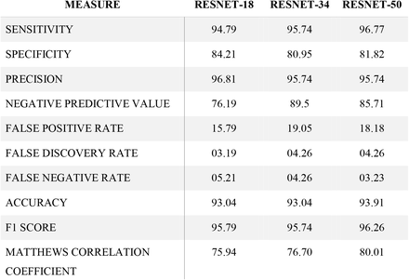
The Histological Diagnosis of Colonic Adenocarcinoma by Applying Partial Self Supervised Learning -Syed Usama Khalid Bukhari, Asmara Syed, Syed Khuzaima Arsalan Bokhari, Syed Shahzad Hussain, Syed Umar Armaghan, Syed Sajid Hussain Shah
Evaluation:

Slide 19
Automating detection & extraction of individual cells from the original histopathology image with 500x500 resolution

Slide 20
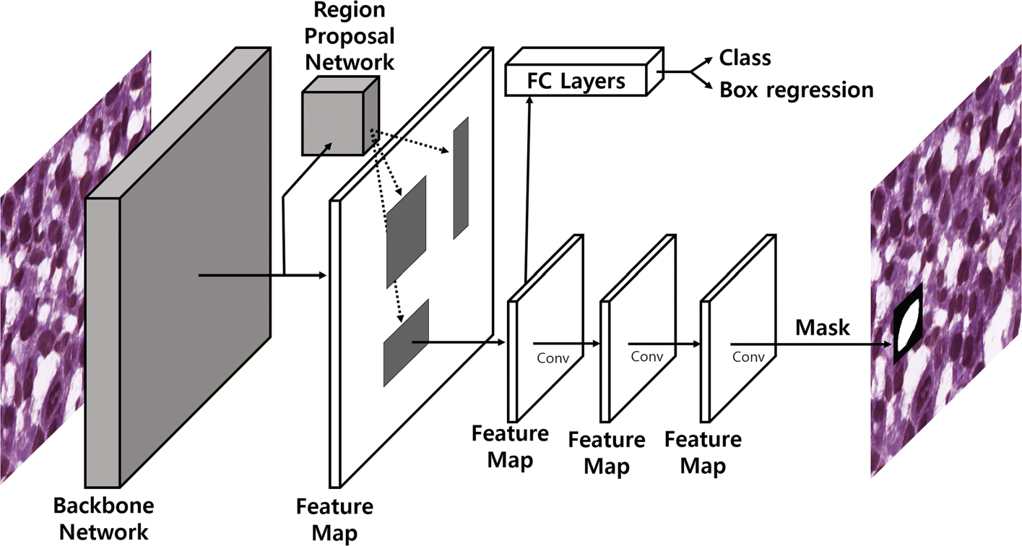
An automatic nuclei segmentation method based on deep convolutional neural networks for histopathology images - Hwejin Jung, Bilal Lodhi & Jaewoo Kang
Methodology:

Slide 21
Thank you

