Slide 1
Human Activity Recognition – Deep Learning
Karthi Narendrababu Geetha (s3835901)

Slide 2
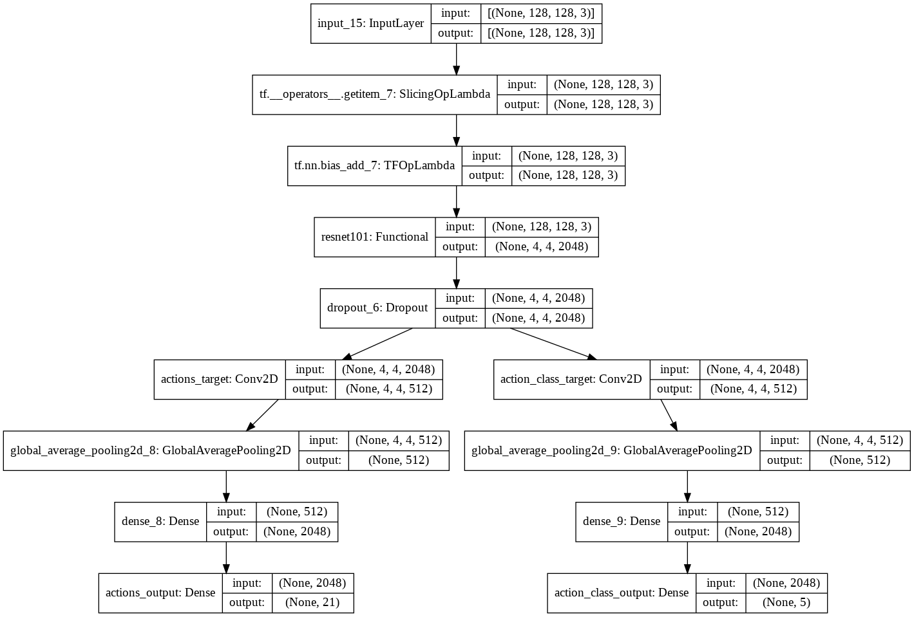
Proposed Model
Pretrained RESNET101 network with ImageNet weights.
More than half of the layers of RESNET101 is retrained.
Evaluation Framework:
Loss: Categorical Cross Entropy
Metrics: Precision, Recall, Avg. F1 Score
Epoch: 15
Optimizer: ADAM

Slide 3
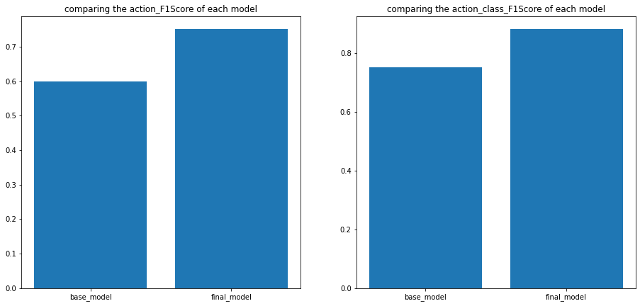
Proposed Model
Performance Measure
 | Action Classification | Action Class Classification
F1 Score | 0.75 | 0.88
Precision | 0.76 | 0.88
Recall | 0.75 | 0.87
Accuracy | 0.75 | 0.88

Slide 4
Literature Review
Ahsan Raza Siyal –
RESNET-18 model with imagenet dataset.
87% accuracy on Stanford-40 dataset.
Bangpeng Yao –
General image Classification based approach do not explore meaningful components.
Attributes and part based representation of human actions.
Shiyang Yan –
Multi-branch attention network
Target person region classification – Fast RCNN
Scene-level classification
Region-level classification
90.7% mAP on Stanford-40 dataset

Slide 5
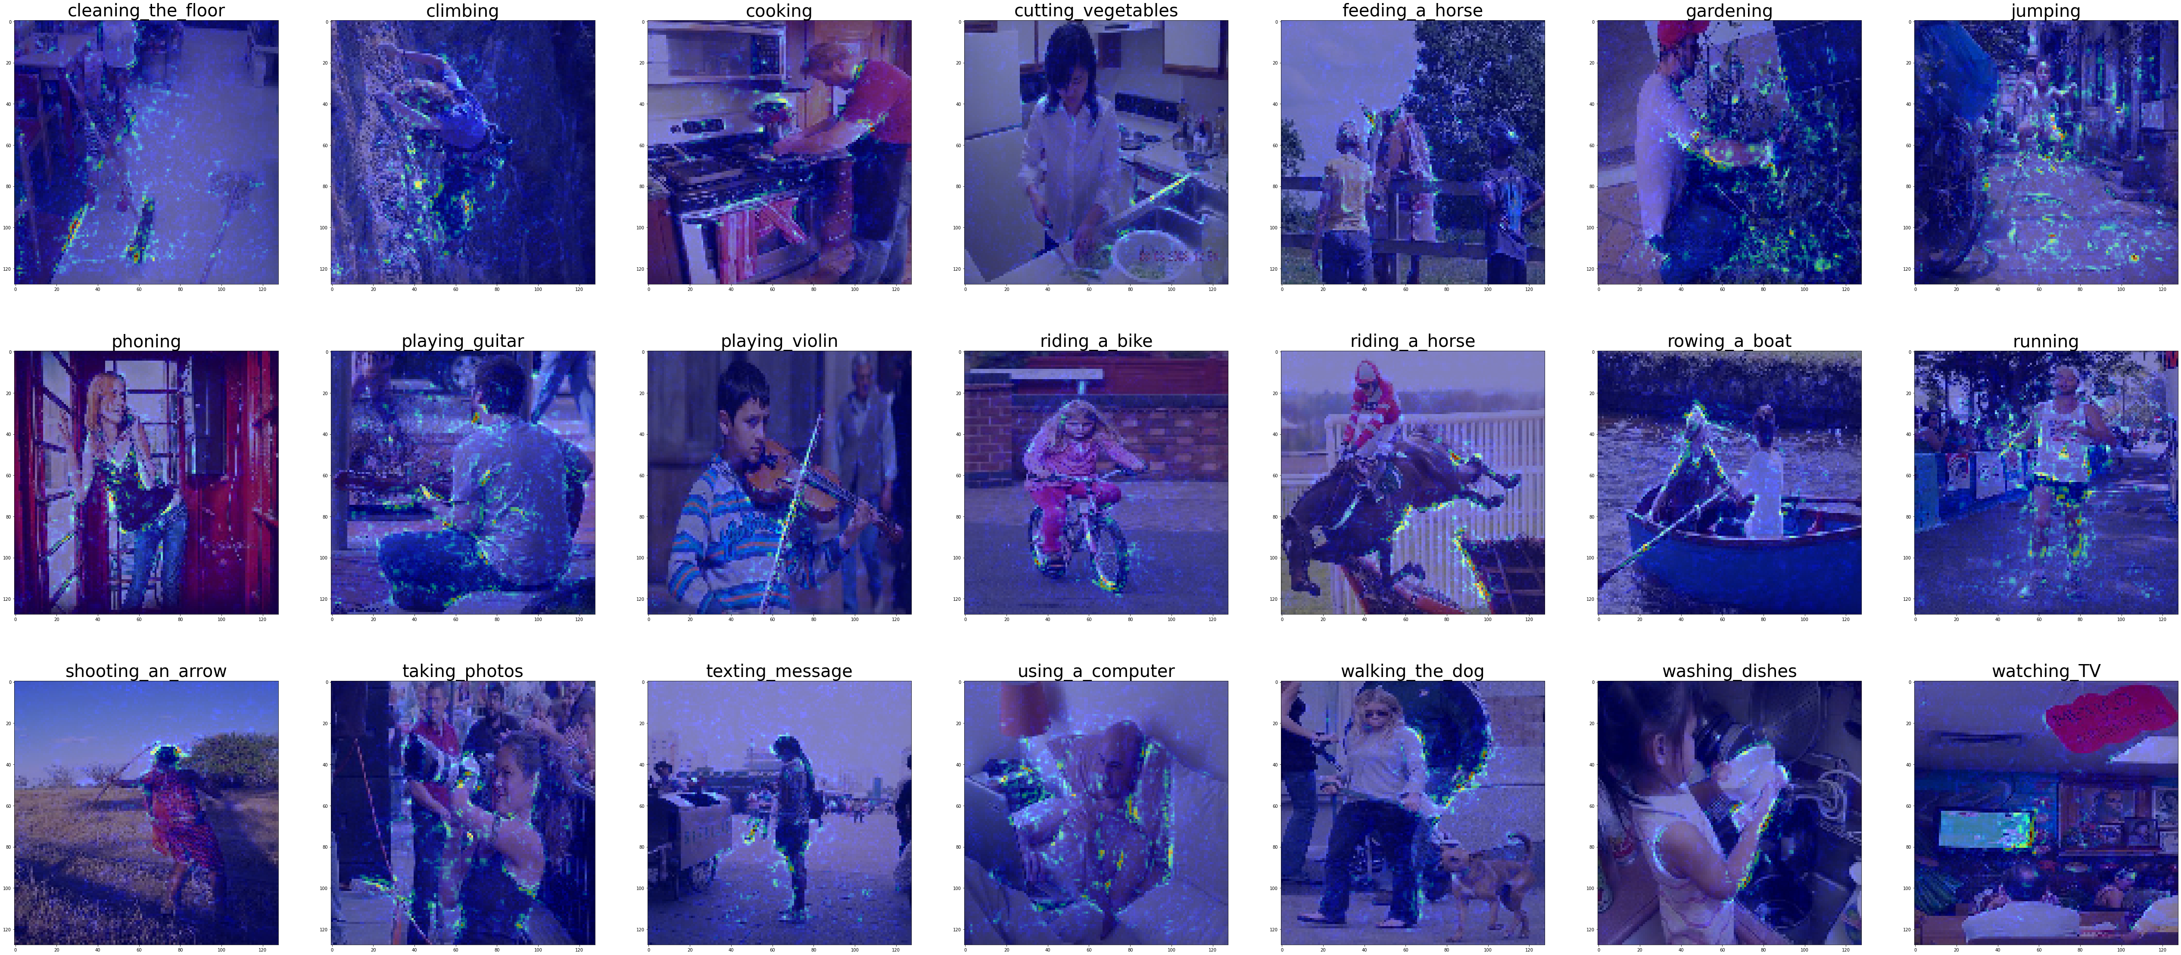
Model Interpretation Techniques – Saliency Features via Back Propagation

Slide 6
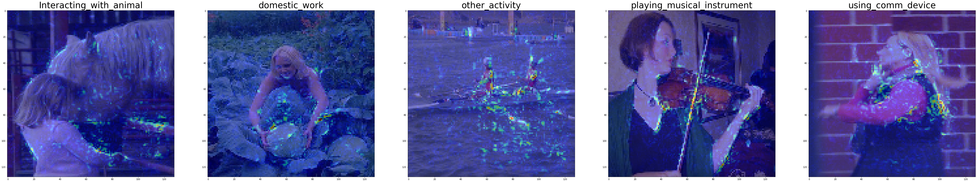
Model Interpretation Techniques – Saliency Features via Back Propagation

Slide 7
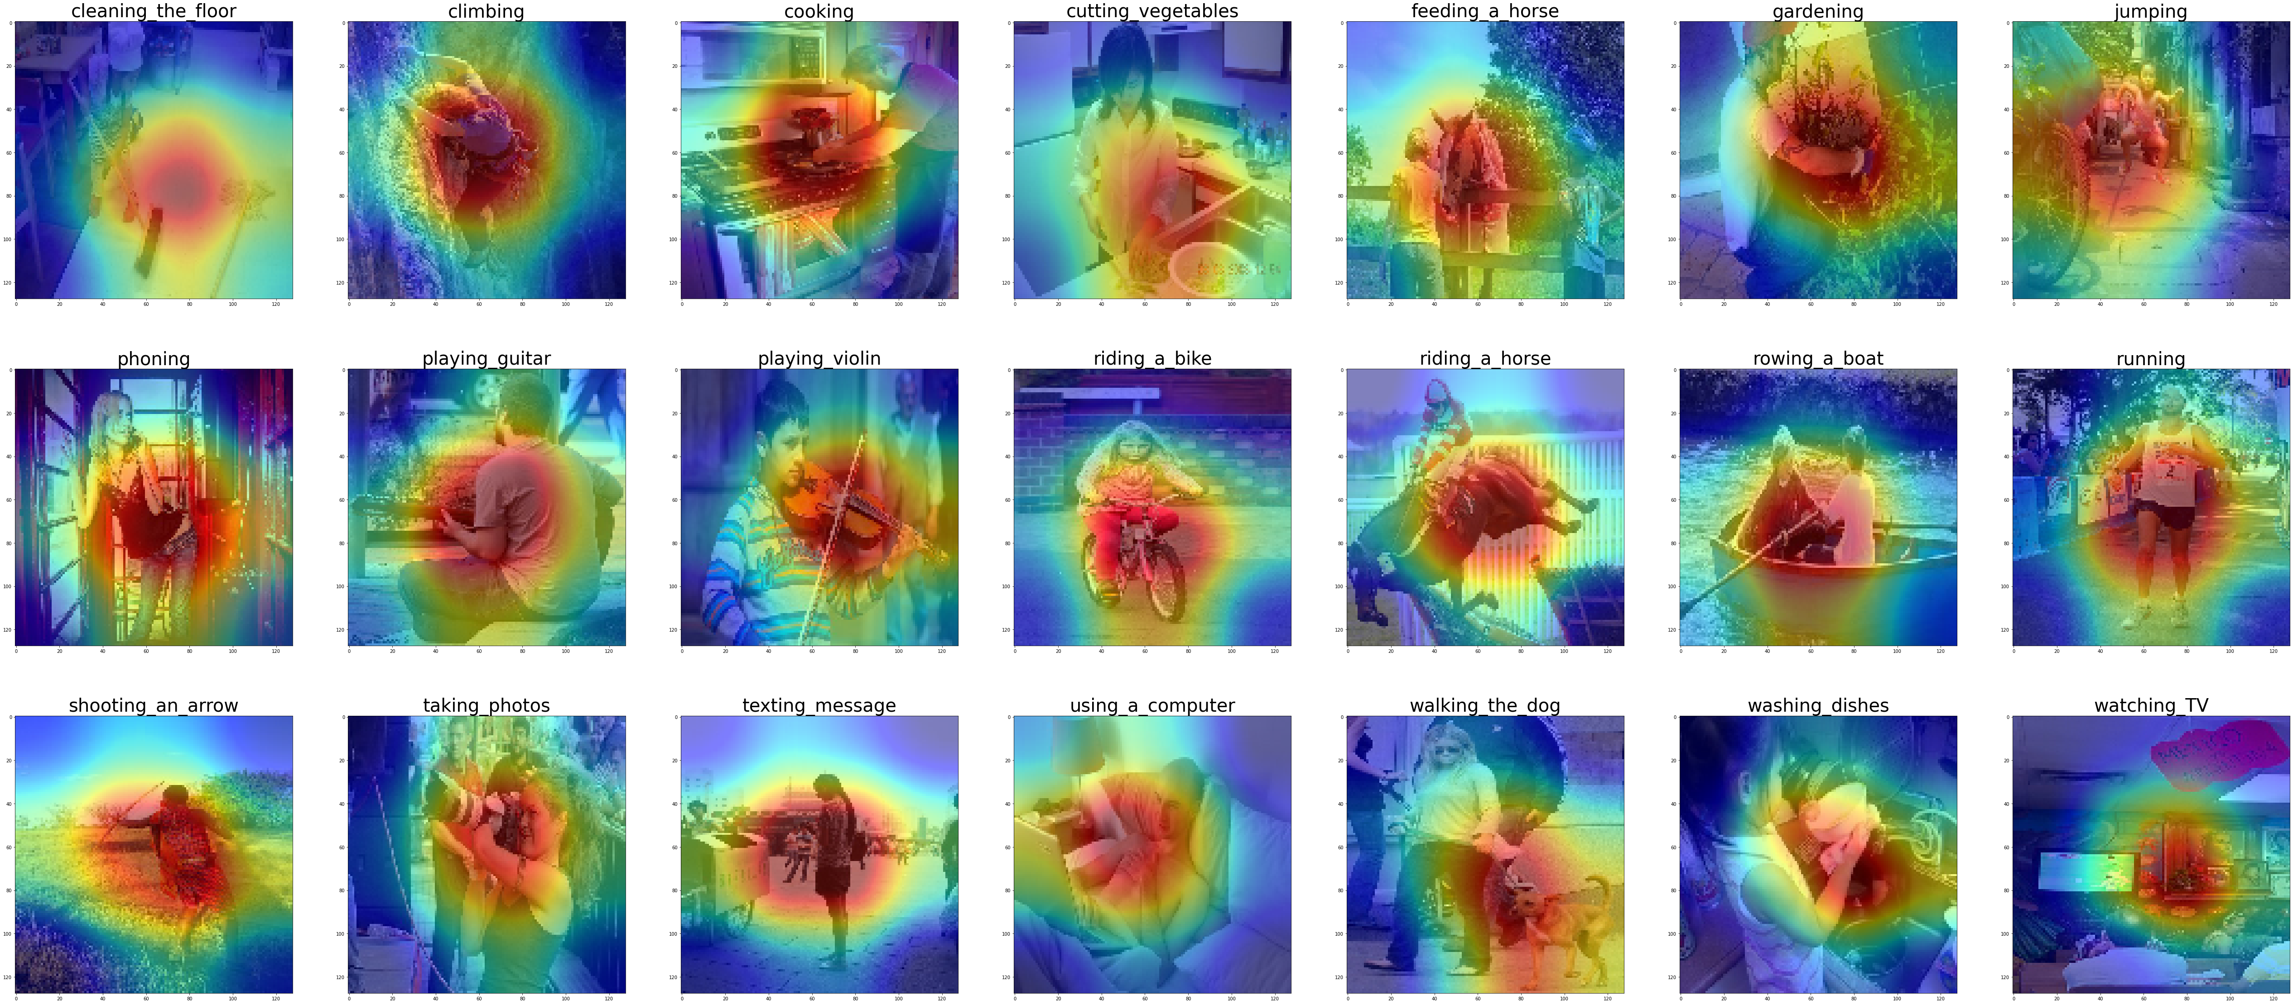
Model Interpretation Techniques - GradCam

Slide 8
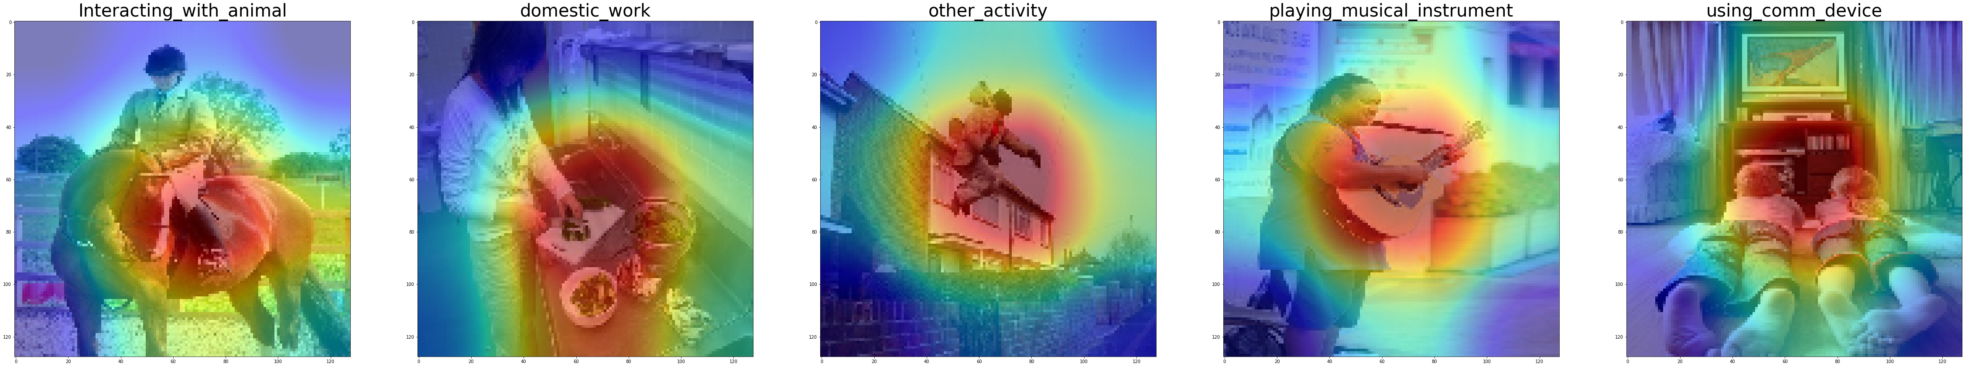
Model Interpretation Techniques - GradCam

Slide 9
Self Supervised Learning – Pretext Invariant Representation Learning (PIRL)
Introduction
Approach
Why Self Supervised Learning ?
Lack of labelled dataset.
To make use abundant unlabelled data.
To produce a generalized model.
Why PIRL ?
PIRL looks for invariance in the data.
Multi-task pretext learning can be done.
Learns based on the contrastive loss.
Input: Unlabelled dataset > 1M
Transformation: Orientation, Jig-saw, In-Painting
Features to be learnt: Similarities between the images.
Contrastive Loss:
Loss(related images) < Loss(unrelated images)
Downstream classification

Slide 10
Self Supervised Learning – Pretext Invariant Representation Learning (PIRL)
Approach – Working overview
Function of input image
Input Image
Image Representation
CONV
CONV
Dissimilar
Classification
similar
Input Image with Transformation
CONV
Dissimilar
Image Representation
Memory bank
Function of transformed input image

Slide 11
Thank you

