Slide 1
2
View from exterior
2.7432
1.323023
1.0207625
0.0254
0.0254
S
4.503738
E
W
N

Slide 2
2
View from exterior
2.7432
(9’)
1.323023
(4’ 4”)
1.0207625
(3’ 4”)
0.0254
6.9492
0.0254
W
7 (23’)
S
N
E

Slide 3
5
View from exterior
4.503738
2.7432
(9’)
1.323023
(4’ 4”)
1.0207625
(3’ 4”)
0.0254
6.9492
0.0254
E
7 (23’)
N
S
W

Slide 4
5
View from interior
4.503738
2.7432
(9’)
1.323023
(4’ 4”)
1.0207625
(3’ 4”)
0.0254
6.9492
0.0254
W
7 (23’)
N
S
E

Slide 5
5
View from top
Occ 0: 2.05, 4.75
4.503738
W
S
N
7 (23’)
E

Slide 6
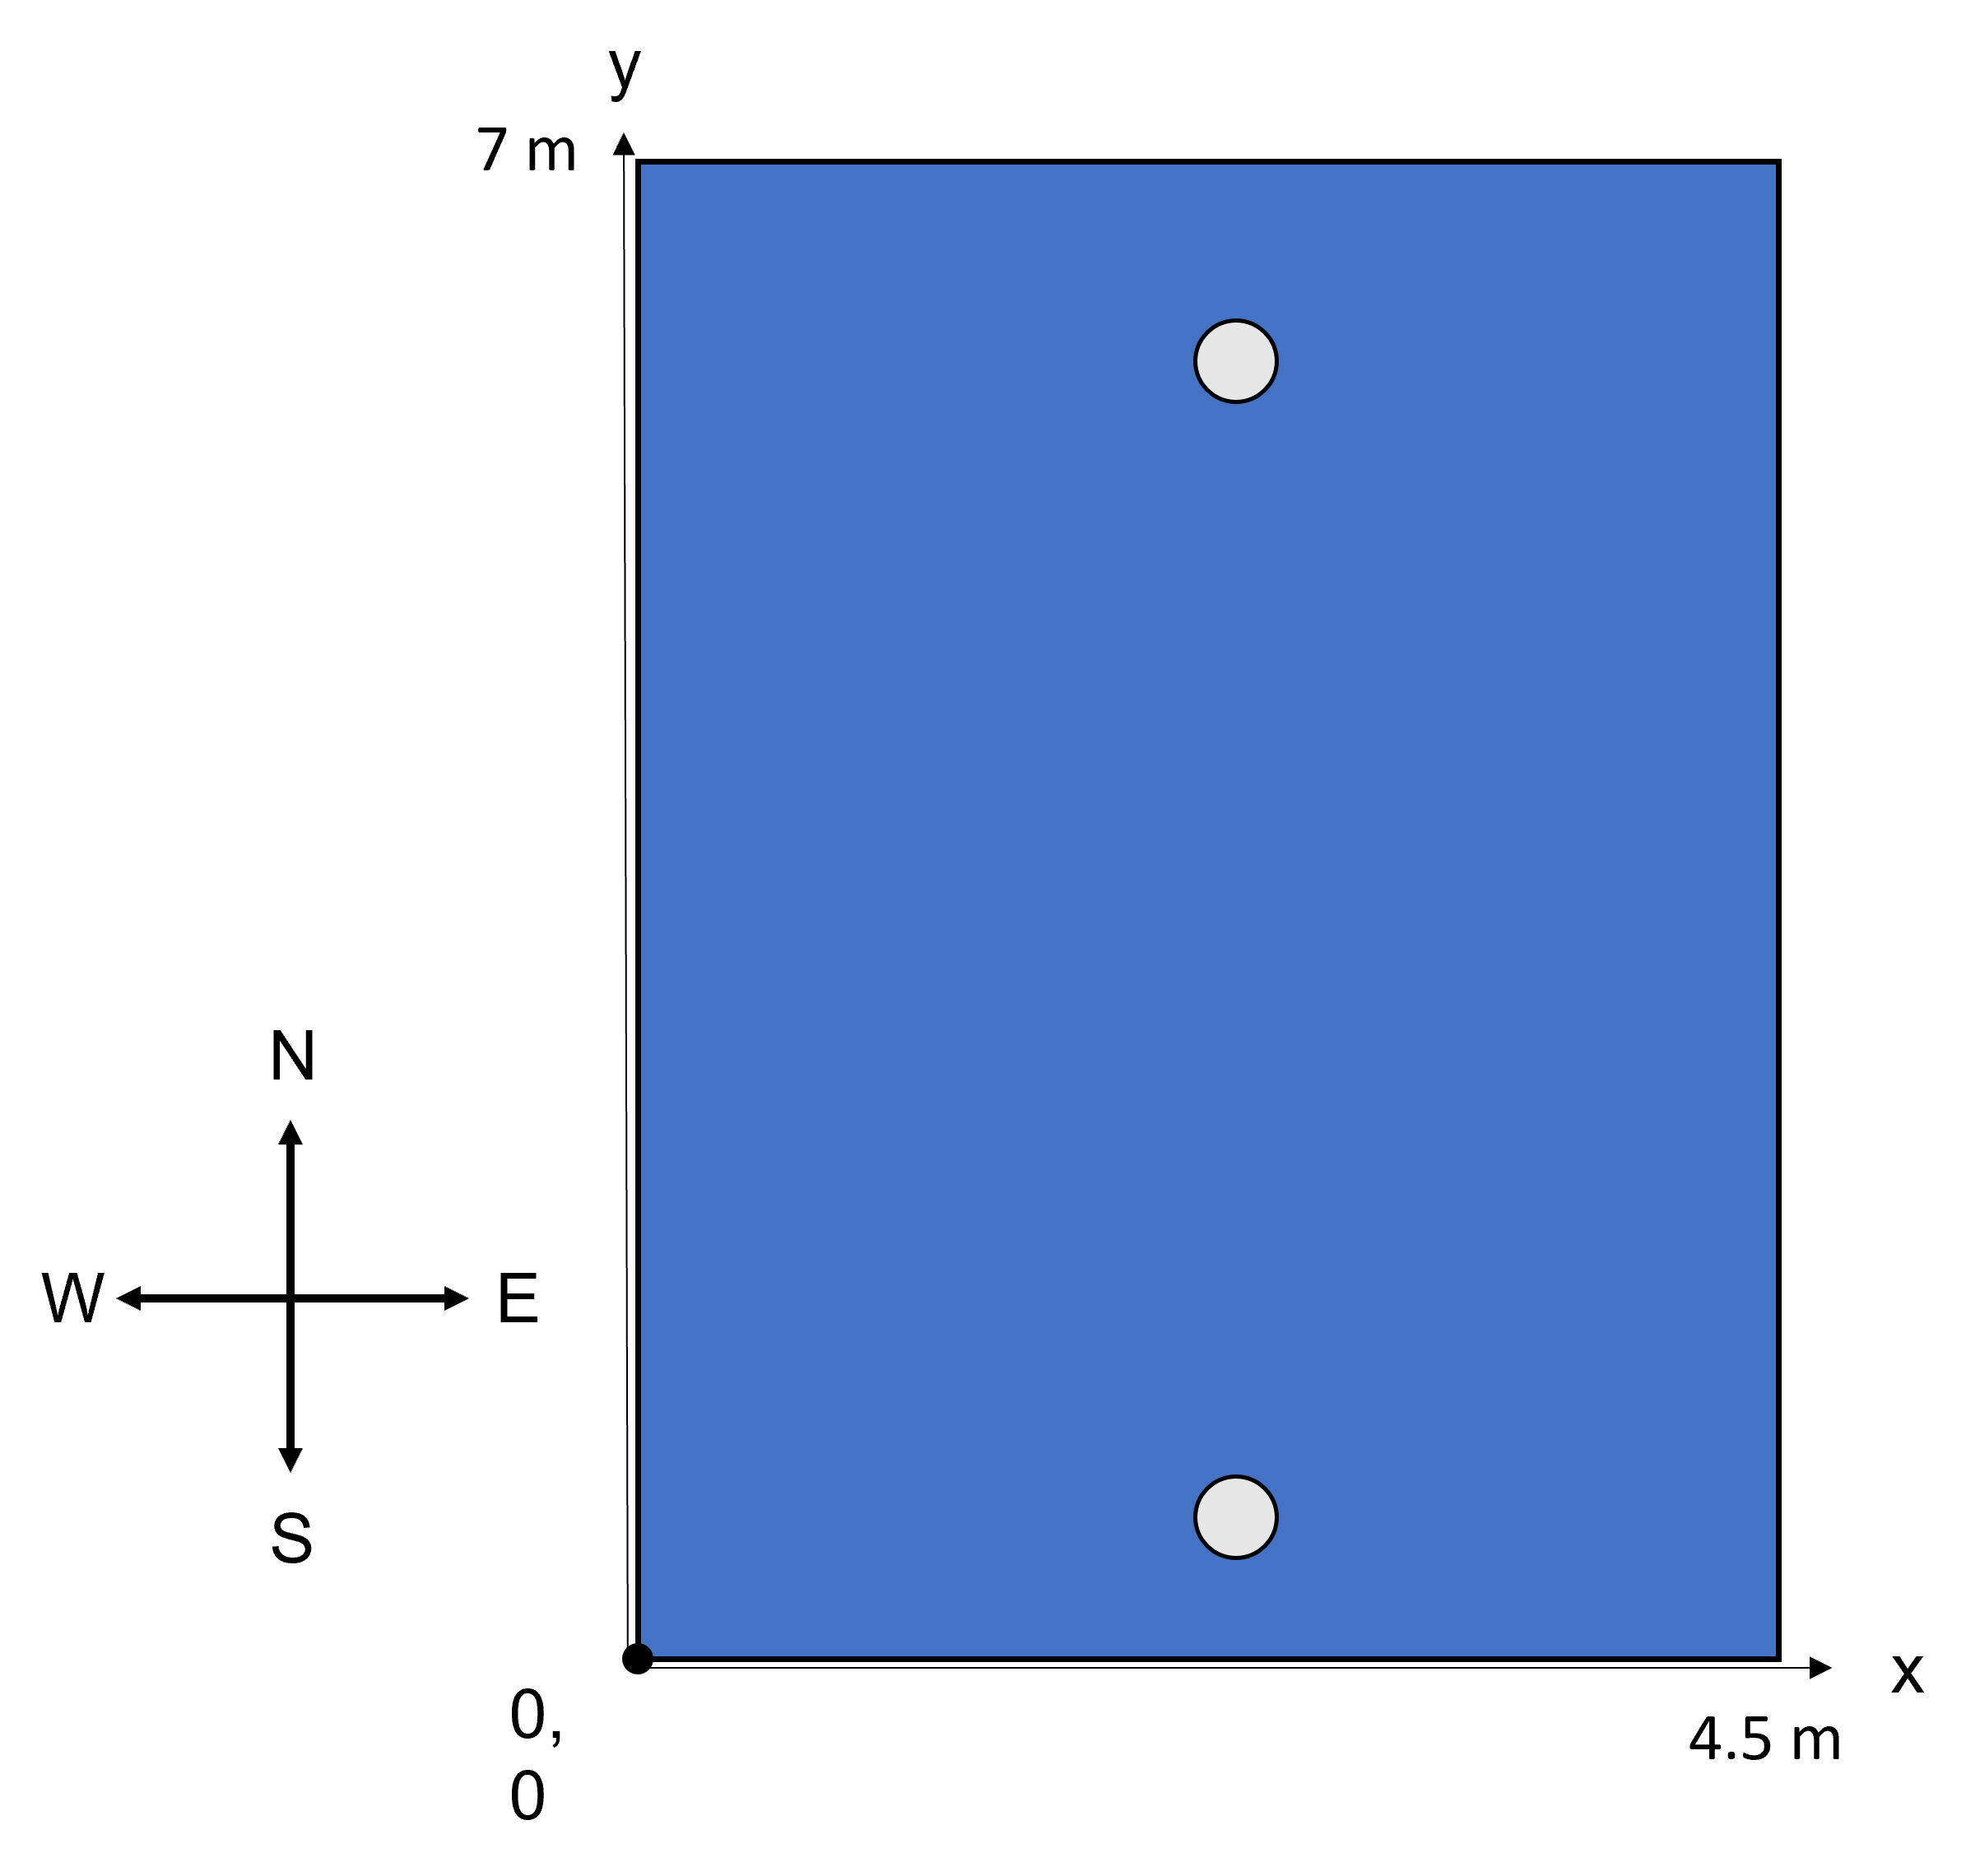
Occ 0: 2.05, 4.75
Occ 1: 2.05, 2.25

