Slide 1




REQUIREMENT ANALYSIS AND DESIGN
PHONE STORE
USE CASE : INVENTORY MANAGEMENT AND PRODUCT MANAGEMENT
PRESENT BY : NGUYEN NHAT NAM - 521H0108

Slide 2



INVENTORY MANAGEMENT

Slide 3
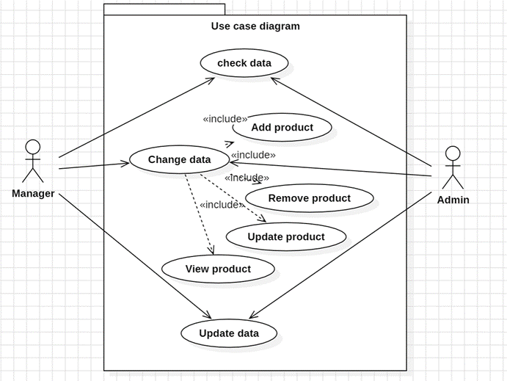
USE CASE DIAGRAM

Slide 4
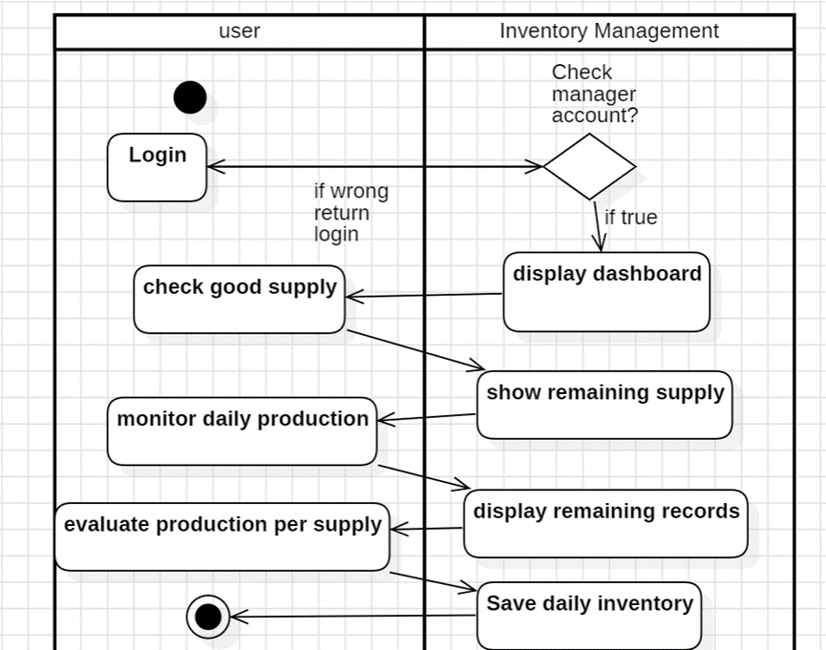
ACTIVITY DIAGRAM

Slide 5
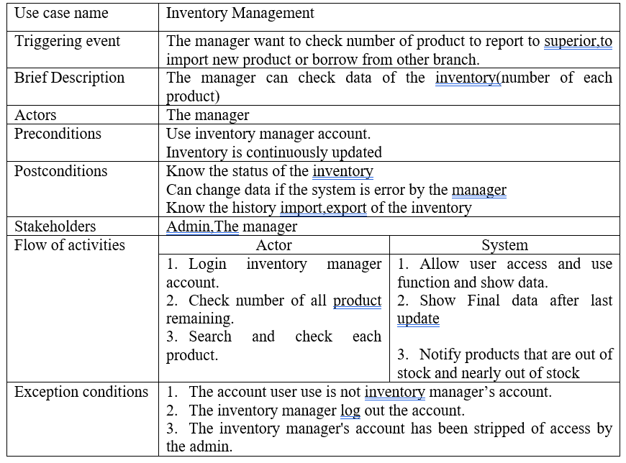
USE CASE DESCRIPTION

Slide 6
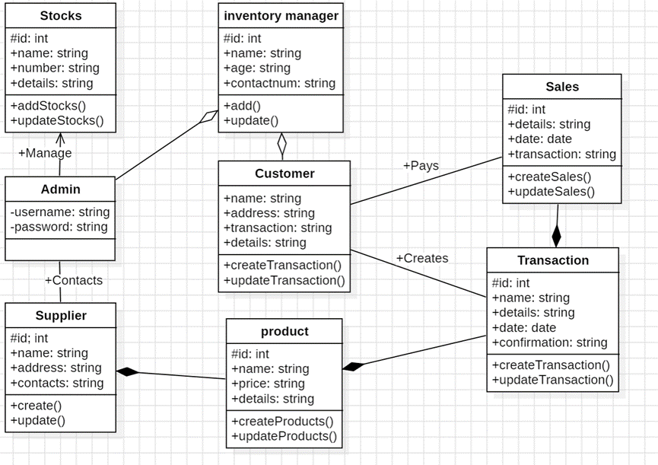
class diagram

Slide 7
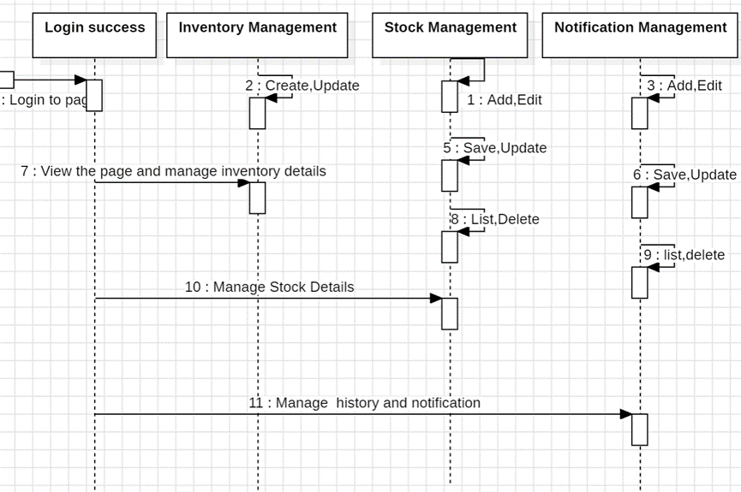
sequence diagram

Slide 8
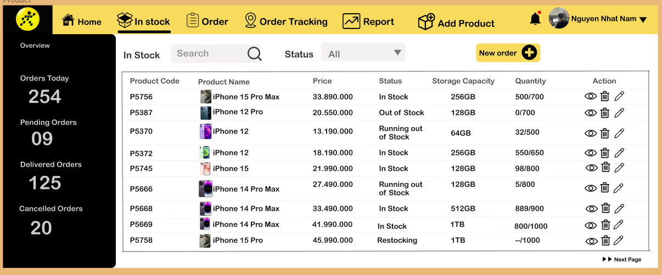
design ui : mANAGE PRODUCT

Slide 9
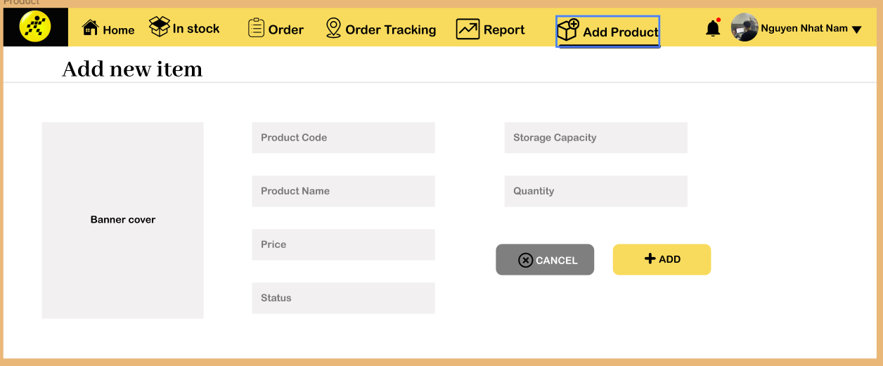
design ui : aDD PRODUCT

Slide 10
Test case
Test case ID | Test case objective | Description | Expected result | Status (Pass/ Fail)
01 | Verify that products under 10 million cannot be searched | Search for products that do not exist in the inventory | Displays an error message “no products”.Textbox gets focus. | Pass
02 | Verify that the product name search does not contain special characters | Search for product names that contain special characters | Displays an error message “Product does not exist”.Textbox gets focus. | Pass
03 | Add item | When adding a product, the information in the textbox is invalid | Displays an error message “Information at location... is invalid”.Textbox gets focus. | Pass
04 | Available item stock | Click textbox In stock | It should reflect automatically item stock | Pass
05 | Delete item | Click textbox bin | It should be deleted automatically | Pass

Slide 11
PRODUCT
MANAGEMENT

Slide 12
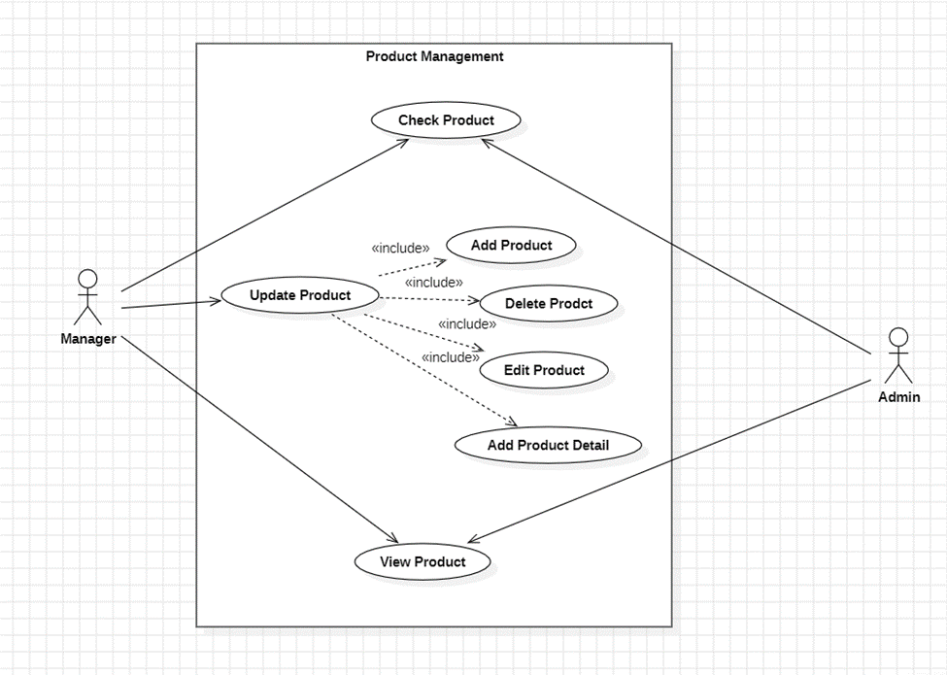
USE CASE DIAGRAM

Slide 13
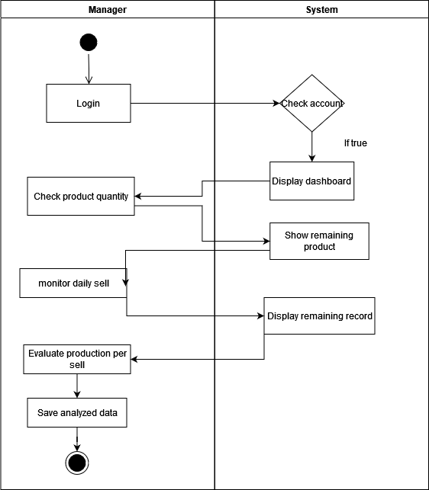
ACTIVITY DIAGRAM

Slide 14
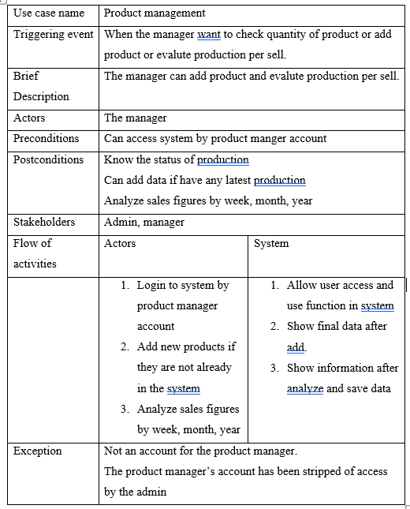
USE CASE DESCRIPTION

Slide 15
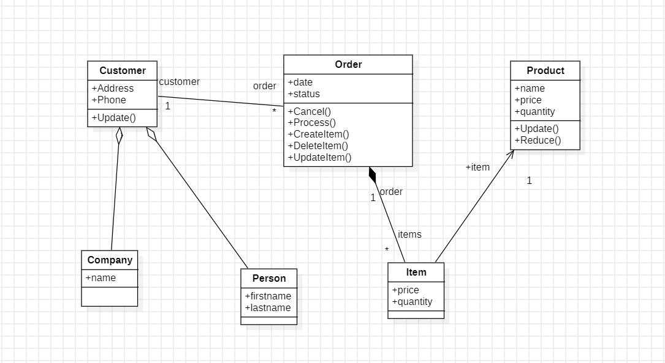
class diagram

Slide 16
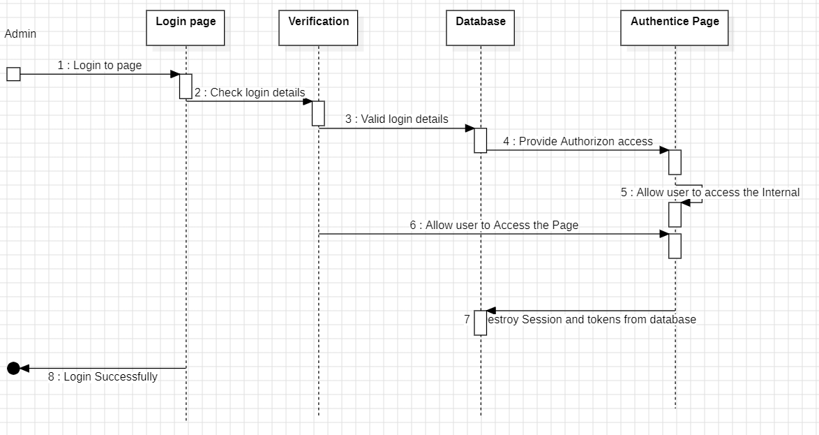
sequence diagram

Slide 17
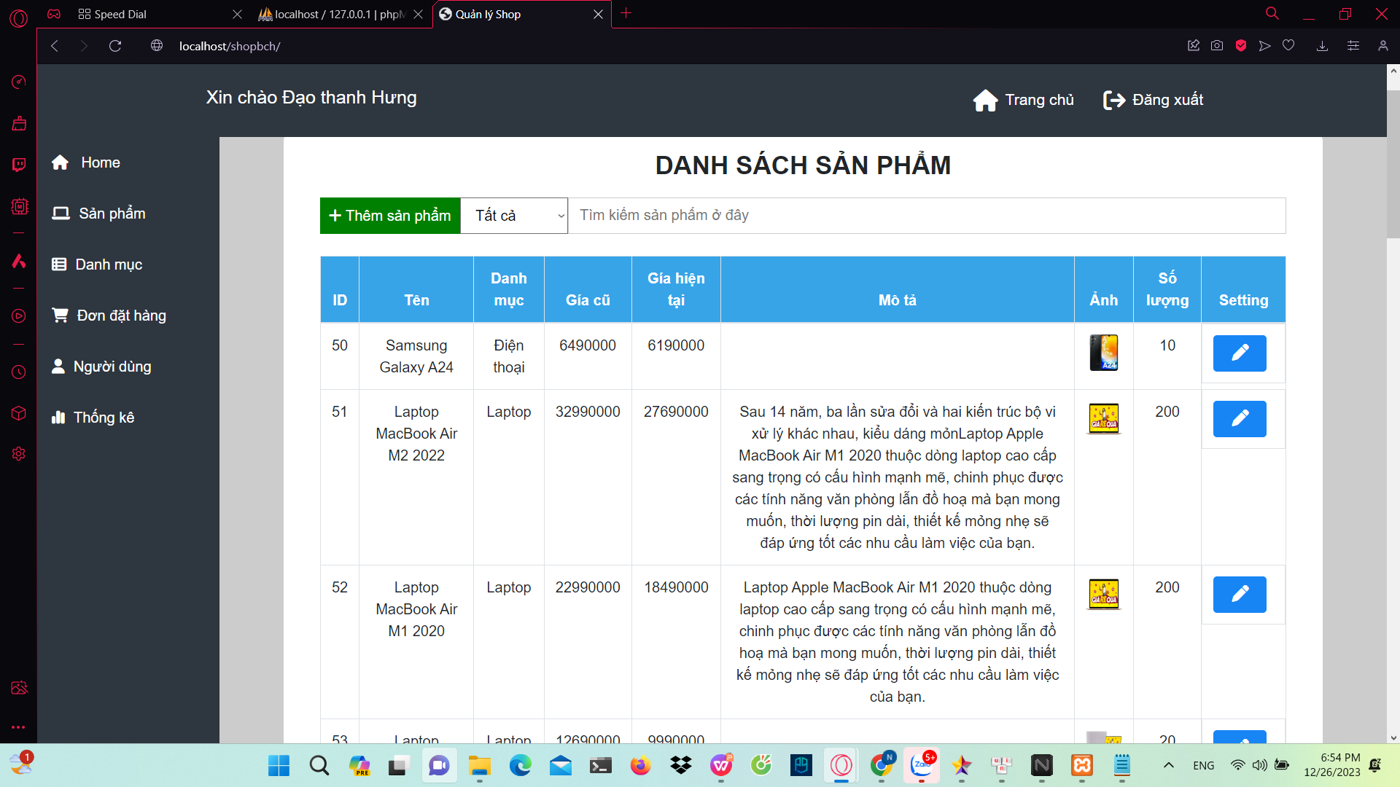
design ui : manage Product

Slide 18
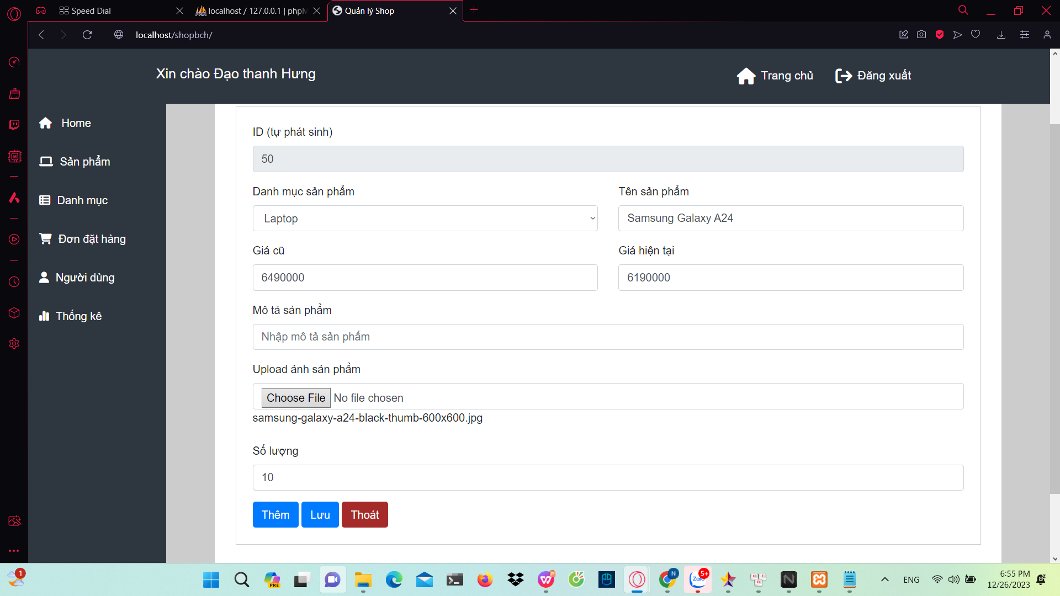
design ui : add product

