Slide 1
Mathematically Sharing Secrets
UMD Girls Talk Math // Spring Event
Noemi Glaeser // May 22, 2021
Notes:
Intro
Ask questions, interrupt - no such thing as a dumb question
Will sweep some details under the rug - if curious, this will be a packet over the summer and I’ll go into more of the details there, including proofs!

Slide 2
What is secret sharing?
Dividing a secret into pieces
Each piece by itself tells you nothing about the secret (privacy)
Putting the pieces back together gives you back the secret (correctness)
Notes:
Is this a good sharing (based on the above properties)?

Slide 3

Why is it useful?
Share a note
Notes:
• Passing notes example: pass note to a friend. Break it into 2 shares so that if the teacher intercepts one, (s)he can’t read it.
• Password to bank account
OR, imagine you did your homework, and you want to make sure that if you get sick you can still turn it in. So you break it into pieces and give a piece to a couple of your friends in the same class, so that no one can copy it and get you in trouble. You trust that they’ll only reassemble your homework (and turn it in for you) if you’re really missing from class.

Slide 4
Why is it useful?
Share a note
Share passwords
Notes:
• Passing notes example: pass note to a friend. Break it into 2 shares so that if the teacher intercepts one, (s)he can’t read it.
• Password to bank account: lose, or unreachable in emergency - family mems can work together
Seems a bit like magic - how do we actually do this?

Slide 5
Sharing numbers
random: don’t depend on s
Share a secret (s = 42) between people (n = 3)
Pick n-1 random numbers: 12, 27
Give 12, 27, and 42-(12+27)=3 to the 3 people
Can they work together to get back the secret?
12+27+3 = 42
Share
Reconstruct
Notes:
A simple way
3 nums are called “shares”

Slide 6
Sharing numbers
random: don’t depend on s
Share a secret (s = 42) between people (n = 3)
Pick n-1 random numbers: 12, 27
Give 12, 27, and 42-(12+27)=3 to the 3 people
Can they work together to get back the secret?
12+27+3 = 42
This is an n-out-of-n secret sharing (for any number n)
Share
Reconstruct
Notes:
Need all n out of total n shares to reconstruct
Less than n parties learn nothing about s

Slide 7
What about reconstructing with less than n (out of n) shares?
Notes:
What if we don’t want *everyone* to have to participate to reconstruct?
Maybe you share your bank password among all your cousins, but you know that they’re not very reliable so some of them might lose their shares — but you don’t know which.
This is possible! But first we have to review polynomials. How comfortable are you all with polynomials? (Checkmark or X reaction)

Slide 8
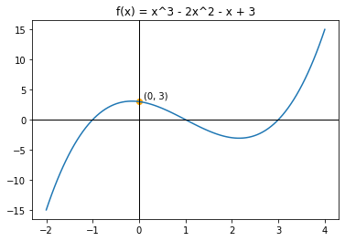
Polynomial Review: Terms
y-intercept:
f(0)
the constant term in the equation:
f(x) = x³ - 2x² - x + 3
y-intercept

Slide 9
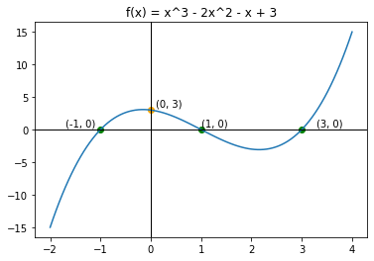
Polynomial Review: Terms
y-intercept:
f(0)
the constant term in the equation:
f(x) = x³ - 2x² - x + 3
zeros:
Values of x where f(x) = 0
y-intercept
zeros

Slide 10
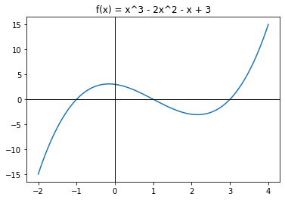
Polynomial Review: Terms
degree:
Highest exponent in the polynomial
f(x) = x³ - 2x² - x + 3

Slide 11
Polynomial Review: Terms
y-intercept:
f(0)
the constant term in the equation:
f(x) = x³ - 2x² - x + 3
degree:
Highest exponent in the equation
f(x) = x³ - 2x² - x + 3
y-intercept
Notes:
The only important things to know about polynomials in our case are that they’re curvy lines with the following properties:
a polynomial is a function (or equation)
We can graph the function for a visual representation
Show x-axis, y-axis
every x-value has only one corresponding y-value (“f of x or f(x)”)
y-intercept:
where graph crosses y-axis
Aka the function evaluated at zero, f(0)
Same as constant term in eqn

Slide 12
Polynomial Review: Terms
y-intercept:
f(0)
the constant term in the equation:
f(x) = x³ - 2x² - x + 3
degree:
Highest exponent in the equation
f(x) = x³ - 2x² - x + 3
y-intercept
Notes:
degree:
highest exponent
Example is degree 3
Notice it has 4 “terms” (degree+1)!

Slide 13
Polynomial Review: Uniqueness
f(x) = ax + b
Degree: 1
Points: 2
Notes:
Another important property: uniqueness
2 points define a unique line
try to change line you lose a point
line is deg 1
2 points sum up an entire line (describe it)

Slide 14
Polynomial Review: Uniqueness
f(x) = ax² + bx + c
Notes:
Quadratic (degree 2), aka parabola
2 points don’t uniquely define it
Other parabolas with same 2 points
Need 3 points

Slide 15
Polynomial Review: Uniqueness
f(x) = ax² + bx + c
Degree: 2
Points: 3

Slide 16
t+1 points uniquely define a degree-t polynomial.
Notes:
True in general: degree t poly def by t+1 points

Slide 17
Shamir Secret Sharing
(t+1)-out-of-n secret sharing
Pick a random degree t polynomial f
Pick t random coefficients
Set the constant term (y-intercept) to the secret s
Pick n points on f
Distribute them to n parties
Any t+1 points uniquely define f!
To get s, compute f(0)
Share
Recon.
Notes:
Okay, so now we can get to our new way of SS
Need only t+1 of n shares to reconstruct (for any t, n)
t+1 points def f: going from points to f is called “interpolation” (sounds scary, but there are standard ways to do this where you plug in the points and get back an equation)

Slide 18
Shamir Secret Sharing
Example: 4-out-of-6 secret sharing with s = 3
Pick a random degree t polynomial f
Pick t random coefficients
Set the constant term (y-intercept) to the secret s
Pick n points on f
Distribute them to n parties
Any t+1 points uniquely define f!
To get s, compute f(0)
Share
Recon.
Notes:
Let’s do an example: 4-out-of-6, secret is 3

Slide 19
Shamir Secret Sharing
Example: 4-out-of-6 secret sharing with s = 3
Pick a random degree t = 3 polynomial f
Pick t random coefficients
Set the constant term (y-intercept) to the secret s
Pick n points on f
Distribute them to n parties
Any t+1 points uniquely define f!
To get s, compute f(0)
Share
Recon.

Slide 20
Shamir Secret Sharing
Example: 4-out-of-6 secret sharing with s = 3
Pick a random degree t = 3 polynomial f
Pick t random coefficients: 1, -2, -1
Set the constant term (y-intercept) to the secret s
Pick n points on f
Distribute them to n parties
Any t+1 points uniquely define f!
To get s, compute f(0)
Share
Recon.

Slide 21
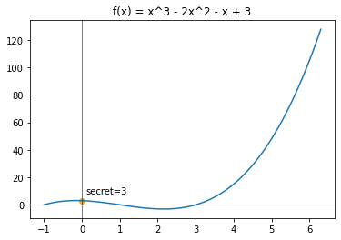
Shamir Secret Sharing
Example: 4-out-of-6 secret sharing with s = 3
Pick a random degree t = 3 polynomial f
Pick t random coefficients: 1, -2, -1
f(x) = 1x³ -2x² -1x + 3
Pick n points on f
Distribute them to n parties
Any t+1 points uniquely define f!
To get s, compute f(0)
Share
Recon.

Slide 22
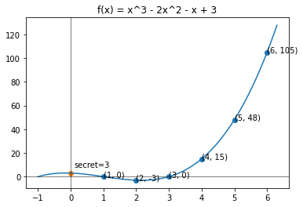
Shamir Secret Sharing
Example: 4-out-of-6 secret sharing with s = 3
Pick a random degree t = 3 polynomial f
Pick t random coefficients: 1, -2, -1
f(x) = 1x³ -2x² -1x + 3
(1, 0), (2, -3), (3, 0), (4, 15), (5, 48), (6, 105)
Distribute them to n parties
Any t+1 points uniquely define f!
To get s, compute f(0)
Share
Recon.

Slide 23
Shamir Secret Sharing
Example: 4-out-of-6 secret sharing with s = 3
Pick a random degree t = 3 polynomial f
Pick t random coefficients: 1, -2, -1
f(x) = 1x³ -2x² -1x + 3
(1, 0), (2, -3), (3, 0), (4, 15), (5, 48), (6, 105)
Distribute them to n parties
Any t+1=4 points uniquely define f!
To get s, compute f(0)
Share
Recon.

Slide 24
Shamir Secret Sharing
Example: 4-out-of-6 secret sharing with s = 3
Pick a random degree t = 3 polynomial f
Pick t random coefficients: 1, -2, -1
f(x) = 1x³ -2x² -1x + 3
(1, 0), (2, -3), (3, 0), (4, 15), (5, 48), (6, 105)
Distribute them to n parties
Any t+1=4 points uniquely define f!
To get s, compute f(0)
Share
Recon.

Slide 25
Shamir Secret Sharing
Example: 4-out-of-6 secret sharing with s = 3
Pick a random degree t = 3 polynomial f
Pick t random coefficients: 1, -2, -1
f(x) = 1x³ -2x² -1x + 3
(1, 0), (2, -3), (3, 0), (4, 15), (5, 48), (6, 105)
Distribute them to n parties
interpolate((1, 0), (2, -3), (4, 15), (6, 105)) $→$ f(x)
To get s, compute f(0)
Share
Recon.
Notes:
To go from points to equation we use some standard interpolation method

Slide 26
Shamir Secret Sharing
Example: 4-out-of-6 secret sharing with s = 3
Pick a random degree t = 3 polynomial f
Pick t random coefficients: 1, -2, -1
f(x) = 1x³ -2x² -1x + 3
(1, 0), (2, -3), (3, 0), (4, 15), (5, 48), (6, 105)
Distribute them to n parties
interpolate((1, 0), (2, -3), (4, 15), (6, 105)) $→$ f(x) = x³-2x²-x+3
To get s, compute f(0)
Share
Recon.

Slide 27
Shamir Secret Sharing
Example: 4-out-of-6 secret sharing with s = 3
Pick a random degree t = 3 polynomial f
Pick t random coefficients: 1, -2, -1
f(x) = 1x³ -2x² -1x + 3
(1, 0), (2, -3), (3, 0), (4, 15), (5, 48), (6, 105)
Distribute them to n parties
interpolate((1, 0), (2, -3), (4, 15), (6, 105)) $→$ f(x) = x³-2x²-x+3
To get s, compute f(0) = 0 - 2(0) - 0 + 3 = 3
Share
Recon.

Slide 28
Shamir Secret Sharing
Example: 4-out-of-6 secret sharing
s = 3; t = 3
Say our random polynomial is
f(x) = 1x³ -2x² -1x + 3
(1, 0), (2, -3), (3, 0), (4, 15), (5, 48), (6, 105)
interpolate((1, 0), (2, -3), (4, 15), (6, 105)) $→$ f(x)
s = f(0) = 3
Share
Recon.
Notes:
Visually walk through sharing 3 using the polynomial running example
Highlight any set of 4 => recover f => f(0) = 3

Slide 29


Activity!
http://bit.ly/ShamirSS
Notes:
Python
Google CoLab notebook: https://colab.research.google.com/drive/18NxRFaAb3H65EaUUPwlHN7pQFXYvsy6n?usp=sharing
I wrote share and recon functions (you can look at the code if you’re curious!) - show code
Use them to share a message in your groups. Pool shares to recover each others’ messages!

