Slide 1

VUEJS
“The Progressive JavaScript Framework”

Slide 2


Prerequisites / Setup
All content for this course will be accessible through the Github repository. Fork and Clone the repo to retrieve the starters and documentation for this lesson.
Repository Link: https://github.com/SamLpt/research-project-sam
Documentation (Videos, etc…)
PowerPoint Presentation
Review Activity Folder (Starter and Instructions)
Solutions Folder (Demo and Activity)

Slide 3
Table of Contents
01
02
03
04
Introduction
What is Vue.js and how does it compare?
How does it work?
Core Concepts
Application Instance, Single File Component and Directives
Events
Events, Custom Events and Event Arguments
In-Class Demo
Vacation Tracker Application using RESTful API

Slide 4
01
What is VueJs?

Slide 5
OVERVIEW
Vue is a open-source JavaScript framework for building user interfaces and single page applications. It is designed to be easy to learn and use, yet powerful enough to handle more complex applications.
It uses a component-based design architecture. This means that the user interface is broken down into small, reusable components that can be easily managed, modified, and reused across different part of the application.

Slide 6

HISTORY
It was created by Evan You in 2014, and was first released to the public in February 2014.
The development of Vue.js was inspired by Evan’s experience working with AngularJS. He wanted to create a framework that was lightweight and easy to use learn, but still provide the performance required in building modern web applications.

Slide 7
How does Vue.js perform so well?
Template System
How does Vue.js performance so well?
Reactive Data Binding
Virtual DOM

Slide 8
Template System
….
In Vue.js, the template system is a way of defining the structure and content of the user interface. it’s designed to be intuitive and easy to use, with a syntax that is similar to HTML, which makes it accessible to developers of all skill levels.
The template systems is also an important part of Vue.js, because it allows developers to declaratively define the UI, which means that the UI is defined in terms of the data and state of the application, rather than in term of imperative instructions for updating the DOM.

Slide 9
Reactive Data Binding
….
Reactive data binding is another important feature of Vue.js that can improve performance. This allows Vue.js to track changes in data and update the UI automatically, eliminating for manual DOM manipulation and reducing the complexity of the code.
{{ }}

Slide 10
Virtual DOM
….
Updating the DOM can be slow, especially when dealing with large or complex UIs. This is because every time a change is made, the entire DOM must be re-rendered and updated, even if only a small part has changed.
The virtual DOM solves this problem by creating a lightweight representation of the DOM that can be updated more quickly and efficient.

Slide 11

Virtual DOM Representation
Element: <div>
Text: “Hello”
Vue create a render function, based on our template, which return a virtual DOM node.
Vue knows how to take that virtual node and update the DOM, which is what we see in the browser.
VNode
{
tag: “div”,
Children: [
{
text: “Hello”
}
]
}
Render Function
render(h) {
return h(‘div’, ‘hello’)
}
The HTML can also be represented by a Virtual Node

Slide 12
Virtual DOM Representation
When a change is made, the render functions gets re-runed, which create another virtual node.
VNode
{
tag: “div”,
Children: [
{
text: “Hello”
}
]
}
Old
Compare old & new VNode and make updates in the most efficient way
Element: <div>
{
tag: “div”,
Children: [
{
text: “Goodbye”
}
]
}
Text: “Goodbye”
New
VNode

Slide 13
02
Core Concepts

Slide 14
The Application Instance
The createApp() function is the entry point of a Vue application and is used to create a new Vue instance that is responsible for managing the application’s data and behavior.
The function takes a configuration object as its argument, which can include the root component definition, as well as global options and plugins.
…..
When creating a Vue instance, it doesn’t know automatically known which HTML element to manage. You can specify this using the mount() method. Without this method, the Vue instance will NOT be able to to attach to the DOM element and make changes to it.

Slide 15
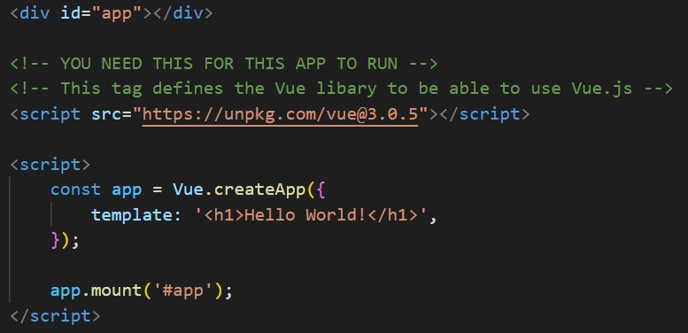
The Application Instance
This is inside body tag in an index.html file

Slide 16
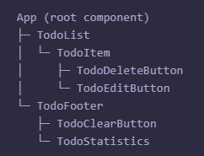
The Application Instance
What is the root component?
The root component is the top-level component in a Vue application component hierarchy. It is the parent component that all other components are nested within, and it is created and mounted when the Vue instance is initialized.
Single File Components (SFC)

Slide 17
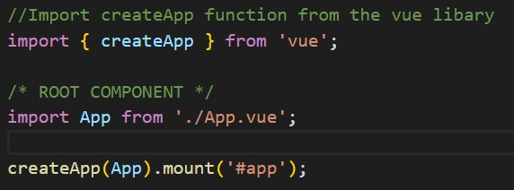

The Application Instance
We are able to import the createApp() from the vue library and a root component (App.vue).
This is inside the main.js file

Slide 18
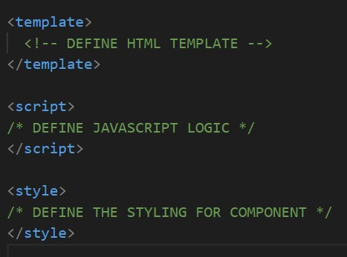

Single File Components (SFC)
How do you define/create a component?
In Vue.js, components are reusable, self-contained modules that encapsulate HTML, CSS and JavaScript logic. This is a fundamental concept in Vue.js and are essential to building complex user interfaces.
We typically define each Vue component in a dedicated component folder, with files that has the .vue extension.

Slide 19
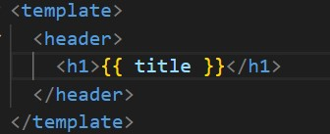
Single File Components (SFC)
Template
This is where you define the HTML structure of the component. It contains the markup and directives that control how the component is rendered.
This section can include plain HTML, as well as Vue.js directives that allow to bind data and dynamically update the component based on changes to that data.
“{{ }}” are used for data binding, also known as interpolation. We are defining the “title” property inside the <script></script>.

Slide 20
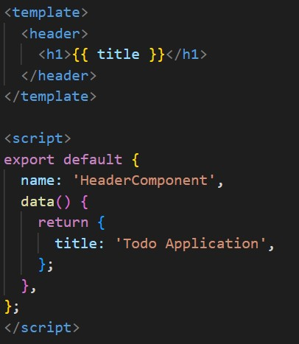
Single File Components (SFC)
Script Block
What is the export default?
It’s where you define the logic and behavior of the component using JavaScript code. You are able to define a Vue.js component using the ‘Vue.component()’ or ‘export default’ syntax.
This syntax is used to export a Vue.js component from a Single File Component. It allows you to define the component’s properties, data, methods, and other object literals.

Slide 21
Single File Components (SFC)
Script Block
What are these Object Literals?
They are used to define the properties and behavior of a component. They are simply JavaScript objects that contain key-value pairs. Here are a few common ones:
data() { return {} } | This is the object that contains the components data. It should be a function that returns an object, in order to ensure that each component instance has its own independent copy of data.
computed : {} | Used to define computed properties. They are values that are derived from the component’s data, and are automatically updated whenever the data changes.

Slide 22
Single File Components (SFC)
Script Block
methods : {} | Used to define methods for the component. They are functions that can be called from the component’s template or other methods. Methods are used to manipulate data and perform other operations.
components: {} | Used to define child components for the specific component.
props: {} | Defines the component’s props. Props are values that are passed into the component from the parent component, and are read-only within the component.
mounted: {} | This is a lifecycle hook that is called after the component has been mounted to the DOM. It can be used to perform initialization or other setup tasks that require access to the DOM.
template: `` | This is a string or a function that defines the component’s template. It can be HTML string or a render function that returns a virtual DOM tree.

Slide 23
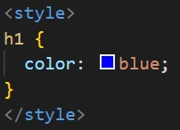
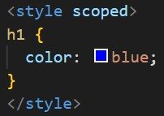

Single File Components (SFC)
Styles
This section is used to define the component’s styles. This is optional, but it allows you to define styles specific to the component without affecting the rest of the application.
Scoped Styles: By default, styles will apply globally to the entire application. However, you can use the ‘scoped’ attribute to limit the styles to the current component only.
Inline Styles: Define component’s style directly in the style section using CSS. This will apply to all h1 tags within the component.
External Styles: You can import in an external CSS file into the component using the ‘import’ statement.

Slide 24
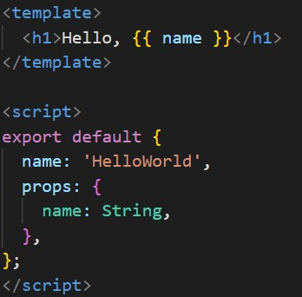
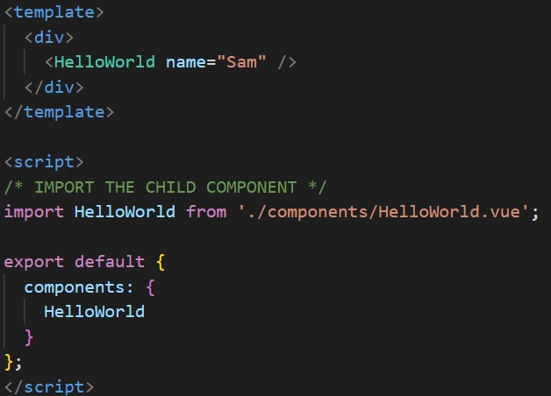
Single File Components (SFC)
How do you use a Component?
To use a child component, we need to import it in the parent component. To expose the imported component in the parent, we need to register it with the components option. (Object literal)
Parent
Child

Slide 25
Directives
In Vue.js, directives are special attributes that allow you to manipulate the DOM in your application. Directives are prefixed with the ‘v-’ binding syntax in the template and allow you to apply special behaviour to an element.
These directives can be used to add behavior to you application, such as toggling visibility, updating styles, and manipulating the contents of an element.

Slide 26
Directives
Some commonly used directives in Vue.js includes:
v-bind | This allows you to dynamically bind values to an element’s attributes or properties.
v-model | Two-way data binding between a form input element and a data property.
v-if | Conditionally renders an element based on a boolean expression.
v-for | Loops through an array and renders an element for each item in the array.
v-on | Binds event listeners to an element, allowing you to respond to user input.

Slide 27
03
Events

Slide 28
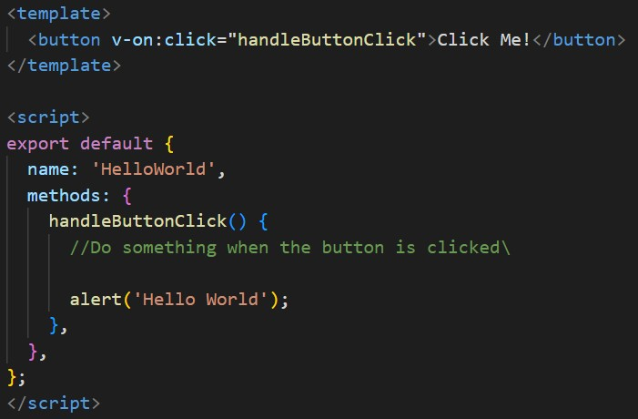
Simple Events
How do you define an event in vue?
An event is a mechanism for triggering a specific action or behavior in response to a user interaction, such as a button click or a form submission. When a event occurs, Vue.js provides a way to capture and response to that event using event listeners.
We have attached an event listener using the v-on directive with the button click event.
When the button is clicked, the defined method is executed.

Slide 29
Custom Events
What happens when you two components that are not necessary connected?
Footer
App
Activate Event
Header
Button
Method that the event is trying to reach

Slide 30
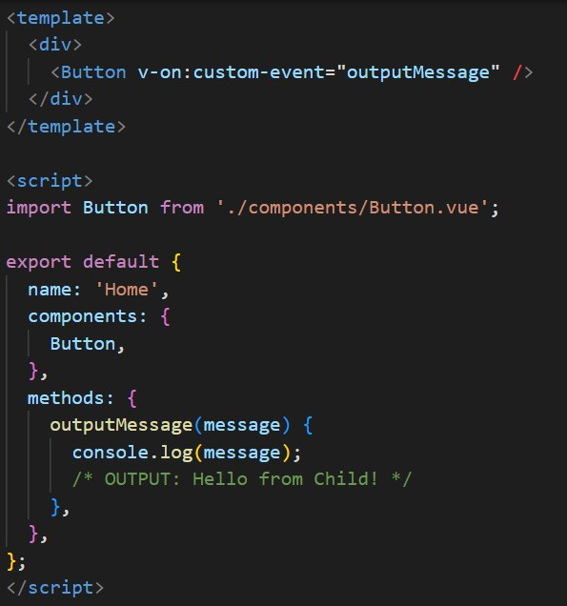
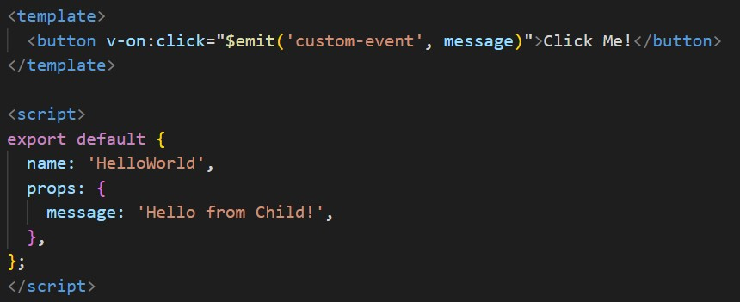
Custom Events
Custom events are a way to facilitate communication between components that are not directly related. These events are created using the ‘$emit()’ method in a child component and can be listened to using the ‘v-on’ directive in a parent component.

Slide 31
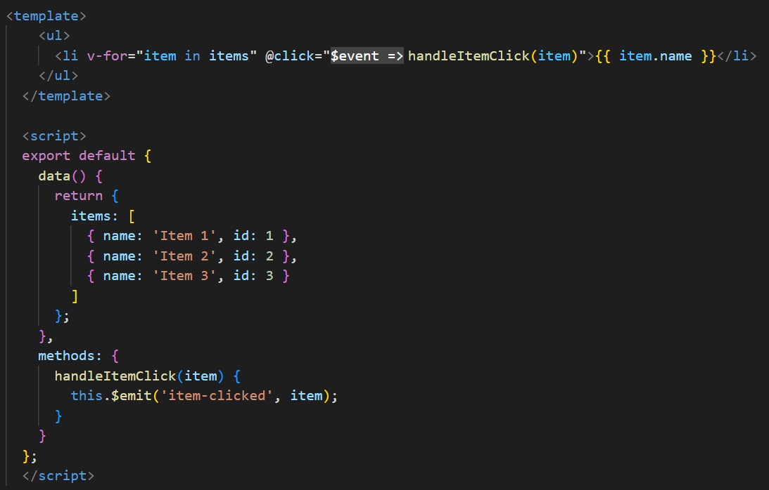
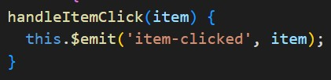
Event Arguments
This refers to the data that is passed along with en event when it is emitted from a child component and captured by its parent component.
Let’s say you have a child component that emits an event called “item-clicked” whenever a user clicks on an items in a list. You are able to pass along some additional data about the clicked item as an argument with an event.

Slide 32
04
In-Class Demo

Slide 33

Video Demonstration

Slide 34
Components Layout
Header
Next Trip
Add Trip
Trip
Purple Component: The is a Trips component thats will list out each trip
Trip
Trip
Footer

Slide 35
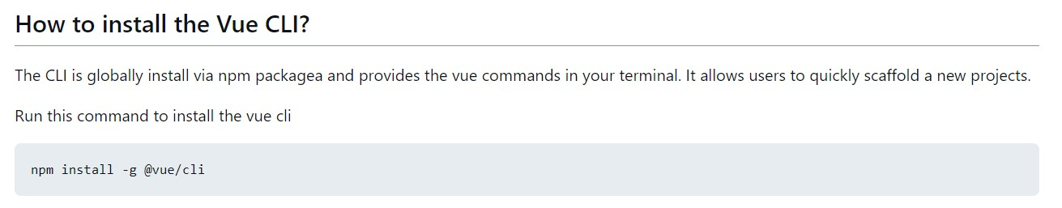
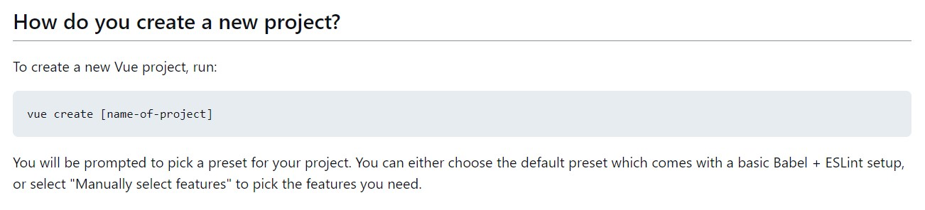
Vue CLI

Slide 36
JSON Server
“Json-server” is a Node.js based command-line tool that allows you to quickly create a fake REST API with a simple JSON file as a data source.
What does it serve for development?
Running a json-server, you can quickly create a RESTful API that serves JSON data, which is useful for developing and testing frontend applications that need to interact with an API.
The data stored in the ‘db.json’ file can be manipulated and queried using the standard HTTP methods (GET, POST, PUT, DELETE).

Slide 37
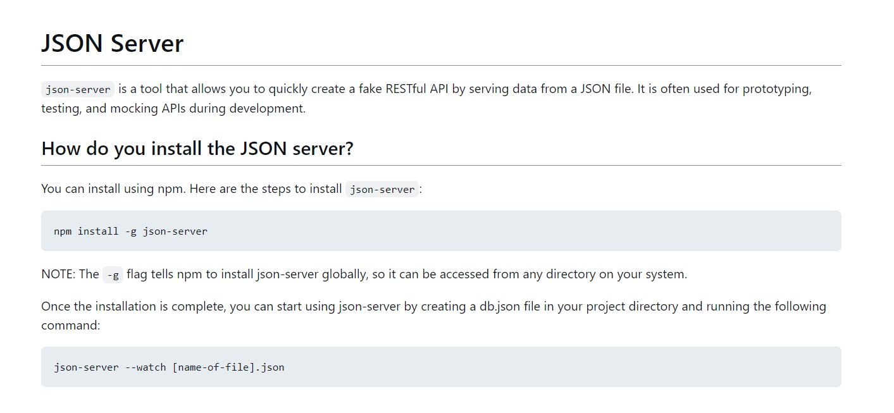
JSON Server
How do you set it up?

Slide 38
LET'S START CODING!

Slide 39
Resources
Documentation
Youtube
Vue.js Official Documentation Website. 2014-2023 by Evan You
https://vuejs.org/
Traversy Media, Web development & Programming Tutorials.
https://www.youtube.com/@TraversyMedia
Vue Mastery, Vue learning channel sponsored by Vue.js
https://www.youtube.com/@VueMastery

